Slide 1
Commission on the Status of Women
Fifty-seventh session
Preparatory panel for 2014
6 March 2013
THE HEALTH MDGS: What works?
What didn't? What’s next?
The Partnership for Maternal, Newborn & Child Health (PMNCH)
Dr Carole Presern Executive Director
Notes:
-Healthy populations are the foundation for sustainable social, economic and environmental development, and for peace and security
Health fundamental human right, yet thousands of women, girls and children die of preventable deaths
progress on health and other determinants , insufficient to reach goals by 2015

Slide 2
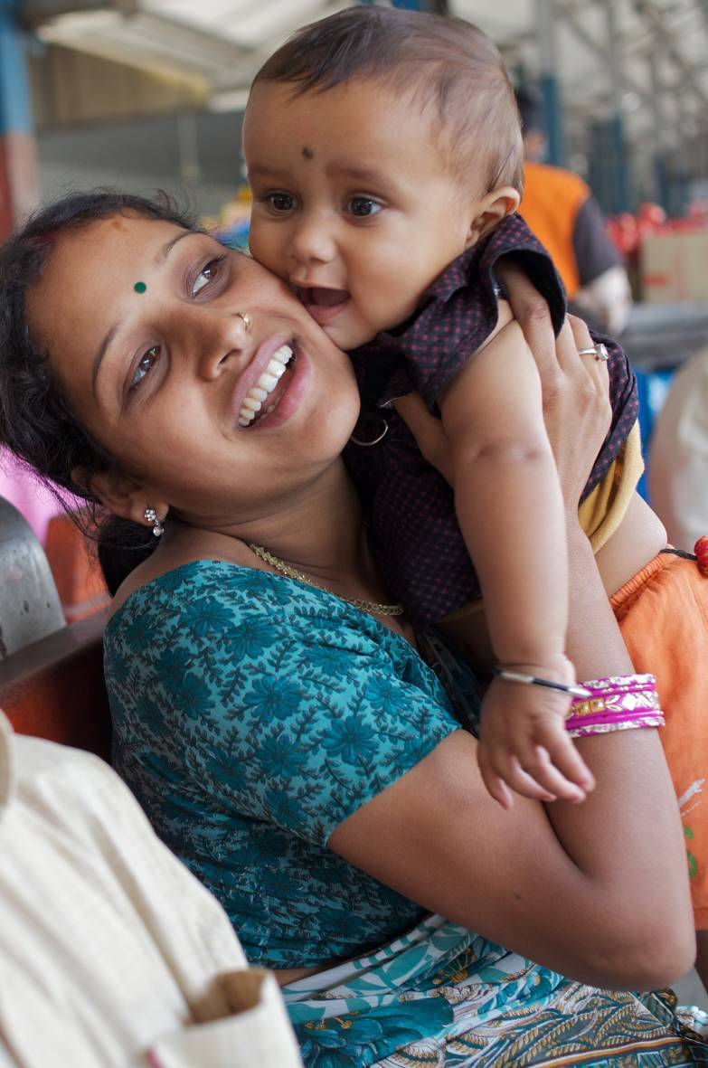
Overview
Context
What has worked?
What didn't?
What's next?
Notes:
Identifying what is working,
where we have failed ,
what lessons have we have learnt and how to keep the momentum alive till 2015 and beyond…
-

Slide 3
Where do we stand?
MDG 4 - Reduce child mortality
Under 5 mortality fell 41% from 1990
Sub-Saharan Africa doubled its average rate of reduction : 1.2 % in 1990-2000 to 2.4 per cent during 2000-2010
MDG 5a - Improve maternal health
Maternal mortality fell 47% from 1990
MDG 5b - Universal access to reproductive health
By 2008, more than 50%women aged 15 -49yrs were using contraception
MDG 6 - HIV/AIDS, malaria and other diseases
New HIV infections declined; Proportion of women living with HIV remains stable at 50%
Notes:
Recent progress is significant
The declines have happened across the continent and across large and small countries, with different cultures and religions, with different rates of economic growth.
*SSAfrica—the region with the highest level of under-five mortality
Contraceptive use: ….except SSAfrica and Oceania.
Maternal mortality has declined dramatically, but faster progress is needed.
Maternal deaths have dropped from 543,000 a year in 1990 to 287,000 in 2010.
Only 9 of 75 Countdown countries are on track to achieve Millennium Development Goal 5; 25 have made insufficient or no progress.
Maternal mortality is concentrated in Sub-Saharan African and South Asian countries: an African woman’s lifetime risk of dying from pregnancy-related causes is 100 times higher than that of a woman in a developed country.
Child mortality is down sharply, but more needs to be done.
Deaths among children under age 5 worldwide have declined from 12 million a year in 1990 to 7.6 million in 2010.
Only 22 of 75 Countdown countries are on track to achieve Millennium Development Goal 4; 3 have made little or no progress.
Despite recent improvements, pneumonia and diarrhoea still cause more than two million deaths a year that could be avoided by available preventive measures and prompt treatment.
Newborn survival is improving too slowly, and stillbirths, especially intrapartum stillbirths, and preterm births need urgent attention.
40% of child deaths occur during the first month of life.
More than 10% of babies are born preterm, a figure that is rising, and complications due to preterm birth are the leading cause of newborn deaths and the second leading cause of child deaths.
Countdown countries that have successfully reduced neonatal mortality—such as Bangladesh, Nepal and Rwanda—offer models for improving newborn survival.
Most Countdown countries face a severe nutrition crisis.
Undernutrition contributes to more than a third of child deaths and to at least a fifth of maternal deaths.
In the majority of Countdown countries, more than a third of children are stunted; stunting is most common among poor children.

Slide 4
But, few countries on track
‘On track’ for MDG 4 only, not for MDG 5a (21)
Bolivia, Botswana, Brazil, Ethiopia, Guatemala, Indonesia, Iraq, Korea DPR, Kyrgyz Republic, Liberia, Madagascar, Malawi, Mexico, Morocco, Niger, Peru, Philippines, Rwanda, Solomon Islands, Tanzania and Zambia
‘On track’ for MDG 5a only, not for MDG 4 (2)
Eritrea and Equatorial Guinea
‘On track’ for both MDGs 4 and 5a (7)
Bangladesh, Cambodia, China, Egipt, Lao PDR, Nepal and Vietnam
Notes:
Based on Interagency Group data from 2010 for MMR and from 2011 for U5MR

Slide 5
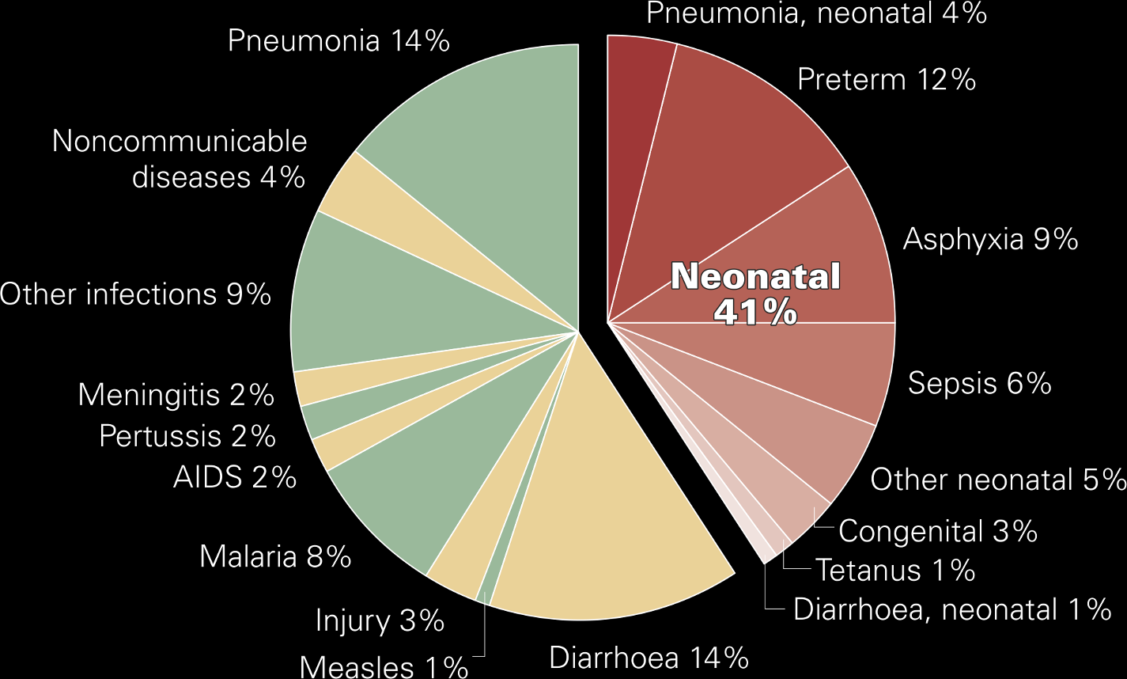
MDG 4: Causes of newborn and child mortality
Source: Countdown to 2015, 2010.

Slide 6
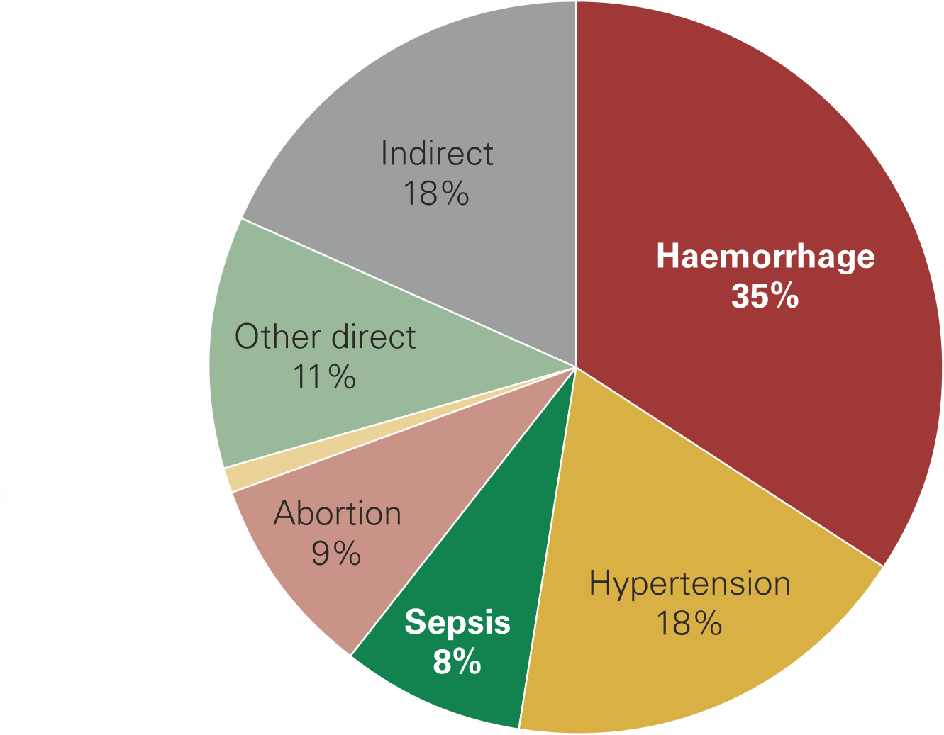
MDG 5a: Causes of maternal deaths worldwide
Source: Countdown to 2015, 2010.

Slide 7
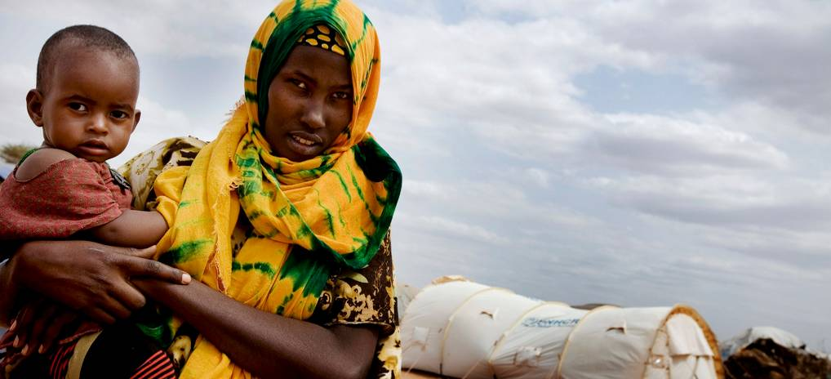
WHAT HAS WORKED…

Slide 8
www.un.org/sg/
Notes:
The Women Deliver 2010 conference was held from 7-9 June 2010 in Washington, DC. The theme of this conference was “Delivering Solutions for Girls and Women.” This is when Ban Ki-Moon delivered the following speech:
"Ladies and Gentlemen;
Women’s health in the developed world has come a long way in my lifetime.
I myself was born at home, in a small village in the Korean countryside. There was nothing strange or special about that fact.
I remember as a child asking my mother why women who were about to give birth would gaze at their simple rubber shoes, which they left at the back door as labour drew near.
My mother explained that the women wondered if they would ever step into those shoes again. Giving birth was so risky. They feared for their lives.
Her answer started me on the journey that has brought me here today. A journey to help every woman step back into her shoes after giving birth.
Women are the glue that holds our societies and our nations together.
Mothers make the world work
But too often, the world is letting mothers down. "

Slide 9
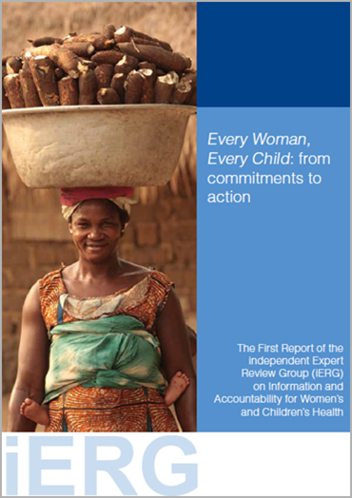
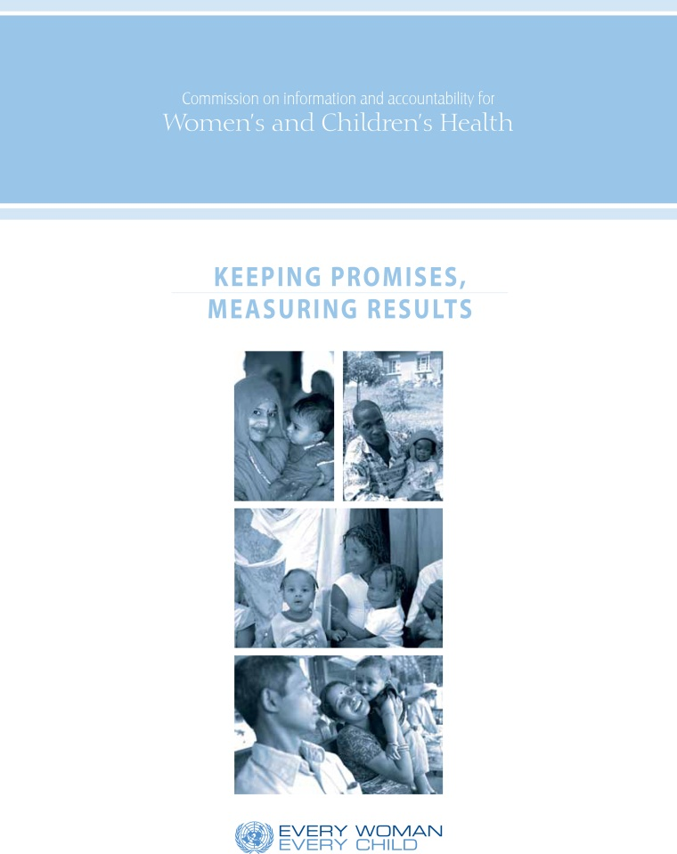
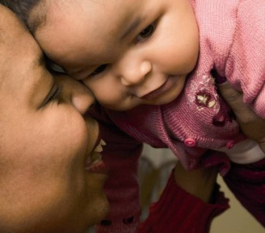
MDGs have spurred global political support and increased health funding

Slide 10
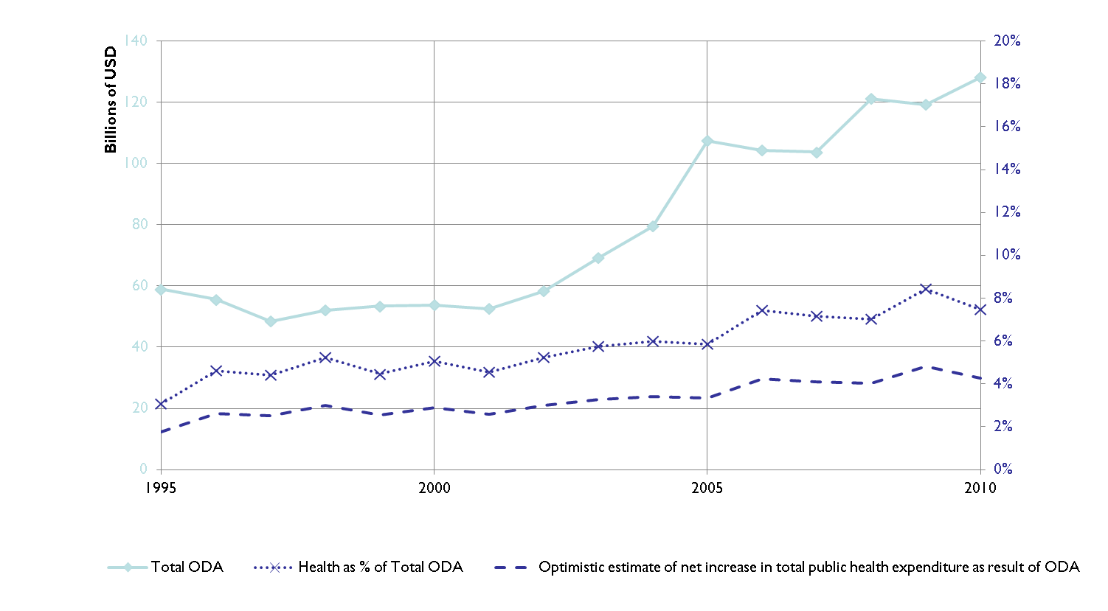
Increased funding for health - ODA to Health, 1995 to 2010
Source: OECD 2011, United Nations Statistics Division 2012, Lu et al. 2010
Notes:
MDGs also increased global focus on health.
MDGs accelerated progress on target indicators, stimulated global political support, fostered research and debate on systemic approaches to improve health outcomes.
They coincided with significantly increased donor financial resources for health.
Explosion of new initiatives and partnerships since MDGS adopted.

Slide 11
This has resulted in
Increased coverage of essential interventions
A focus on health systems strengthening
Particularly human resources and commodities
More partnerships for health
More innovation and research
Increased accountability

Slide 12
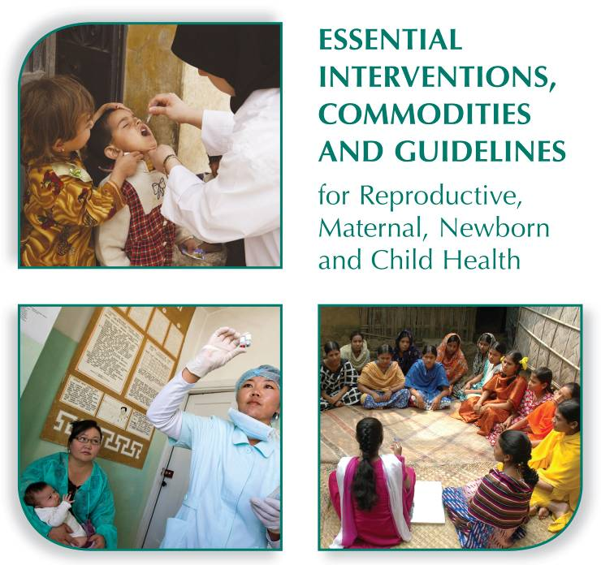
We know what works

Slide 13
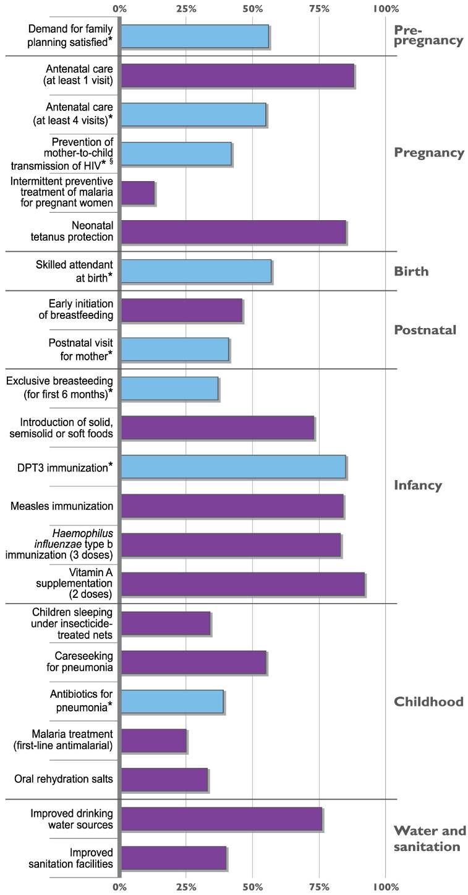
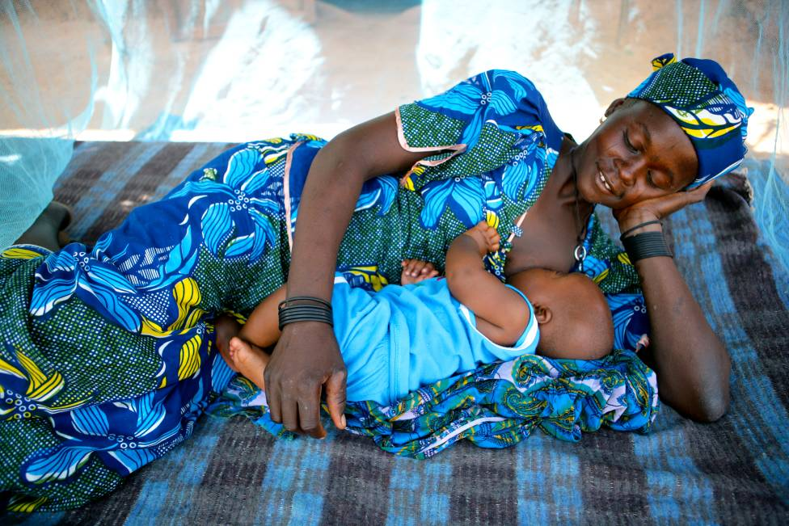
Coverage
* Coverage indicators from Recommendation 2 of the Commission on Information and Accountability for Women’s and Children’s Health (2011).
Adapted from: Countdown to 2015, Building a Future for Women and Children, The 2012 Report (2012).
§ Global HIV/AIDS Response: Epidemic update and health sector progress towards Universal Access, Progress Report 2011. WHO, UNICEF and UNAIDS (2011).

Slide 14
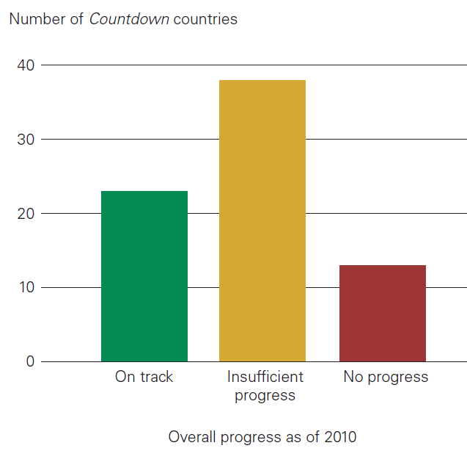
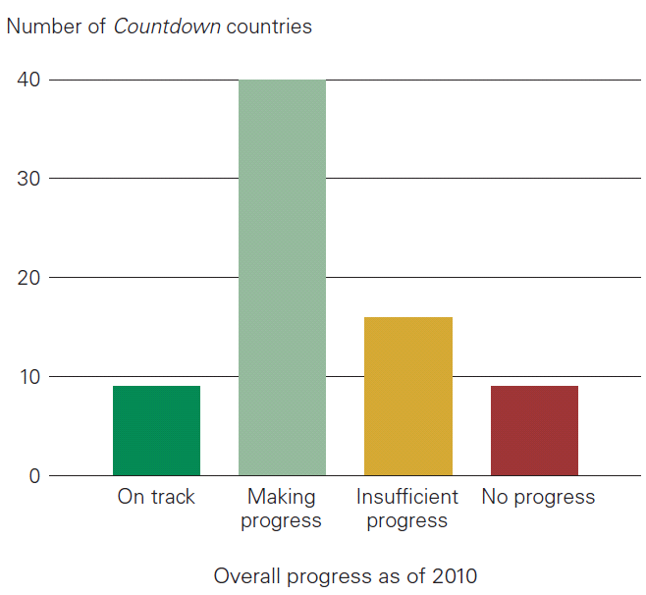
A mixed picture
MDG4 for child survival
MDG5 for maternal health
SOURCE: Countdown to 2015.Building a future for women and children. The 2012 Report. Countdown to 2015 analysis based on UNICEF, WHO, World Bank and UNDESA, 2011.
Notes:
Poverty, social exclusion, and remote location are factors that make some people more vulnerable than others. Everywhere, these factors intersect with gender norms to place some women and children at the highest risk of poor health and hardest to reach. Prioritising dedicated efforts to reach these groups would be a powerful strategy for reducing inequality, advancing the health MDGs, and interrupting the inter-generational transfer of ill health and poverty.

Slide 15
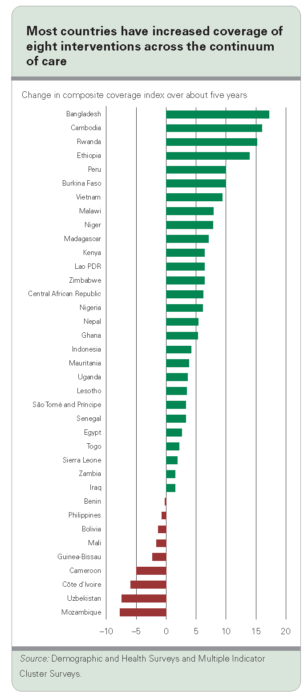
Change in composite coverage indicator over about five years
Some countries are doing very well, and in others coverage has actually declined
Notes:
This slide show you that some countries are doing very well, and in others coverage has actually declined over the past five years, based on a composite index covering eight interventions across the continuum of care. The Countdown research program is conducting in-depth analysis to try to understand the determinants of coverage change, so that the results can be used to strengthen programs.

Slide 16
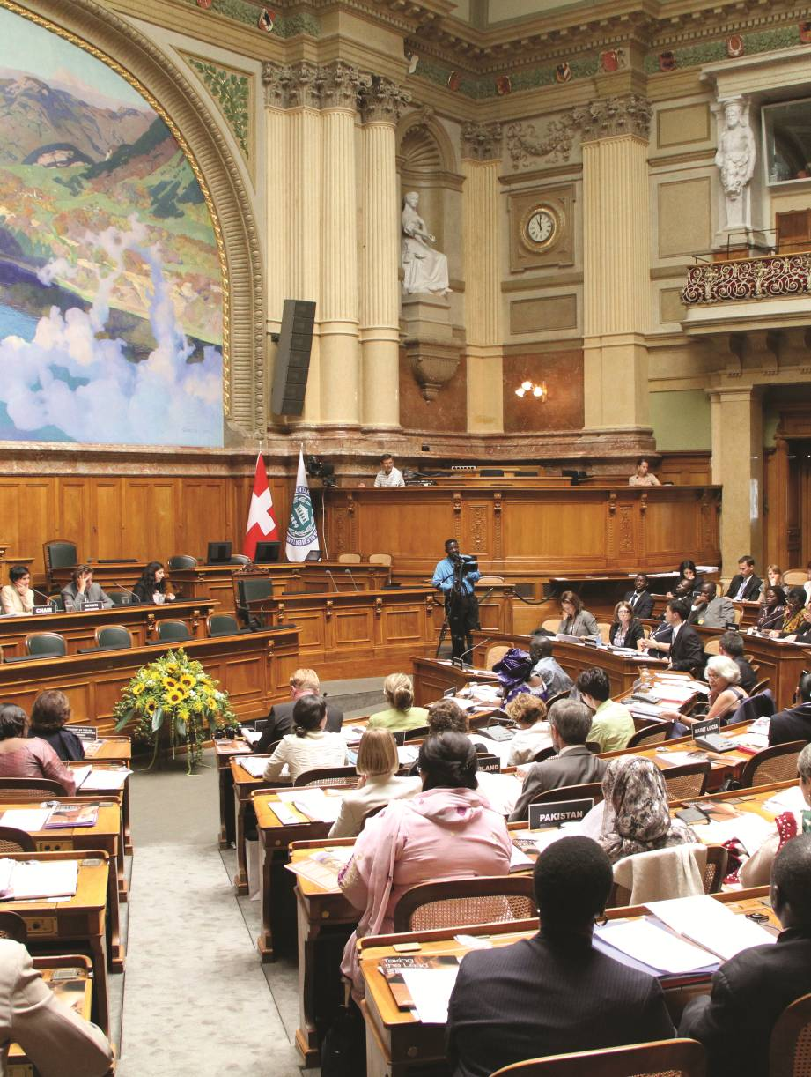
Parliamentarians
Representing the voice of women and children
Advocating nationally and internationally
Legislating
Budgeting for reproductive, maternal, newborn and child health
Holding the government to account for implementing policies
Notes:
The crucial role of parliaments has been recognized by the Inter-Parliamentary Union and the “Countdown to 2015” initiative which identified 5 core actions that parliamentarians can take in positioning, promoting and protecting the health of women and children.

Slide 17
WHAT DIDN'T?

Slide 18
Progress - but not enough
Good progress in reducing under-five & maternal mortality, but overall rates still too high
Note: MDG target calculated by countdown to 2015
Notes:
From Countdown to 2015: Tracking Progress in Maternal, Newborn and Child Survival, which disseminates essential country-by-country data that enables countries to monitor their own progress. Country data includes equity factors such as socio-economic status.
Detailed analyses are necessary to reveal which women face the greatest reproductive risk, which children are the most vulnerable, and which young people are most susceptible to HIV infection.

Slide 19
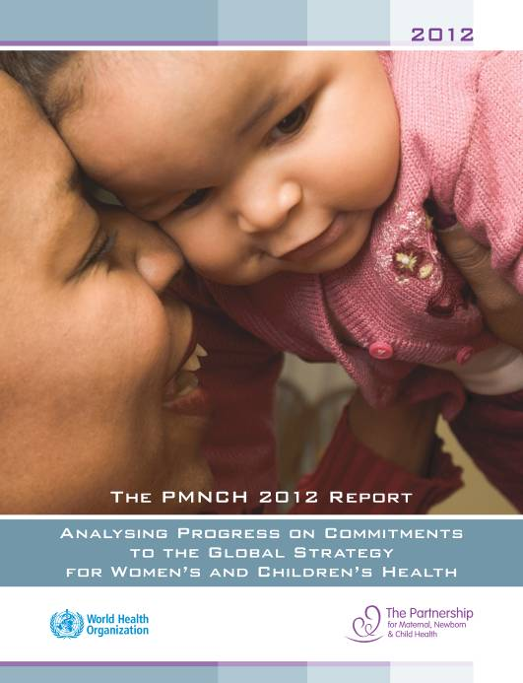
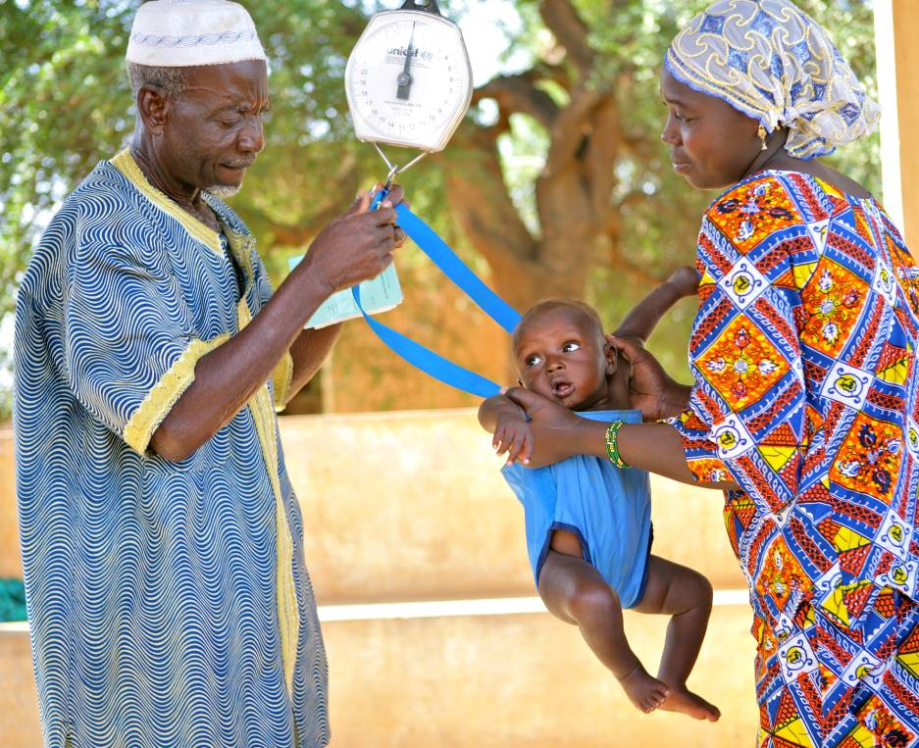
Barriers
Insufficient funding (87% of implementing countries)
Human resources (89% of implementing countries)
Other health system constraints:
Commodities
Poor infrastructure
Weak governance
Notes:
The PMNCH 2012 Report analysed progress on commitments to the Global Strategy…
Financial and human resources were seen as the main bottlenecks to implementation of their commitments by respondents
Financial constraints (87% of LICs and MICs identified this as a bottleneck) included:
Lack of funding, and..
Slow release of funding
Human resources problems (89% of LICs/MICs) include not only shortages of health workers but also:
unequal geographic distribution
inadequate training and skills
low retention and migration
insufficient recruitment capacity of the public health sector.
Other health system constraints include:
shortages of health commodities and poor infrastructure
weak governance
instability caused by civil conflict, natural disasters
Sociocultural barriers and gender discrimination were also mentioned as barriers

Slide 20
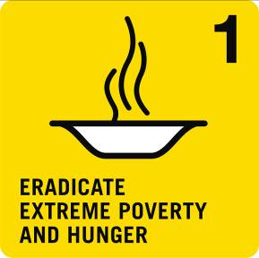
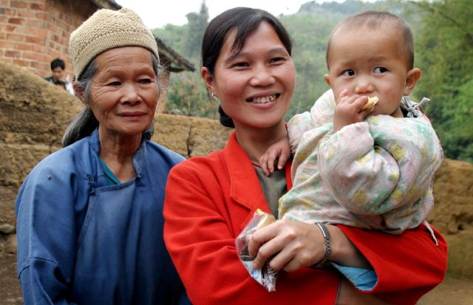
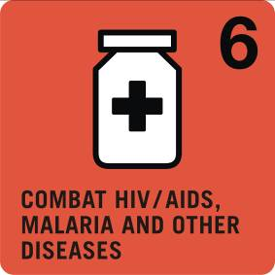
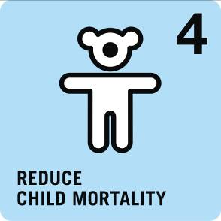
Health outcomes require a multi sectoral approach
Notes:
As we have learned from the MDGs improving health outcomes will require a focus on equity, integrated health services, strengthening health systems as well as a cross sectoral approach that addresses social determinants of health such as clean water and sanitation, education, gender equality, and improved nutritional status.
Gender inequality is a critical prohibitive factor for improved health.
Child marriage, constrained access to schooling and economic resources, gender-based violence, inadequate access to health care, and other gender based discrimination shape girls’ and women’s health status.

Slide 21
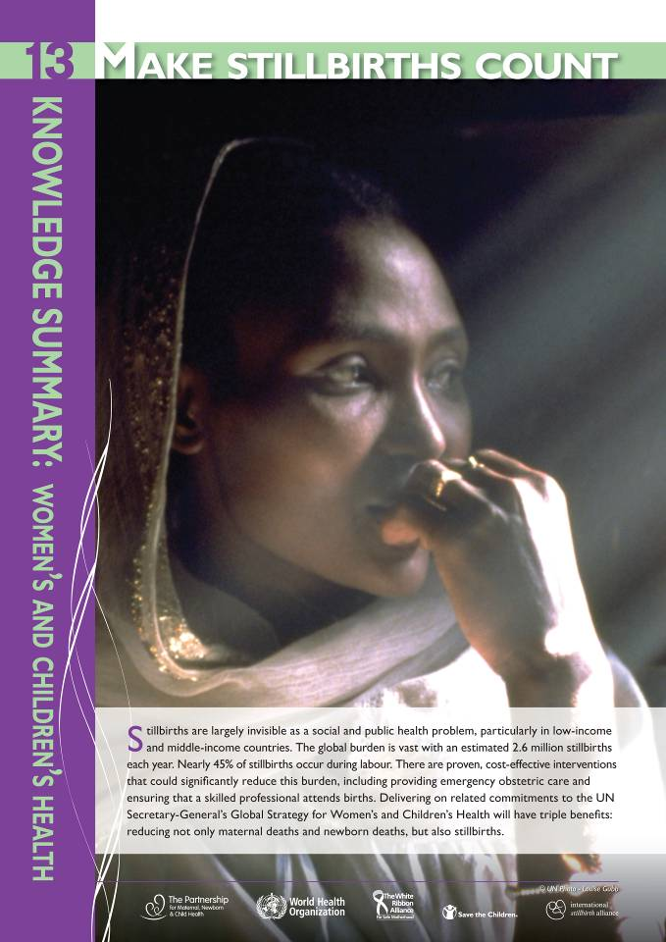
Stillbirths - an invisible issue
Stillbirths declined by only 1.1%: from 3 million/year in 1995 to 2.6 million in 2009
This is slower than reductions for child and maternal mortality
The MDGs do not count stillbirths
Social stigma about stillbirths and a lack of public awareness contribute to the silence

Slide 22
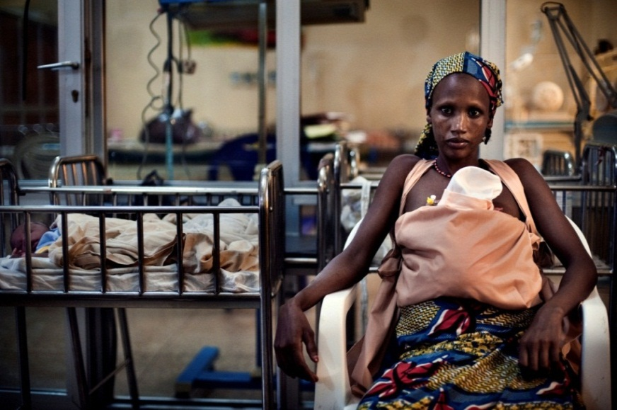
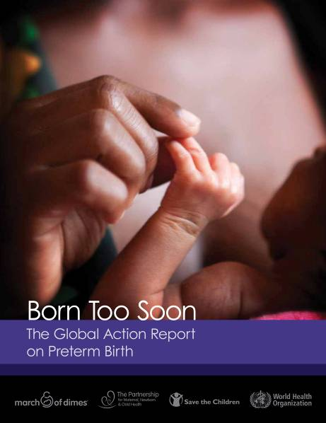
Born Too Soon
Of the 6.9 million who die before their 5th birthday…..
Over 40% die in their first month
Preterm birth is the second leading cause of death for children under 5 years, after pneumonia
1.1 million babies die directly from complications of preterm birth
Source: CHERG/WHO estimates for 2010, Li Liu et al Lancet in press, 2012

Slide 23
Behind every statistic is a story…

Slide 24
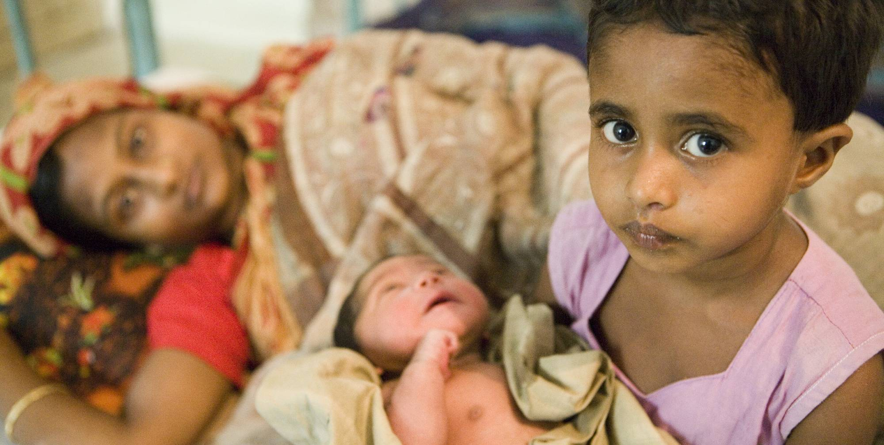
WHAT`S NEXT?

Slide 25
Sustain investment
It helps women and children realize their human rights
People are entitled to the highest attainable standard of health
It stimulates economic productivity and growth
Maternal and newborn deaths slow growth leading to annual global productivity losses of US$15 billion
It is cost effective
Essential health care prevents illness and disability, saving billions of dollars annually in treatment costs
It reduces poverty
Healthy women are more productive and earn more throughout their lives
Notes:
Healthy women work more productively, and stand to earn more throughout their lives. Addressing under-nutrition in pregnant women and children leads to an increase of up to 10% in an individual’s lifetime earnings.⁵ In contrast, poor sanitation leads to diarrhea and parasitic diseases, which reduce productivity and prevent children from going to school.

Slide 26
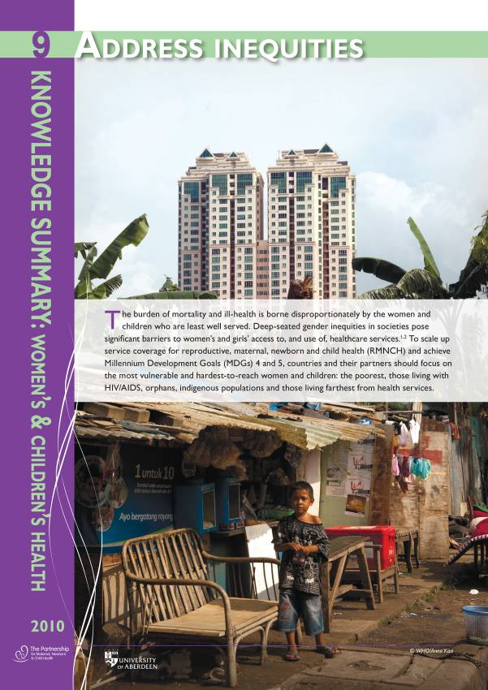
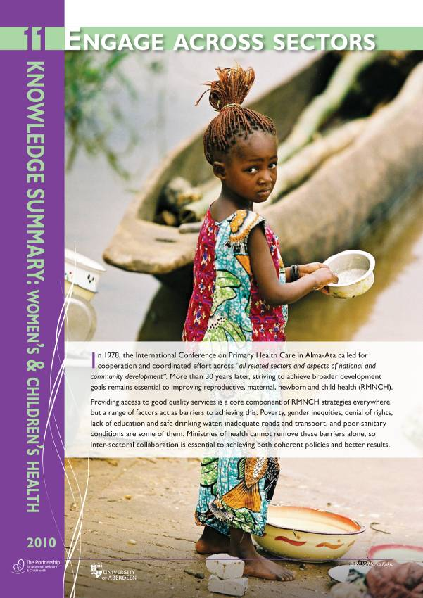
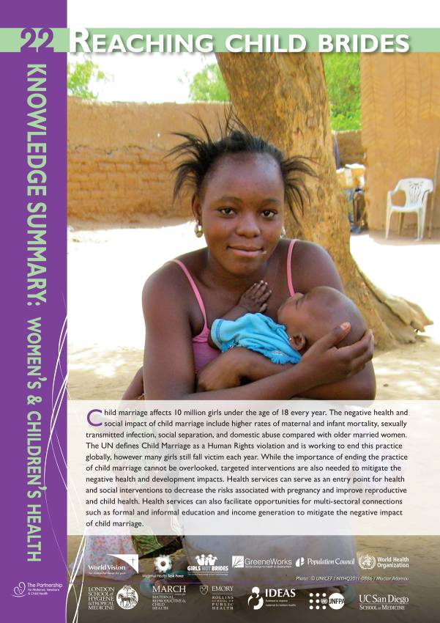
Focusing on gender equity
Notes:
Access to education
Child marriage
Gender based violence
Other social determinants rooted in gender inequality: Environmental and climate change, threatening access to clean water, adequate nutritious food, stable living environments, and essential services.
Combine to reduce girls’ and women’s resilience, increase their instability, and increase vulnerability to health problems.

Slide 27
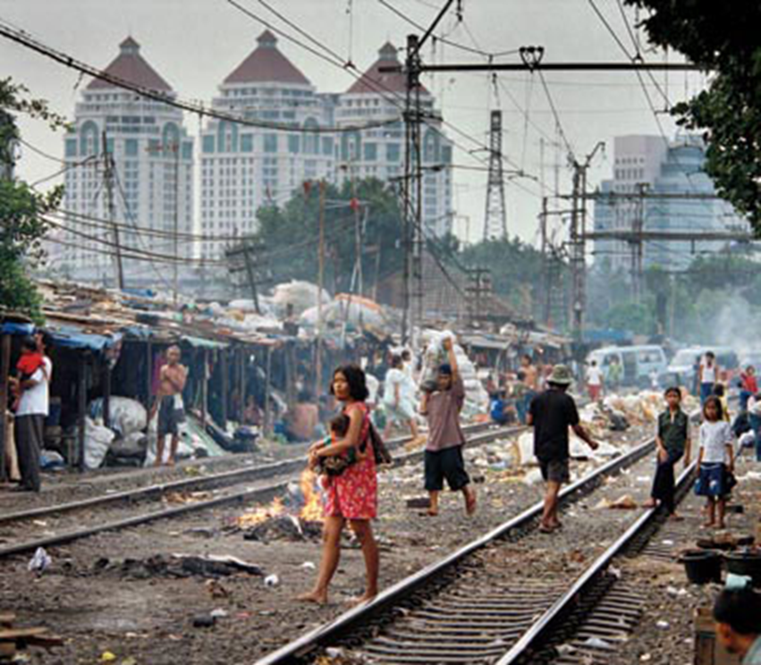
A gender sensitive approach to social, economic and environmental determinants
Work across sectors and communities to expand economic empowerment, safe spaces, and other proven approaches
Educate girls
Tackle violence, malnutrition, climate change
Engage men and boys
Notes:
It will be impossible for health systems to reach those at highest risk of maternal and child mortality and reduce their risk without greater emphasis on the social determinants of health. The need to work across sectors to do so is urgent. Health planners and funders should do more to recognise that effective action outside of the health sector has health benefits, particularly when it chips away gender inequality.
Empowering girls and women so they can control their reproduction and health care;
providing girls and women with assets such as micro-credit, financial management skills, and mobile technology.

Slide 28
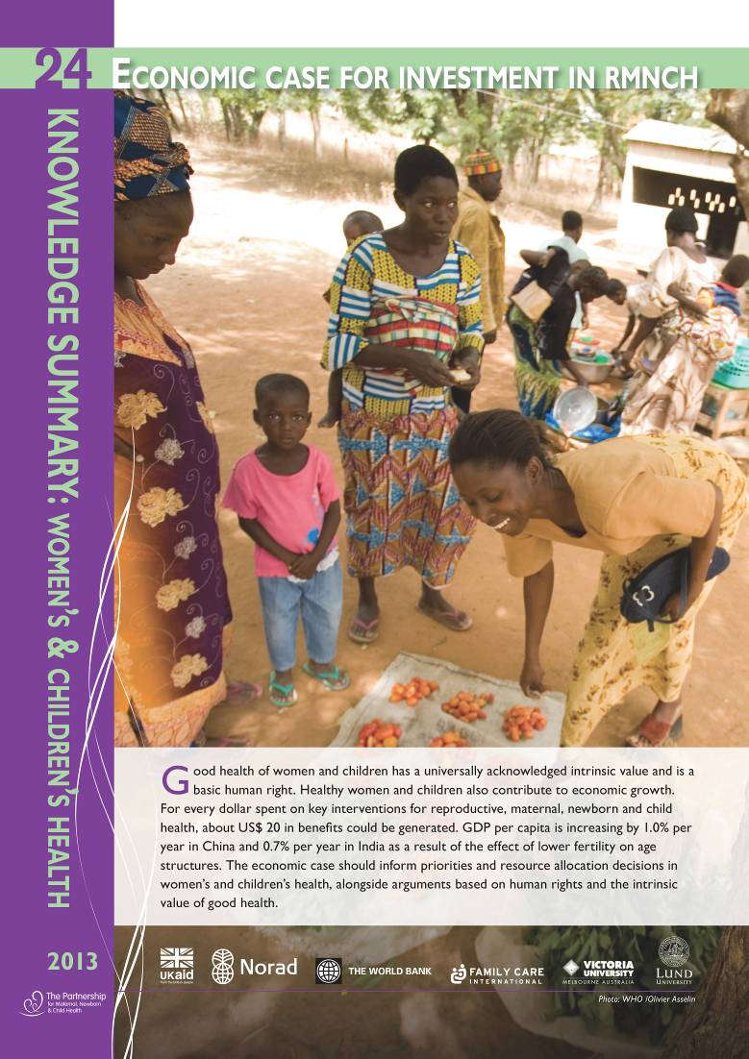
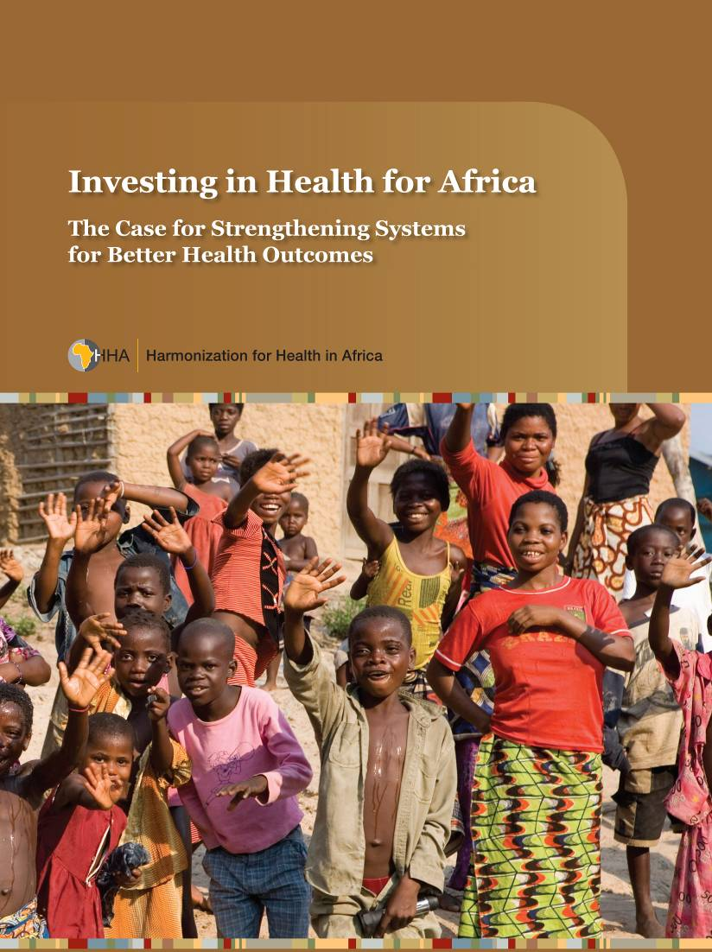
Healthier is wealthier

Slide 29
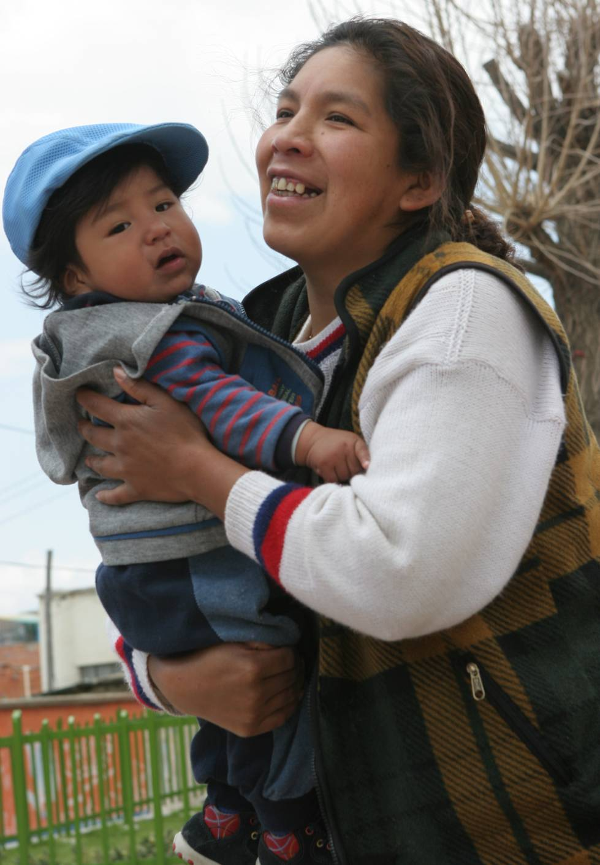
POST 2015?

Slide 30
Process
Rio +20
High Level Panel - over 50 national and thematic consultations, community based discussion and a Global Online Conversation - all of which will contribute to a vision for The World We Want beyond 2015.
President Yudhoyono of Indonesia, President Johnson Sirleaf of Liberia and Prime Minister Cameron of the United Kingdom were appointed in May, 2012 as co-chairs of the High Level Panel.
Tasks team for Global Thematic Consultation on health – WHO and UNICEF Botswana and Sweden

Slide 31
11 thematic consultations
Conflict and Fragility
Governance
Growth and Employment
Energy
Environmental Sustainability
Population Dynamics
Education
Health
Food Security and Nutrition
Inequalities
Water

Slide 32
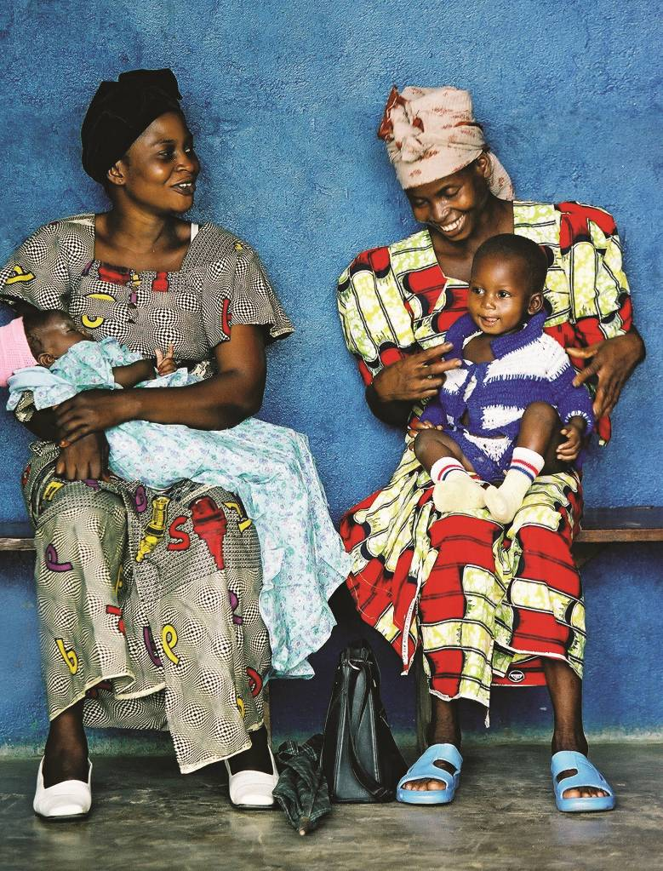
1000 days…..
The unfinished agenda
Ending preventable deaths and morbidity, especially amongst women and children
Notes:
The focus on health MDGs for women, children and girls as a lead up to 2015 and beyond should include a goal focused on the health of populations:
where the target should be ending preventable deaths and morbidity, especially amongst women and children who are the most vulnerable. The global community needs to come together to champion the cause of “healthy life expectancy” which addresses intersectorality and universality and moves beyond single theme issues, which have been a major obstacle in achieving the MDGs. Investing in girl’s education, investing in efforts to reduce violence towards women and investing in improving gender-sensitive, population centric and equitable reproduction , maternal , newborn and child health policies is an investment in social and economic growth and an obligation to realize the human rights for all.

Slide 33
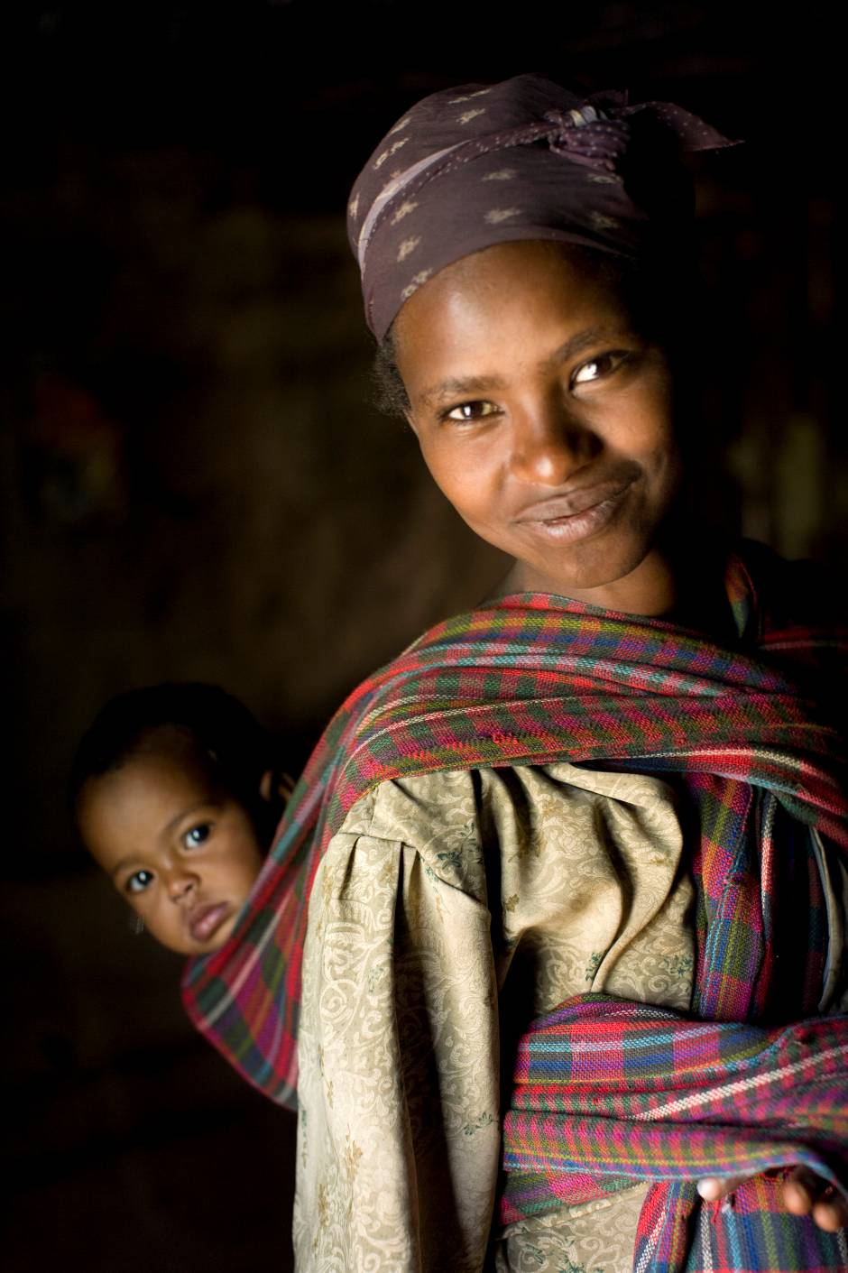
Thank you

