Slide 1
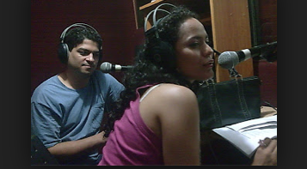
Commission on the Status of Women Fifty-seventh Session
Review Panel “Equal Sharing of Responsibilities between Men and Women, including Caregiving in the Context of HIV/AIDS”
Gender Equity and the Media
Warren Feek
Executive Director
The Communication Initiative
www.comminit.com
Image from “Puntos de Encuentro“- Nicaragua
http://www.comminit.com/hiv-aids/content/catalyzing-personal-and-social-change-around-gender-sexuality-and-hiv-impact-evaluation-

Slide 2
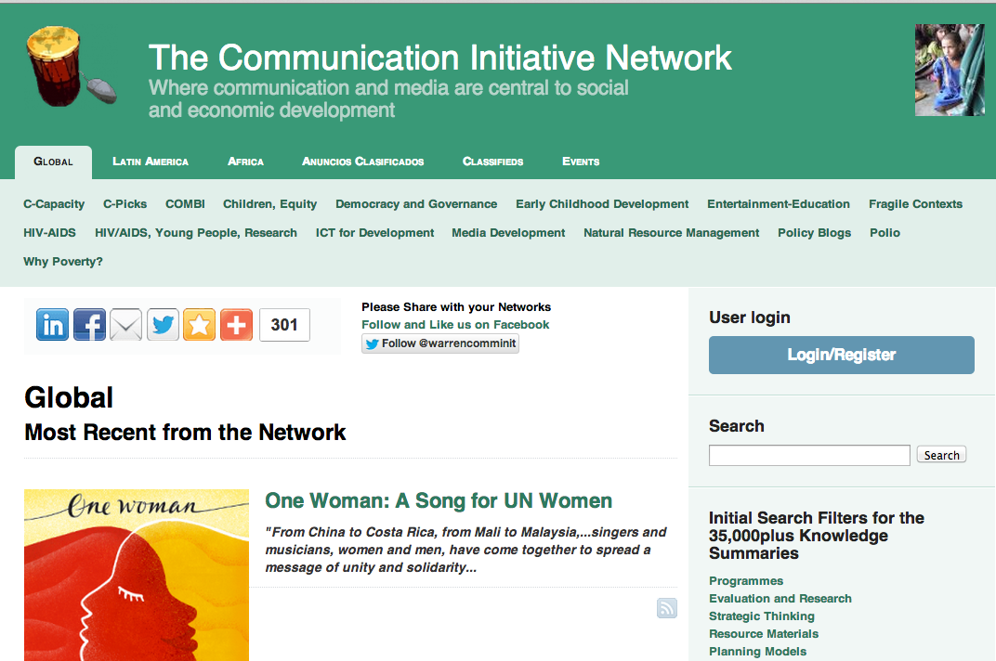
Mission:
To convene the communication and media development, social and behavioural change community for more effective local, national, and international development action
23 Partner agencies – strategic direction and resource support
Registered network of 90,000in 200
90,000 have registered to the network
35,000 knowledge summaries shared
Full social networking process
1 million plus user sessions per annum
Compelling data re people using to improve their work
Independent Africa run and Latin America run processes

Slide 3
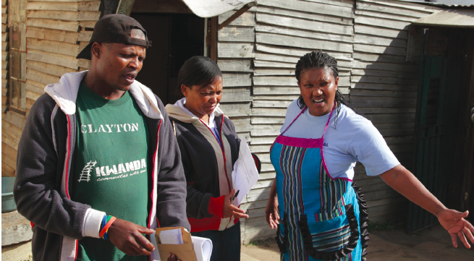
HIV/AIDS in Context
Gender Issues in HIV/AIDS reflective of overall social dynamics/issues
Progress on HIV/AIDS has required/still requires key elements
of any social change process: Voice, Debate, Dialogue, Organisation
Media can and do play a crucial role in this process
Gender equity within the media is key to this being accelerated
Image from “KWANDA – Soul City” – South Africa
http://www.comminit.com/hiv-aids/content/soul-city-institute-kwanda-report-2011

Slide 4
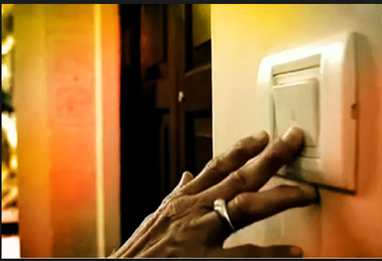
Some indicative and trend data
(with 2009 or other baseline comparisons where possible)
12%
1995 – Women in top media
management jobs (39 nations)
International Women’s Media Foundation, “Global Report on Status of Women in the News Media”, 2011 http://iwmf.org/pdfs/IWMF-Global-Report.pdf
27%
2011 – Women in top media
management jobs (59 nations)
15%
Overall women in all media positions – Democratic
Republic of Congo
27%
Overall women in all media positions – Malawi
27%
Overall women in all media positions – Zimbabwe
Image from “Bell Bajao” – India and now Global
http://www.comminit.com/hiv-aids/content/ring-bell-bell-bajao

Slide 5
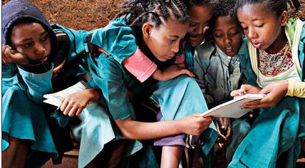
Some indicative and trend data
(with 2009 or other baseline comparisons where possible)
17%
2003 – proportion of women sources in the news
– Southern Africa
19%
2010 – proportion of women sources in the news
– Southern Africa
Gender Links Survey – 33,000 news stories – SADCC countries
Image from “Our Lives aren’t Like the Lives of Other Children” – Ethiopia
http://www.comminit.com/hiv-aids/content/our-lives-arent-lives-other-children-documentation-approaches-process-and-best-practices

Slide 6
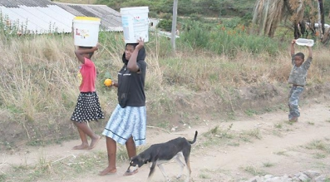
Some indicative and trend data
(with 2009 or other baseline comparisons where possible)
“Based on a series of portrayal analyses, for the last 10 years or so there has been no real change in the representation of women on screen. Pan industry there is a ratio of about male: female 2:1 (though this can differ amongst genres). Older women are less visible and there is a sharp decline at about 45 yrs.
BBC overview
of portrayal
data

Slide 7
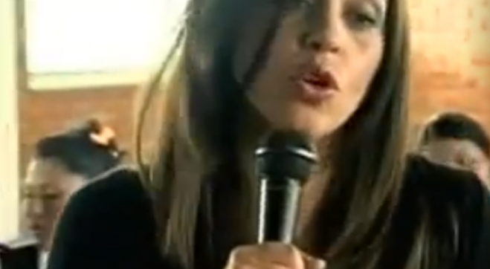
Some indicative and trend data
(with 2009 or other baseline comparisons where possible)
Facebook - 2008, there were 100 million users; today (March 3 2013), there are 963,812,360 – with 61 million in India, 47 million in Indonesia, and 30 million in the Philippines. Fastest growth - Burundi and Mauritania
Twitter: In February 2009, there were 6 million unique monthly visitors; by December 2012, there were 200 million unique monthly visitors
Mobile phones: From 1990 to 2011, worldwide mobile phone subscriptions grew from 12.4 million to over 6 billion. In 2011, 78% of people in (so-called) developing nations had mobile phone subscriptions (This figure will now be woefully out of date).
Image from “Revelados” – Colombia
http://www.comminit.com/revelados/

Slide 8
Some indicative and trend data
(with 2009 or other baseline comparisons where possible)
Text messaging (SMS): 1.6 trillion messages were sent in 2011 rising to (projected) 7.7 trillion messages in 2016
Wikipedia: In 2009, users submitted 14 million articles; now, there are 25 million articles available in 285 different languages
iPhone Apps: There are now over half a millions apps for the iPhone alone, with the vast majority launched in the last 4 years
Image from “Revelados” – Colombia
http://www.comminit.com/revelados/

Slide 9
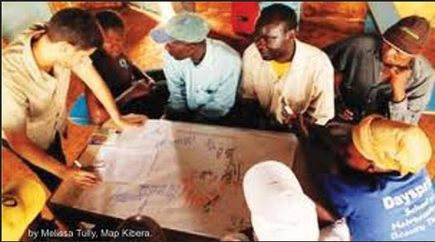
Some indicative and trend data
(with 2009 or other baseline comparisons where possible)
There are 300 million fewer female mobile phone subscribers than male subscribers
In low- and middle-income countries, a woman is 21% less likely to own a mobile phone than a man
Lower- and middle-income countries have significantly less Facebook use by women. In Ghana, 69% of Facebook users are male; in Sri Lanka, the percentage is 68%
Lower- and middle-income countries have significantly fewer Twitter accounts by women. For example, in India, 85% are male users
Image from “Kibera - Crowdsourcing Tools, Open Data Initiatives and Digital Media
to Support and Protect the Vulnerable – Kenya - http://www.comminit.com/global/content/mediating-voices-communicating

Slide 10
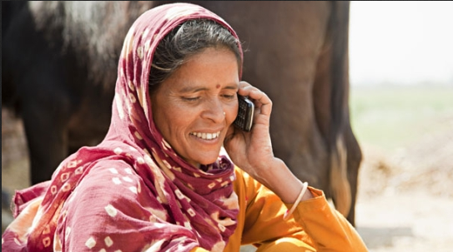
Some indicative and trend data
(with 2009 or other baseline comparisons where possible)
Women’s representation in the computing and information technology workforce fell from a peak of 38% in the mid-1980s down to 29.6%
The percentage of women software developers in the United States has declined from 42% in 1987 to less than 25% today
In BBC only 25% of people involved in technology and engineering roles are female - with no women at senior or high management roles
Image from BBC Media Action initiative "Health on the Move: Can Mobile Phones Save Lives?
http://www.comminit.com/global/content/health-move-can-mobile-phones-save-lives

Slide 11

Some indicative and trend data
(with 2009 or other baseline comparisons where possible)
Women own 40% of the private businesses in the United States, according to the Center for Women’s Business Research. But they create only 8% of the venture-backed technology start-ups. (NB There seems a paucity of international data on this really important area)
Image from UNAIDS Initiative Crowd Out AIDS
http://www.comminit.com/global/content/crowdoutaids

Slide 12

Some indicative and trend data
(with 2009 or other baseline comparisons where possible)
Progress – somewhat - with “traditional” media
The “traditional” media are rapidly being overtaken by the
“new media” (perhaps this has already happened)
These “new” media have the “qualities” required to help
advance issues such as the gender dynamics in HIV/AIDS as…
…they are tailor made to amplify voices; expand inter-personal dialogue; enhance national debate; increase the gender perspectives and women’s voices in that dialgue and debate; and (really important) provide an organisational base that can be undertaken independent of “mediators”
Image from “We Will Speak Out Coalition”
http://www.comminit.com/hivaids-youngpeople/content/we-will-speak-out-coalition-working-together-end-sexual-violence

Slide 13
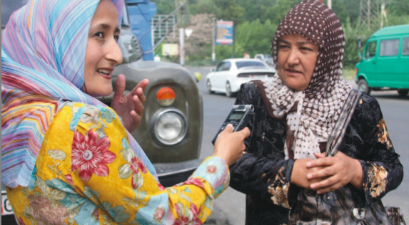
Some indicative and trend data
(with 2009 or other baseline comparisons where possible)
Hundreds of millions of women are appropriating and using these technologies
BUT – Men are appropriating these technologies at much faster rates!
So – on the most powerful and relevant technologies the gender gap is increasing
Image from “Counting women to Making Womn Count – by Internews – JUST PUBLISHED
http://www.internews.org/research-publications/WomenCount

Slide 14

What to do?
Three ideas prompted by the data
1. Support gender focused HIV/AIDS social movements to both appropriate digital/mobile technologies and integrate them
with their other media work
2. Formally monitor and report both the “new” and “traditional”
media gender equity trends – in real-time for “new”
3. Promote women owned, run and invested in digital/mobile
companies and organisations

