Slide 1
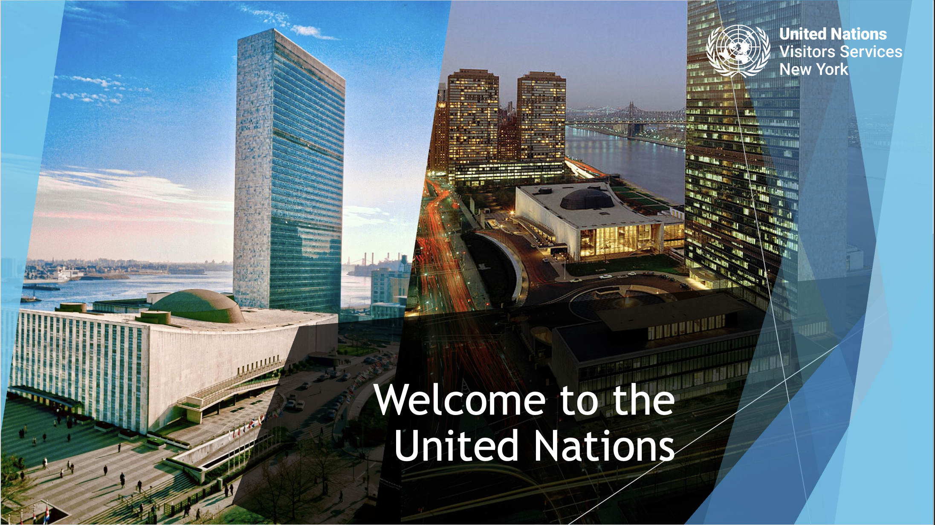

Slide 2
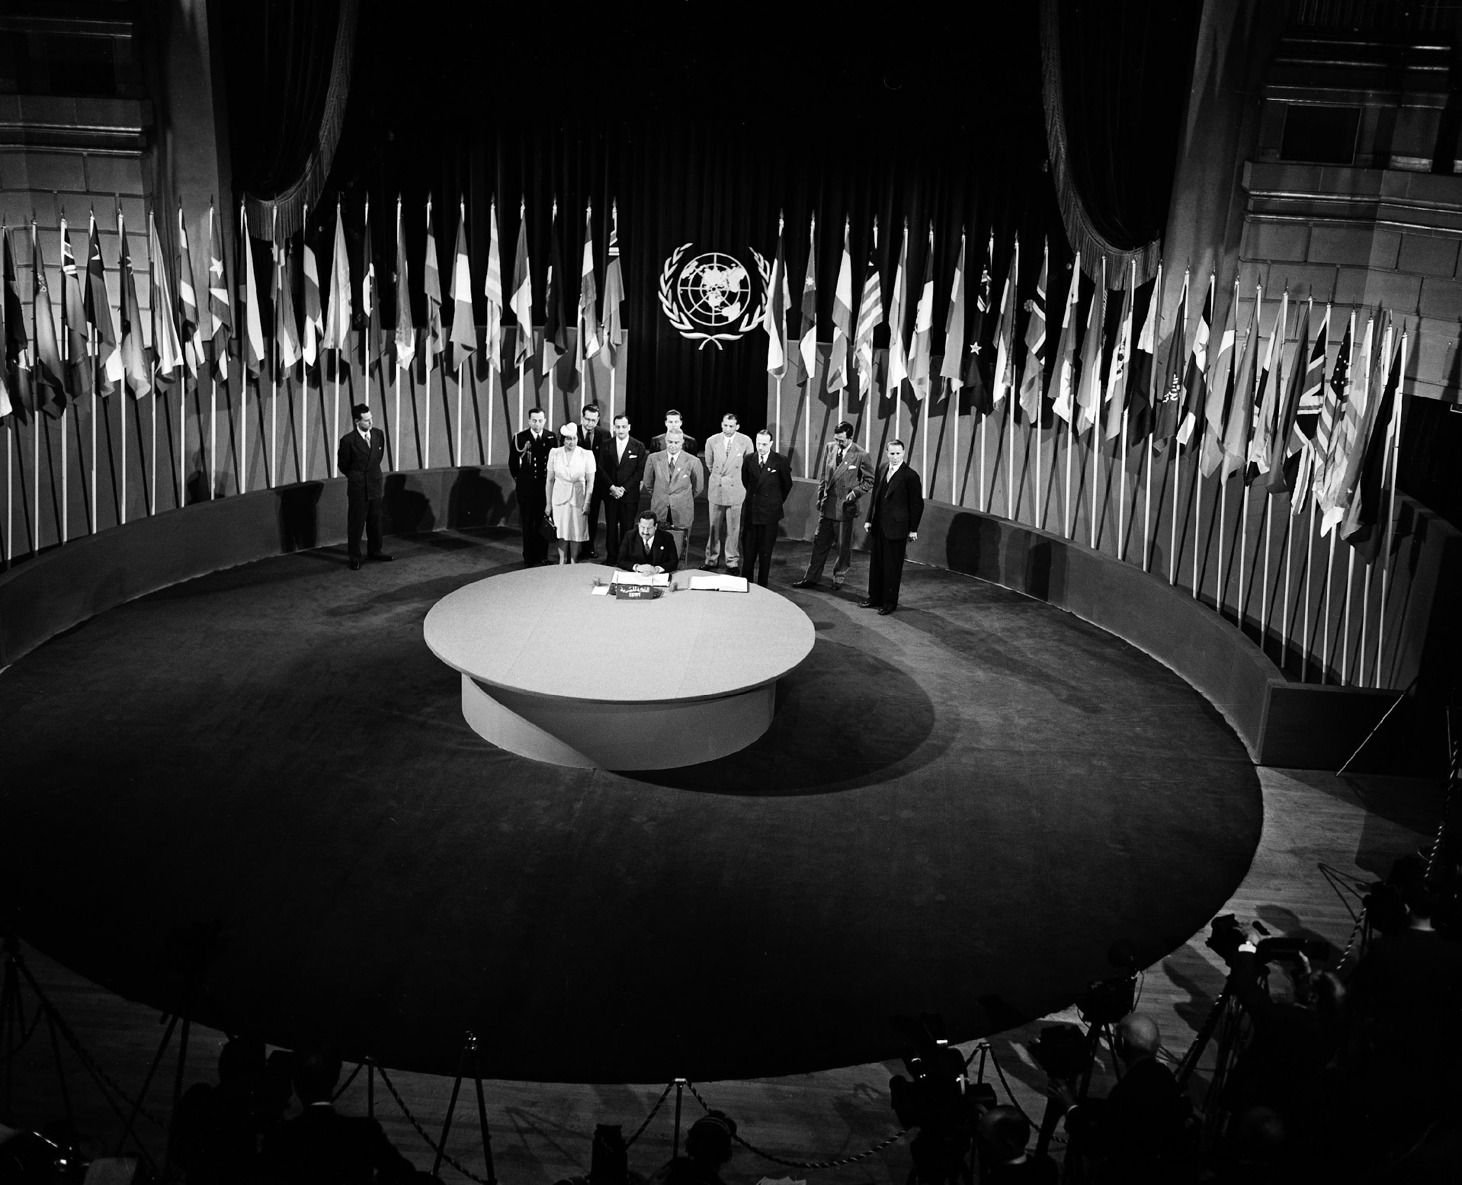
About the UN
The UN was created in 1945 at the end of World War II, and the Charter entered into force in San Francisco on 24 October.
The name “United Nations” was coined by US President Franklin D. Roosevelt.
51 countries joined the UN in 1945, and now there are 193 Member States.
Today, there are over 125,000 staff working worldwide for the UN System.
The three Pillars of the UN are:
- Maintain international peace and security
- Further economic and social development
- Promote human rights

Slide 3
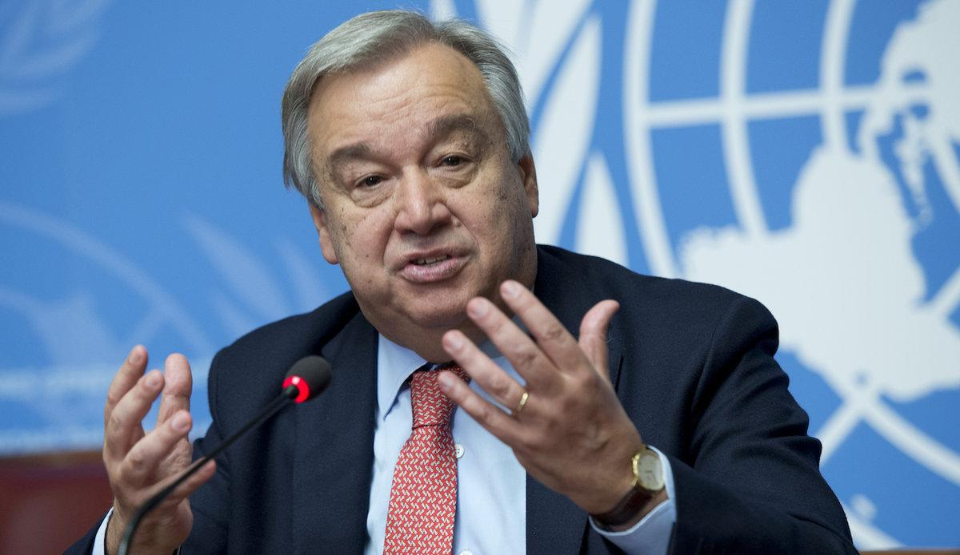
Secretary-General: António Guterres (Portugal)
2017-2021; 2022-2026

Slide 4

Principal Organs of the UN
General
Assembly
Security
Council
Economic and Social Council
Trusteeship
Council
International
Court of Justice
Secretariat
Notes:
All main organs are based in New York, apart from the International Court of Justice which is based the The Hague, Netherlands.
The Trusteeship Council suspended its operations on 1 November 1994, a month after the independence of Palau, the last remaining United Nations trust territory. By a resolution adopted on 25 May 1994, the Council amended its rules of procedure to drop the obligation to meet annually and agreed to meet as occasion required

Slide 5
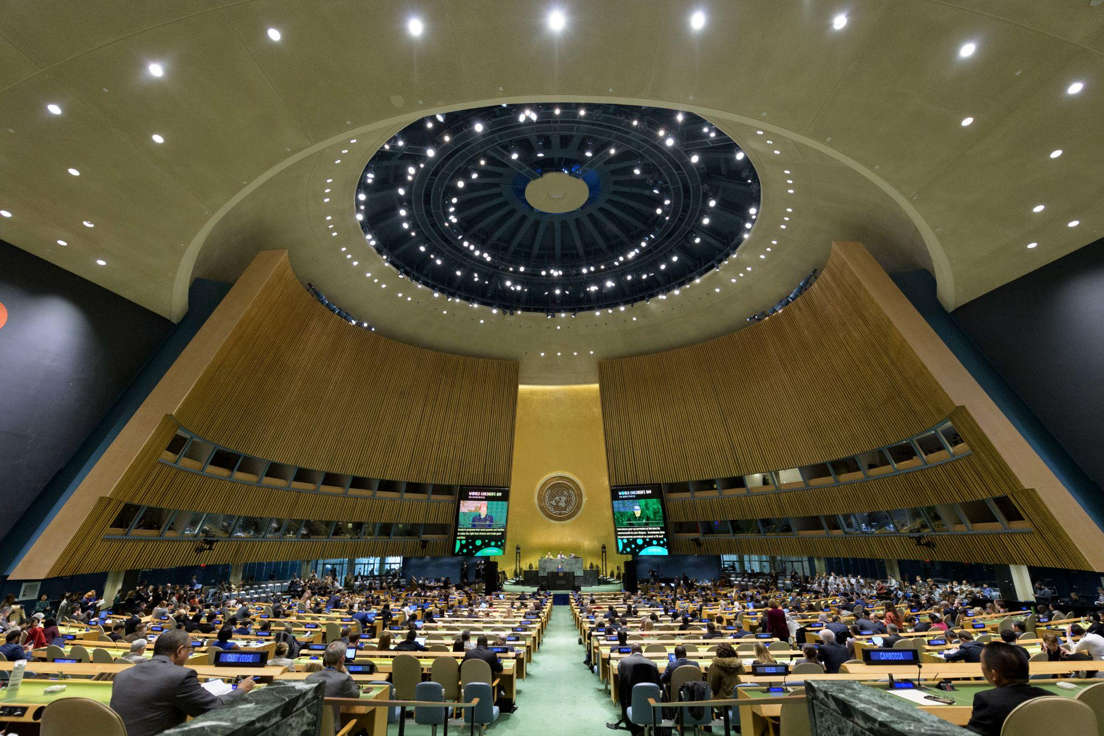
General Assembly
An international forum to discuss global issues and to promote dialogue and cooperation.
All countries are equally represented. Each country has one vote.
Resolutions are not legally binding but can lead to international treaties or agreements.
Notes:
Central organ of the United Nations.
All countries are equally represented. Each country has one vote.
International forum to discuss global issues.
Resolutions are not legally binding but can lead to international treaties or agreements.
“The General Assembly has not been created to rule the world, but to be a forum to promote dialogue and international cooperation.”

Slide 6
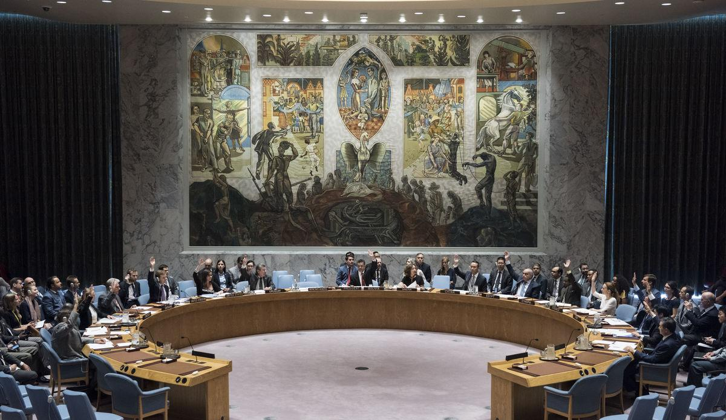
Security Council
Its role is to maintain international peace and security.
15 members: 5 permanent with veto power (US, Russia, China, UK and France) + 10 non-permanent.
Resolutions are legally binding.
Actions the Council may take:
- Peaceful settlement of disputes
- Peacekeeping operations
- Enforcement measures
Notes:
Its role is to maintain international peace and security.
15 members: 5 permanent with veto power,
10 non-permanent.
Resolutions are legally binding.
Actions The Council May Take
Peaceful settlements of disputes.
Peacekeeping operations.
Enforcement measures.

Slide 7
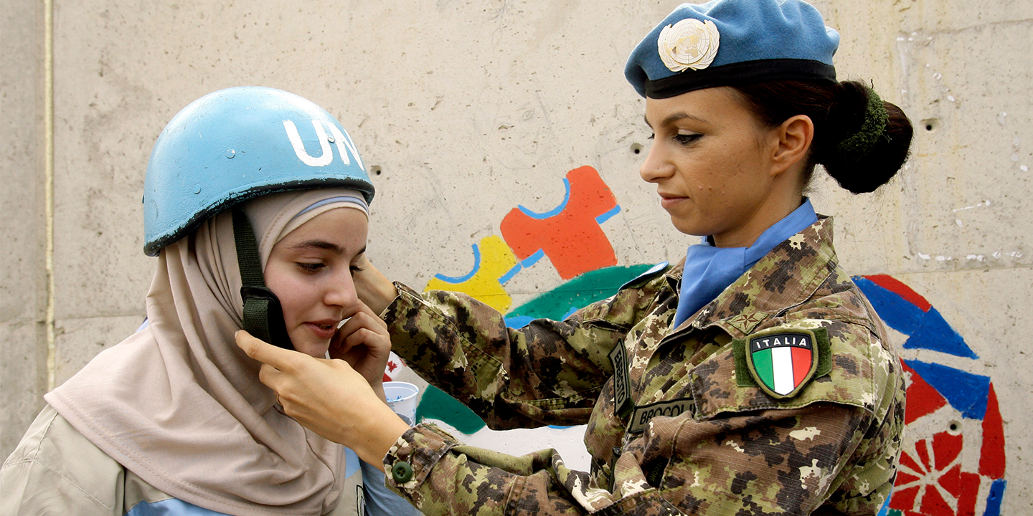
Peacekeeping Operations
More than 70 operations worldwide since 1948
(currently 11).
Nearly 100,000 UN personnel are deployed in UN peacekeeping missions, both uniformed (military and police) and civilian.
Over 4,409 peacekeepers have died in the line of duty
(as of 30 November 2024).
Notes:
Peacekeeping is one of the most effective tools to respond to challenges of global peace and security.
Helps build national capacities to become more resilient to conflict and build sustainable peace and stability.
Peacekeeping is a collective enterprise. Partnerships, including with Member States and regional organizations, are critical to achieving results.
Guided by three basic principles
Consent of the parties;
Impartiality;
Non-use of force except in self-defense and defense of the mandate.

Slide 8
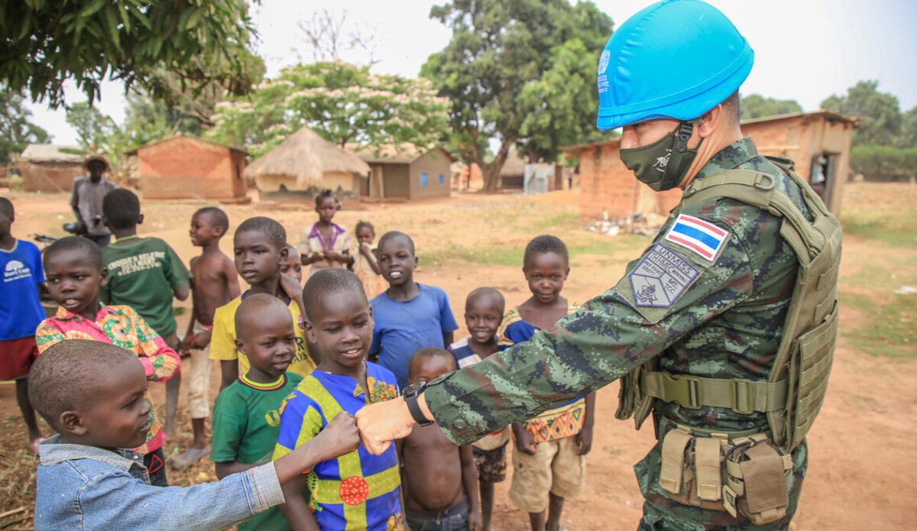
Functions of Peacekeeping
Protect civilians
Prevent conflicts
Build rule of law and security institutions
Promote human rights
Deliver field support
Ensure women’s role to achieve and sustain peace
Principles of a Peacekeeping Operation
Consent of the parties
Impartiality
Non-use of force except in self-defense and defense of the mandate

Slide 9
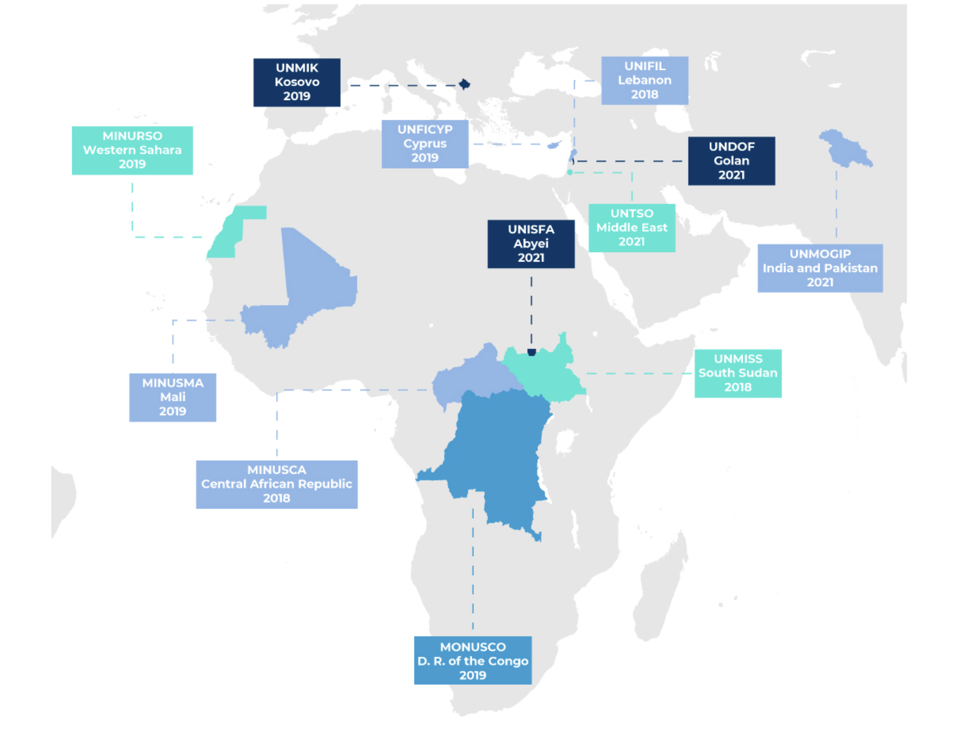
The Map of Peacekeeping Operations
More information on UN Peacekeeping website: https://peacekeeping.un.org/
Notes:
Multidimensional peacekeeping includes:
Protecting civilians
Supporting political processes
Disarmament, Demobilization and Reintegration of former combatants
Supporting rule of law institutions and justice systems
Monitoring human rights and building the capacity of national human rights institutions
Supporting electoral processes
Clearing minefields and disposing safely unexploded ordnance
Supporting the work of humanitarian agencies
Over 70 years, peacekeepers have helped bring peace and stability to many places, including recently in Côte d'Ivoire and Liberia.
71 operations worldwide since 1948 (57 completed and currently 14)
More than 110,000 peacekeepers: military, police & civilians.
Peacekeeping budget for 2018-19: $6.7 billion (less than 1% of global military spending)
First peacekeeping mission: UNTSO, Middle East (1948).
Over 3,500 peacekeepers have died in the line of duty.

Slide 10
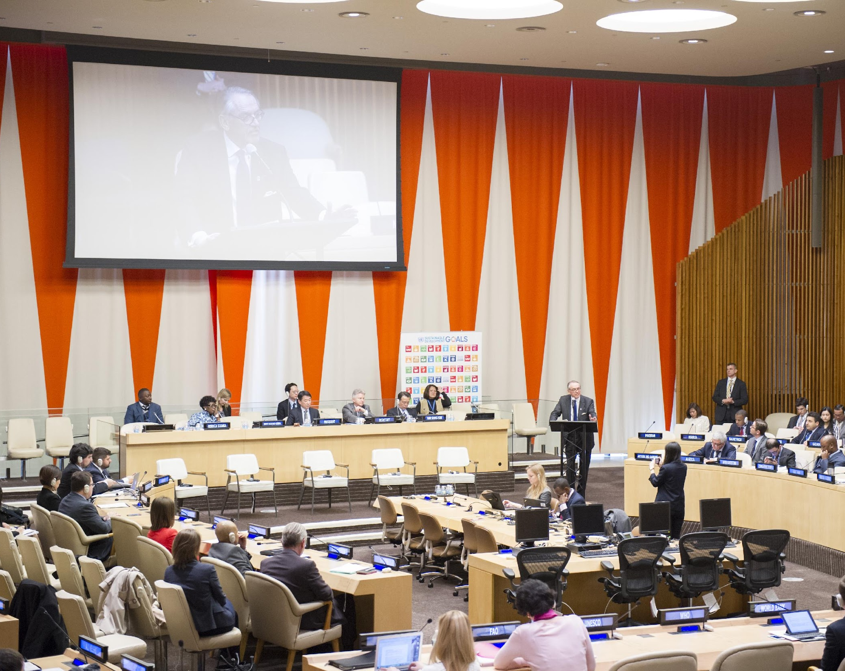
ECONOMIC AND SOCIAL COUNCIL (ECOSOC)
Promotes higher standards of living, full employment, and economic and social progress.
Identifies solutions to international economic, social and health problems.
Facilitates international cultural and educational cooperation.
Encourages universal respect for
human rights and fundamental
freedoms.
Notes:
Economic and Social Council
The Economic and Social Council is the principal body for coordination, policy review, policy dialogue and recommendations on economic, social and environmental issues, as well as implementation of internationally agreed development goals. It serves as the central mechanism for activities of the UN system and its specialized agencies in the economic, social and environmental fields, supervising subsidiary and expert bodies. It has 54 Members, elected by the General Assembly for overlapping three-year terms. It is the United Nations’ central platform for reflection, debate, and innovative thinking on sustainable development.

Slide 11
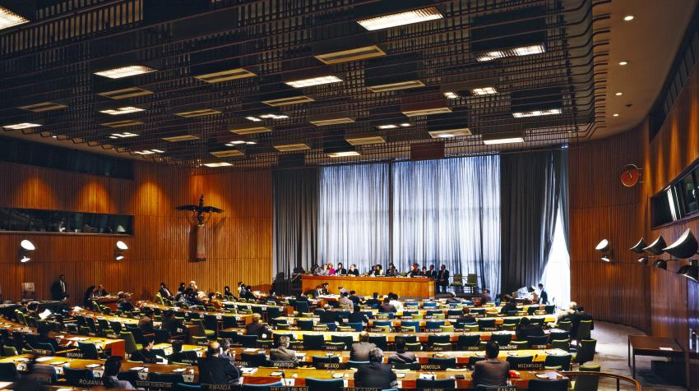
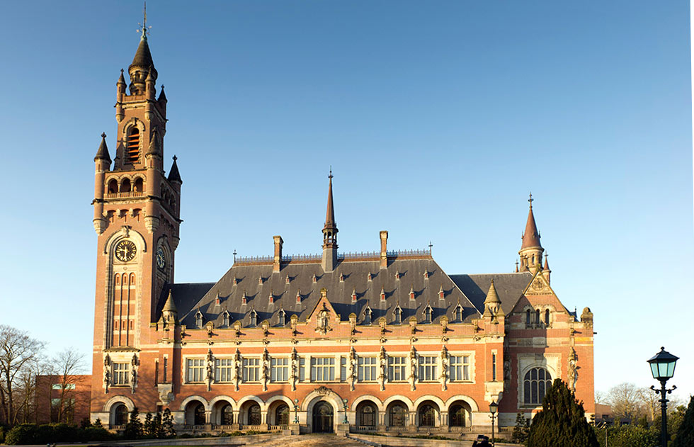
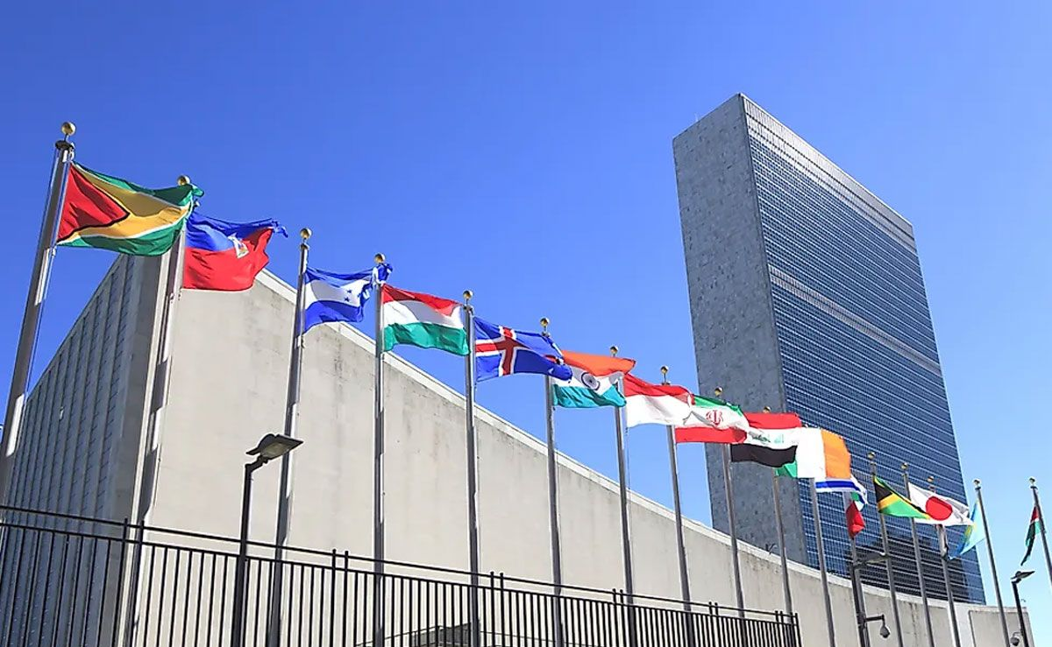
International Court
of Justice
Trusteeship Council
Secretariat
Established to supervise the administration of trust territories as they transitioned from colonies to sovereign nations. The Council suspended its activities in 1994, when Palau, the last of the original 11 trust territories, gained its independence.
Located at the Peace Palace in The Hague, Netherlands. The Court’s role is to settle legal disputes submitted to it by States and to give advisory opinions in accordance with international law.
Carries out the day-to-day work of the UN. Offices and Departments under the Secretariat coordinate with each other to ensure cohesion in the UN’s programme of work.

Slide 12







































The UN Family of Organizations
Listed here are Specialized Agencies, Funds and Programmes, and other related organizations in the UN System
Notes:
More than 40 Specialized Agencies, Funds and Programmes

Slide 13

Sustainable Development Goals (SDGs)
The Sustainable Development Goals (SDGs) were adopted in 2015 to build upon the achievements of the Millennium Development Goals (MDGs) adopted in 2000.
The global goals are a shared agenda to end poverty, fight inequality and injustice, and protect the planet. The SDGs address the root causes of poverty and the universal need for development for all people, ensuring that no one is left behind.

Slide 14

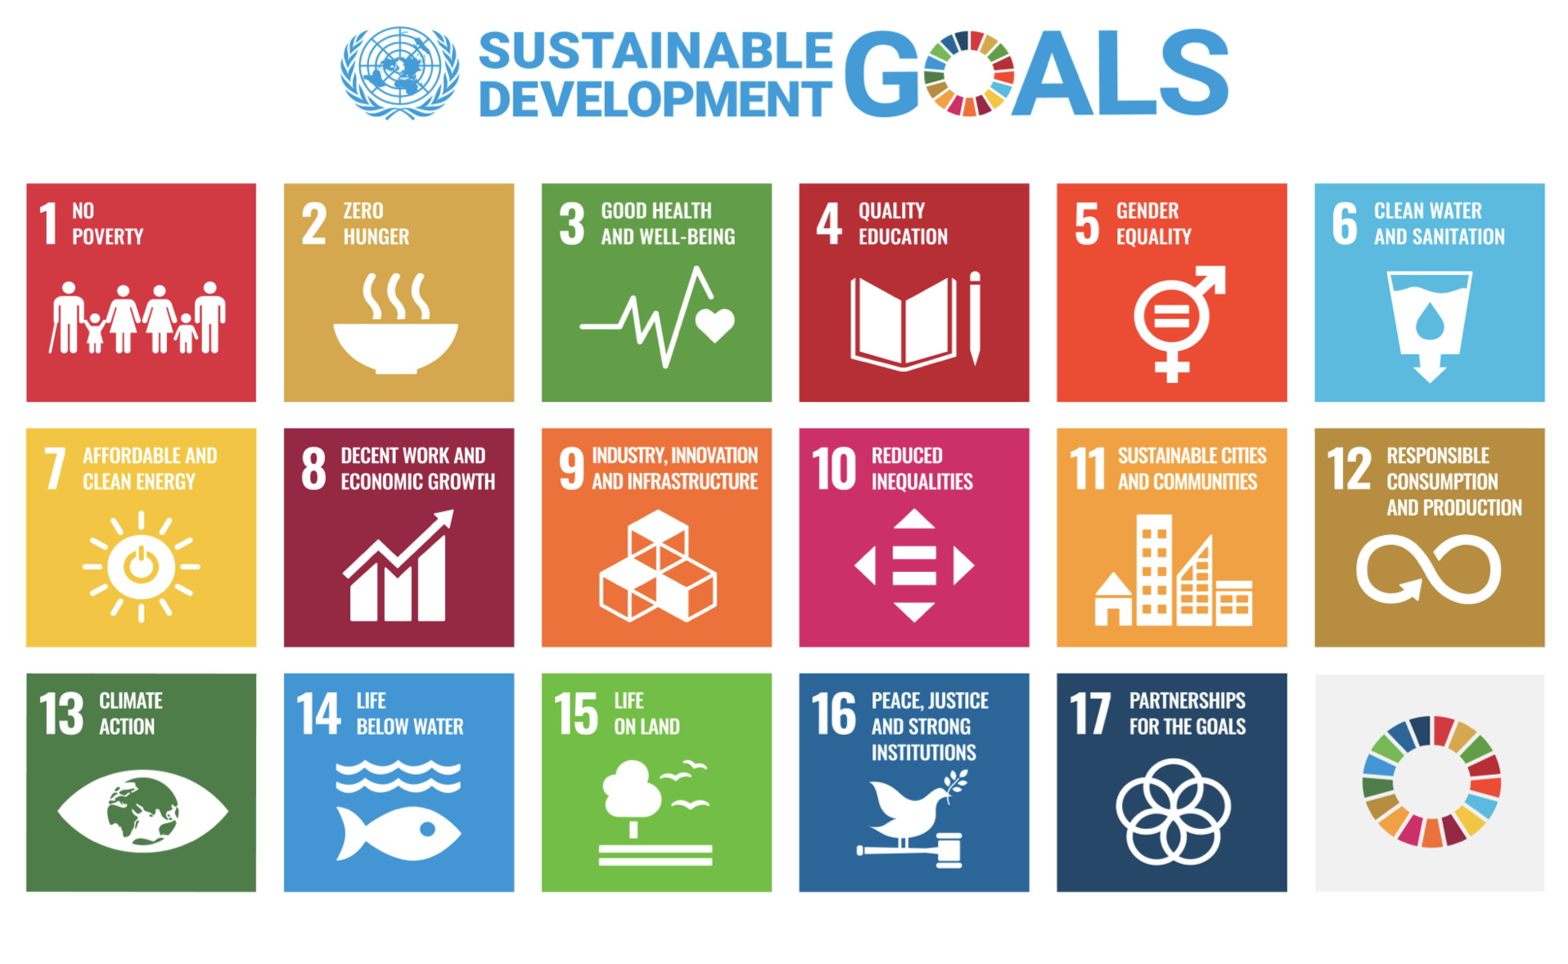

Slide 15

Goal 1. End poverty in all its forms everywhere
Goal 2. End hunger, achieve food security and improved nutrition and promote sustainable agriculture
Goal 3. Ensure healthy lives and promote wellbeing for all at all ages
Goal 4. Ensure inclusive and equitable quality education and promote lifelong learning opportunities for all
Goal 5. Achieve gender equality and empower all women and girls
Goal 6. Ensure availability and sustainable management of water and sanitation for all
Goal 7. Ensure access to affordable, reliable, sustainable and modern energy for all
Goal 8. Promote sustained, inclusive and sustainable economic growth, full and productive employment and decent
work for all
Goal 9. Build resilient infrastructure, promote inclusive and sustainable industrialization and foster innovation
Goal 10. Reduce inequality within and among countries
Goal 11. Make cities and human settlements inclusive, safe, resilient and sustainable
Goal 12. Ensure sustainable consumption and production patterns
Goal 13. Take urgent action to combat climate change and its impacts
Goal 14. Conserve and sustainably use the oceans, seas and marine resources for sustainable development
Goal 15. Protect, restore and promote sustainable use of terrestrial ecosystems, sustainably manage forests, combat
desertification, and halt and reverse land degradation and halt biodiversity loss
Goal 16. Promote peaceful and inclusive societies for sustainable development, provide access to justice for all and
build effective, accountable and inclusive institutions at all levels
Goal 17. Strengthen the means of implementation and revitalize the global partnership for sustainable development
Notes:
Universal Declaration of Human Rights
Adopted on 10 December 1948 by the General Assembly
30 articles
“All human beings are born free and equal in dignity and rights. They are endowed with reason and conscience and should act towards one another in a spirit of brotherhood.”

Slide 16
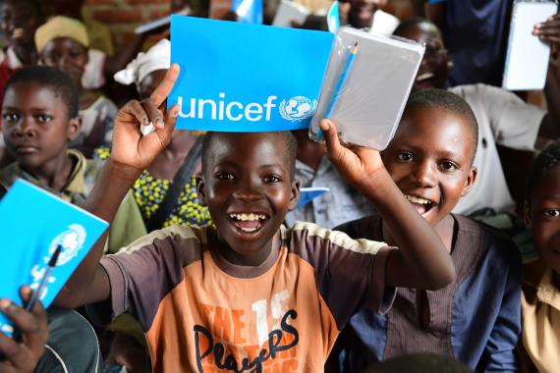
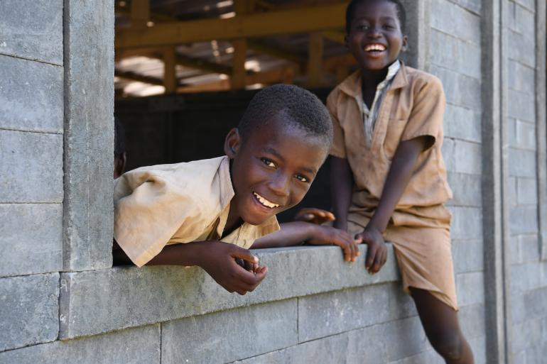
Example of Progress on SDGs
SDG Goal 4: Ensure inclusive and equitable
quality education + SDG Goal 11: Sustainable Cities and Communities (UNICEF)
UNICEF helps 48.6 million out-of-school children access education, including 6.4 million children on the move and 31.7 million in humanitarian settings (as of 2021).
Example: Building Schools with Plastic Bricks
Côte d'Ivoire needed 15,000 classrooms to meet the needs of children without a place to learn. To help fill this gap, UNICEF partnered with Conceptos Plásticos, a Colombian company, to use recycled plastic collected from polluted areas in and around Abidjan to build 500 classrooms for more than 25,000 children from 2019 to 2021, with the potential to increase production beyond.

Slide 17

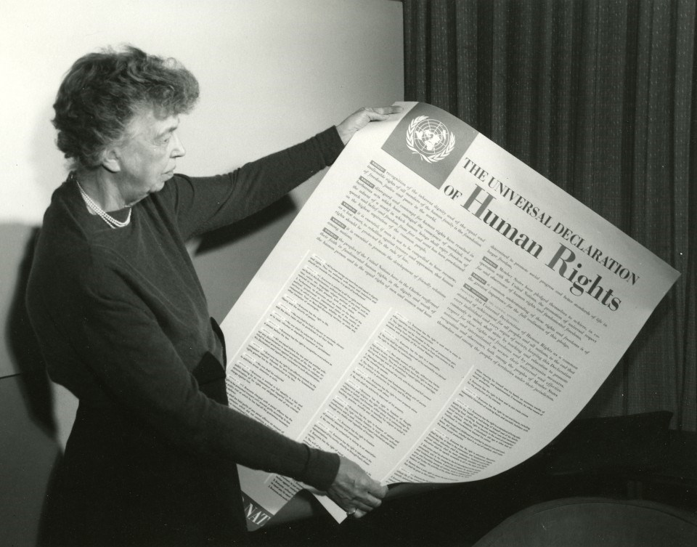
Universal Declaration of Human Rights
The Universal Declaration of Human Rights (UDHR) is a milestone document in the history of human rights.
It was adopted on 10 December 1948 by the General Assembly as a common standard of achievements for all peoples and all nations. It set out, for the first time, fundamental human rights to be universally protected.
It has been translated into over 500 languages.
The UDHR has paved the way for the adoption of more than seventy human rights treaties.

Slide 18
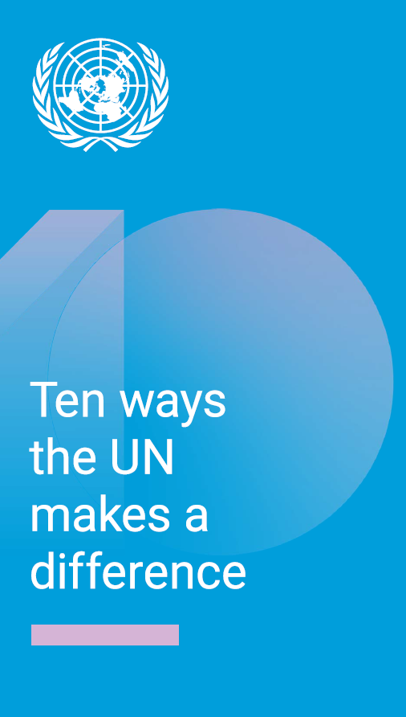
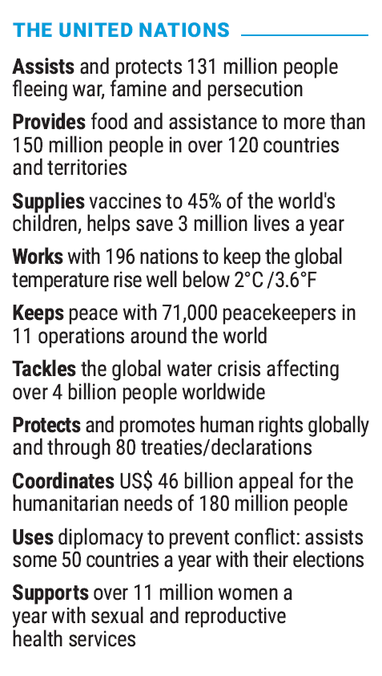

Slide 19
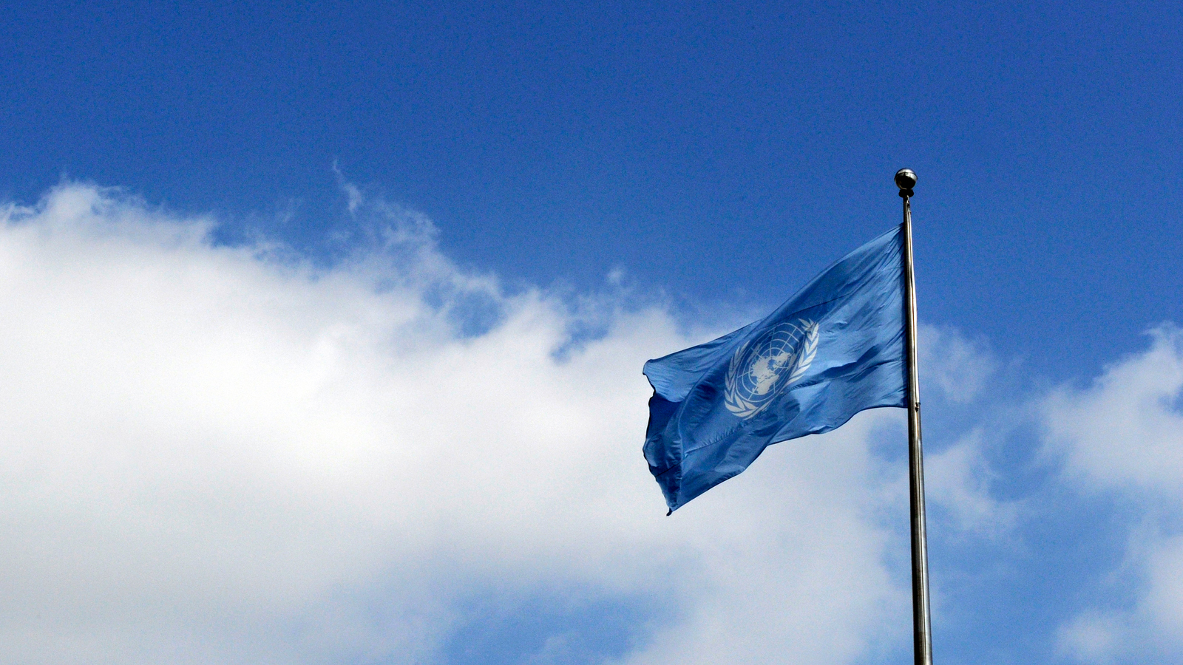

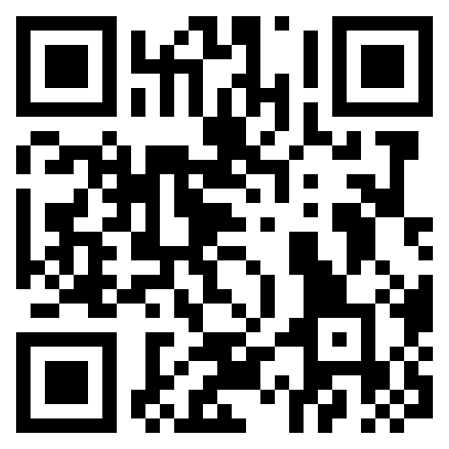

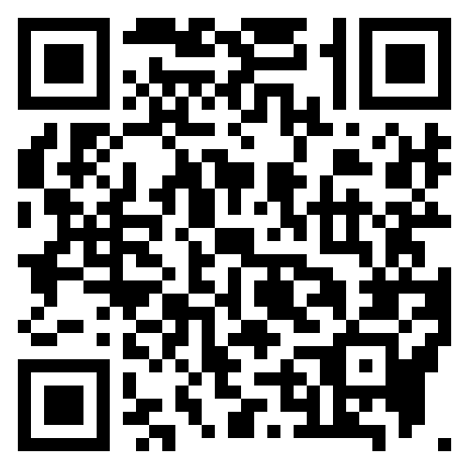

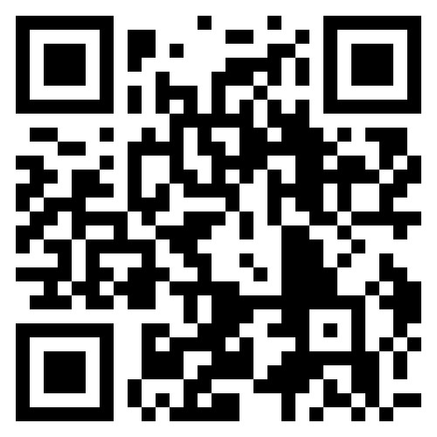


Thank you for your attention!
@VisitUN
@UNVisitorsCentre
www.un.org/visit
dgc-teachtheun@un.org

