Slide 1


The rights and dignity of victims of sexual exploitation and abuse and sexual harassment
A training module on the meaning and application of a victim-centred approach to sexual exploitation and abuse and sexual harassment
Notes:
The training module provides a broad framework on the victim-centred approach. The facilitator notes have been prepared to guide facilitators as they present the training content and lead the participant activities. The notes include general background information that may be useful during the delivery of the training and may be read out or paraphrased. Facilitators are encouraged to tailor the delivery of the training module in accordance with the training needs of the participants and their entities.
For more detailed information about the victim-centred approach and the topics that will be addressed in the training, please see the Facilitator Background Notes at www.un.org/victimsrightsfirst.
If you have any questions about preparing for the training, contact ovra@un.org.

Slide 2
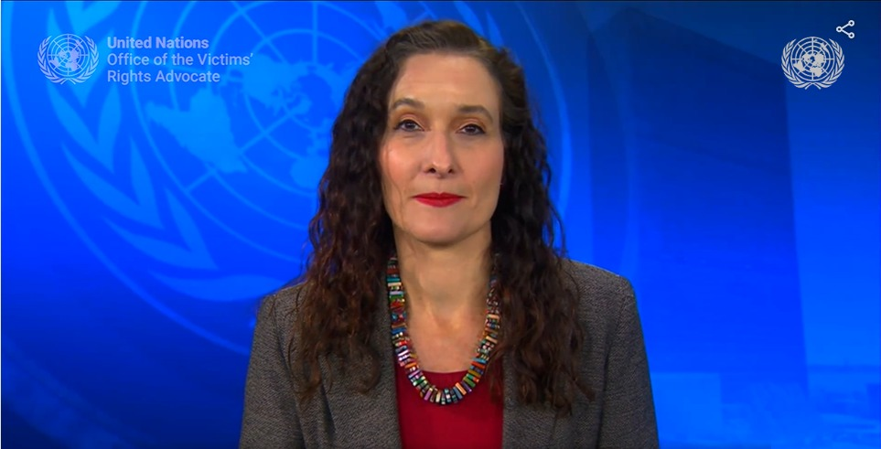
Welcome message from the United Nations Victims’ Rights Advocate, Assistant Secretary-General Najla Nassif Palma
https://www.youtube.com/watch?v=IoLW6pTWXQA&list=PLwoDFQJEq_0YmsZKn6cOopfcm09H_7BfB&index=4
Notes:
asdlkjasldkjasdlkajsdlaskjdsalkasdlkajslkasdlkasjlaksjdsalk

Slide 3


“I have the right”
Short film

Slide 4
Training overview
Context and objectives
Staff rules, standards, terminology and definitions
Core documents
The victim-centred approach
Case studies
Reporting channels
Prevention initiatives

Slide 5

Why there is a need
for this course
Putting the RIGHTS AND
DIGNITY of victims first

Slide 6




Foundations
Sexual exploitation and abuse and sexual harassment
Staff rules
Standards
Terminology
Definitions

Slide 7

Definitions
Sexual exploitation
Any actual or attempted abuse of a position of vulnerability, differential power or trust for sexual purposes, including, but not limited to, profiting monetarily, socially or politically from the sexual exploitation of another.

Slide 8

Definitions
Sexual abuse
Actual or threatened physical intrusion of a sexual nature, whether by force or under unequal or coercive conditions.

Slide 9

Definitions
Sexual harassment
Any unwelcome conduct of a sexual nature that might reasonably be expected or be perceived to cause offence or humiliation, when such conduct interferes with work, is made a condition of employment or creates an intimidating, hostile or offensive work environment.

Slide 10

Core documents
United Nations framework related to sexual exploitation and abuse
IASC Six Core Principles Relating to Sexual Exploitation and Abuse
United Nations Policy on Integrating a Human Rights-Based Approach to United Nations Efforts to Prevent and Respond to Sexual Exploitation and Abuse
Secretary-General’s Bulletin: Special measures for protection from sexual exploitation and abuse
Victims’ Rights Statement
Comprehensive Strategy on Assistance and Support to Victims of Sexual Exploitation and Abuse by United Nations Staff and Related Personnel
Entity-specific policies (UNHCR, UNFPA, UNICEF, IOM)
United Nations Protocol on the Provision of Assistance to Victims of Sexual Exploitation and Abuse

Slide 11
Core documents
United Nations framework related to sexual harassment
Secretary-General’s Bulletin: Addressing discrimination, harassment, including sexual harassment, and abuse of authority
Chief Executives Board Task Force on Sexual Harassment: Advancing a Common Understanding of a Victim-Centred Approach to Sexual Harassment
UN System Model Policy on Sexual Harassment
Entity-specific policies (UNHCR, UNFPA, UNICEF, IOM)
Chief Executives Board Task Force on Sexual Harassment Investigators’ Manual: Investigation of Sexual Harassment Complaints

Slide 12


The victim-centred approach
Inter-Agency Standing Committee Six Core Principles
  Any sexual relationship between those providing humanitarian assistance and protection and a person benefitting from such humanitarian assistance and protection that involves improper use of rank or position is prohibited. Such relationships undermine the credibility and integrity of humanitarian aid work.
  Sexual exploitation and abuse by humanitarian workers constitute acts of gross misconduct and are therefore grounds for termination of employment.
Sexual activity with children (persons under the age of 18) is prohibited regardless of the age of majority or age of consent locally. Mistaken belief regarding the age of a child is not a defence.
Where a humanitarian worker develops concerns or suspicions regarding sexual abuse or exploitation by a fellow worker, whether in the same agency or not, he or she must report such concerns via established agency reporting mechanisms.
Exchange of money, employment, goods, or services for sex, including sexual favours or other forms of humiliating, degrading or exploitative behaviour is prohibited. This includes exchange of assistance that is due to beneficiaries.
Humanitarian workers are obliged to create and maintain an environment which prevents sexual exploitation and abuse and promotes the implementation of their code of conduct. Managers at all levels have particular responsibilities to support and develop systems which maintain this environment.

Slide 13
The victim-centred approach
Victims have the right:
  To be treated with respect
To be heard
To be protected
To get information
To receive assistance and support
To justice and accountability
To decide how involved to be
To a remedy
To privacy and confidentiality
To complain

Slide 14
The victim-centred approach
Guiding principles
  Respect
Informed consent
  Non-discrimination
Coordinated and holistic victim-centred support and assistance
Safety and do-no-harm
Prevention
Confidentiality

Slide 15
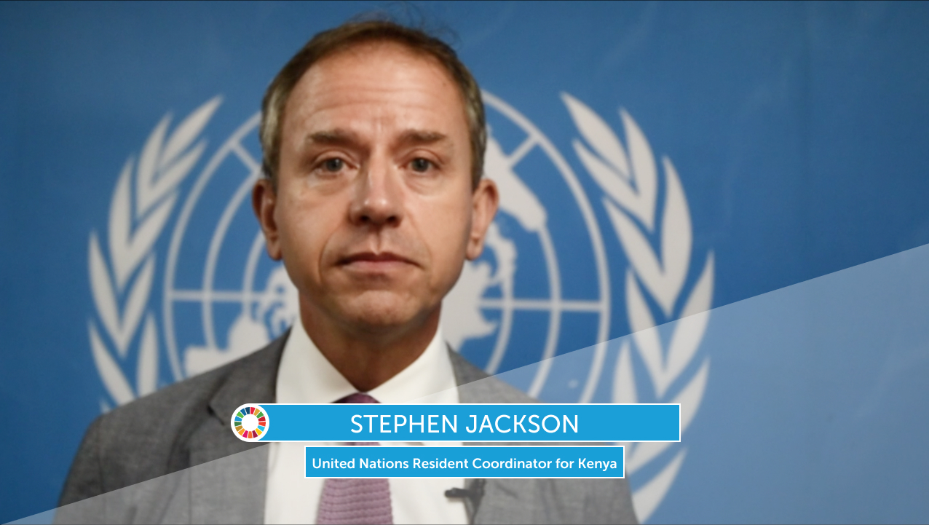
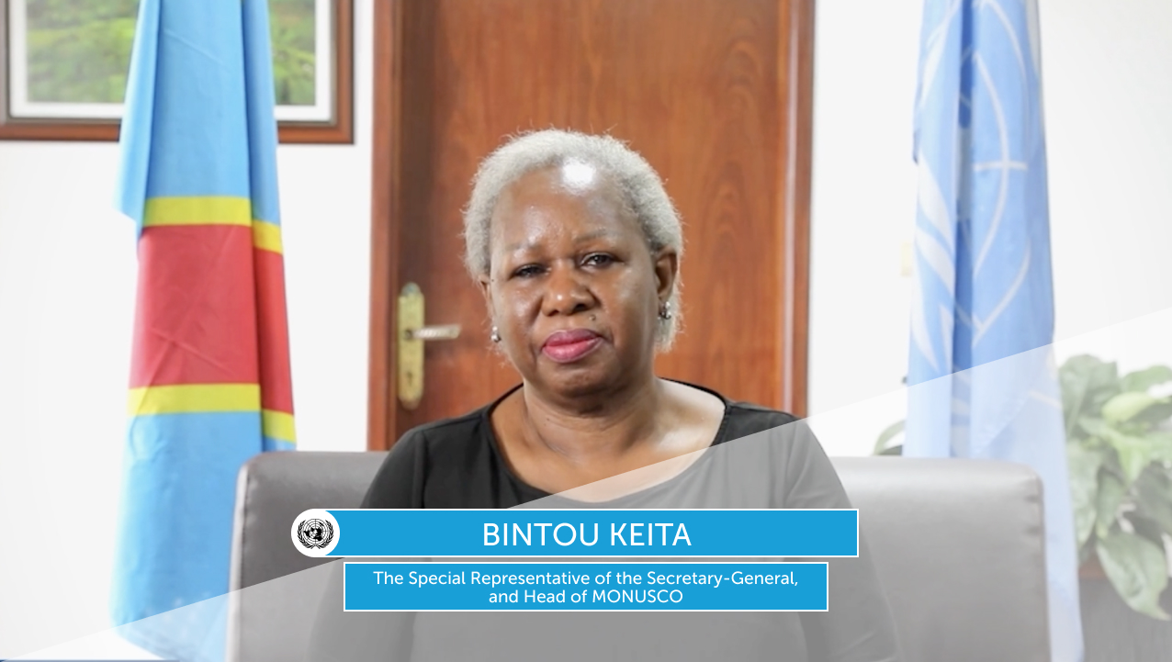

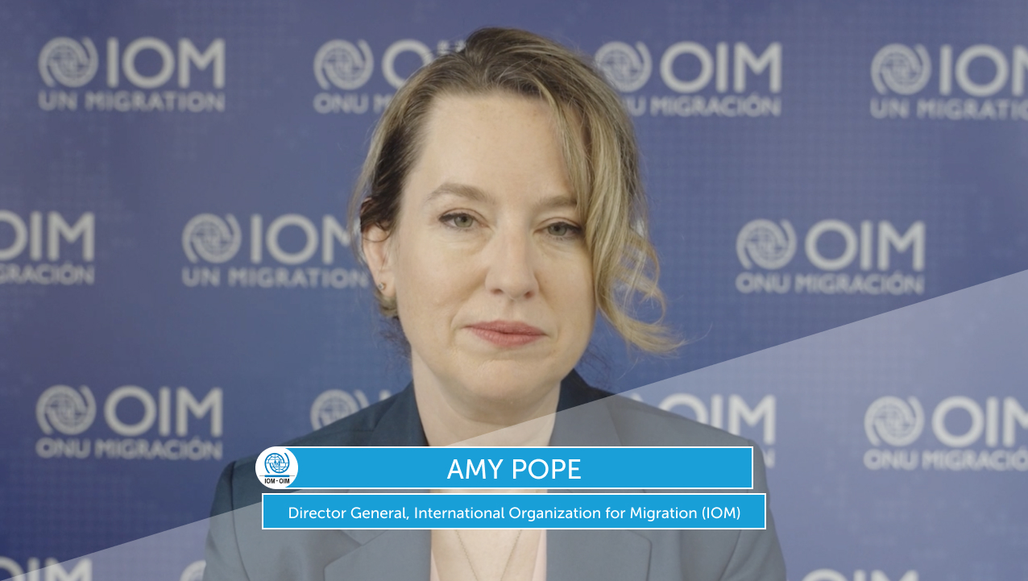
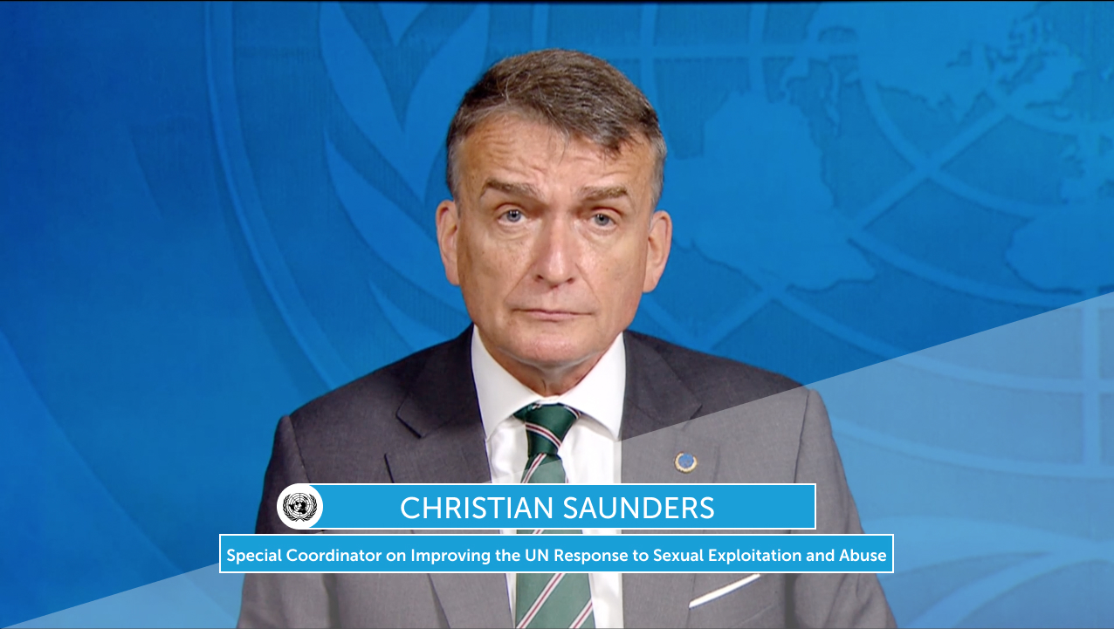
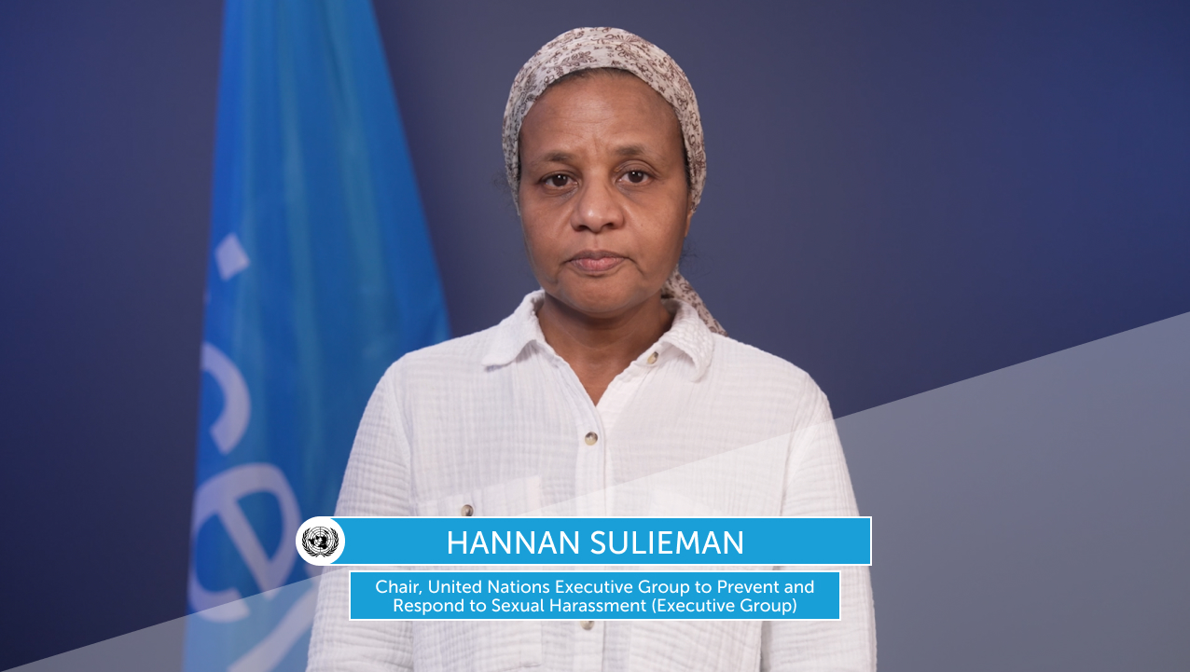
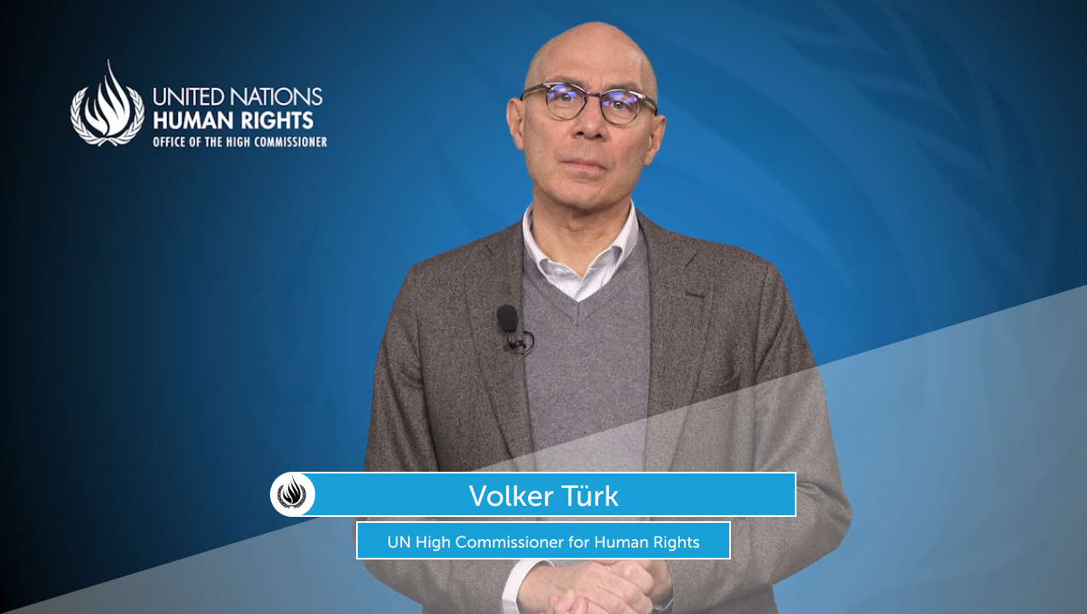
Commitment across the United Nations system
Videotaped statements from United Nations leaders about the victim-centred approach

Slide 16






Applying the victim-centred approach
Case studies
Explore case studies of victims of sexual exploitation and abuse
and sexual harassment.
Identify what could and/or should have been done to put the
rights of the victim first.
Sarita
Eloise
Amelia
Farah
Sam

Slide 17
Sarita’s, Eloise’s and Amelia’s rights
Sexual exploitation and abuse case studies debrief
Sarita
Eloise
Amelia
  To be treated with respect
To be heard
To be protected
To get information
To receive assistance and support
To justice and accountability
To decide how involved to be
To a remedy
To privacy and confidentiality
To complain

Slide 18
Farah’s and Sam’s rights
Sexual harassment case studies debrief
Farah
Sam
  To be treated with respect
To be heard
To be protected
To get information
To receive assistance and support
To justice and accountability
To decide how involved to be
To a remedy
To privacy and confidentiality
To complain

Slide 19
Sexual exploitation and abuse reporting channels
United Nations resources
OIOS (Office of Internal Oversight Services)
Reporting sexual misconduct in United Nations field missions
Web page and web-based reporting form
https://oios.un.org/report-wrongdoing
https://conduct.unmissions.org/report-now
“How to report” web page
(links to entity-specific reporting pathways)
https://www.un.org/preventing-sexual-exploitation-and-abuse/content/how-report
Each person who is working under the United Nations flag is obligated to report suspected, rumoured or disclosed allegations of sexual exploitation and abuse.

Slide 20
Sexual harassment reporting channels
United Nations resources
OIOS (Office of Internal Oversight Services)
Ombudsperson and Mediation Services
Web page and web-based reporting form
https://oios.un.org/report-wrongdoing
Dedicated offices within the Secretariat, Agencies, Funds and Programmes
UN Speak Up Helpline
Staff Counsellor
Practical guidance about protection, support
and reporting
speakup@un.org
scohq@un.org
Act and speak up when you witness behaviour you think is inappropriate.

Slide 21
Bystander intervention
Taking action against sexual harassment
You can play an important role in stopping inappropriate behaviour and creating and maintaining a healthy work environment.
The 5Ds of bystander intervention
Detect: Learn to identify forms of sexual harassment
Direct: Directly intervene to stop the behaviour
Distract: Cause a distraction to interrupt the behaviour
Delegate: Contact the appropriate office or support services for guidance
Discuss: Follow-up with the affected person after the incident(s)
Act and speak up when you witness behaviour you think is inappropriate.

Slide 22
Prevention initiatives
ClearCheck
Centralized database
Misconduct Disclosure Scheme
Bilateral sharing of misconduct data
Entity-specific strategies
Informed by the
victim-centred approach

Slide 23

Commitment to act
Looking ahead
How can you and
your Organization
better apply the
victim-centred approach?

Slide 24





TOGETHER,
WE WILL MAKE A DIFFERENCE.
Thank you for your participation today.

