Slide 1


UN System Workplace Mental Health & Well-being Strategy

Slide 2

Background: 2018-2023 Strategy
Led by a multi-agency, multi-disciplinary board
Progress made
Leaders and Managers programme
Stigma reduction activities
Communication (for example events, articles, website)
Development of an implementation guide and scorecard

Slide 3

Background: 2022-2023 Scorecard Results
1.2 Psychological counseling available
(All personnel can access psychosocial service within 72 hours of request regardless of duty station)
94%
1.3 Facilitation for external referrals when needed
100%
1.5 Support in case of critical incident and crisis management
100%
4.2 Training and education in mental health and psychosocial wellbeing
99%
4.5 Support for conflict resolution (reconciliation, conflict coaching, mediation)
100%

Slide 4

Background: 2022-2023 Scorecard Results
2.5 SOP or policy on return-to-work arrangements after time off when experiencing a mental health condition
44%
2.6 Input is being sought from personnel who have experienced a mental health condition in planning appropriate actions
44%
2.7 Programs addressing chronic mental health conditions as reported by personnel are established
13%
2.8 Leadership has taken an active role in communication about stigma
27%
3.5 SOP or policy on adjusting work arrangements due to mental health conditions are in place and enacted
41%
3.7 Suicide prevention programs developed and communicated to all personnel
28%

Slide 5
2024 and beyond Strategy: 2023-2024 milestones
Deputy Secretary-General
launches
Nov 2023
Implementation
begins
1 Jan 2024
Scorecard
Cut-off
31 Dec 2024
HLCM
approves
Oct 2023

Slide 6

2024 and beyond Strategy: Elements
Strategy document
Implementation Guide
Scorecard
Toolkit for each of the indicators

Slide 7
2024 and beyond Strategy: Essentials for effective implementation
Everyone has a role to play
It is not one-size-fits-all
System-wide coordination and support
Mainstreaming mental health and well-being
Leadership support is crucial
The role of managers is pivotal
Data-informed decision-making
Change is possible

Slide 8
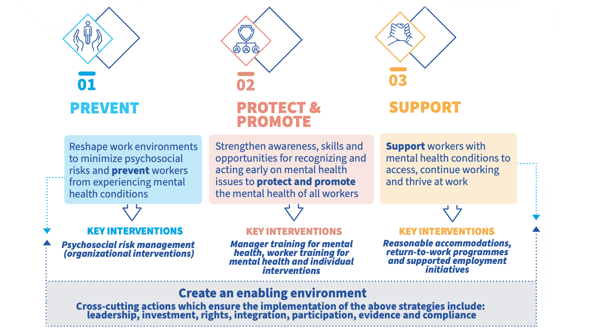
2024 and beyond Strategy: Key Pillars

Slide 9






Implementation: Key Indicators
5. Stigma reduction
activities
4. Mental health
literacy training
6. Implementation of
well-being initiatives
2. Policy & practice mainstreaming
PROMOTE
8. Access to
psychosocial support
1. Risk assessment
(Prevention & mitigation)
3. Manager education and training
7. Enabling dignified
work
9. Quality control for psychosocial support
CROSS CUTTING
10. Leadership
11. Reporting
12. Participation
PREVENT
SUPPORT
9

Slide 10
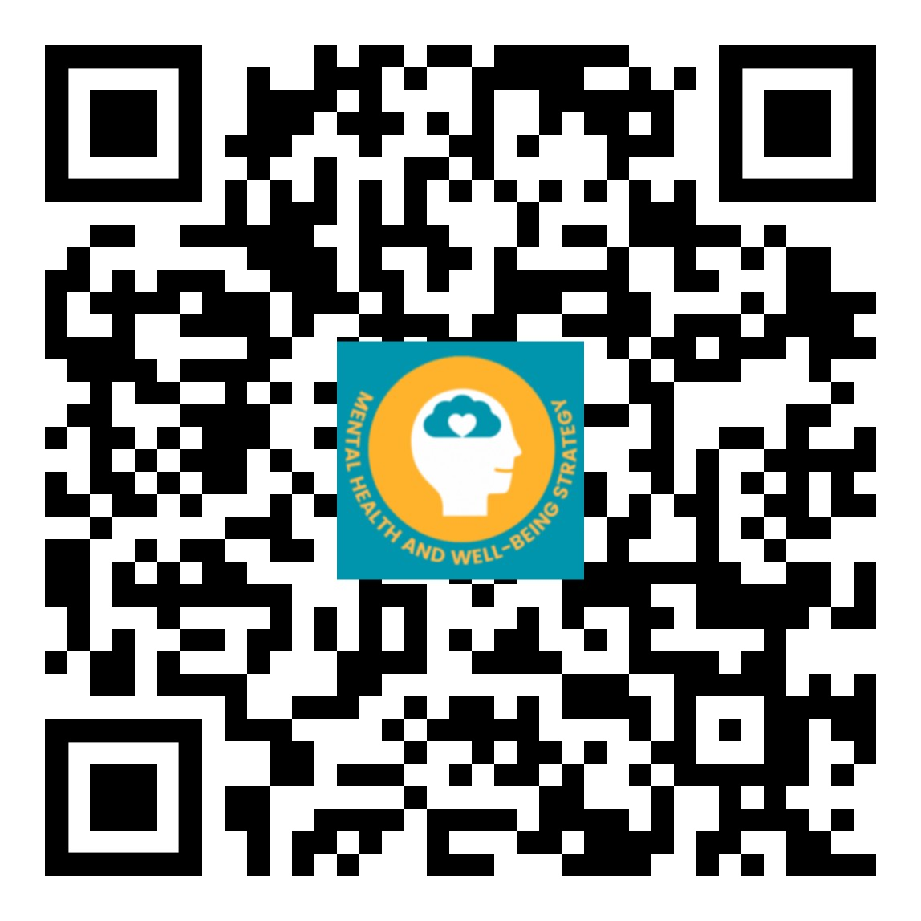
Website:
https://www.un.org/en/healthy-workforce/
mhs@un.org
Email:
Twitter + Instagram:
@UN4MentalHealth

