Slide 1
ADDRESSING COVID-19 VACCINE HESITANCY
DHMOSH Public Health Section
Dr. Esther Tan
Senior Medical Officer
May 2021

Slide 2
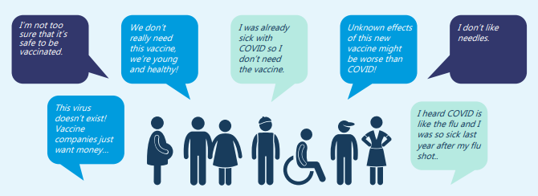
Concerns About the COVID-19 Vaccine

Slide 3


Slide 4
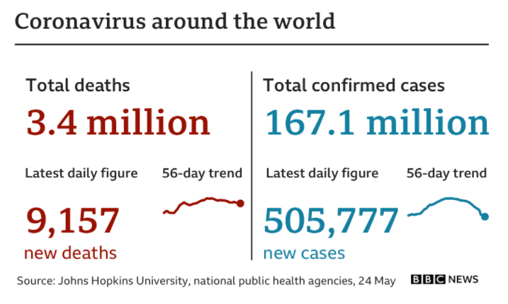

Slide 5
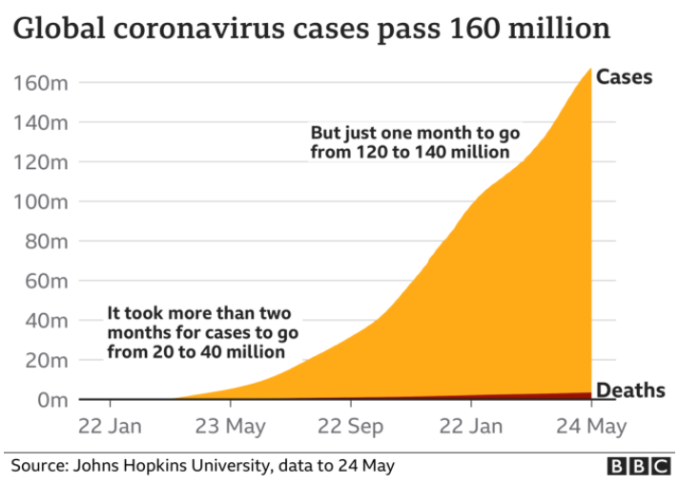

Slide 6
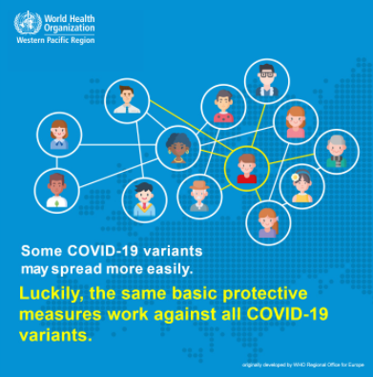

Slide 7
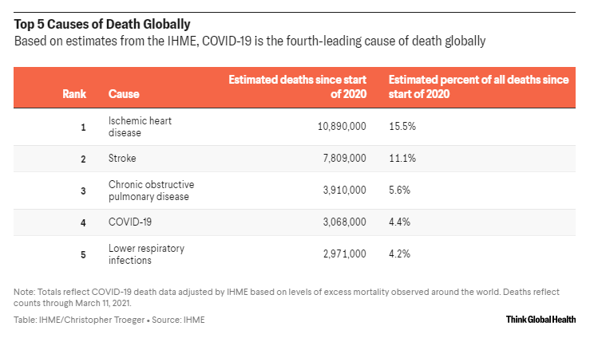

Slide 8
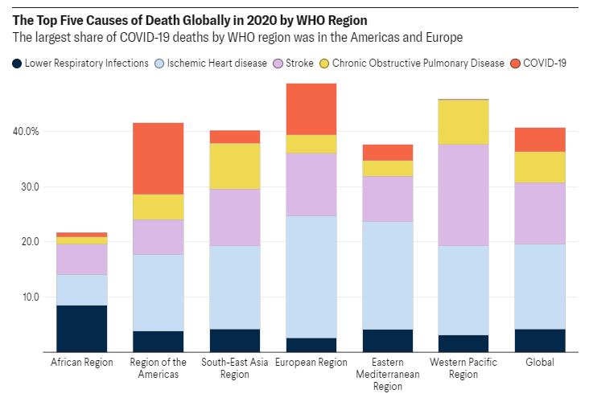

Slide 9
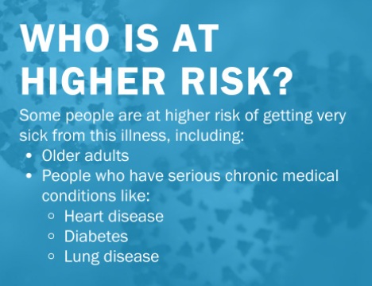

Slide 10


Slide 11
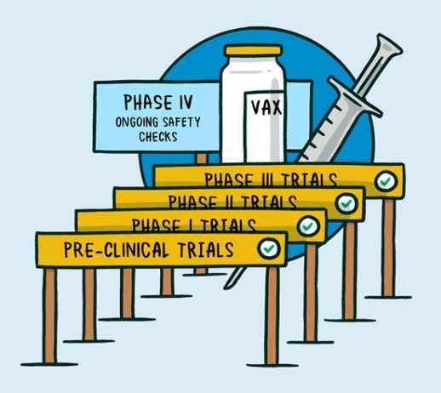
How Is Vaccine Safety, Immune Response, Efficacy Tested?

Slide 12
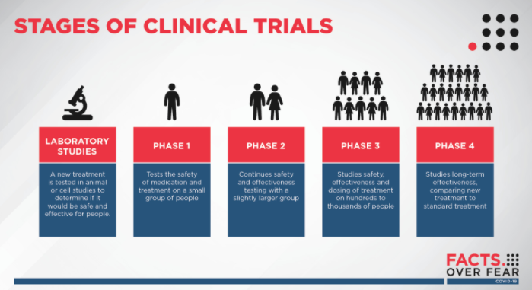

Slide 13
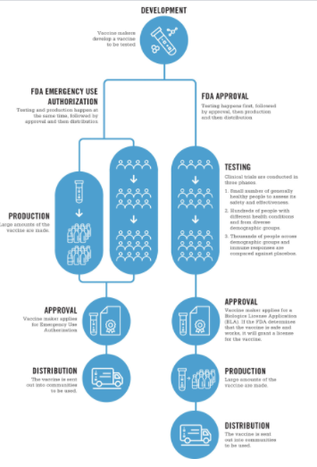
Sequential Steps vs In Parallel

Slide 14
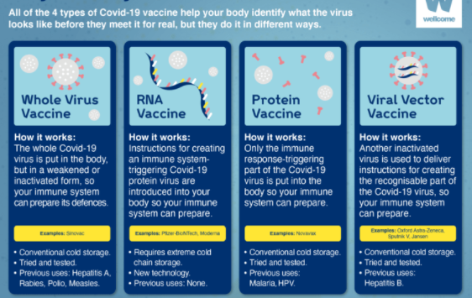

Slide 15
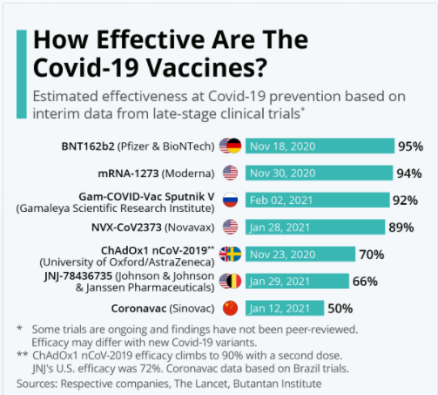

Slide 16
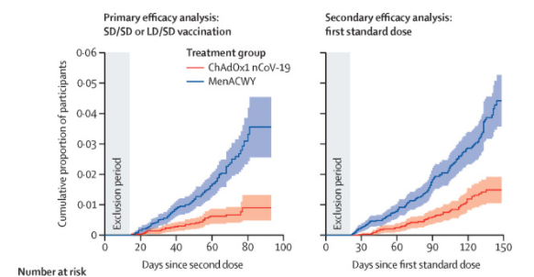
AZ Vaccine Phase 3 Trial of 11,000 persons 30 cases in Vaccine Group vs 101 cases in Control Group

Slide 17
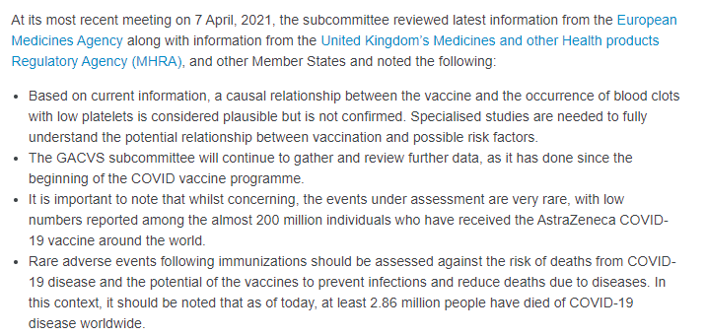
Risk of Rare Blood Clots/Low Platelet Condition (TTS)?

Slide 18
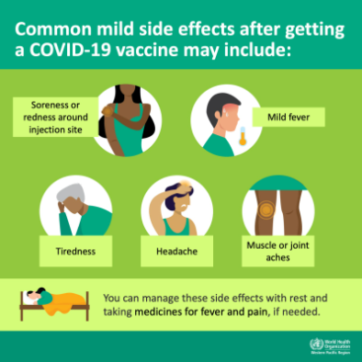

Slide 19

What Choice Will You Make?

Slide 20
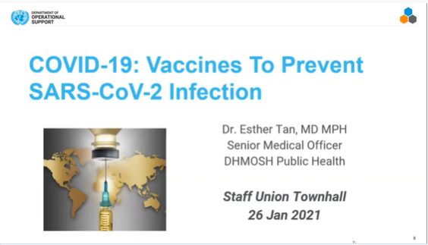
Learn More About Basics of COVID-19 Here
https://youtu.be/hcs2Esr0CFQ

Slide 21

Any questions, please contact dos-dhmosh-public-health@un.org Covidvaccines@un.org

