Slide 1
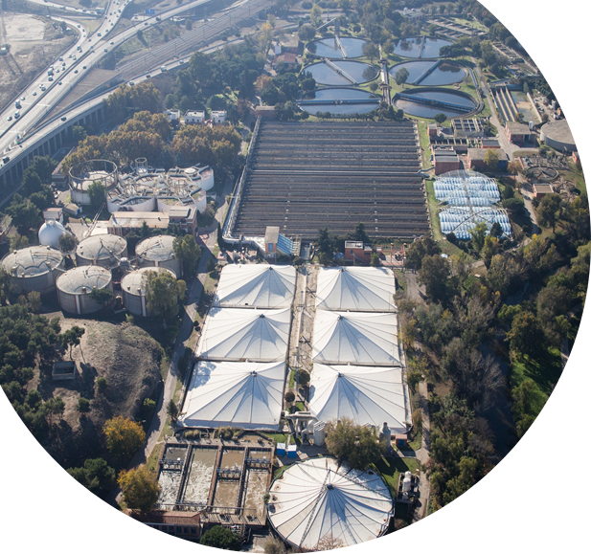






Sustainable Water and Energy Solutions supporting Climate Change and Biodiversity Objectives through Innovation and Clean Technologies
Canal de Isabel II – 9th November 2022
Ms. Pascual Fernández, CEO

Slide 2

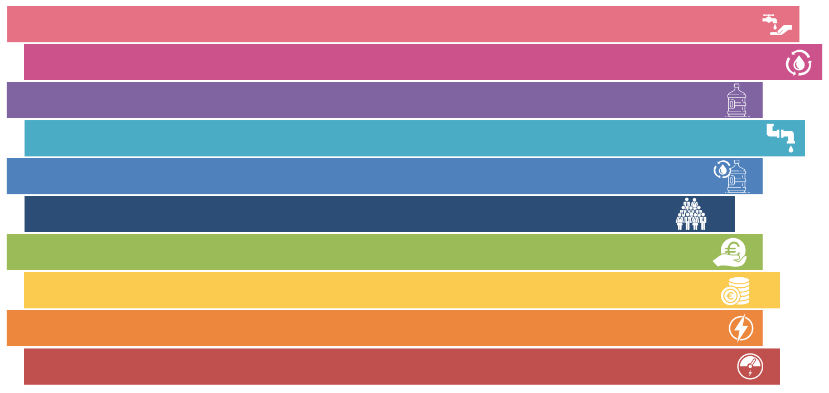
Canal de Isabel II: Climate change challenge
Canal de Isabel II is the company responsible for the integral water cycle in the Region of Madrid. We also provide urban water services in other regions of Spain and in several Latin America cities.
Population vs Rainfall & Demand
7,52 million inhabitants supplied
587 hm³ diverted for consumption
7,16 million inhabitants served, sanitation
501 hm³ purified in WWTP
120 hm³ of reclaimed water supplied
9.000 employees
1.000 million euros in business turnover
142.5 million euros in investments
109 MW installed for electricity generation
420 millions KWh produced (87% of consume)
Rainfall
¿How do we face Climate Change challenge?
Our planning includes adapting and mitigating the consequences of climate change by implementing several plans throughout the integrated water cycle.

Slide 3


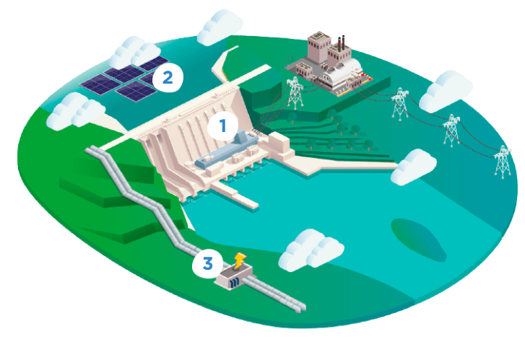
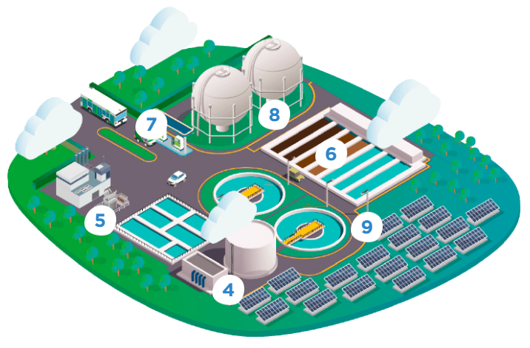

Climate Change Solutions
Clean Energy Sources
1
Hydraulic power plants
9 facilities: 35,52 MW
Solar plants 50 MW (installing) and
Floating plants (in Project)
Hydroelectric microturbines
9 facilities: 0,83 MW
Biogas power plants
17 facilities: 26,3 MW
Biogas microturbines
3 facilities: 0,26 MW
Thermal sludge drying plant
2 facilities: 44,7 MW
2
In 2021, we had the highest installed electric capacity for power generation in the Region of Madrid, with 109 MW.
3
4
5
6
7
Biomethane for transport
1 facility
Green Hydrogen Plant 1 MW (installing)
and 5 MW (in Project)
Solar plants
Installed capacity: 1,23 MW (+50 Mw)
8
9

Slide 4

Current situation: Power generation and Consumption
2018
Production: 312.2 GWh
Consumption: 462.4 GWh
% Self-production: 67.5 %
2019
Production: 363.9GWh
Consumption: 467.3 GWh
% Self-production: 77.9 %
2020
Production: 378.8 GWh
Consumption: 514.0 GWh
% Self-production: 73.7 %
2021
Production: 419.9 GWh
Consumption: 484.7 GWh
% Self-production: 86,6 %
2022 (July)
Production: 221.3 GWh
Consumption: 303.6 GWh
% Self-production: 72,9 %
Cogeneration in thermal dryings of sludge
WWTP Biogas
Other
Hydroelectric
Selfproduction (%)
Notes:
Here we have the production of the Canal generation park. In green we have the electrical energy with biogas that acts as a base and is very constant. above all, there is the energy from the 45 MW of high-efficiency cogeneration. It should be noted that half of this capacity was put into operation in December 2018.
In blue is the energy from the water, which as seen varies according to the year (wet to dry)
we are close to 100% self-consumption throughout the year!!!

Slide 5

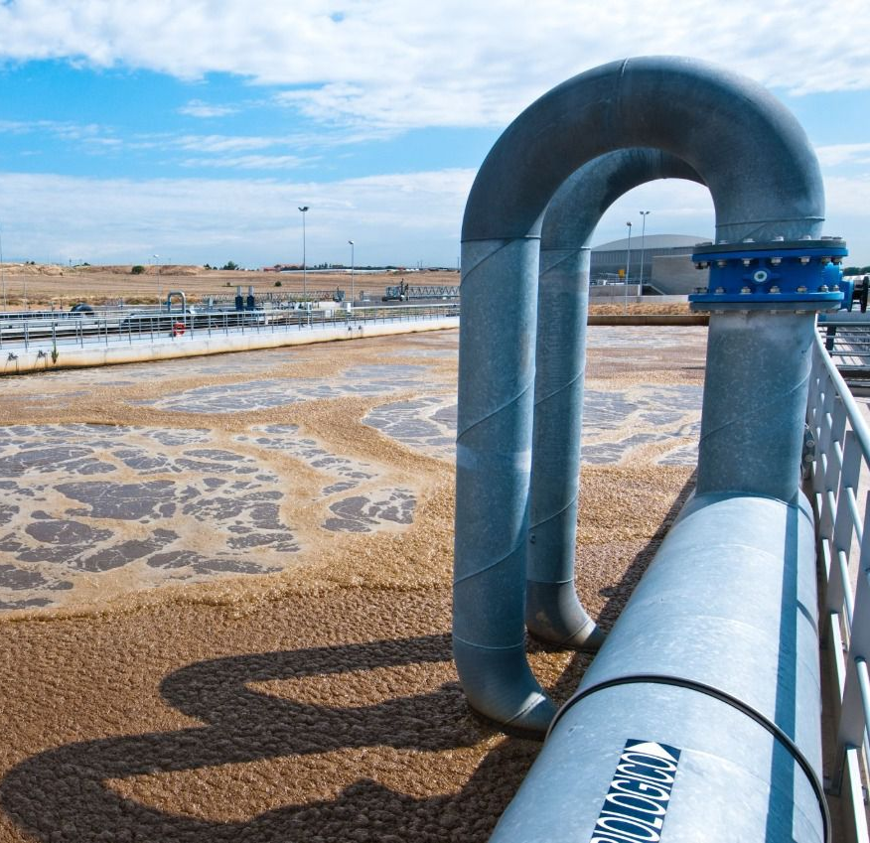


Climate Change Solutions
BIOGAS
Canal de Isabel II obtained more than 51 million cubic meters of biogas in 2021. From this biogas, we generated more than 88 GWh in the 17 power generation facilities, the equivalent of the annual electricity consumption of a 75,000 population.
These facilities
can reach a 100% degree of termal coverage and around 50% of its electrical consumption

Slide 6

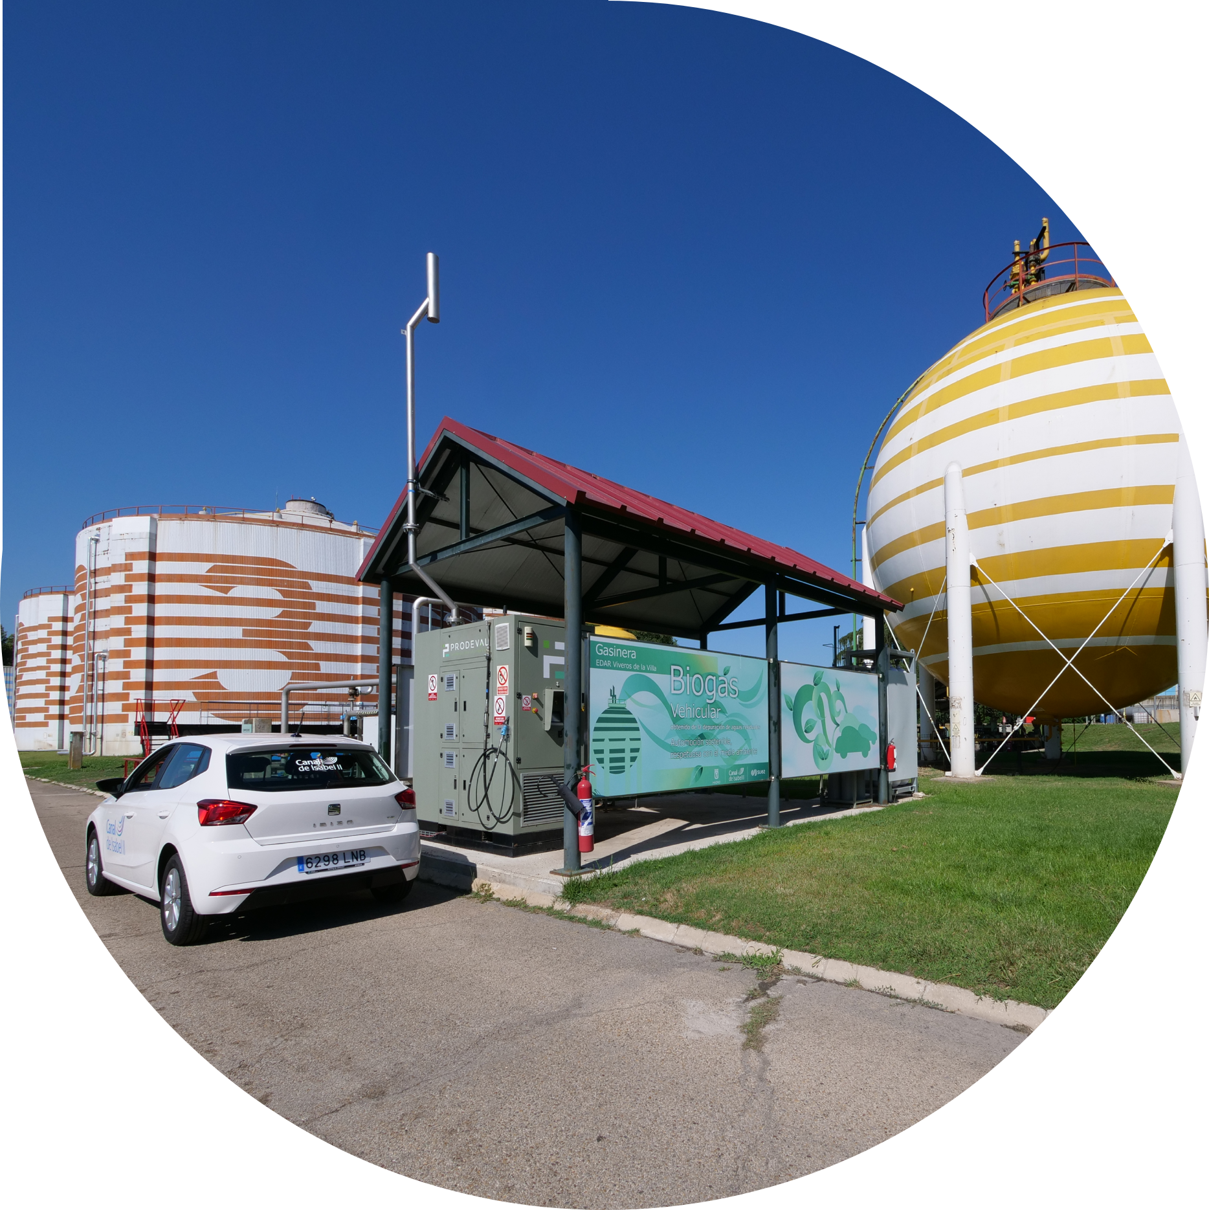


Climate Change Solutions
BIOMETHANE
The main use of biogas is to obtain thermal energy and electricity for the industrial installation itself. But the potential of biogas does not simply lie in power generation:
Biogas is made up of 65% methane and 35 % in CO2. If we remove this CO2, we can transform it into biomethane and use it in vehicles, thanks to the so-called “gasification plants”.
We can also inject biomethane into the natural gas distribution network, in the compliance with the environmental decarbonization objectives proposed by Europe in 2030.
.
More than
twenty automobiles can refuel with biomethane, a zero-emissions fuel with
vast heating
power

Slide 7

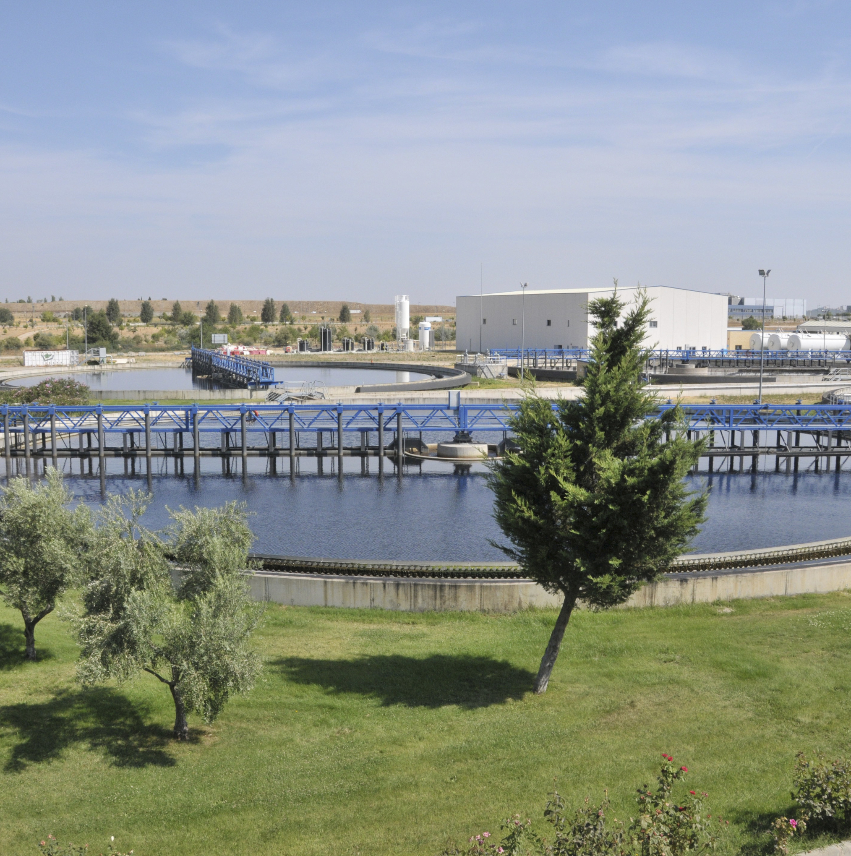

Climate Change Solutions
Innovation & Strategy
Canal has taken a proactive stance grounded in research, development and innovation through many initiatives:
Maximizing the use of biogas and biomethane production
Since 2019 we have been committed to the evolution of our facilities towards biomethane. In the medium term, new upgrading technologies will allow us to become a benchmark in biomethane injection into gas network.
Promoting Green Hydrogen and technology hybridization
We are launching a pioneer plant that will generate green hydrogen using hybridization power (photovoltaic electricity and biogas cogeneration) and reclaimed water. Thanks to technology hybridization, we aim to achieve a reasonable and competitive green hydrogen production cost.
We expect to increase the installed capacity of our Green Hydrogen plant from 1 MW in 2023 to 5 MW in
2025
Notes:
Compromiso 3. Economía Circular.
Nuestra estrategia es impulsar la Economía Circular con el objetivo de descarbonizar nuestra actividad. Las depuradoras son minas inagotables de recursos: desde lodo y fertilizantes para agricultura, hasta agua regenerada para riegos, pasando por electricidad y biometano para mover vehículos 100% libres de emisiones
Biogás: Producimos 90 GWh / año de electricidad que se consume en nuestras Plantas de Tratamiento de Aguas Residuales, esta energía es 100% renovable. Se produce y consume in situ, reduciéndose las pérdidas de transporte y distribución de electricidad.
Biometano. Las posibilidades del biogás no se reducen a la generación de electricidad. Se puede convertir en biocombustible y utilizarlo en vehículos, una utilidad que ya estamos testando en tres instalaciones de depuración: La Gavia, Butarque y Viveros. Allí hemos instalado las conocidas como ‘gasíferas’, donde más de una veintena de automóviles pueden repostar biometano.
Hidrógeno Verde. En una Estación Depuradora de Aguas Residuales se va a instalar la primera planta que producirá hidrógeno verde empleando agua regenerada. El objetivo es que en una primera fase la planta genere el suficiente hidrógeno verde como para abastecer a unos 10 autobuses al año y a partir de ahí ir aumentando la producción paulatinamente.
Planta de Fertilizantes. Contamos con la mayor planta de producción de estruvita del país. Se encuentra localizada en una Estación Depuradora de Aguas Residuales, donde pueden llegar a producirse dos toneladas diarias del considerado “oro blanco” de los residuos, por su alto contenido en fósforo. El fósforo presente en los residuos líquidos puede cristalizarse de manera controlada y dar origen a este fertilizante de alto valor. En 2020 hemos producido 486 toneladas de este fertilizante.

Slide 8

There are many alternatives to contribute to climate action. Canal is close to generate 100% of our consumption but also there are some projects and initiatives to do.
Thanks to the multiple synergies of our processes, we will increase our efficiency and mitigate the risks associated with energy dependence.
<
<

Slide 9

www.canaldeisabelsegunda.es
If you require any further information, please feel free to contact us:
contacto@canal.madrid
We take care of the water, we take care of you

