Slide 1
Energy solutions to support climate goals and the SDGs
9th November, 2022

Slide 2
Sustainable Energy Solutions for Africa (SESA)
Collaborative project between the EU and 9 Africa countries (Ghana, Kenya, Malawi, Morocco, Namibia, Nigeria, Rwanda, SA, Tanzania). (Oct 2021 to Sept 2025)
Aims to provide replicable energy access technologies and business models through local living labs.
The living labs are expected to facilitate co-development of scalable solutions to be tested, validated and later replicated in the Region.
Solutions include solar PV, innovative energy storage systems inc. use of second-life EV batteries, smart micro-grids, waste-to-energy systems (biomass to biogas), climate-proofing.
Incubator programme has been launched to support local innovation.

Slide 3
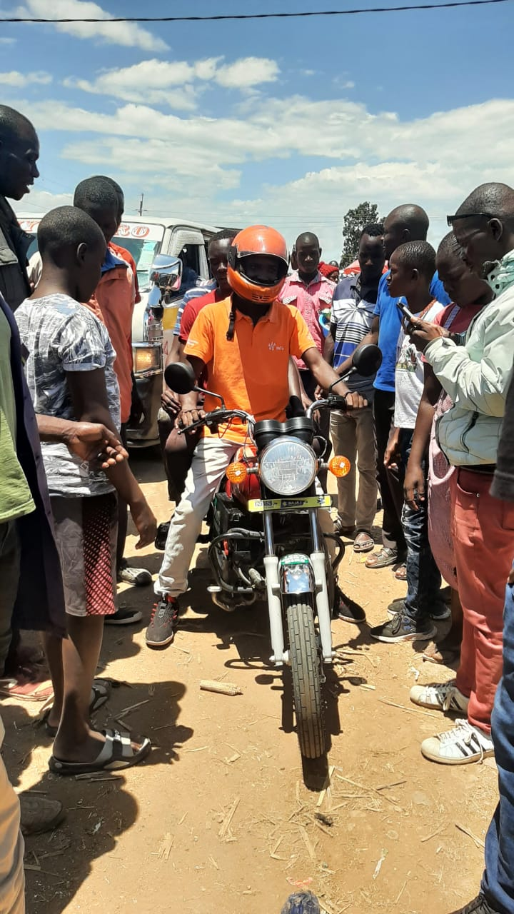
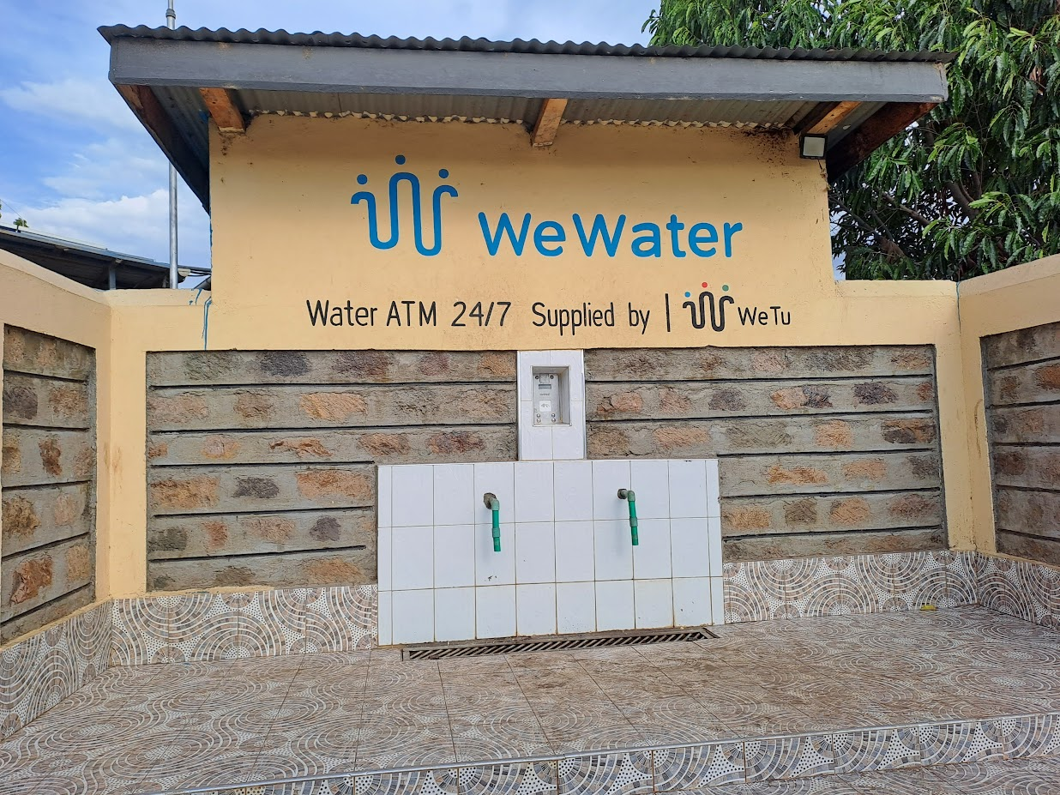
Kenya Living Lab in Lake Victoria Region
Real-life test bed to pilot and test solutions to address three focus areas; access, productive use and a circular economy.
Implemented by WeTu providing:
Innovative solar-powered solutions including >300 solar fishing lanterns per day. #WePower
>3000 liters of clean water per day. #WeWaterATMs
Pilot two-wheelers electric bikes, testing motor, gears, battery, inverters & payment models. #WeMobility
Collection canters for recycling and reuse of
e-waste. #WeCollect

Slide 4
Coherent implementation of SDGs & climate goals
SDG Synergies – a practical tool for understanding how groups of policy areas and targets interact using systems thinking.
SEI has supported governments to better align their national development plans, policies and strategies to the SDGs, climate goals and other agendas in Africa, Asia and Latin America.
E.g. alignment of national energy and mining plans in Colombia to the SDGs, NDC and OECD best practices
https://www.sdgsynergies.org/

Slide 5
Keep in touch! Ivonne Lobos Alva Senior Expert SEI Latin America Ivonne.lobos@sei.org Carol Mungo Research Fellow SEI Africa carol.mungo@sei.org
Photo credit: Getty / yimwow
Notes:
Template note:
To create a new Section Divider slide, either a) copy this slide and edit the existing text; or b) copy the white brand shape (in place) to a newly added Section Divider slide from the template library.
Due to the way PowerPoint handles layers, the brand shape on the section divider slide cannot be locked in place. Ensure that this shape is not moved, resized or otherwise altered when using this template slide. The image can be changed.
Photo credit: Getty images / yimwow https://www.gettyimages.com/license/490316478

