Slide 1
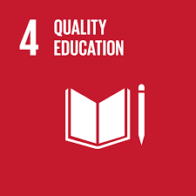
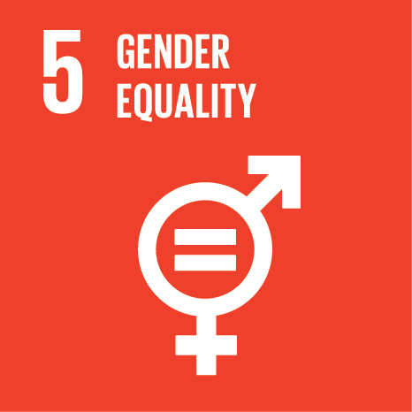
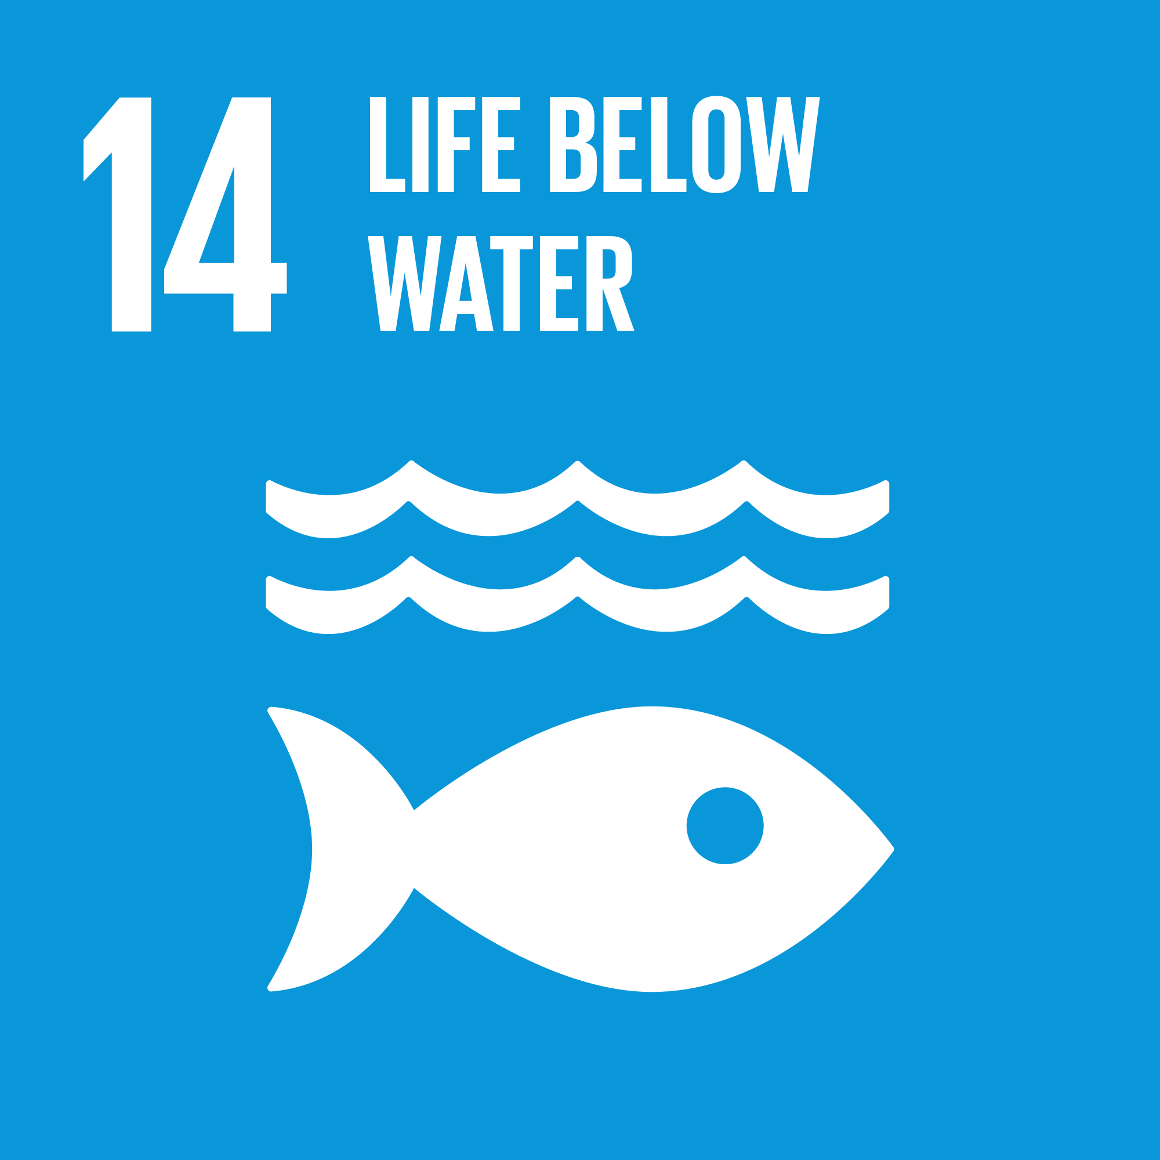
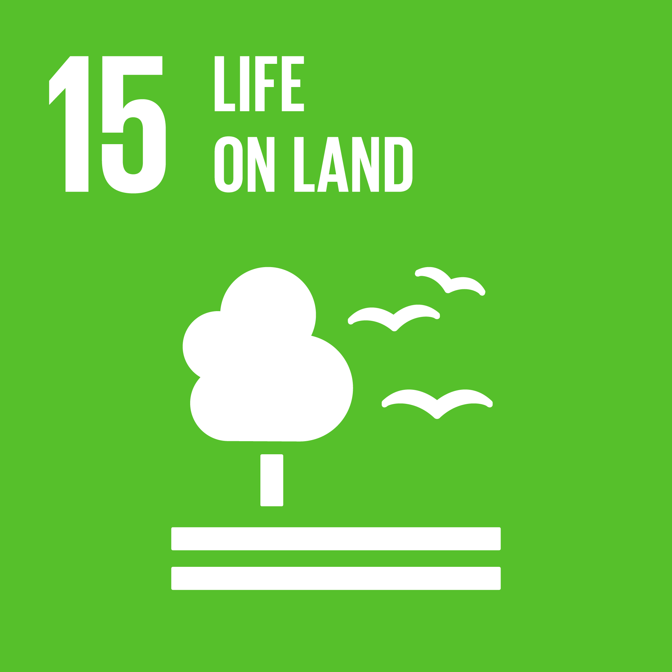
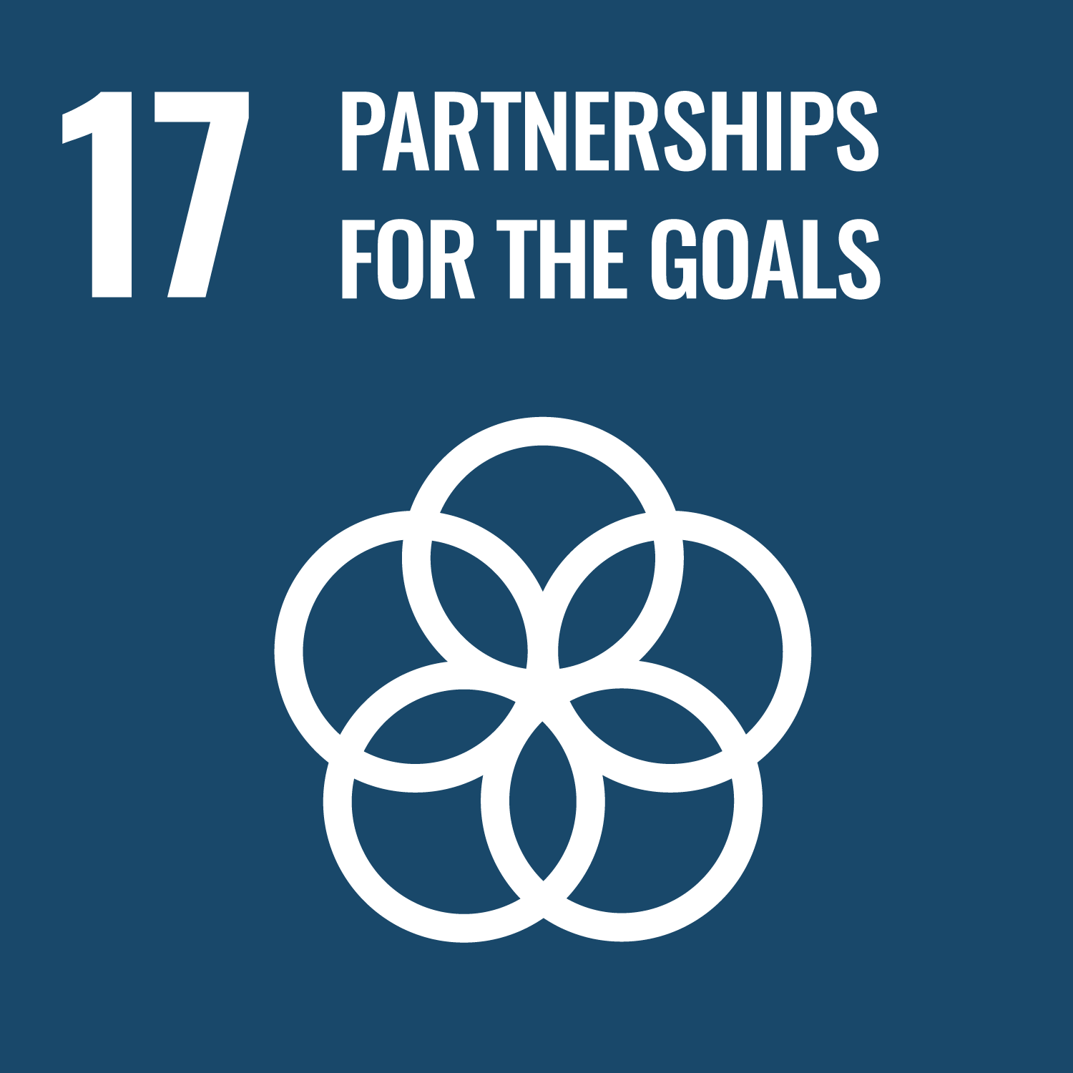



High Level Political Forum 2022.
Canal de Isabel II
July 2022
Notes:
Thank you for invite Canal to this High Level Political Forum, it´s always a pleasure to be here sharing our Projects and Best practices. I will try not to extend more time.

Slide 2




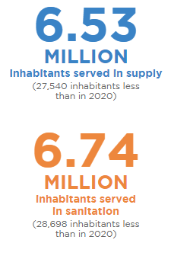
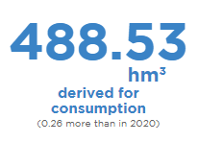
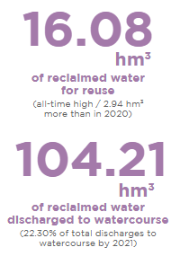
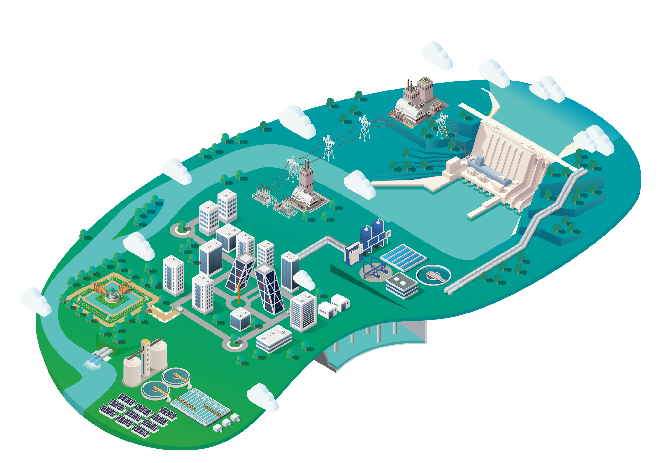

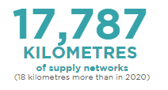
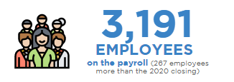
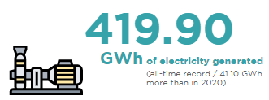


Canal de Isabel II
Region of Madrid
Notes:
As many of you know, Canal is one of the largest and most developed companies in Europe.
100% public CANAL supplies drinking water to more than 6.5 millions of inhabitants only in the region of Madrid.
Integrated water cycle is our key activity but thanks to cycle synergies we produce energy, fertilizers and provide telecommunications services among other activities related to water.

Slide 3
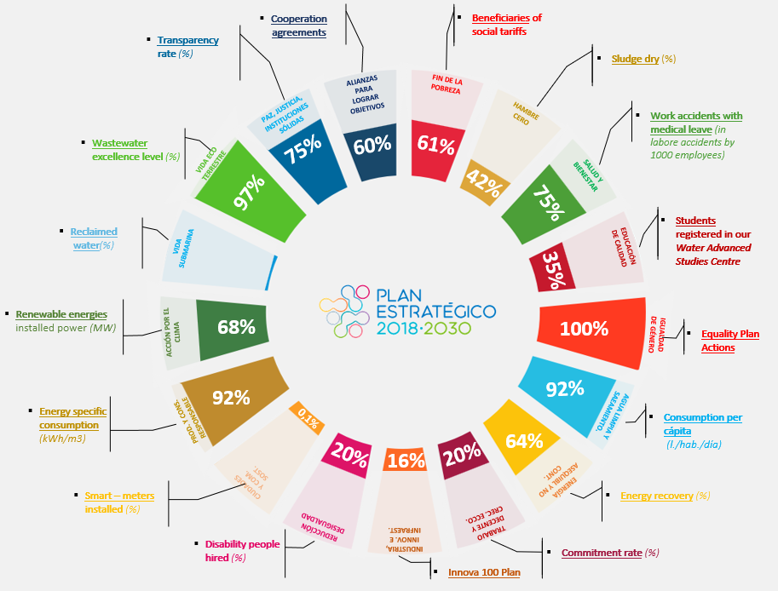


A 2030 strategy…
Monitoring progression
Specific indicators
> 100 plans
Quarterly evaluation
Public information
Screenshot of MIDENET
Notes:
With a 2030 strategy plan, Agenda 2030 is the biggest challenge for the company in this moment. Monitoring the contribution to all SDGs is an strategy goal for Canal. We have a specific tool and also an strucuture to follow and track the implementation of Agenda 2030 with concretes targets for every year and its corresponding indicators.

Slide 4
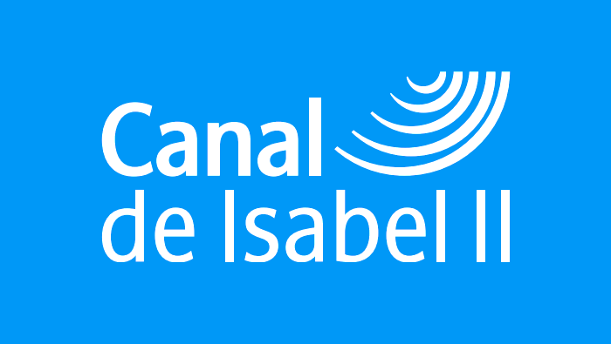
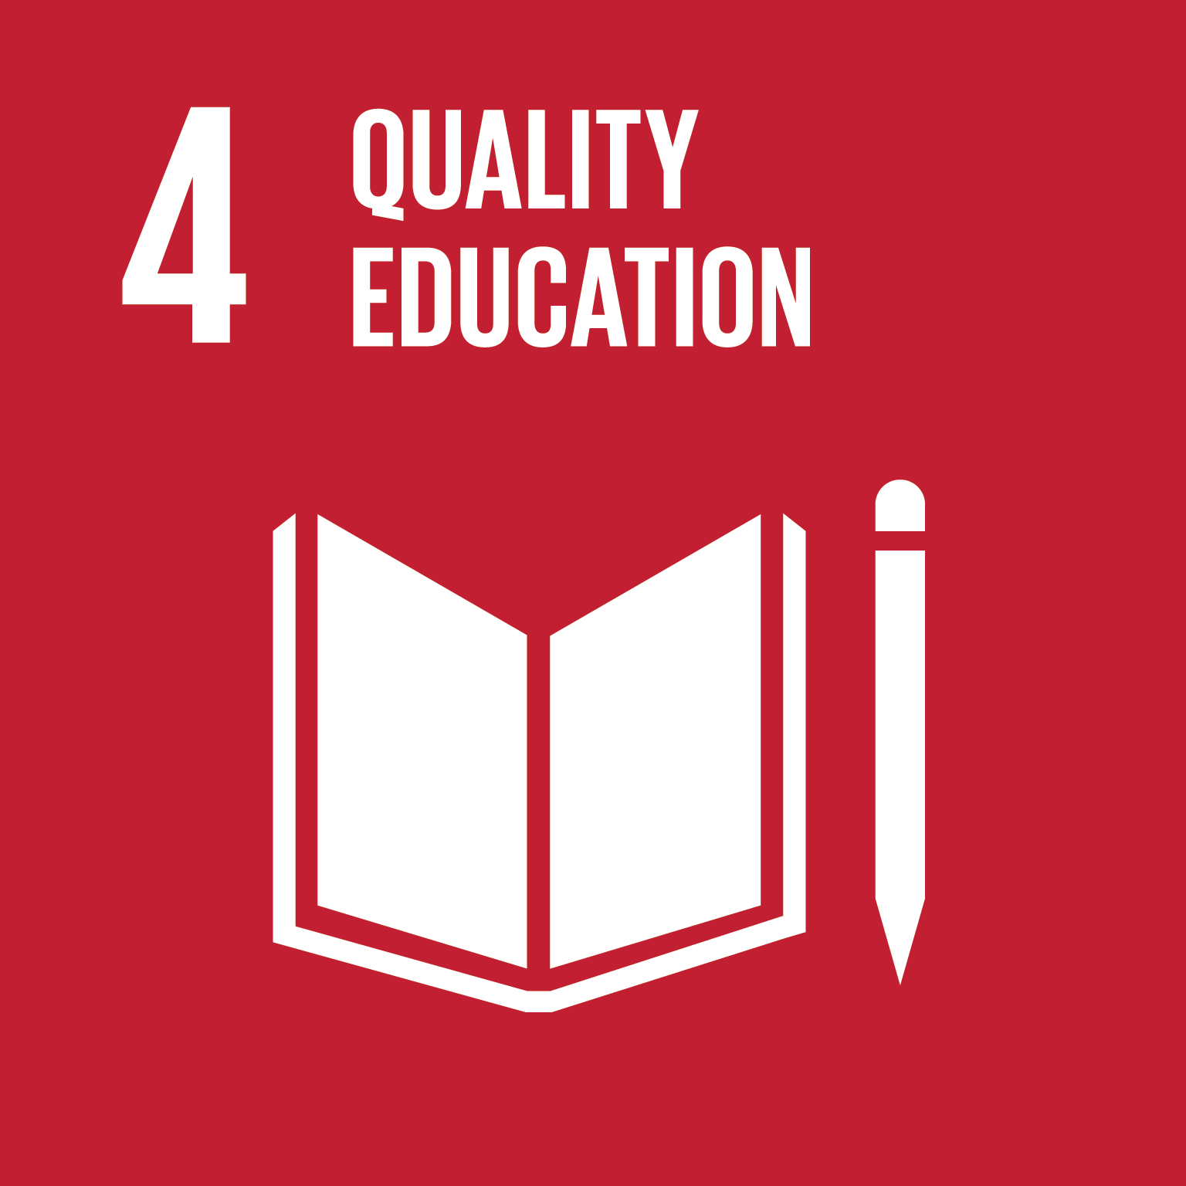
Ensure inclusive and equitable quality education and promote lifelong learning opportunities to all
Notes:
Well, SDG#4, Quality Education…

Slide 5
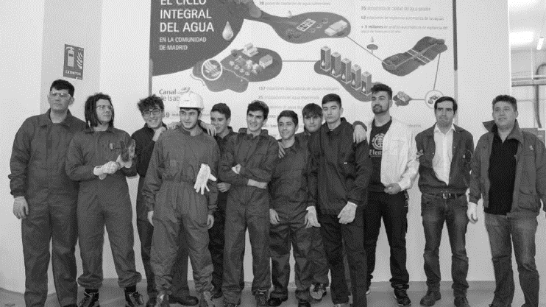
Why does education on water matter?
Notes:
Why does education on water matter? In Canal we have two diferents points of view. An internal and external vision.
As you know a water public utility that supply more tan 6,5 millions of inhabitants only in one region have a huge impact in labor, social and economic terms. The activity we make in the Region of Madrid employs more than 6.000 people.

Slide 6
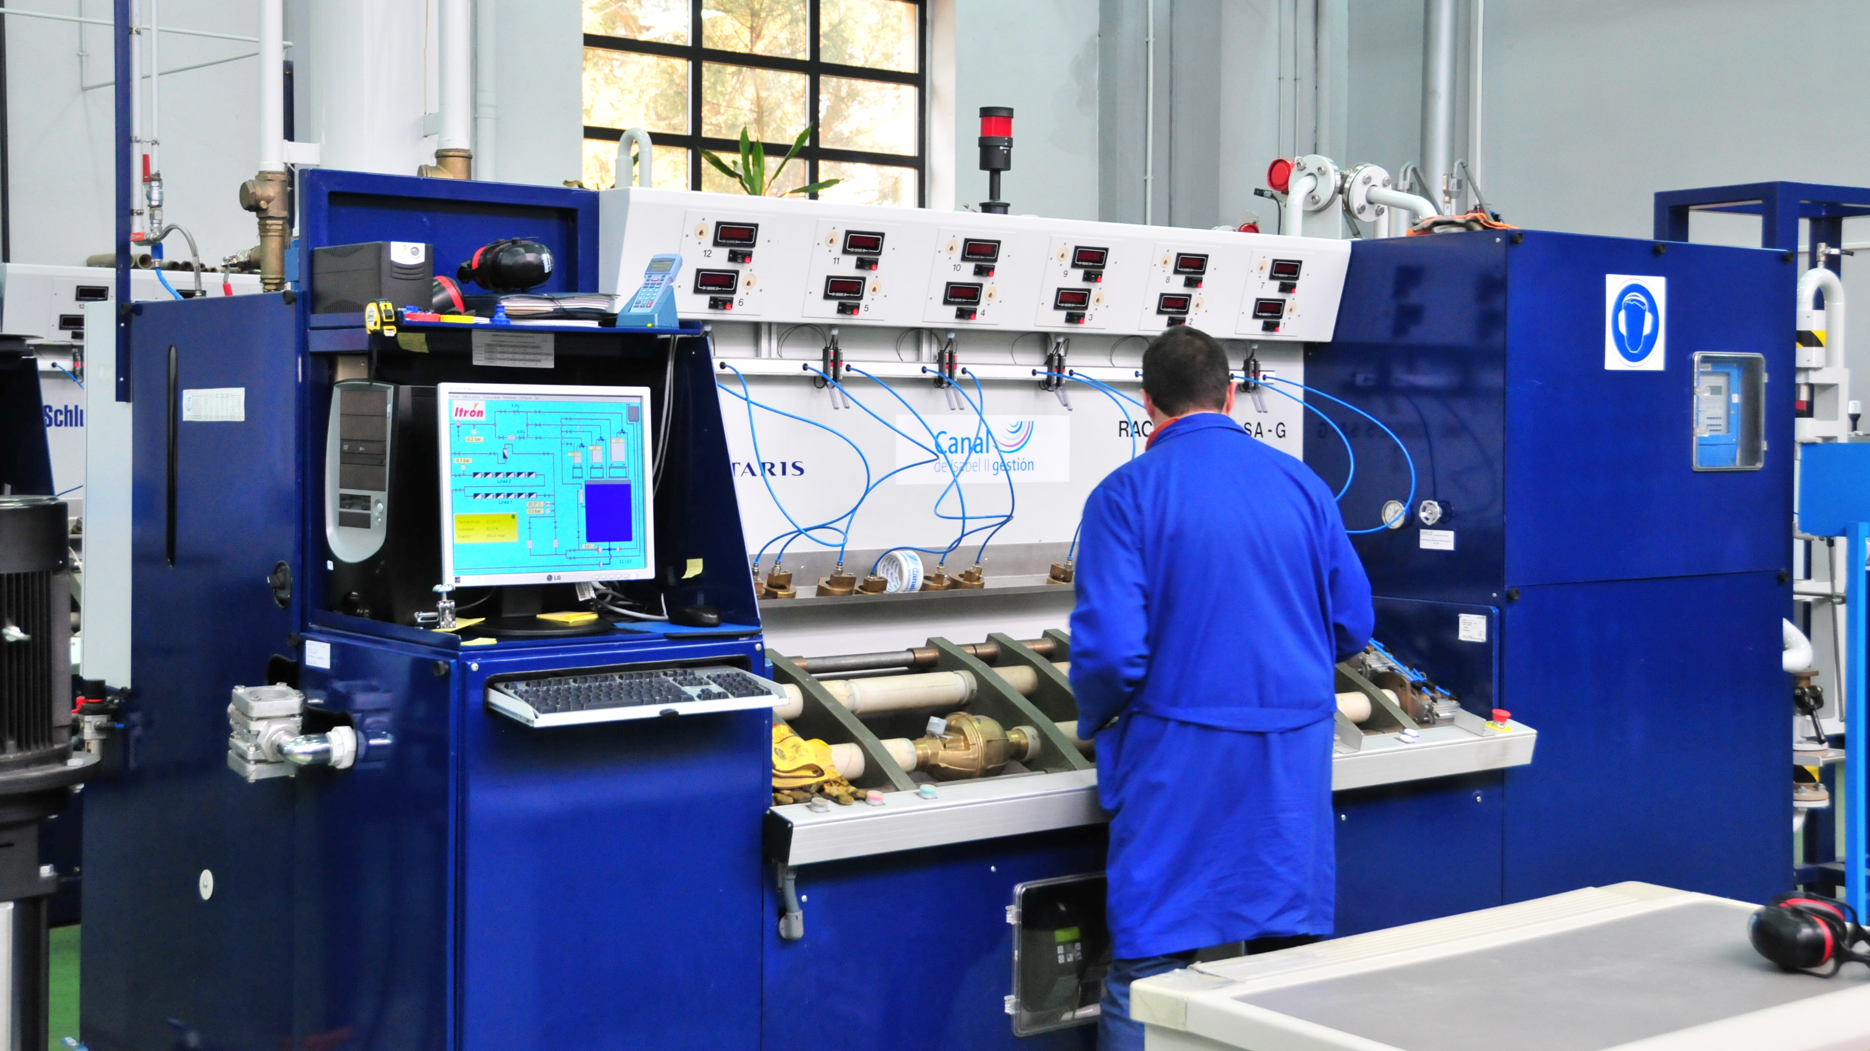



Center for advanced water studies
100 students
per year
Dual
programme
Notes:
Academic and Practice training is really important to us. We have to train the future water proffesionals to ensure the activity but also considering the water activity is extending more and more in new subactivities DUAL PROGRAMME
A specialization programme for future water professionals in Spain and in other countries.
Medium-grade and Superior, as well as university postgraduates of all kinds: engineers, scientists, lawyers and economists.
Internships on Canal and water sector companies in the second year.

Slide 7
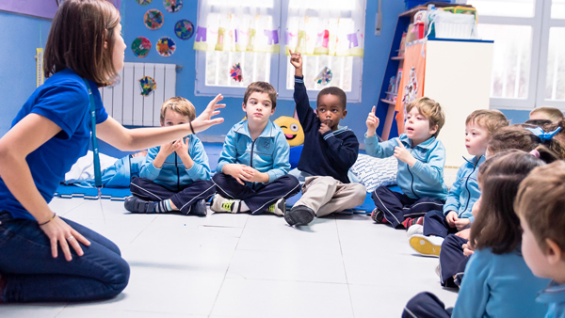
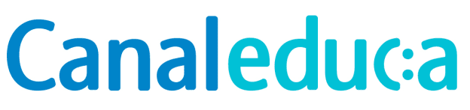



30.000
participants per year
Virtual &
in-person
Water cycle
Tecnologies
Sustainability
Environment protection
Notes:
Canal Educa is an educational program on the sustainable use of water and the search for solutions to climate change. 30.000
participants per year. 25 years of initiative. Aimed at students of any educational stage: Infant, Primary, Secondary and High School.
How?
Face-to face, webinars, visits to facilities, bilingual.

Slide 8
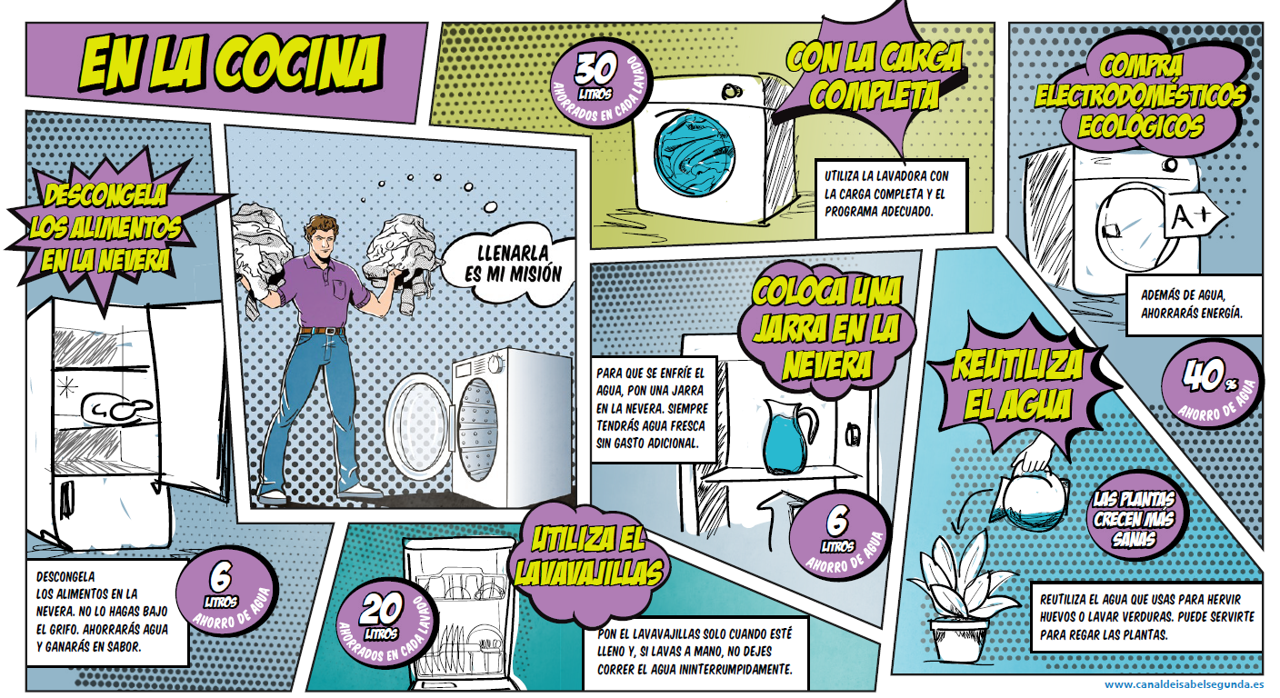
Notes:
But also education for our clients is really important. Every year our Communication and Marketing department launches diferents campaigns to attract the attention of customers in order to reduce the domestic consumption. This is one of the last campaigns where we want to consider each of our client is a superhero and have the power to reduce consumption with specific actions as you can see.

Slide 9
Achieve gender equality and empower all women and girls

Slide 10
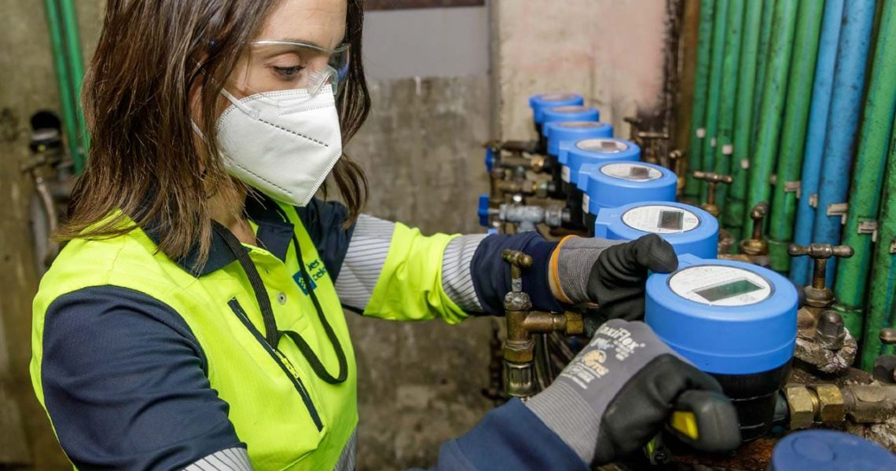


Achieve gender equality and empower all women and girls
Canal de Isabel II collective agreement does not recognize any difference on salary, permissions or any retribution between men and women.
Average wage by gender Canal de Isabel II, 2021
37K €
37K €
Notes:
About gender equality first of all, is important to say that in our company agreement we have established the salarys by category and not by gender. In fact our REAL and EFFECTIVE average SALARY is the same considering all the categories. It doesn´t mean we have nothing to do. HOWEVER we have some areas of improvement we are working in our next EQUALITY PLAN

Slide 11
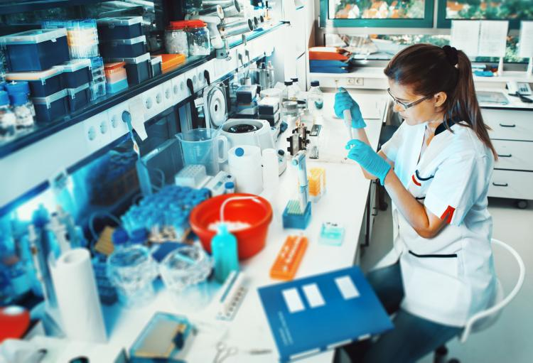
Equality plan
In 2019, Canal de Isabel II started to work on a new Equality Plan.
Proffessional development
Trainning
Co-responsible language
1,033
2,188
Staff distribution by gender
Canal de Isabel II, 2021
Notes:
Issues like: sexual harrasment, proffessional development, specific training and using co-responsable language are some of the general lines of this Plan. We know water sector is a very masculinazed sector and this is something we would like to contribute with actions like these.

Slide 12
Conserve and sustainably use the oceans, seas and marine resources

Slide 13
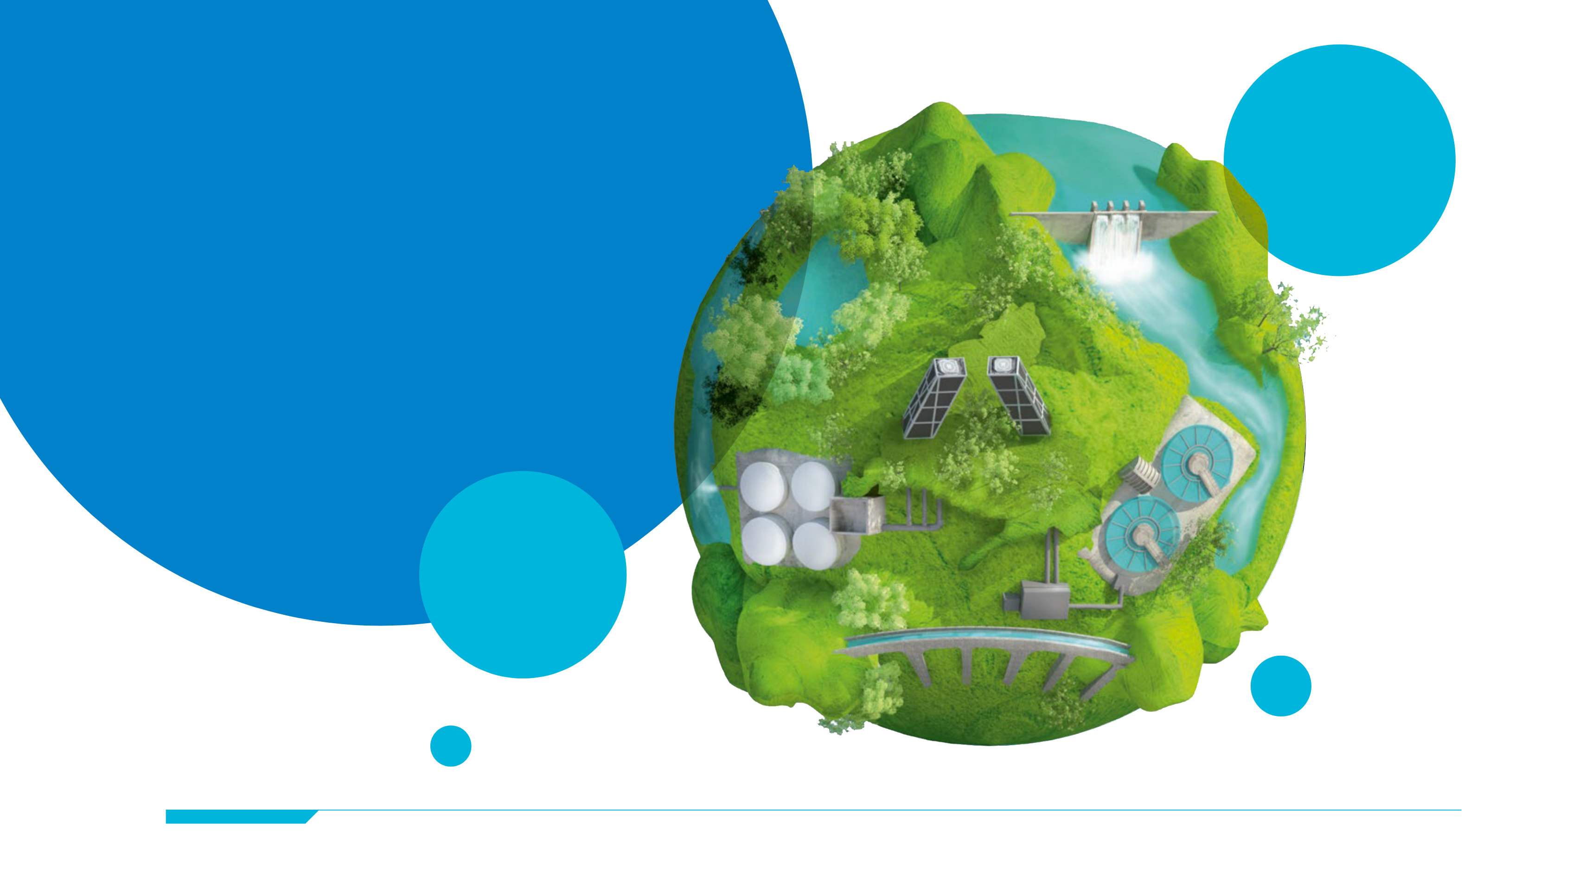
Madrid is 300 km. far from sea…but the sea starts on sewage system
Waste ends up in the rivers and then in the oceans, causing negative effects on life below water.
Healthy seas and oceans have enormous benefits in other sustainablility ambits so we have the responsability to take care of them.

Slide 14



How are we contributing?
Wastewater
valorization
Water bodies care
Circular economy
Waste water treatment
Recycled water production
Stormwater tanks
WWTP as biofactories
Renewable & clean energy production
Phosphorus recovery
Sludge sanitization

Slide 15
Protect, restore and promote sustainable use of terrestrial ecosystems, sustainably manage forests, combat desertification and halt and reverse land degradation and halt biodiversity loss

Slide 16
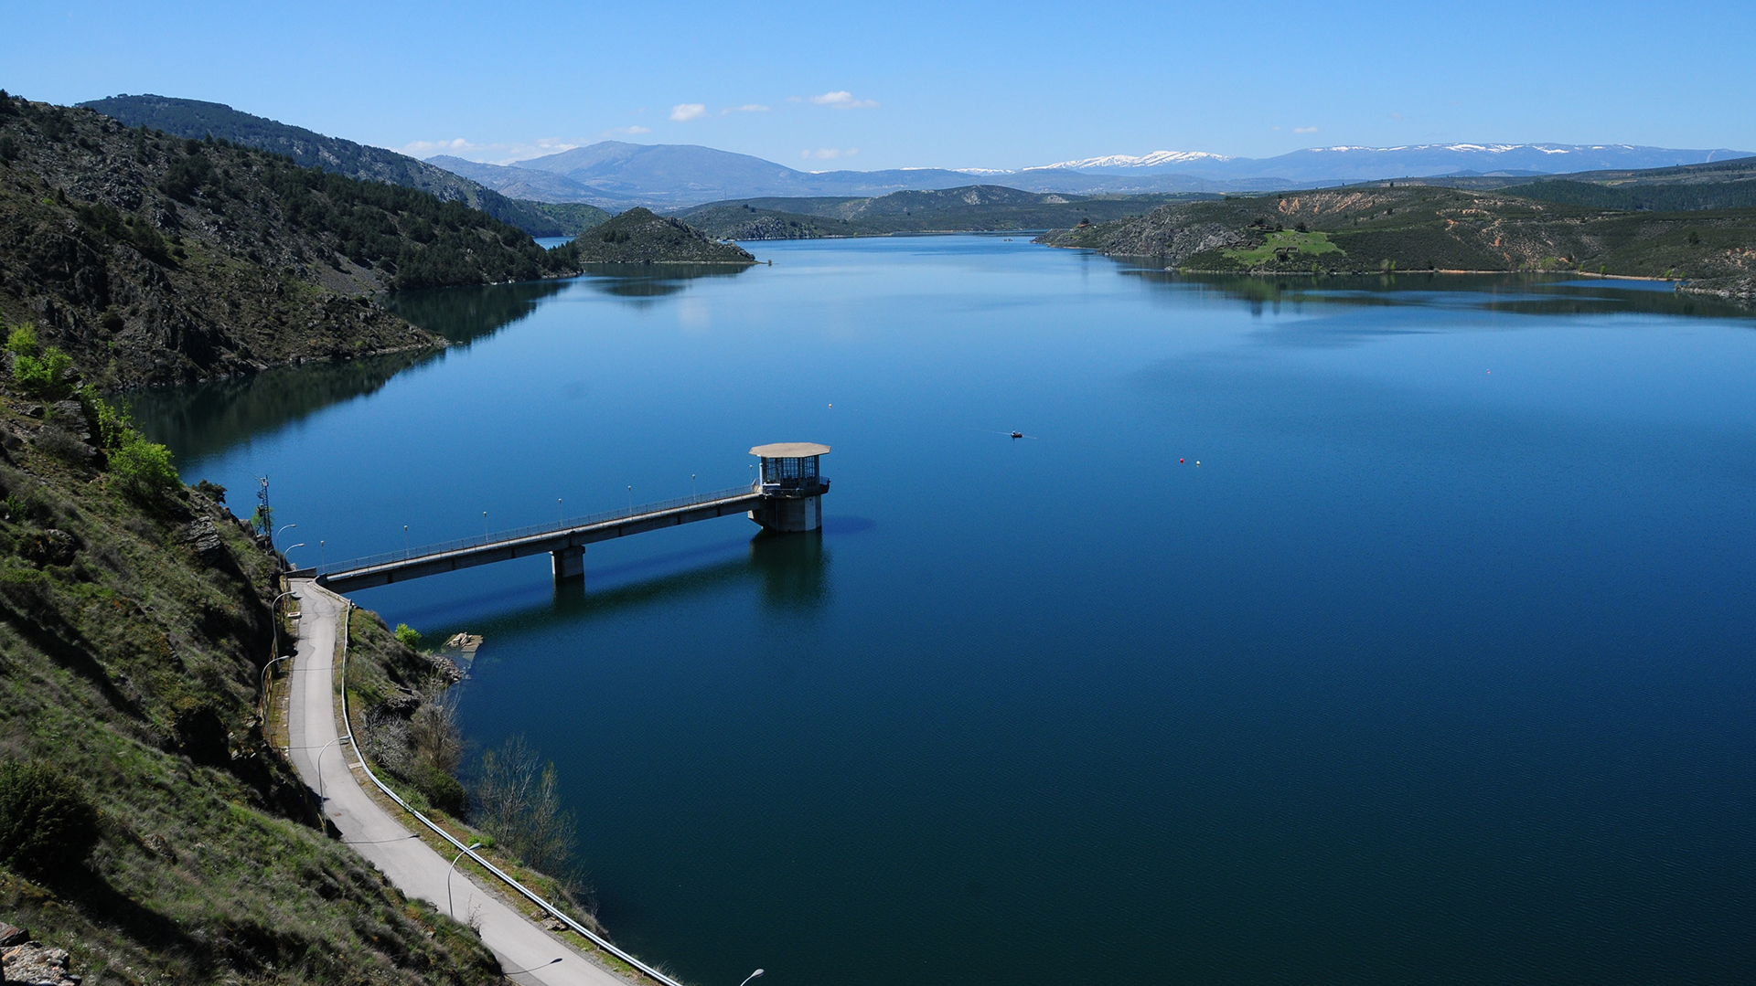

Slide 17



Impact reduction
Pest control
Monitoring & modelling
Promoting environmental investigation
Ecosystem conservation
Monitor climate change
Forests to capture CO2

Slide 18
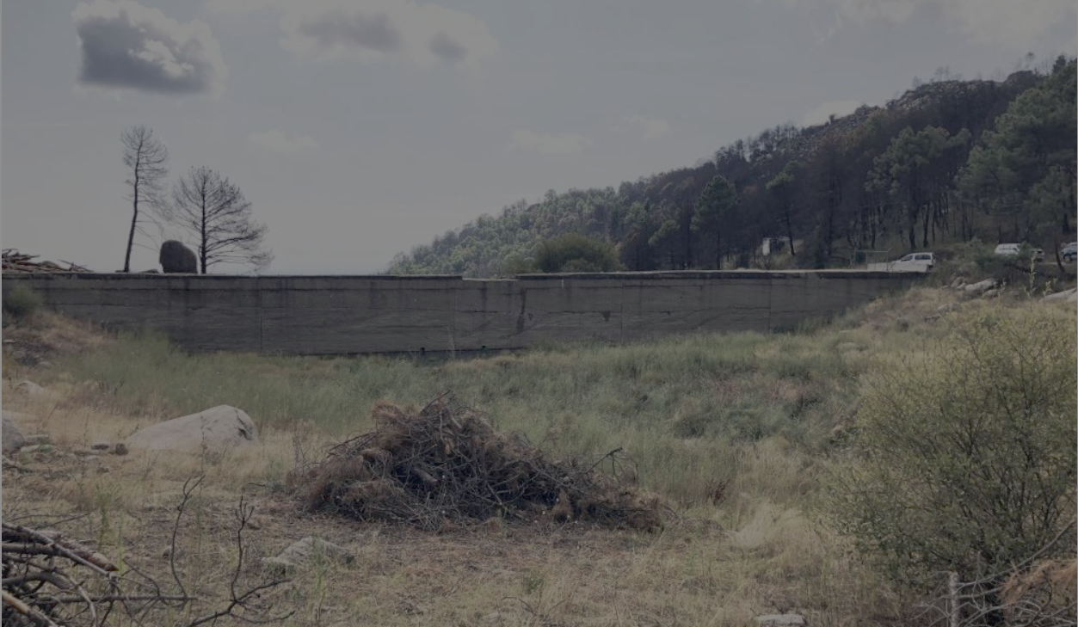
LIFE IN LAND EXAMPLE:
THE RESTORATION OF AN OLD DAM

Slide 19
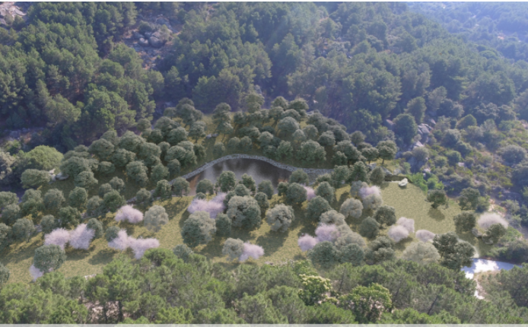




LA ALBERCA (OLD DAM)
Bats and amphibians protection
Gallery dam
Reuse of contruction materials
Vegetal recover according species needs
Notes:
A new use for La Alberca dam:
- Bats and amphibians protection - Maintain of gallery dam - Reuse of construction materials - Vegetal recover according to species needs

Slide 20
Strenghten the means of implementation and revitalize the global partnership for sustainable development
Notes:
In Canal we love to talk about Leadership before Partnership.

Slide 21
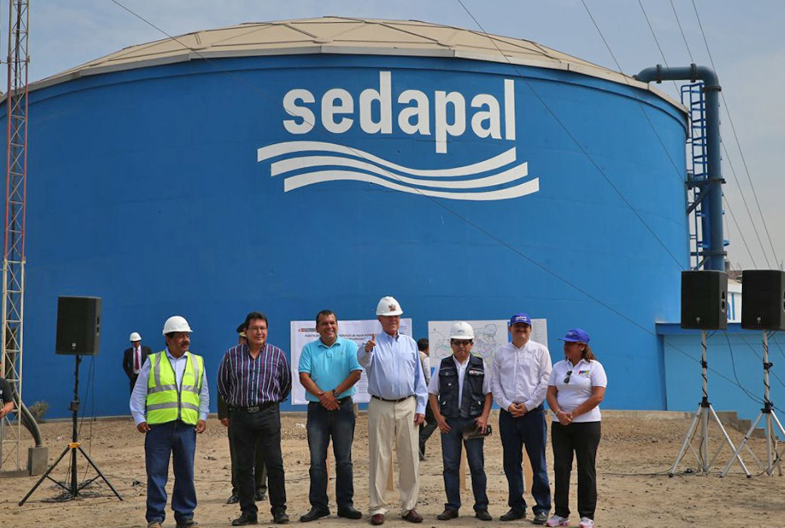



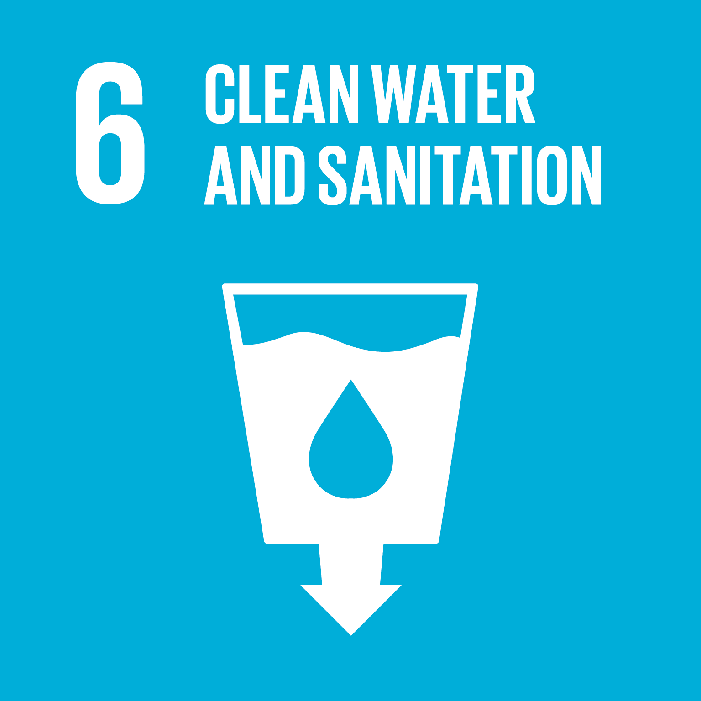

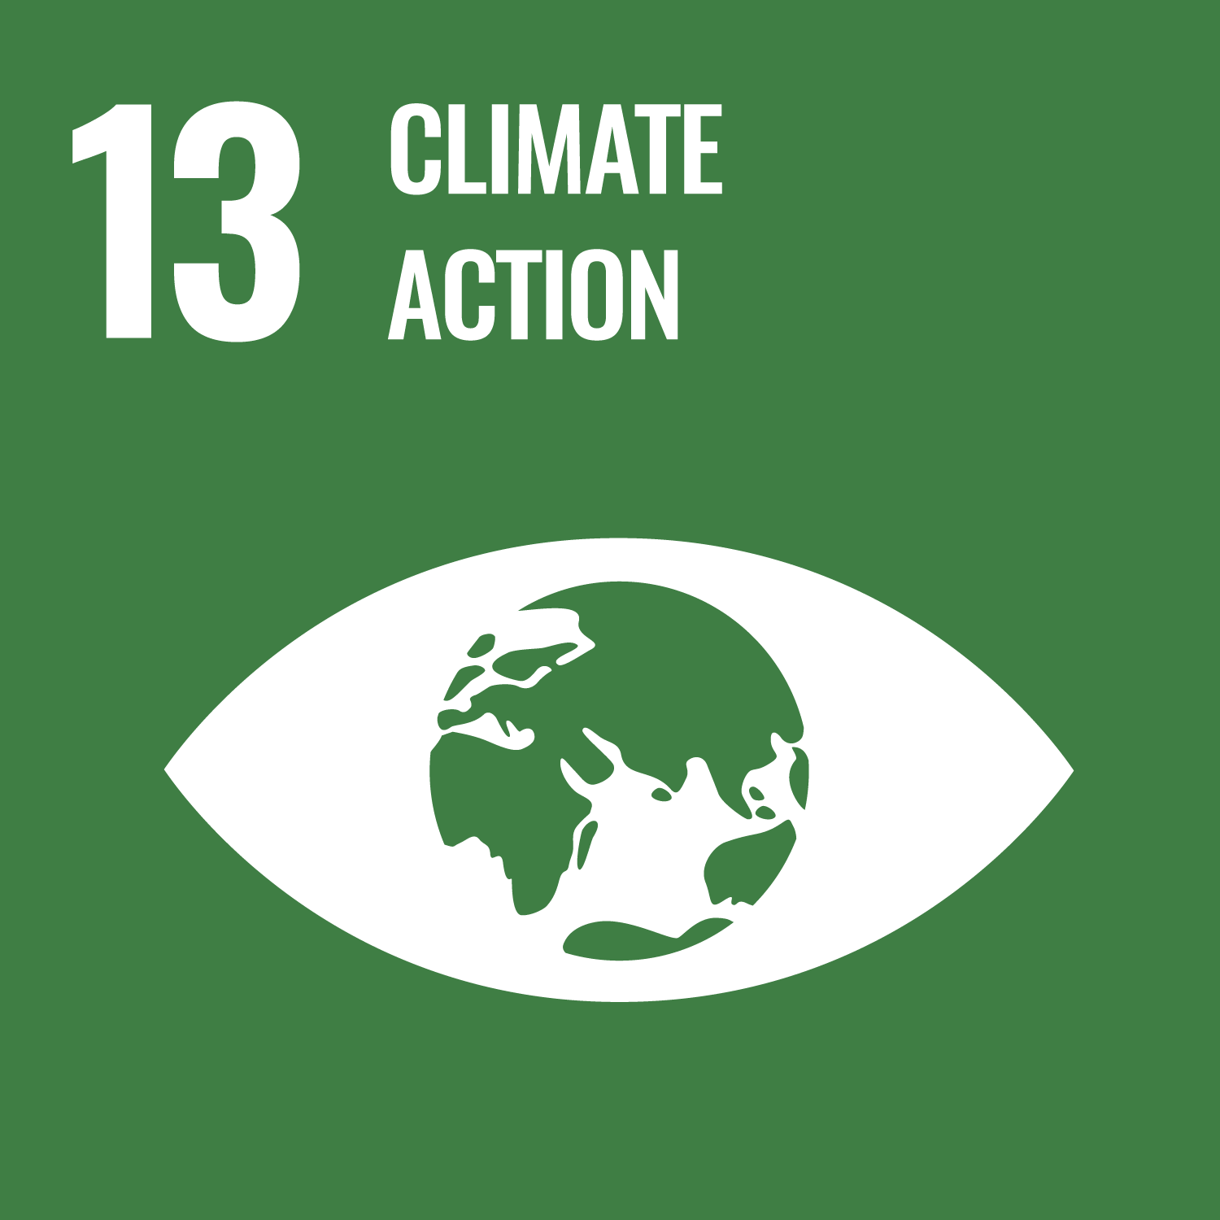

EU-WOP with Sedapal
In 2021, Canal de Isabel II signed a technical cooperation agreement
with Sedapal the public water operator in Lima, Perú.
COVID-19 early detection system implementation
Reclaimed water optimization and waste exploitation
Benchmarking programme participation
Notes:
This is a water operator Partnership project (3 years duration) financed by EUROPEAN UNION and UN-HABITAT to improve and strenghten the capacities of Sedapal.

Slide 22
Wrap up
Attract more water sector proffesionals
Very masculinized sector is something to consider
Effective waste water treatment protects sea
Caring for environment is caring for water
Leadership for contributing to other SDGs
Notes:
LIFE BELOW WATER we have seen different ways to take care the bodies of water but the only one that a water utility can do is an effective waste water treatment and this connect DIRECTLY to SDG NUMBER 6.
In Canal we understnad PARTNERSHIP as LEADERSHIP that means to have consolidated the know-how in one or more capacities or tecnhologies that allow us to aspire to achieve other different goals and share this experience and good practices with other utilities around the world. Canal for example thanks to its integrated model with more than 50 years ensure the complete water cycle to the supplied population also take advantage of the water synergies and produce energy in the different phases of the activity.

