Slide 1
ASAZGUA The support of the Guatemala Sugar Agroindustry focused on health as a tool for economic development
Luis Miguel Paiz
Guatemala Sugar Producers Association

Slide 2
About
ASAZGUA
11 Sugar Mills
1957
1990
1992
1994
2011
2021

Slide 3
SDG 3: GOOD HEALTH AND WELL-BEING
The Guatemala Sugar Agroindustry has multiple initiatives in place with the aim of ensuring sustainable human development, and promoting the well-being of the population of Guatemala, strengthening education, health and local governance.
Activities supporting healthy lives by the Sugar Agroindustry are coordinated through the Foundation of Sugar of Guatemala (Fundazúcar).
ASAZGUA created Fundazúcar in 1990 as the organization in charge of relationship-building across the communities and local governments surrounding the sugar mills for the improvement of social and economic indicators.
The Foundation designs and implements programs at the community level with a focus on women, youth, teachers, health workers, community leaders and municipal leaders who are all key actors for responsible citizenship.
The Social Strategy of the Guatemala Agroindustry
emphasizes building human capital with an integrated
focus that empowers people to implement changes
towards the improvement of their quality of life
and autonomy.

Slide 4
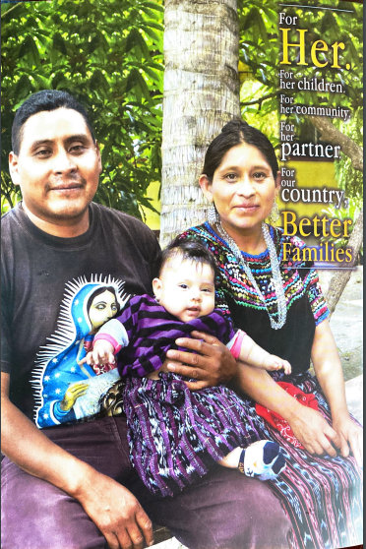
MEJORES FAMILIAS PROGRAM
Innovative model for food and nutrition security.
Focus on women > 15 yrs old – 45 yrs old and children under 5 years.
Skills developed: self-esteem, autonomy and self management.
Educate women to develop healthy food practices.
Improve living conditions of the child-mother, women’s family and her community.
Strengthening of the citizenship participation as women and leaders.
Since its inception in 1998, the program has trained more than 532,000 women in Guatemala and Honduras. The program supports efforts for the reduction of poverty and is making a direct impact in the reduction of chronic child malnutrition by up to 7% (source: external evaluation by CIENSA, 2014).

Slide 5
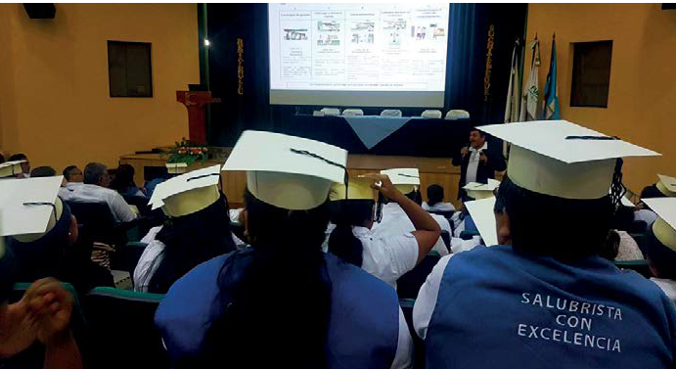
MI SALUD PRIMERO PROGRAM
The program is directed to the public health professionals of the first level of attention of the Ministry of Health in 27 municipalities of the south coast region.
The main objectives for the community health are:
Preventive health
Epidemiological registry
Quality service in a daily basis
Counseling and reference
The 500 health workers who have been trained through this program are strengthening risk reduction and sickness prevention particularly in the poor and vulnerable communities. This is allowing healthier and more productive people available to compete for better job opportunities.

Slide 6
PLANNING AND
DEVELOPMENT
This program began in 1997. The objective of the program is to foster citizen participation, leadership and decision-making by community groups within the framework of the national institutional structure, through the formulation and execution of “Comprehensive Community Development Plans” for 10-year terms.
The Program promotes responsible citizenship
through active participation of people in the building of social support, strengthening of institutions and the harnessing of public services.
Through the Comprehensive Community Development Plans about $27.5 million of public funds have been mobilized for the benefit of more than 534,200 people prioritizing water and sanitation to ensure better health conditions.

Slide 7
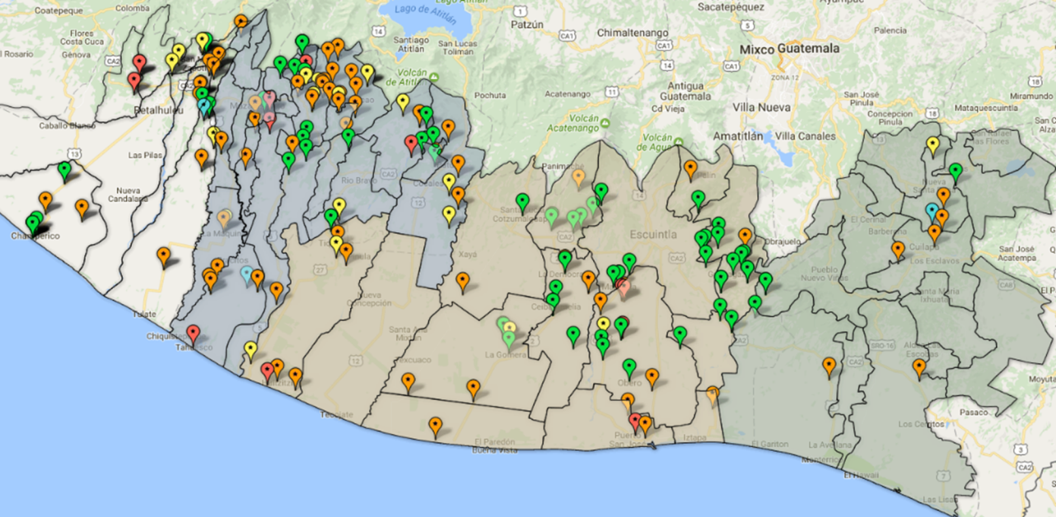
Funds movilized
UNISAN STUDIES 2001 - 22
280 projects designed
129 executed
14 on execution
34 with funds approved
+US$ 37 million in funds movilized
Population coverage 536,546

Slide 8
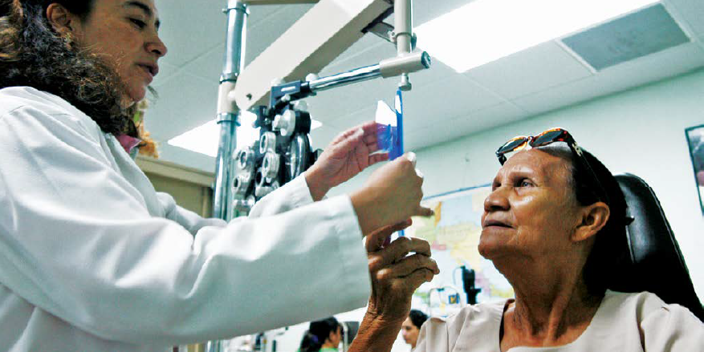
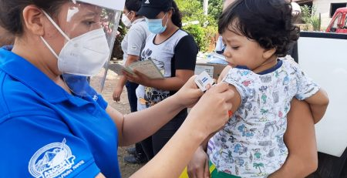
FUNDAZUCAR MEDICAL CLINIC PROGRAM
As a PPP established in 1992, the Fundazúcar Medical Clinic is located in Escuintla and operates through an agreement with Ministry of Health of Guatemala. Patients pay just a symbolic amount of 30 Quetzales (about US$ 3.8)
From an equity vision, the clinic services are open to the general public in five medical specialties: general medicine, pediatrics, dermatology, ophthalmology and odontology.
The Fundazúcar Medical Clinic is providing quality services in communities in Guatemala allowing access to over 45,000 patients to essential health services every year. The program represents a social protection mechanism covering poor and vulnerable people in Guatemala.

Slide 9
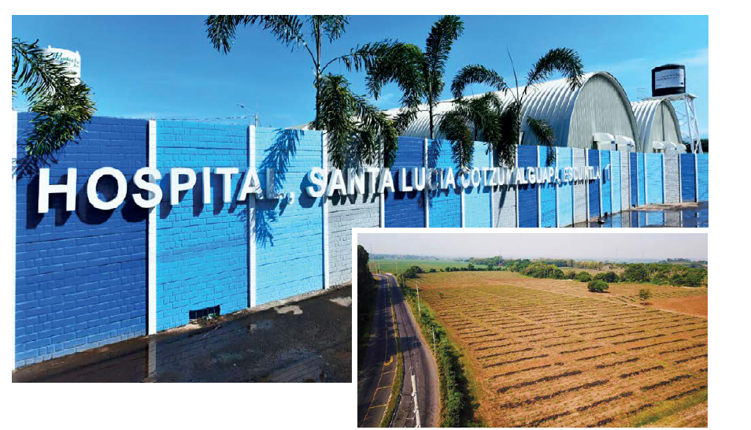
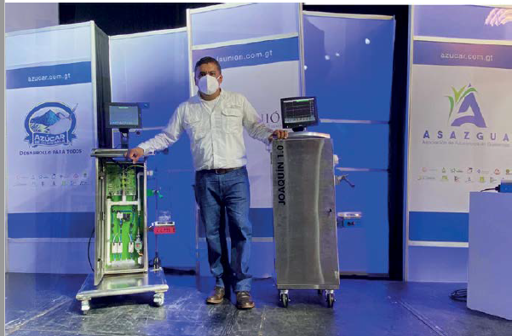
COMBATING THE COVID-19 PANDEMIC
The Sugar Agroindustry donated the land for the Santa Lucía Cotzumalguapa Hospital built to attend COVID-19 patients.
Additionally, about $1 million were donated for medical equipment for this hospital located in the south coast region.
-Over 7,300 kits of personal protection equipment (PPE) were donated to health workers in 65 health centers.
-Around 21,500 surgical masks were distributed in 26 municipalities and over 2,000 gallons of glycerinated alcohol were donated.
-The industry also donated 110,000 pounds of sugar for the kit that the government distributed to vulnerable families.
The Sugar Agroindustry also developed the first mechanical ventilator created in Guatemala for patients receiving the necessary medical attention related to the COVID-19 pandemic. This effort included the
development of parts, software and electronic systems that allowed the functioning of this innovative ventilator.

Slide 10
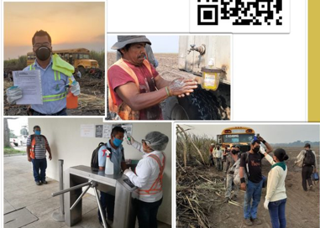
BACK TO WORK PROTOCOL
Aligned with Government requirements.

Slide 11
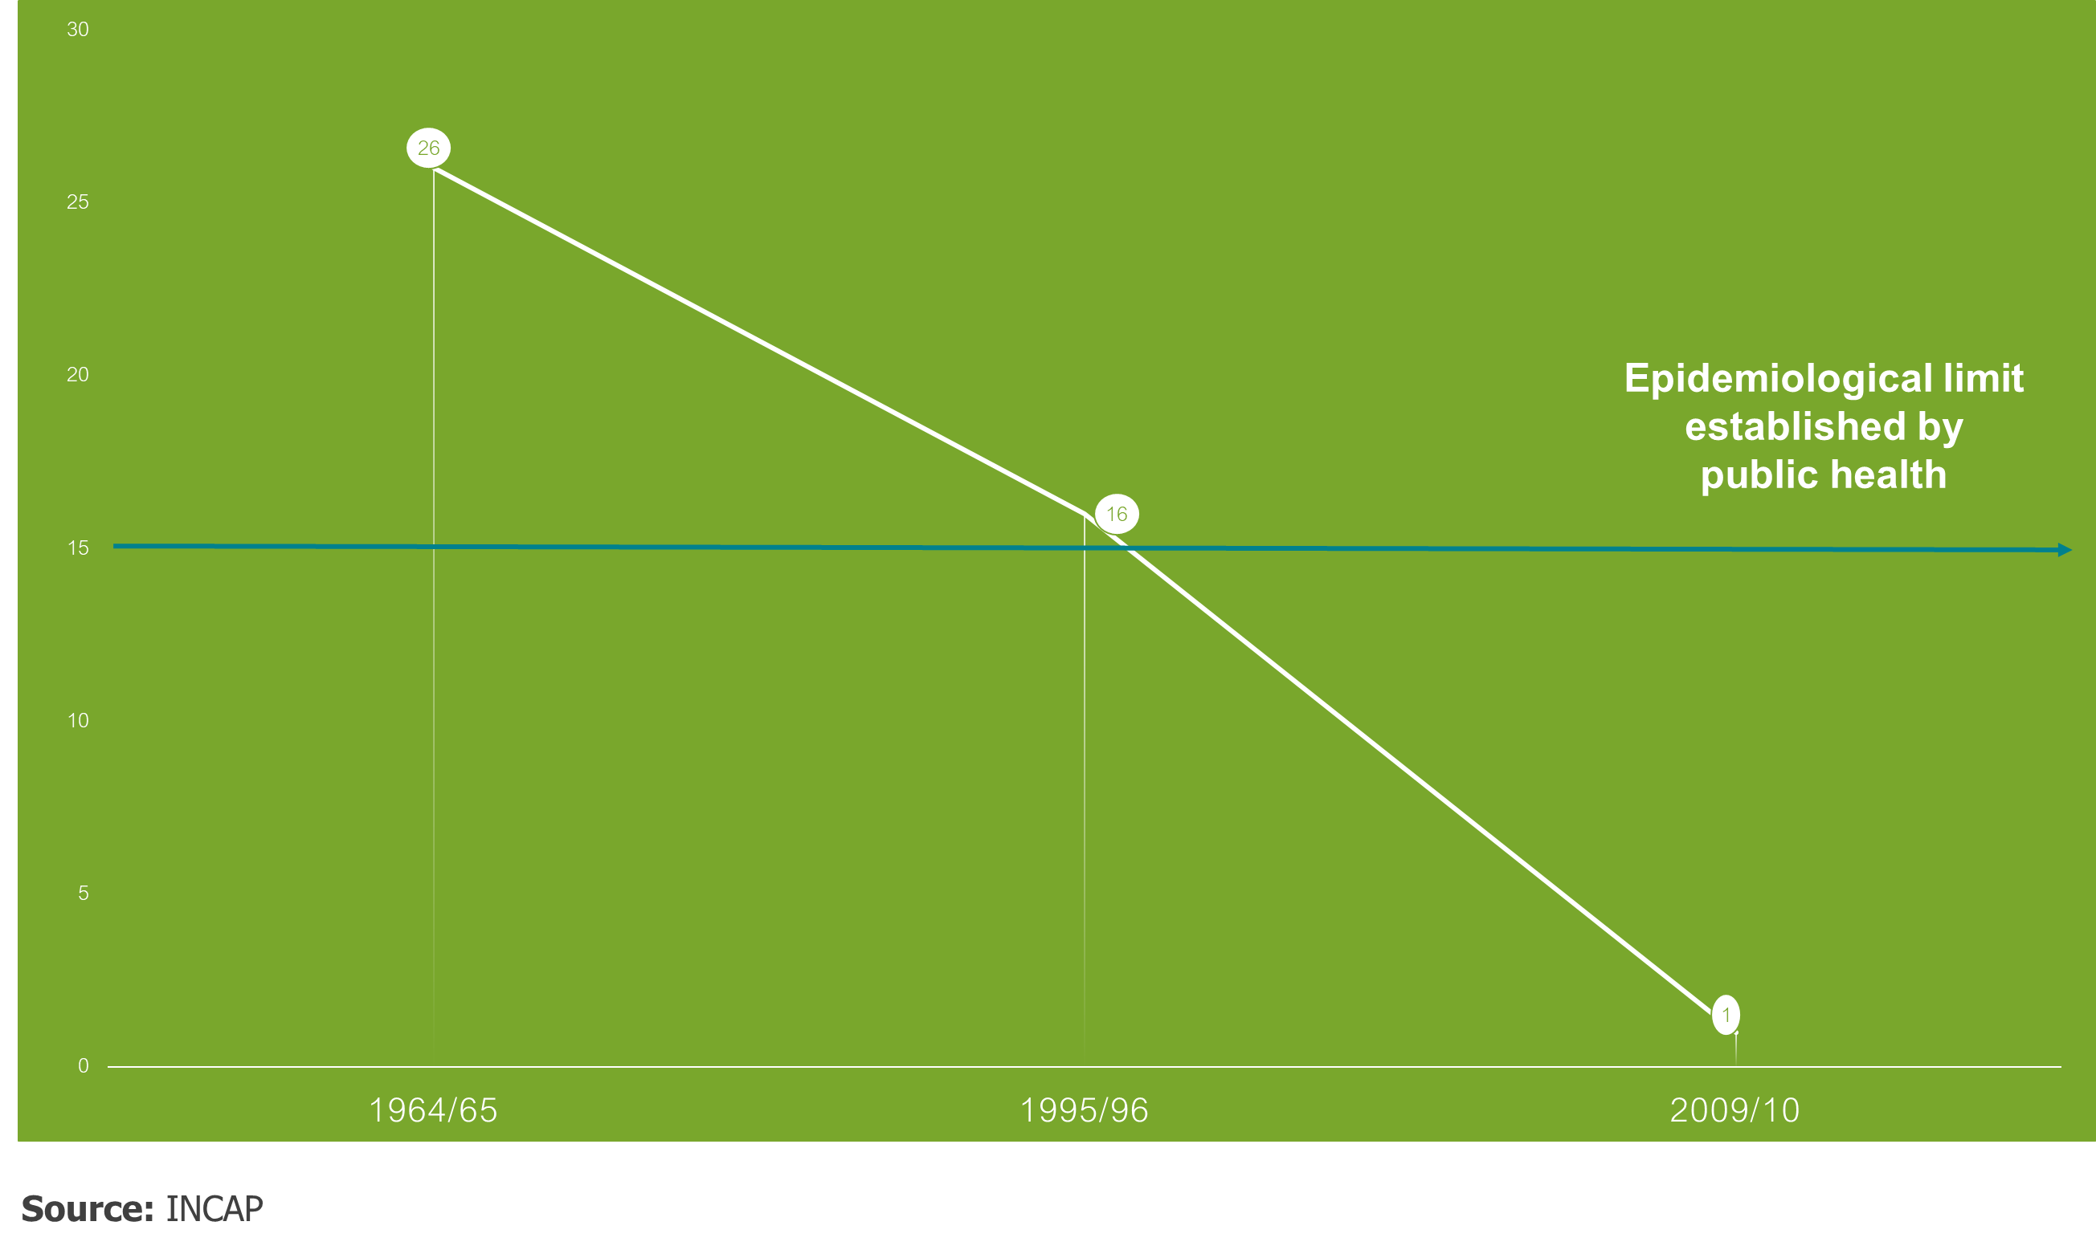
FORTIFICATION OF SUGAR WITH VITAMIN A
During the 1969-1974 period, the Institute of Nutrition of Central America and Panama (INCAP) determined that sugar was the best vehicle for providing vitamin A to the most vulnerable population and moved forward developing the corresponding technology for the fortification of sugar with this vitamin.
As a result, through a PPP, the Guatemala Sugar Agroindustry started the fortification of sugar with vitamin A in 1975 by its own expenses and responsibility.
In 1996 UNICEF recognized the Guatemala Sugar Agroindustry as a pioneer on the fortification of sugar with vitamin A, given the positive impacts in the health of children.
The Sugar Agroindustry continues to maintain an appropriate level of fortification in the sugar for Guatemala’s market as recommended by INCAP and has invested over $2.3 million in technology updates, process modifications, laboratories, testing, quality control and capacity building since 2008.

Slide 12
ASAZGUA The support of the Guatemala Sugar Agroindustry focused on health as a tool for economic development
Luis Miguel Paiz
Guatemala Sugar Producers Association

