Slide 1
Transformation of the panela production subsector through the initial implementation of the NAMA in Colombia.
Biodiversity & Industry scope
CAF project, funded by the GEF
May 10th, 2022

Slide 2


The Green Bank of Latin America and the Caribbean
CAF’s vision and action
Understanding the challenges and opportunities of LAC in regards to increasing #ClimateAction and boosting #BiodiversityPositive, CAF has been a catalyst for green financing sources for the region, including low-cost co-financing.
As part of our mandate, we help drive sustainable development based on the strategic vision of our Green Agenda, through which we fund initiatives that promote a more equitable economic development, guided by conservation, the enhancement and sustainable use of biodiversity and responsible climate action.
During COP26, CAF made a Pledge commitment to allocate USD 25 billion over the next five years for green operations.

Slide 3






CAF and the Paris Agreement
Article 2 - Objective
CAF Regional Facility
2.1.(a) Global temperature goal and emissions reductions.
Decarbonization of the Energy Matrix
2.1.(b) Ability to adapt to the adverse impacts of climate change and low greenhouse gas emissions development.
Low-Carbon and
Climate Resilient Development
2.1.(c) Making finance flows consistent with a pathway towards low GHG emissions and climate-resilient development.

Slide 4






Colombia
The GEF:
Cofinancing
USD 2 millones
USD 94,8 millones
Transformation of the panela production subsector through the initial implementation of the NAMA in Colombia.
Objetive:
Contribute to the implementation of NAMA through the productive and technological transformation of the Panela subsector.
Components:
1. Improving panela production practices and restoring affected natural systems at local and national level; 2. Integral Technological Transformation of Panela's production processes in Colombia; 3. Capacity building of the Panela subsector for the implementation of NAMA; and 4. Monitoring, Reporting and Verification (MRV), and Knowledge Management.
SDG´s:
36,040 direct beneficiaries
290,000 tCO2eq reduces

Slide 5
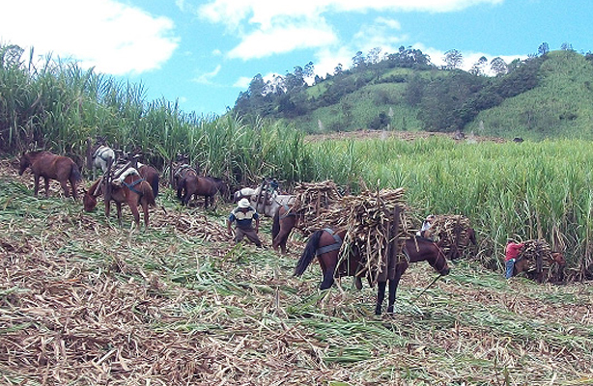
Transformation of the panela production subsector through the initial implementation of the NAMA in Colombia.
Energy & Biodiversity
Improve panela production practices and restoration of affected natural systems at the local and national levels, Natural and Local Participation Based Solution.
Compensation mechanisms for historical deforestation up to 2030; Efficient use and management of nitrogen fertilizers based on soil studies; Sugarcane repopulation plans (40PU- 6 departments, 400 PU replica); Forest restoration plans developed (80 Ha- 6 departments, 400 UP replica); and Demonstration strategies for the efficient use of nitrogen and/or organic fertilizers, in at least 6 departments.
Improve panela production practices and restoration of affected natural systems at the local and national levels.
Installation of electric motors installed as an alternative power suppl; Elimination of the use of tires and reduction of consumption of firewood as heat sources; Removal of diesel use as an energy source; Design of credit-based financial mechanisms to support panela producers in reproducing and scaling-up technological transformations and improving sustainable panela production processes. Implementation of waste management plans for products subject to at least three alternative uses Installation of installed wastewater systems (40PU- 6 departaments, 400 PU replica).

Slide 6
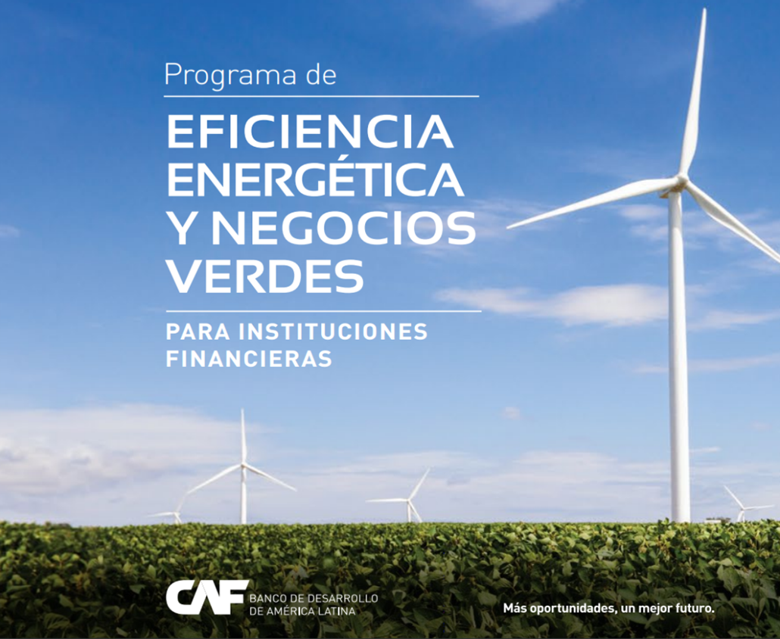



Mechanism for Financing and Technical Assitance to support decarbonization
Asistencia técnica de CFA/KFW
(ejecutada por IPC y Deuman)
Formación capacidades
Apoyo en visitas a clientes
Fondos de CAF
Instituciones financieras
Cliente Final
Fondos de KFW
Fondos dirigidos a EE-D
Créditos EE-D
Notes:
A manera de ejemplo, queremos resaltar el Programa de Eficiencia Energética y Negocios Verdes de CAF que busca canalizar a través de intermediarios financieros USD 1,200 MM de dólares en la región para promover proyectos de esta temática en Latinoamérica y el Caribe.
En este marco se está trabajando con socios estratégicos como KFW y Fondos como el GEF y el GCF para apoyar esta transición energética en la región.
En la actualidad estamos promocionando en todos los países la Línea de Financiamiento de Eficiencia Energética desde la Demanda con recursos de KFW € 70 MM que junto a recursos de AT del gobierno Alemán están preparando a numerosos bancos de la región como BdP, BNB (de Bolivia), Sudameris, AFD (de Paraguay), entre otros para tener líneas de financiamiento verde, herramientas de monitoreo, Reporte y verificación de co-beneficios ambientales, sociales y climáticos del uso de los recursos, SARAS robustos, para el uso adecuado de los recursos y estudios de demanda en al menos 7 países latinoamericanos.
En este año iniciará también la implementación del Programa de Instituciones Financieras Locales que se financia con USD 100 MM del GCF y que permitirá acelerar el desarrollo y el volumen de los proyectos de cambio climático en Panamá, Ecuador, Perú y Chile con el objetivo de reducir las emisiones de gases de efecto invernadero, dentro de los sectores de energía y uso de la tierra, al ayudar a los actores del mercado a superar las barreras clave para la creación de proyectos viables.

Slide 7












Green projects, Green Finance Mobilization and pre-investment facility
USE OF PROCEEDS
COFINANCING &
REFINANCING
ACCREDITED ENTITY
FEES
Biodiversity and Climate
PRE-INVESTMENT FACILITY
GREEN BONDS
STRATEGIC FINANCIAL PARTNERS
MULTILATERAL GREEN FUNDS
BUSINESS UNITS
Established the baseline
Ex ante expected resultas
Ex post monitored results
documented
Green projects

Slide 8

¡Thank you!
rgomezgarcia@caf.com

