Slide 1



Water and Energy for Sustainable Development
Integrated Water and Energy Solutions supporting
Sustainable Cities and Human Settlement
Mr. Javier Fernández, Canal de Isabel II, Spain

Slide 2


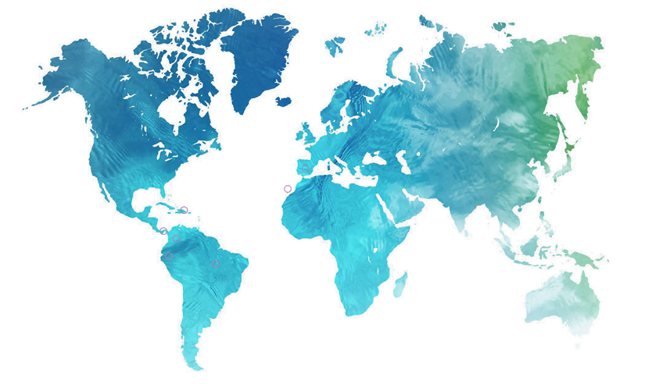
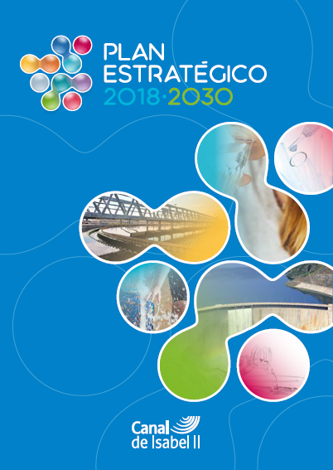


Key figures
  Canal de Isabel II is a 100% public company responsible for the integral water cycle in the Region of Madrid (179 municipalities)
  We also provide urban water services to other regions of Spain and Latin America
  7.5 million inhabitants served in total
  9,000 employees (direct and indirect)
  1,000 million euros in business turnover
A 2030 strategy…
Canal reflects its faithful commitment to the 17 SDG through its Sustanaibility Plan comprising more than 100 actions, 45 plans and 10 lines, which were created to respond to the major challenges of modernisation and sustainability.

Slide 3
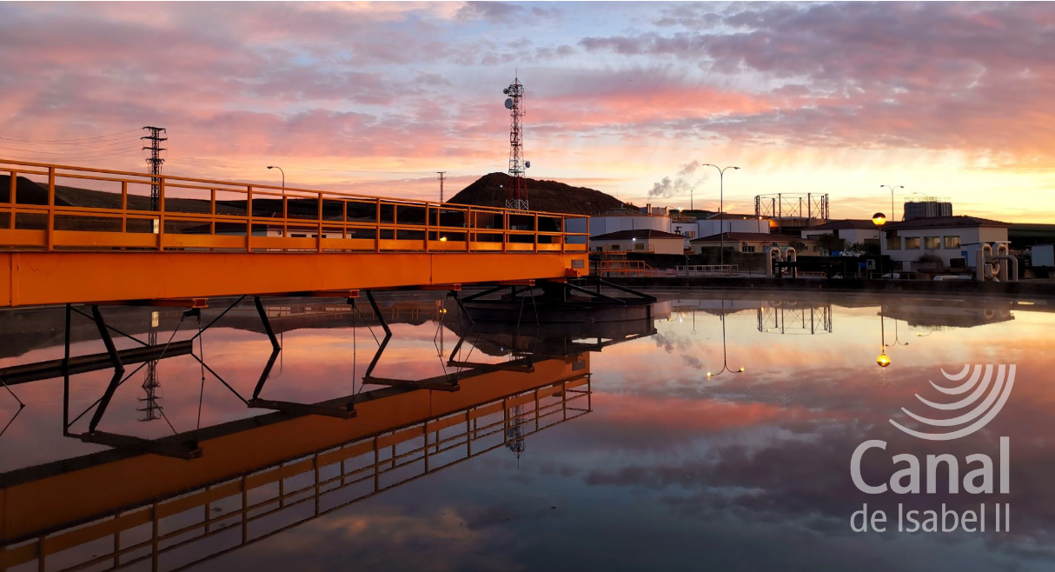

1. Integrated water solutions
2. Climate resilience
3. Water and energy
4. Human settlements

Slide 4


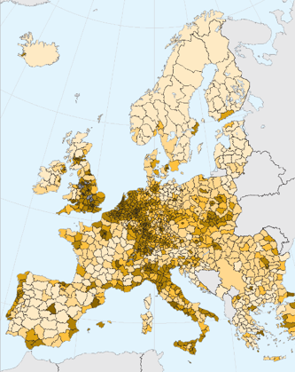

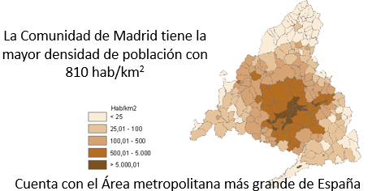

The Region of Madrid has a high population density with 810 inhab/km²
Integrated
management model
Region of Madrid
6.74 million inhabitants
An area of 8,000 km²
179 municipalities
Madrid is the second largest city in the European Union after Berlin. 5,472 inhab/km²
Madrid is the widest metropolitan area in Spain
Supra-municipal management model:
Inter-municipal solidarity, economies of scale and operational synergies through the integral water cycle services
Annual precipitation (mm/year)

Slide 5
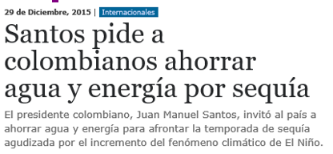
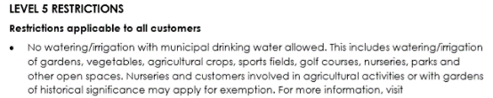
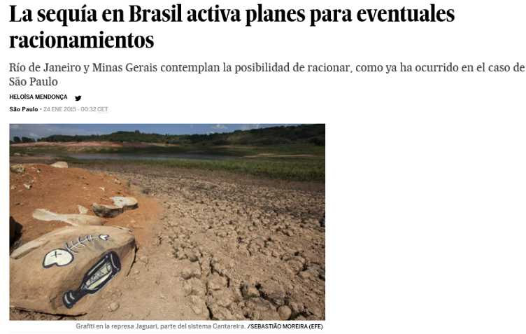
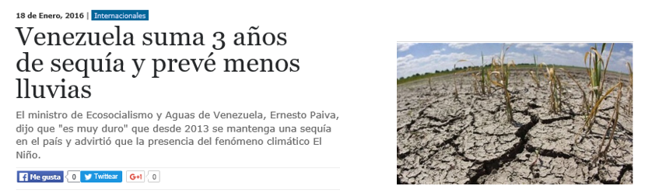
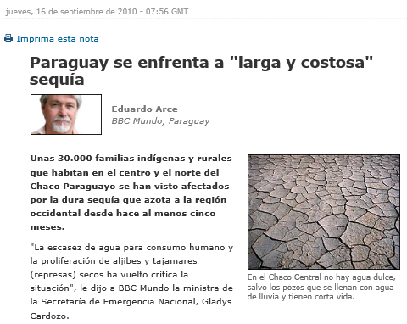
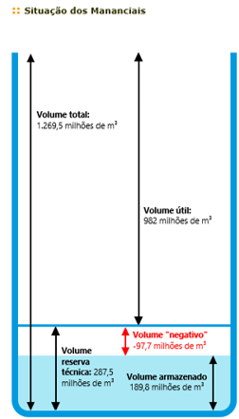
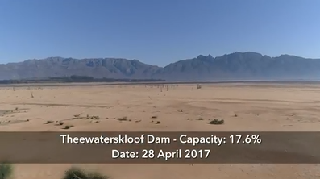
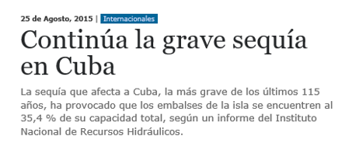

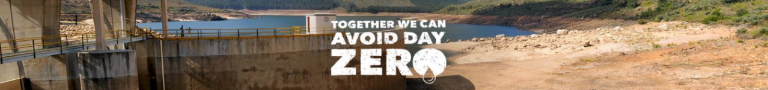
Regional challenges
Scarcity and rainfall irregularity
Santos asks Colombians to save water and energy because of the drought
Drought in Brazil activates plans for eventual rationing
Rio de Janeiro and Minas Gerais contemplate the possibility of rationing water, as has happened in Sao Paulo.
Paraguay faces a long and expensive drought.
Venezuela has been 3 years under drought and expects decreasing rainwater resources
Capacity
480 hm³
The serious drought in Cuba continues

Slide 6


CLIMATE RESILIENCE
Best way to save energy is to save water
Compared to the last 30 years, rainfall has decreased by almost 20% as of 2022. At the same time, the Region of Madrid has undergone a large population increase.
Against this difficult backdrop, we have reduced per-head consumption by 32%. However, will we be able to guarantee current supply levels in the foreseeable future faced with these challenges?

Slide 7
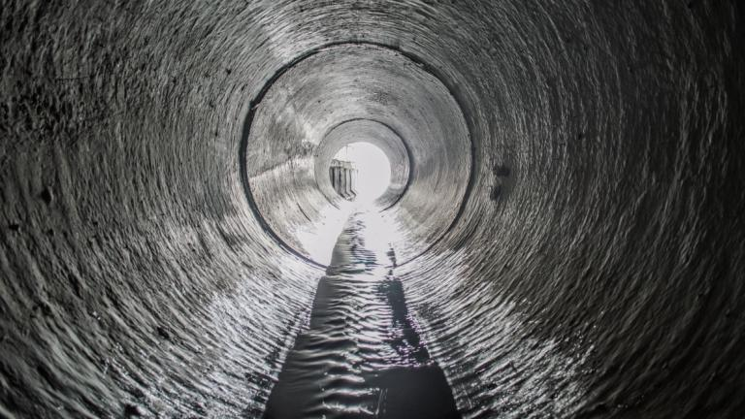
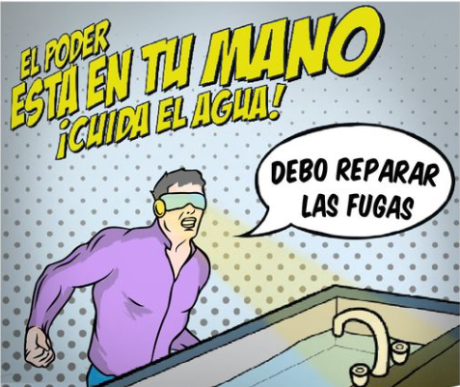
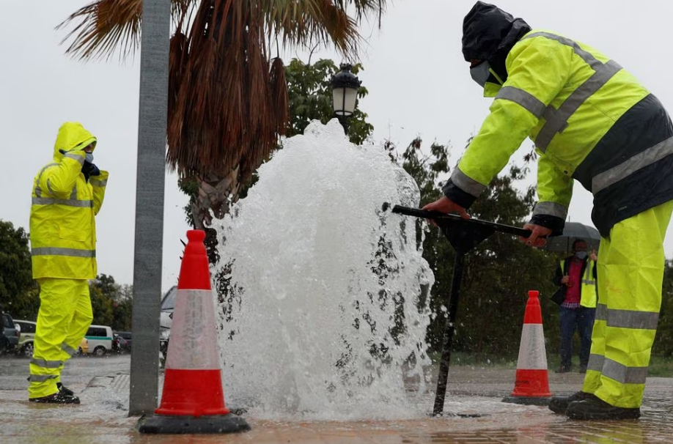
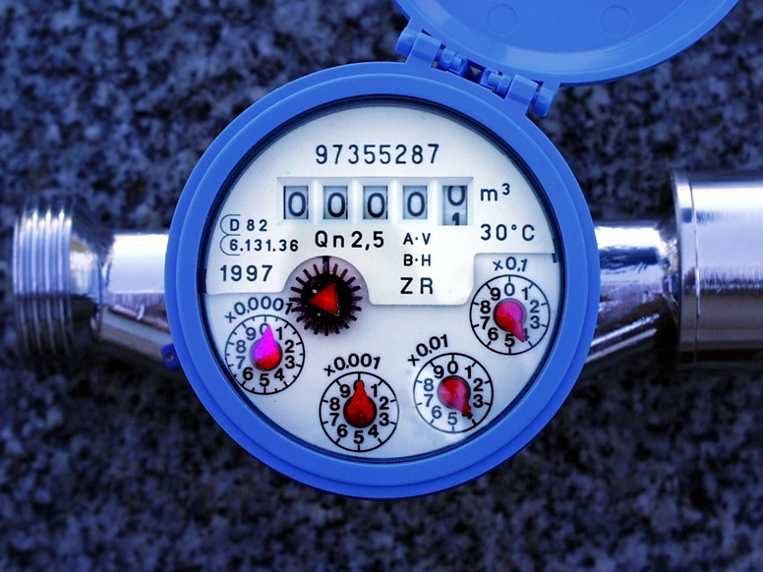
Plan Red: by 2030, we will have renewed more than 3,000 kilometers of pipeline, replacing obsolete materials with more technologically advanced ones and significantly reducing loss.
Actions
Plan Smart Region: installing smart meters using latest technology to enable remote reading and avoid under-recording problems. By 2026, we will have achieved 100% implementation.
3. Plan SANEA works to achieve excellence in the sewerage system in the Region of Madrid. Its primary focus, is that of preventing the effects of heavy rain, runoff and floods.
4. Social Awareness Campaigns: permanent presence in the media encouraging citizens to be aware of the efficient use of such a scarce commodity as water.

Slide 8
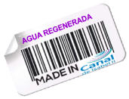
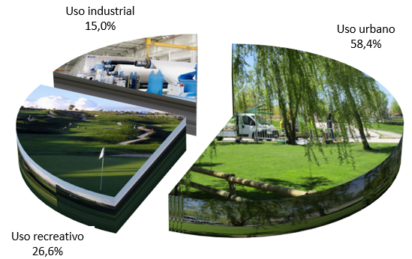
108 hm3 of reclaimed water production in 2022. Of this, 17.05 million m3 for reuse in the paper industry; irrigation of golf courses and municipal parks.
RECLAIMED WATER
Need for alternative resources
Supply-demand gap
Industrial use
15.0%
Urban use
58.4%
Contributions to rivers
Recreational use
26.6%

Slide 9
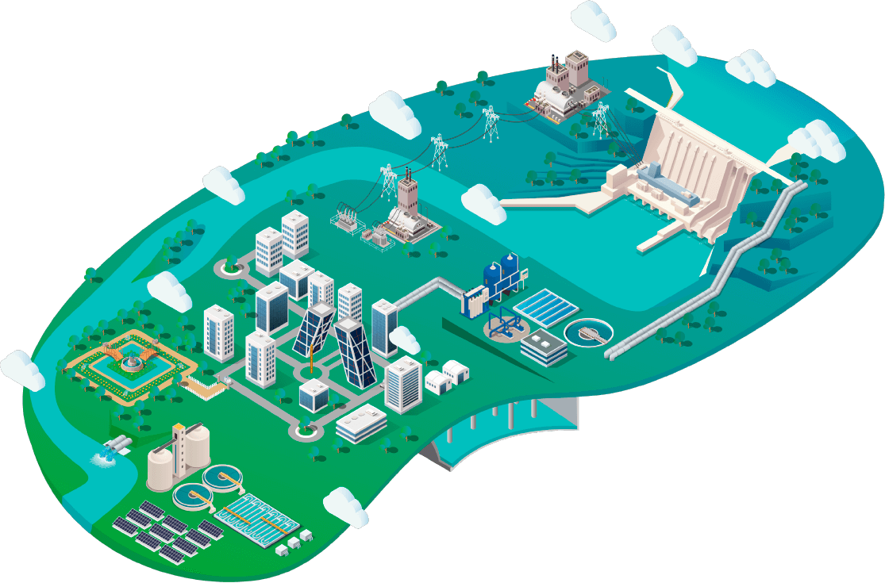
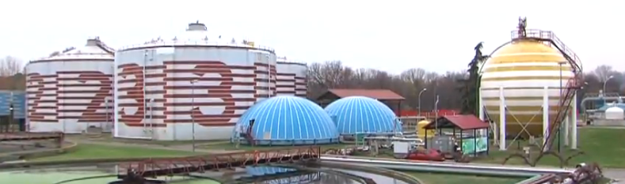
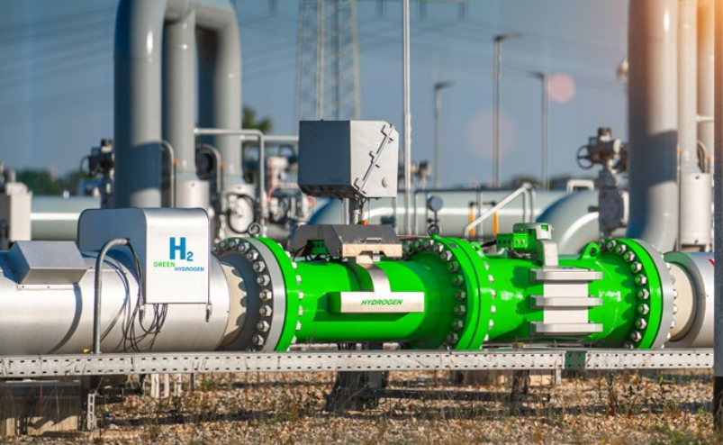
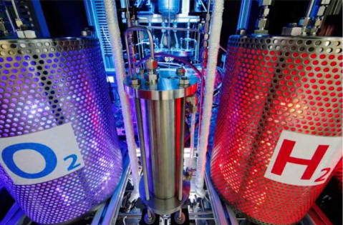
WATER & ENERGY
Environmental infrastructure sustainability
Decarbonisation of processes and reduction in reliance on fossil fuels boosts the production of renewable energy at treatment plants.
Convertible biogas generation through its upgrade into biomethane
Green hydrogen generation from reclaimed water

Slide 10
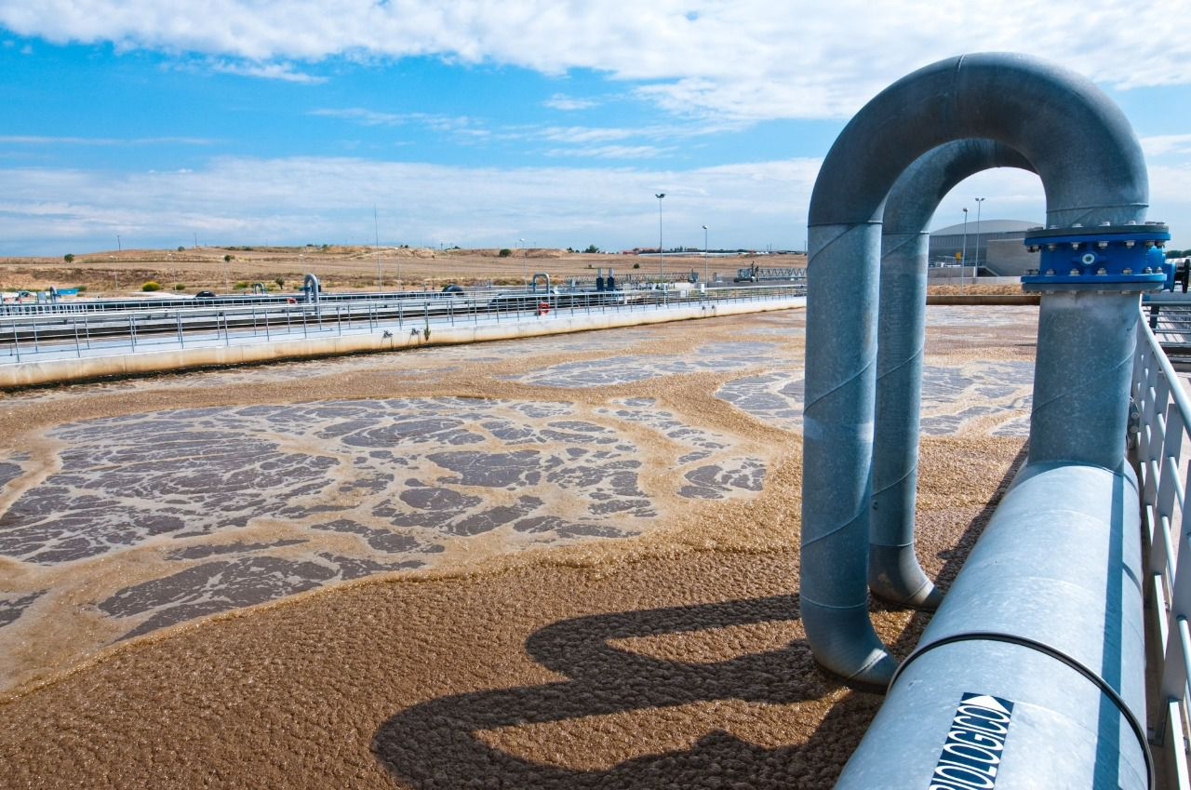
Treatment plants as biofactories
At Canal, waste has been transformed from a problem into an opportunity in terms of new raw materials and energy sources:
We use biogas to produce electricity and vehicle fuel. In 2022, we obtained almost 52 million cubic meters of biogas which in turn generated 350 million thermal kWh.
From the phosphorus contained in wastewater we produced 365 tonnes of struvite, a highly valued fertiliser.
We apply advanced cleaning treatments to sludge, a by-product of from wastewater treatment process, to be used as an excellent quality fertiliser. In addition, it can converted into into fuel for its use in cement plants, as it has a similar calorific value to lignite coal.

Slide 11



HUMAN SETTLEMENTS
Care of vulnerable people
Human settlements are dwindling in Spain. That said, we do supply drinking water to a few deprived areas off the grid. This service is carried out free of charge using tankers.
Social tariff
It’s been a while since our social tariff came of age. Since beginning in 1996, we have offered a water bill rebate for large families. This assistance provided by Canal continues to grow. Over the years, an increasingly wide cross-section of the population has benefited from rebates that reduce their bills.
> 260,000
beneficiaries
of social tariff

Slide 12
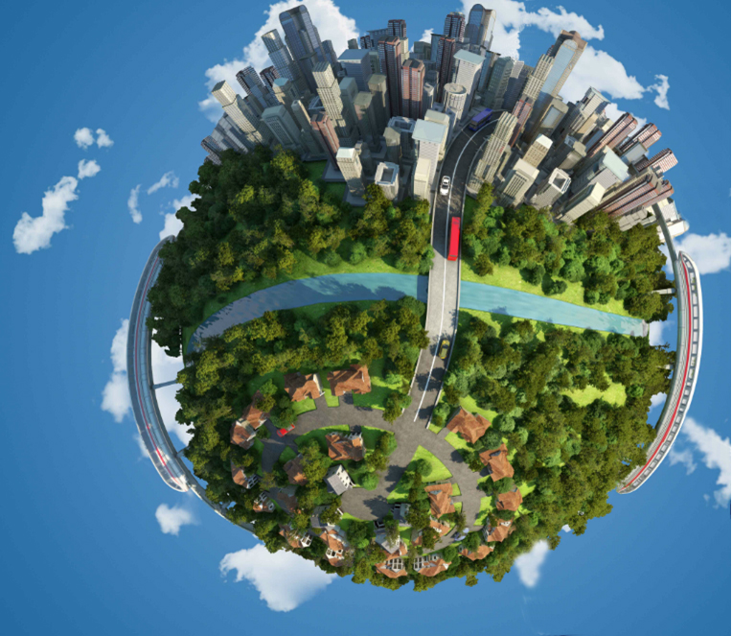
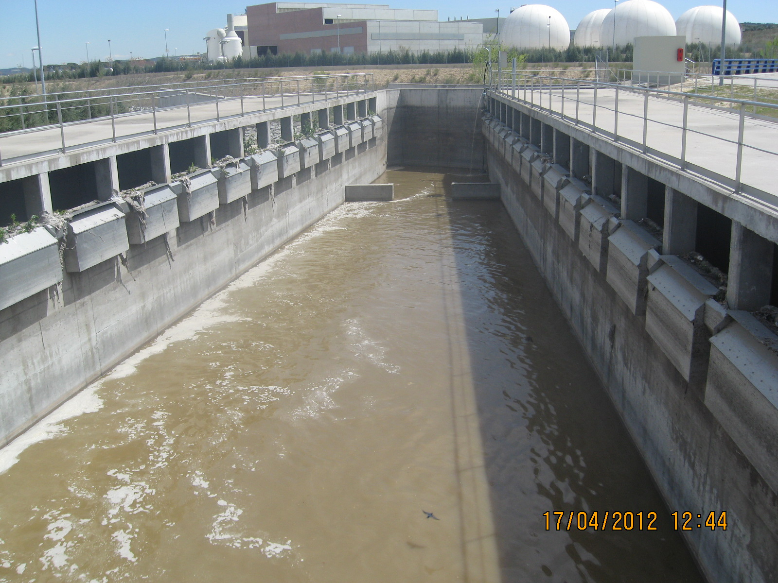
CONCLUSIONS (The future of cities)
Self-sustainability of environmental infrastructure is within reach
Canal de Isabel II has managed to guarantee water supply both in quality and quantity thanks to ambitious policies regarding efficiency, increased resources and sustained investment, by reinvesting the income from water in infrastructure development.
With regard to wastewater treatment, we have reached a point of almost zero-residue and significant self-sufficiency as far as energy consumption is concerned.
· Struvite and sludge are reused as fertiliser.
· Biogas is either used as an energy source for the wastewater process or fed as vehicle fuel.
Arrival collector

Slide 13

Thank you for your attention

