Slide 1
Capacity Building and Analytical Tools for Sustainable Integrated Energy and Water Solutions
Integrated Water and Energy Solutions supporting
Sustainable Cities and Human Settlements
HLPF 2023 Side Event
Hal Turton, Planning and Economic Studies Section, IAEA
14 July 2023
version 7 July 2023

Slide 2

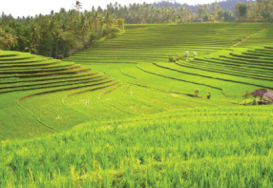

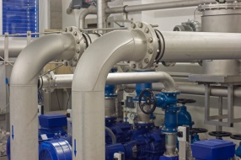





Energy, water, land & climate are critical to SDGs
…and closely linked
Energy (2021)
8.6% of global population without access to electricity
29% without access to clean fuels and technology
Water (2020)
26% without safe drinking water
46% without safe sanitation
Land / agriculture (2021)
770 million people undernourished (2021)
2.3 billion facing moderate or severe food insecurity
Climate (2021)
Emissions back at record levels after the pandemic
Record post-industrial average temperature; increasing frequency and severity of extreme climate events
Agriculture and energy account for 90% of freshwater withdrawals
Water supply/treatment consumes ~4% of electricity (up to 10% in some regions)
Crop production consumes 4–5% of final energy (entire food supply chain up to 30%)
Bioenergy: ~15% of global maize and oil seed output for biofuels in recent years
Energy, agriculture and land use contribute >90% of GHG emissions
Source: SDG Global Database, https://unstats.un.org/sdgs/dataportal
Sustainable resource planning must account for linkages between different resource systems
PESS.Contact-Point@iaea.org

Slide 3
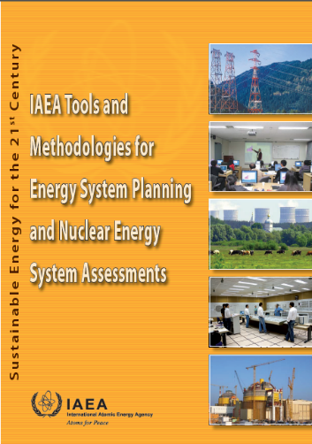
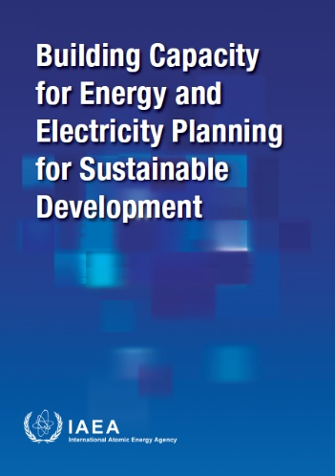
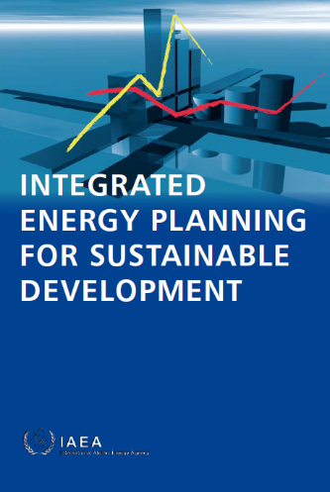
IAEA …
… assist Member States in reinforcing national capabilities to conduct energy system analysis, so that countries can assess options and develop their own sustainable energy strategies, i.e. support decision and policy making
…strengthen the provision of support to Member States in integrating the SDGs…through national and regional energy studies
PESS.Contact-Point@iaea.org

Slide 4










IAEA’s Capacity Building Program for Integrated Energy Planning*
Independent program and analytical tools
Up to date methodologies
Driven by Member States
Aimed at national experts/teams
* accounting for linkages with other resource systems (water, land, climate)
Distance learning
Field trainings
Expert missions
Advanced trainings
Teacher trainings
Fellowships
Ongoing support
External experts
Delivered via multiple channels
Public administration
Regulatory agencies
International organisations
Across complementary scales
Energy Sector & CONSULTANTS
Academic
General public
LOCAL
National
Regional
Interregional
PESS.Contact-Point@iaea.org
Notes:
IAEA’s Capacity building program is independent of third parties
Tools are developed in-house and are distributed free-of-charge to the IAEA’s Member States
Here note that things are changing as tools are increasingly being made available as open source
IAEA's Tools use up to date methodologies
Technologically neutral, suitable for small and large systems/countries, developed and emerging countries
IAEA's Capacity building program provided through Technical Cooperation
National, regional and inter-regional projects
IAEA's Support to Member States constantly available
AREAS WHERE MEMBER STATES MAY BENEFIT FROM IAEA ASSISTANCE
Supporting Member States’ energy development strategies, with or without an interest in assessing the role of nuclear power.
IAEA provides full scale service – model developments and updates, bug fixes, documentation – user manuals, different types of training – distance learning, national trainings, expert missions, hosting fellowships or in cooperation with other specialized organizations, advanced - teachers’ trainings, constant support to users, technical assistance in study conducts…
-----
Keep national teams in constant training
Combination of trainings and intermediate tasks
Distance learning
Field trainings
Expert missions
Advanced trainings
Teachers' trainings
Fellowships (on-the-job training)
Continuous Support (TSES – Tele Support Expert Service)
Supported by international experts
----
Base of users of energy models is large, and each institution will use models according to their needs. Sometimes the same models are used by various stakeholders in a different way in order to analyse
International institutions
Global development scenarios, policy directions and negotiations
Public/State governance and administration (Ministries)
Planning and development
Analysis of country position in regional and global context
Regulatory agencies (for energy)
Public service regulation
Market monitoring
Energy industry (companies, utilities, system operators)
Investment planning
Market and competition analysis
Risk management, research and development
Academic and research community (Universities)
Development and application of new methods and methodologies
Scientific work and research of new topics
Consulting companies
Services and analyses for clients in private and public domain
General public and non-governmental organizations

Slide 5


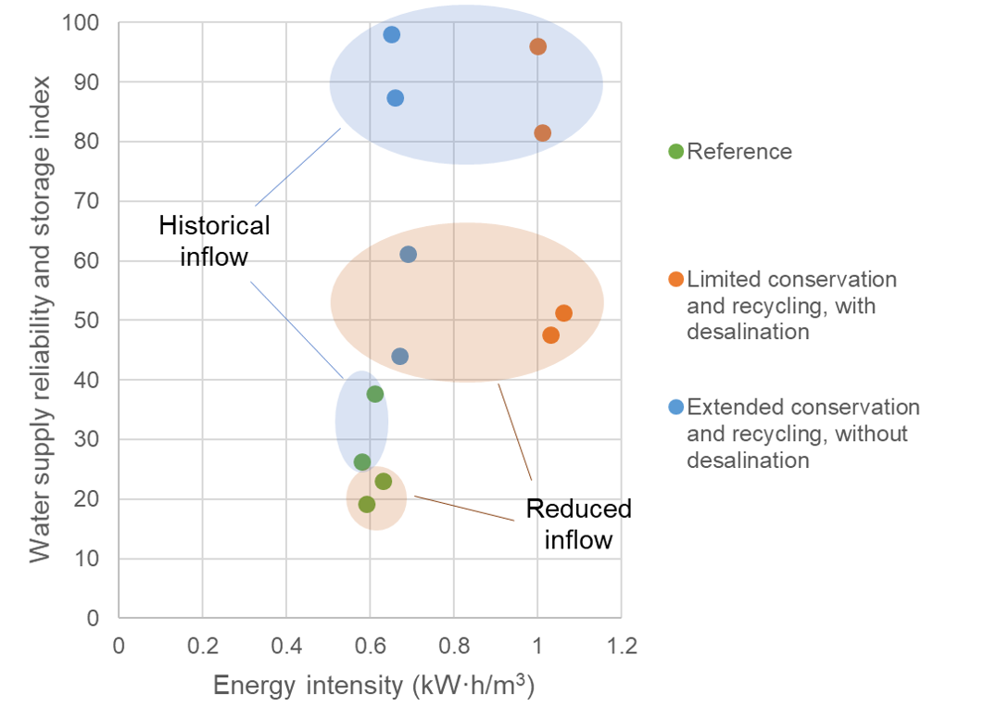
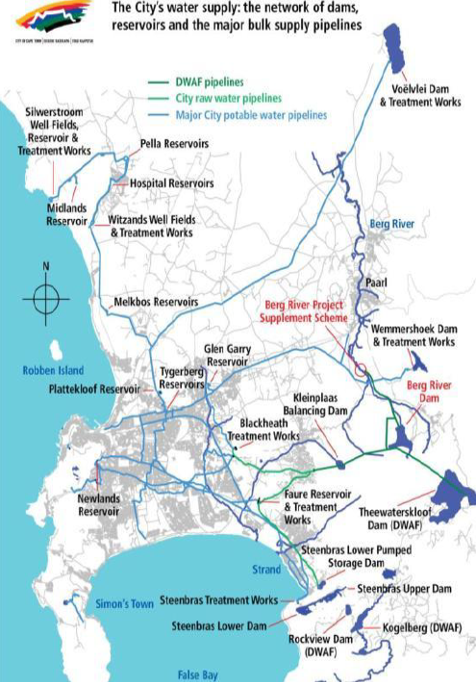
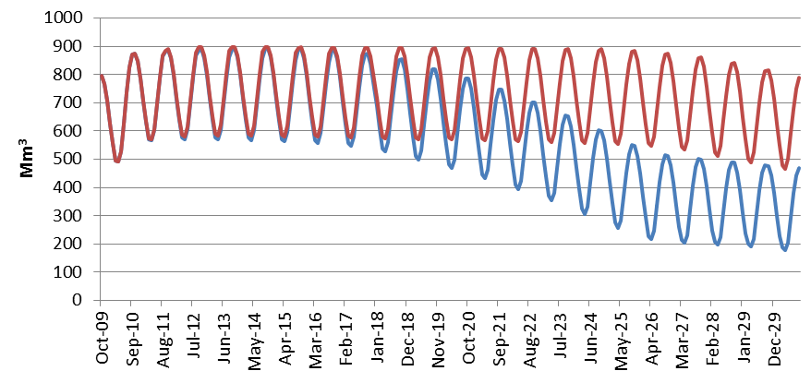
Example case study: climate, land, energy and water strategies in the City of Cape Town
CLEW
Climate, Land,
Energy and Water Nexus
Supported under IAEA Coordinated Research Project
Facing potential water shortages owing to increasing demand and climate change
Energy–water synergies & trade-offs
Simulated dam storage levels
Energy–water synergies and trade-offs across management options
Source: Ahjum, F., Hughes, A., Fant, C., Climate, Land, Energy and Water Strategies in the City of Cape Town, Energy Research Centre, University of Cape Town, Cape Town (2015).

Slide 6











At the core of the IAEA’s Capacity Building Cooperation – Collaborations – Partnerships
Provision of tools
Exchange of information
Joint training activities
Complementary in-country support
Events participation
PESS.Contact-Point@iaea.org
Notes:
Cooperation with other organizations
We are not sole organisations engaging in this activity
Cooperation with donors organisations (for implementation) – e.g. GIZ
Areas of cooperation
Provision of tools, exchange of information on countries and users, joint trainings, complementary country support, meeting/event participation
External partners
IRENA (International Renewable Energy Agency)
IEA (International Energy Agency)
UN DESA (UN Department of Economic and Social Affaires)
UN SD (UN Statistics Division)
UNIDO (UN Industrial Development Organization)
Regional UN commissions (UNECA, UNESCAP…)
ANL (Argonne National Lab, USA)
KTH (Royal Institute of Technology, Sweden)
…

Slide 7
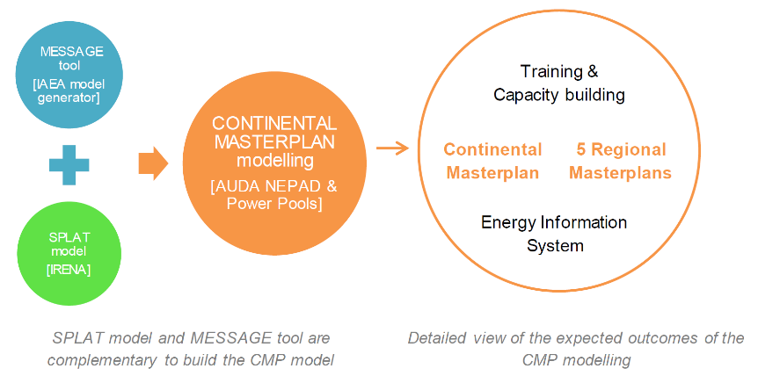
Example: IRENA–IAEA partnership for development of a Continental Power System Masterplan (CMP) for Africa
In 2018/2019, African Ministers, through the AU Specialised Technical Committee, directed the African Union Development Agency (AUDA-NEPAD) to lead development of a CMP
→ "blueprint" to solve Africa’s energy challenge
IAEA and IRENA selected by AUDA-NEPAD to provide modelling tools, support and training, along with advice, expertise and data
PESS.Contact-Point@iaea.org
Notes:
System Planning Test (SPLAT)

Slide 8
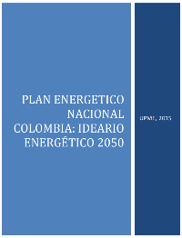
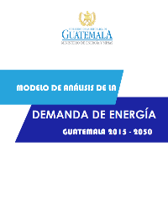
Looking ahead: supporting the development of integrated energy plans considering water, land and climate in Latin America and the Caribbean, 2024–2027
CLEW
2024
2025
2026
Sub-regional workshops to present national studies on energy, climate, land & water:
Regional trainings water-energy-climate modelling:
pre-2022
15 LAC countries, 250 experts of the MSs national teams trained in IAEA’s Energy Planning tools
National projects: Nicaragua, Guatemala, Saint Lucia
Expected results 2023: National capacities strengthened for developing energy policies and sustainable energy action plans
Mesoamerica & Caribbean
2027
Regional Project: “Supporting the Preparation of Sustainable Energy Development Plans at a Regional Level”
Project kick-off and energy-water-land-climate scoping workshop
2022-23
Mesoamerica & Caribbean
South America & Andean region
Mesoamerica & Caribbean
South America & Andean region
South America & Andean region
Regional workshop to present integrated methodology and example case study
South America & Andean region
Final workshop and coordination meeting
Mesoamerica & Caribbean
Regional workshops on energy modelling
Regional trainings on land use-energy-climate modelling:
Climate, Land,
Energy and Water Nexus
PESS.Contact-Point@iaea.org

Slide 9

Thank you! More on capacity building support and tools: PESS.Contact-Point@iaea.org
Notes:
Thank you!

Slide 10

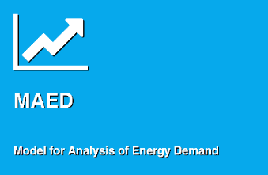
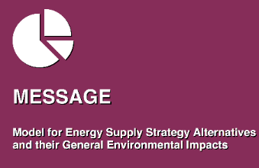
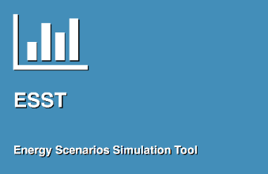
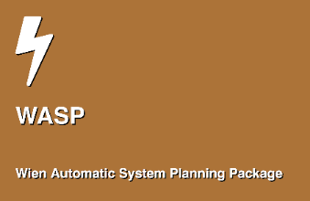
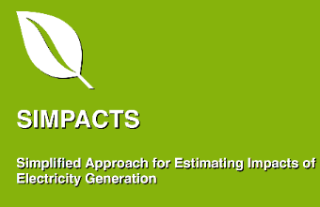
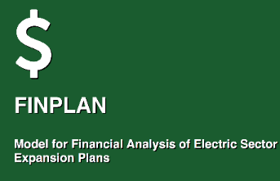

IAEA's Energy System Assessment Tools
Energy Statistics and Energy Balances compilation
Energy Demand Analysis and Projections
Energy Supply Optimization and Simulation
Energy Scenario Simulation Tool for fast estimates
EMPOWER
Macroeconomic
Analysis
Power Generation Investments and Expansion Planning
Analysis of Power Plants Environmental Impacts
Analysis of financial viability of power generation projects
Quantification of macroeconomic effects of strategies
PESS.Contact-Point@iaea.org
Notes:
Set of own energy system assessment tools and capacity building program covering whole energy planning process, available free of charge for MSs
Suite of the IAEA’s tools is designed to cover various stages of the energy planning process: data collection, statistics, energy demand analysis (here we strictly avoid term “forecasts”), energy supply simulation/optimization, power generation expansion, simplified environmental impacts, financial analysis …
Training in the use of models are always designed around certain topic and national experts develop national case studies to analyze various energy related questions and consequences of alternative energy policies

Slide 11
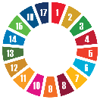

Frameworks for Energy System Assessments
CLEW
Concepts and sets of methodologies and approaches used to analyze various aspects of energy systems and interactions with other economic activities or elements
Climate, Land,
Energy and Water Nexus
Climate, Land and Water use and Energy Interactions
ISED
Indicators of Sustainable
Energy Development
Energy, Economy, Environment and Social interactions
SEA
Strategic Environmental
Assessment (Nuclear)
SEA of National Nuclear Power Program
PESS.Contact-Point@iaea.org
Notes:
Concepts and sets of methodologies and approaches used to analyze various aspects of energy systems and interactions with other economic activities or elements
Application of frameworks is supported by tools
ISED (Indicators of Sustainable Energy Development)
ISED framework is a series of ‘snapshots’ of indicators reflecting interaction of energy with economic, environmental and social pillars of sustainable development over time
CLEW (Climate-Land-Energy-Water)
Climate, land-use, energy, and water methodology to analyse complex interactions between key resources and climate change
SEA (Strategic Environmental Assessment)
Process to ensure that environmental impacts arising from policies, plans & programmes are considered

