Slide 1
Gonzalo Sáenz de Miera
Director of Climate Change and Alliances
Integrated Water and Energy Solutions supporting Sustainable Cities and Human Settlements
United Nations Headquarters
New York
14 July 2023

Slide 2
Renewables as key instrument for a sustainable energy and water model
We are facing multiple crises simultaneously: climate, energy, water, biodiversity...
All of them have a common origin, an energy model based on fossil fuels, and a common solution, renewable energies.
The good news is that thanks to the technological revolution, clean energies, particularly renewables, have become a competitive solution that offers cheap, clean energy while consuming less water.
Renewables are an essential tool for energy transition and for successfully addressing climate change and water scarcity.
Renewable energies consume less water than fossil fuels, but their development should be aligned with greater harmony with nature and people.
Notes:
Joining forces

Slide 3
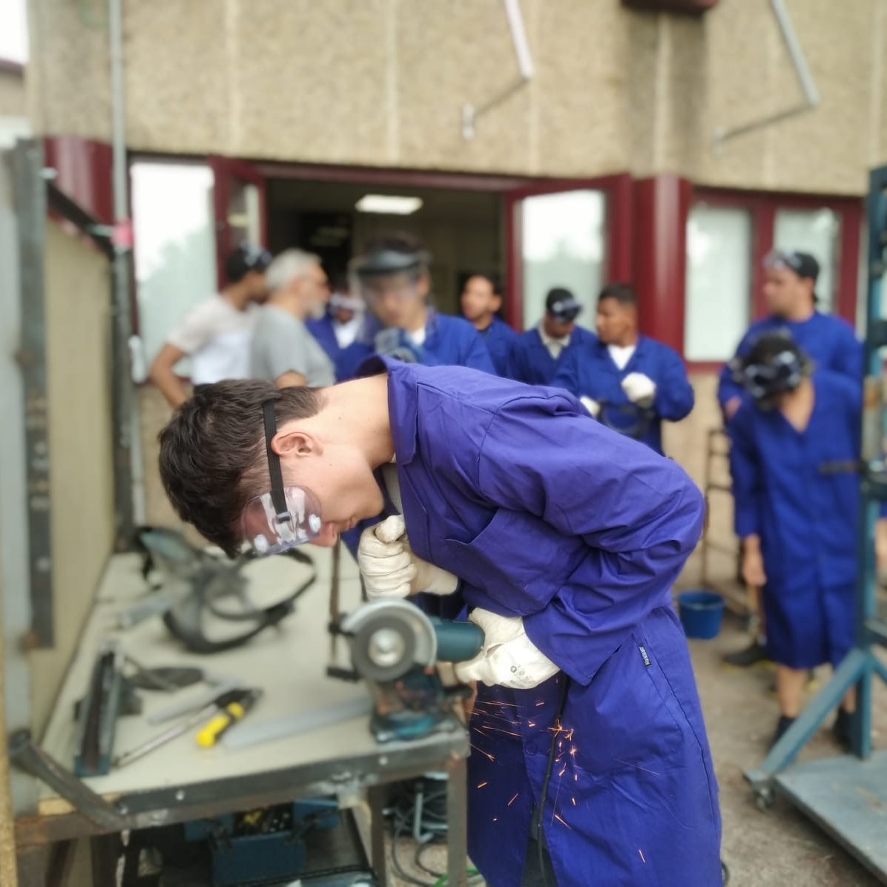
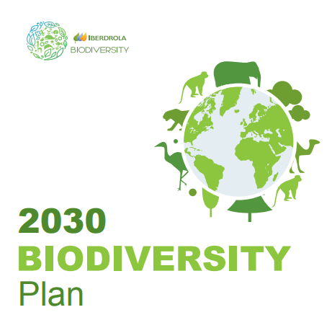
Renewables deployment, positive for people and nature
Living
Together
People
Nature
Alliances
Industry
Jobs
Integrate landuse
Biodiversity Plan:
2030 – net positive impact on biodiversity
Ambitious approaches
Local communities
Conservation hierarchy (avoid, reduce, restore)
Nature Based Solutions
Expert dialogues
Results
Awareness
Notes:
Joining forces

