Slide 1

Integrated Water and Energy Solutions supporting Sustainable Cities and Human Settlements
Edgar Herrera
Executive Director –LAICA-
United Nations
July 14th, 2023

Slide 2
Thanks everyone for making it to New York on this very important event!! My appreciation to the organizers for inviting me to this prestigious international meeting
So, we all made it here!!
We all required energy to get here

Slide 3
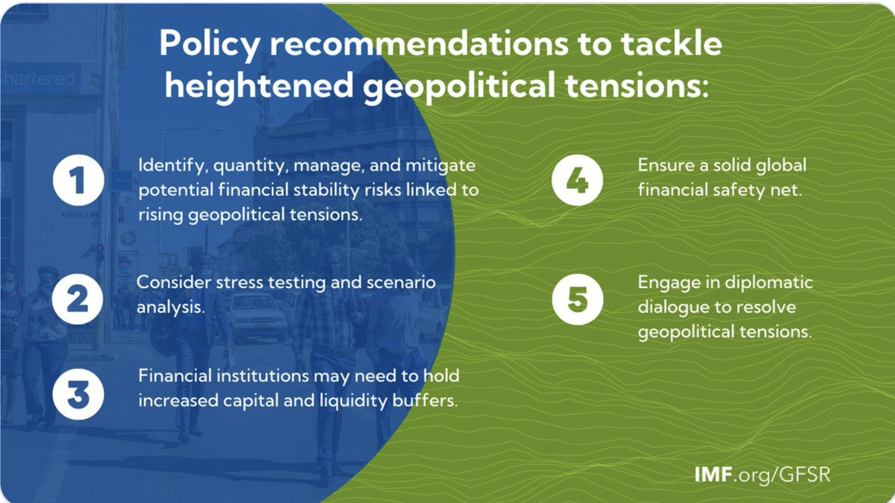
In today’s world and real environment and geopolitical scenario... Does it matter more how we got here? Let’s look at the recent IMF recommendations to countries:

Slide 4
The world entered a new phase of global instability and climate change deepens its effects.
We’ve moved from times of relative stability to the restart of war conflicts at major scales.
The recent and still ongoing wars has had worldwide repercussions and has brought a renovated spirit to those who are not in agreement of respecting the world order... And the human being continues to try to eliminate the human being...
Some of the major repercussions have already been felt :
  The human drama of forced migrations.
  Interruption in the flow of vital food ... New famines...
  Interruption in the flow of vital feedstocks on a worldwide basis.
  Countries have prohibited food and fertilizer exports in order to safeguard their interests and security.
  Vital sources of energy interrupted definitively or on a temporary basis.
  The world remains distracted from sustainability and the serious climate change consequences we are living that are threatening survival of the human being.
What is missing in IMF recommendations?

Slide 5
With absolute reason, one of the concerns of the nations of the world is how to feed their population and how to guarantee water and food supplies. The efforts are clear and forceful. The richest countries on the planet subsidize agricultural producers for reasons of social balance and guarantee of food sovereignty.
But... We still have a long way to go in terms of food, water supply and energy security and, if we are all here is because we acknowledge the problem.
The integration of water and energy solutions and the holistic management and utilization of water and energy resources in a coordinated manner are fundamental to support human settlements. These solutions aim to address the interdependencies between water and energy systems, maximize resource efficiency, and promote sustainability.
However, it’s clear that we are not doing enough.
WE CANNOT CONTINUE POSTPONING DECISIONS
What was missing in IMF recommendations
Energy, water and Food Security

Slide 6
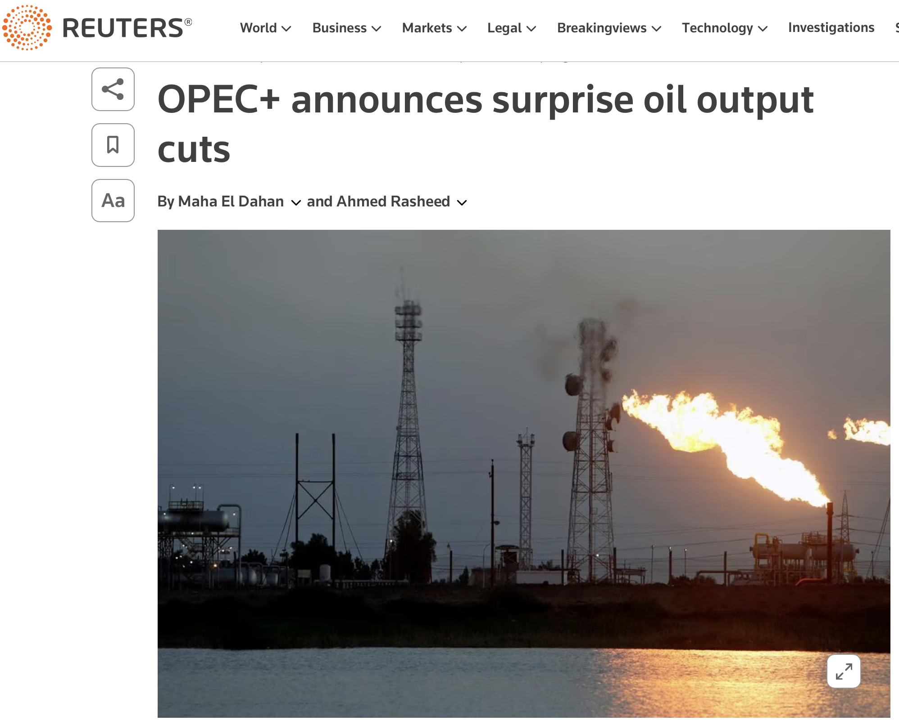
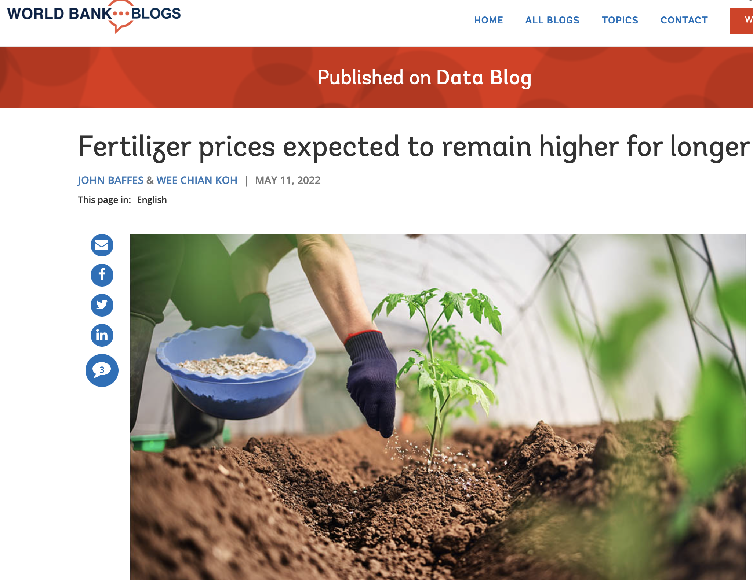
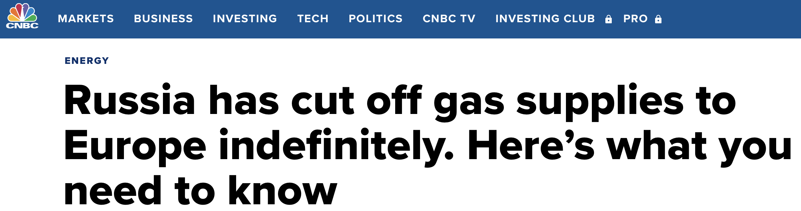

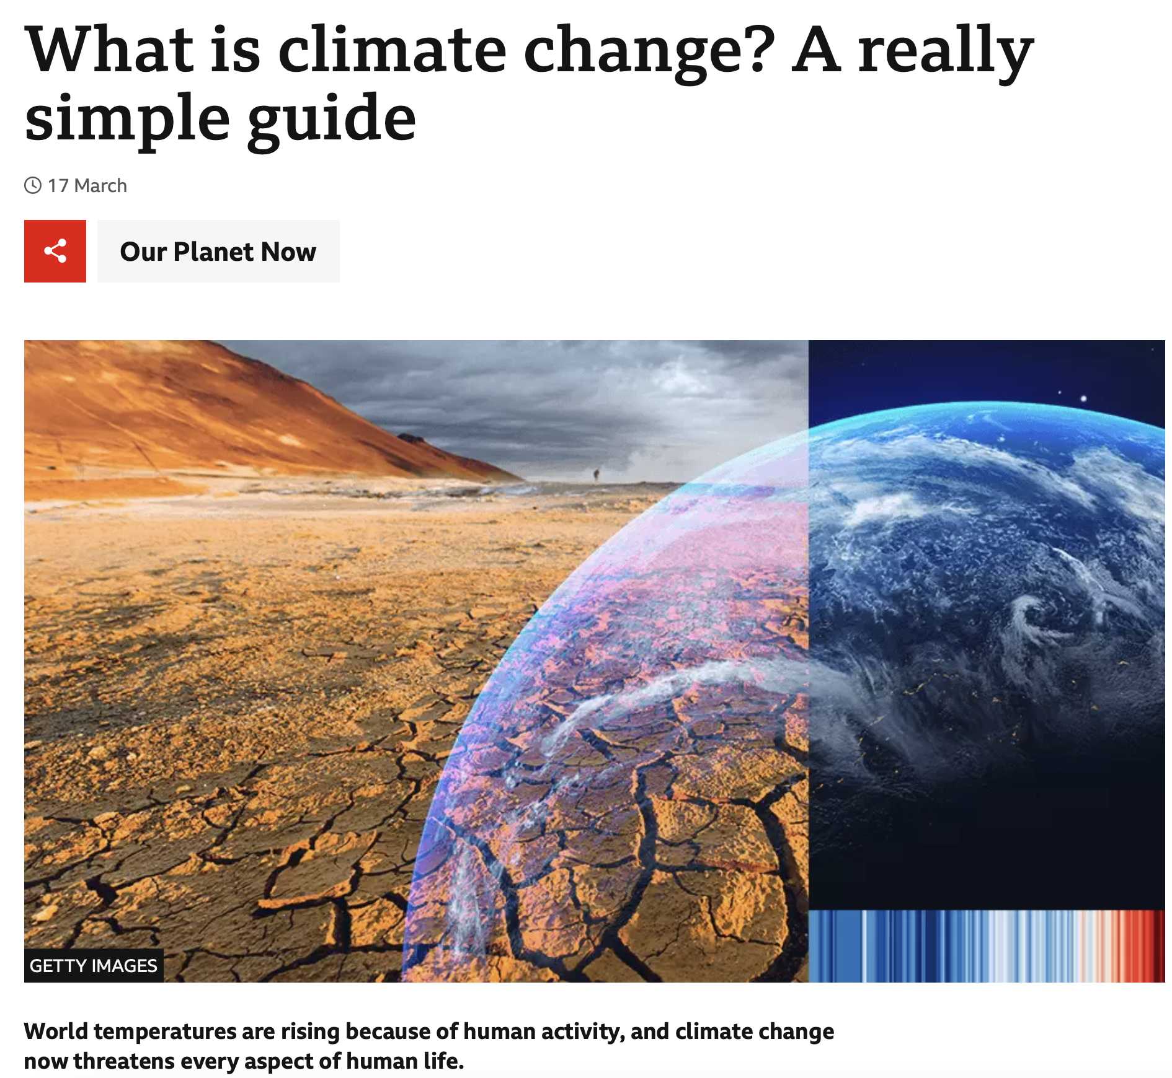
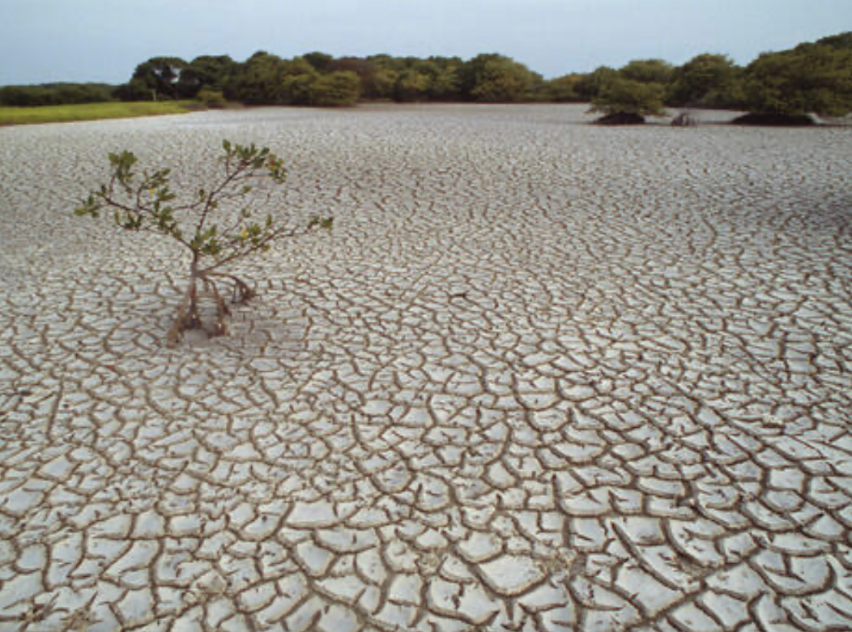

Slide 7
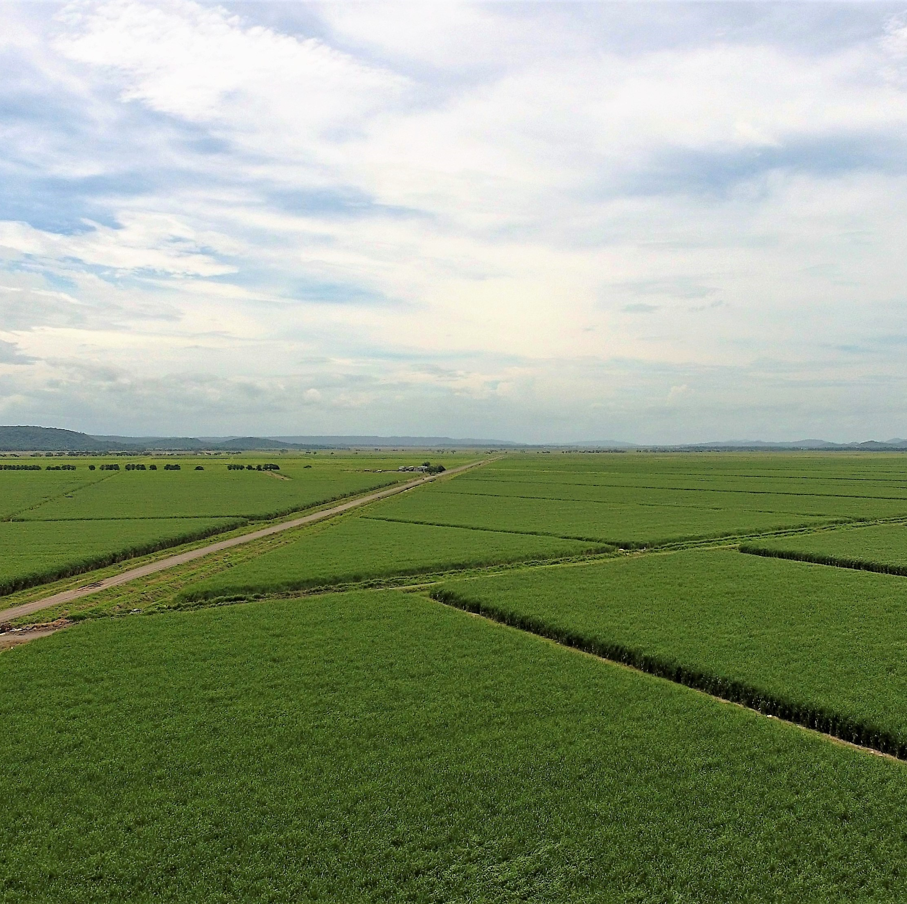
An example from the energy standpoint:
As part of the future and the different new options, we have in front of us a source of renewable and clean energy that brings benefits to our societies
Renewable
Clean and proven
Employment in rural areas
Energy & Food Security

Slide 8
Energy, water supply and food security becomes dramatically crucial
Many countries are vigorously developing new alternative energy sources based on their natural and competitive advantages. Here we find: solar, electric, ethanol and maybe, in the farther future, hydrogen.
Countries that are dependent on imported energy sources should have turned their eyes towards those that with great foresight that have already developed new alternatives.
ETHANOL represents an energy source that has met and continues to meet the fundamental requirements for energy independence:
It is sustainable.
It does not run out as it comes from renewable sources.
Proven technology (Since 1973 Brazil created the “Pro-álcool” program, after the oil crisis).
Reduces the pressure for “hard” currency (Dollars) for the purchase of hydrocarbons.
It translates into a generator of employment and booster of the rural economy (Where we need it most)
The technology has been supported by the world's largest car manufacturers such as: Chevrolet, Fiat, Ford, Peugeot, Renault, Volkswagen, Honda, Mitsubishi, Citroen and Toyota.

Slide 9
ENERGY SECURITY BECOMES DRAMATICALLY CRUCIAL FOR CENTRAL AMERICAN COUNTRIES
Energy Security: The region is heavily dependent on imported oil for its energy needs, which makes it vulnerable to price volatility and supply disruptions. The use of biofuels can help reduce dependence on foreign oil and enhance energy security.
Economic Development: The production of biofuels provide opportunities for rural development and job creation, particularly in areas with limited economic opportunities. The development of a domestic biofuels industry also help to reduce trade imbalances and strengthen the regional economy.
Environmental Sustainability: Biofuels reduce greenhouse gas emissions and improve air quality, which is important for the health and well-being of the population. The use of biofuels can also help to reduce deforestation and promote the use of sustainable agricultural practices.
Diversification of Energy Sources: The use of biofuels can help diversify the region's energy sources, reducing the reliance on fossil fuels and increasing the use of renewable energy.
Overall, the development of a biofuels industry can bring many benefits to the Central American region, including enhanced energy security, economic development, environmental sustainability, and diversification of energy sources.

Slide 10
WHAT DO WE NEED URGENTLY: Generate the Environment for Growth
Water- Food & Energy Nexus: Integrated solutions acknowledge the interdependencies between water, food and energy systems, emphasizing the importance of considering the three sectors together. This approach enables a more comprehensive understanding of resource management and allows for the identification of synergies.
Efficient Water Use: Integrated solutions promote efficient water use practices within human settlements. This includes implementing water-saving technologies, such as low-flow fixtures and efficient irrigation systems, and promoting awareness among residents about water conservation.
Renewable Energy Integration: Integrated solutions prioritize the integration of renewable energy sources within water systems. For example, solar energy can power water treatment plants or be utilized for heating water, reducing dependence on fossil fuels and lowering greenhouse gas emissions.
By adopting clear public policies related to integrated water, food and energy solutions, human settlements will achieve greater resource efficiency, reduce environmental impacts, and enhance overall sustainability. Moreover, human settlements will achieve greater resource efficiency, reduce environmental impacts, and enhance overall sustainability.

Slide 11
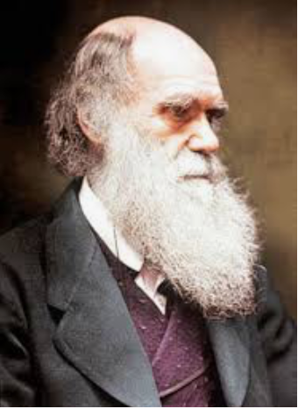
Act Different, Think Different and Make a Difference... Because:
“It is not the strongest of the species that survives,
not the most intelligent that survives.
It is the one that is the most adaptable to change.”
“Those who survive are the ones who most accurately perceive their environment and successfully adapt to it”
Charles Darwin
1809-1882
If the evidence is here among us… Why not moving ahead before it is too late?

Slide 12
Thanks!

