Slide 1
Integrated Water and Energy Solutions supporting sustainable cities and Human Settlements
Doris Edem Agbevivi
Energy Analyst Energy Commission

Slide 2
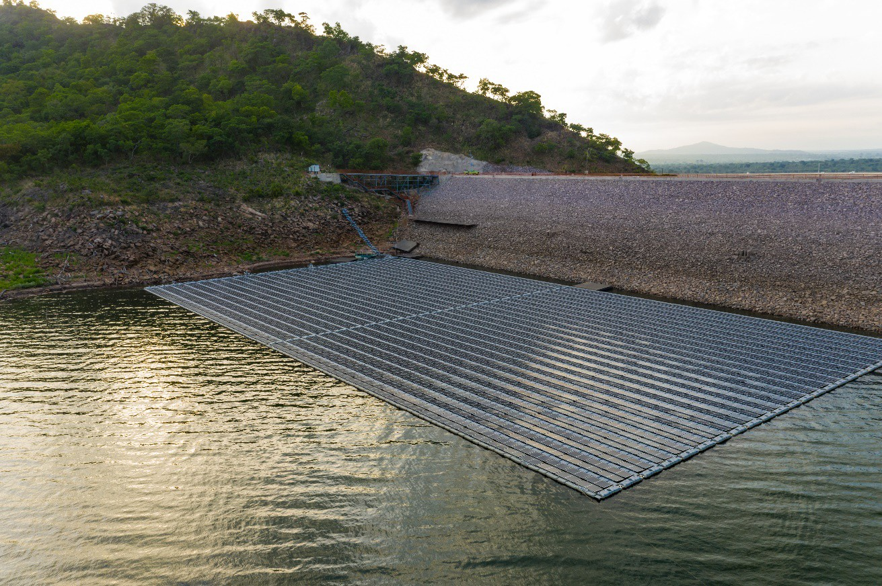
Case Studies+ Bui Power Plant
400 MW Generating Station
5MWp Floating Solar on the reservoir
•

Slide 3
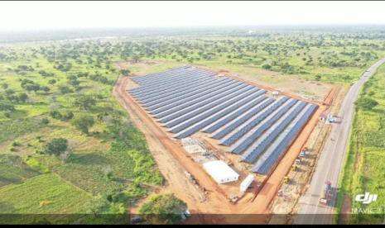
Volta River Authority (VRA) ‘s 6.5MW Lawra solar power plant

Slide 4
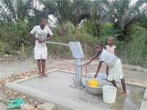
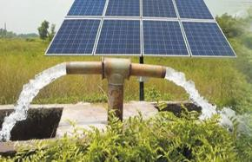
Case Studies
The need to produce water as well as treat it depends on renewable energy in water production and treatment to bring down cost
Achieving safe treatment of waste water and energy preferably renewable energy options
Safi Sana is a Dutch business that builds systems for generating energy from biological waste

Slide 5
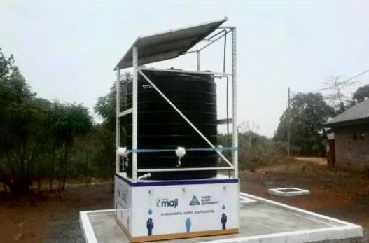
Solar&powered Water Facilities
VRA built solar powered water facility for the people of Volo in the North Tongu District of Ghana

Slide 6
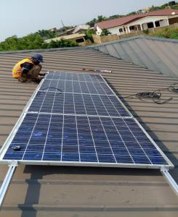
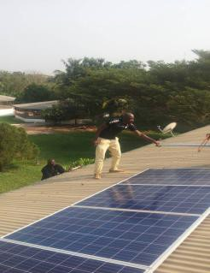
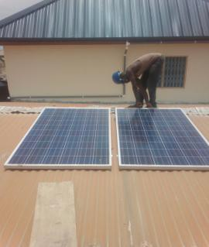
Solar programs
2018 rollout of a national rooftop solar program aiming to install 200 MW of rooftop solar across the country.
A total of 1083 confirmed installations in the urban areas and rural off=grid households

Slide 7
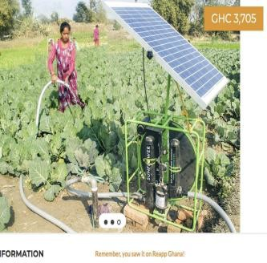
Success Stories
Some local Ghanaian projects that leverage energy5water include solar5powered water pumps as an alternative to piped water
Agriculture accounted for 80% of withdrawals in SSA
Oxfam’s solar energy pilot project in Kpatua, Ghana 5 a new well is powered by 10 solar panels
that can generate 1,800 watts.
5 10 households, primary school and clinic have access to renewable energy.
5 solar lamps distributed to 100 households.
5 Solar Irrigation for farming in almost every region in the country some privately funded while others

Slide 8
Success Stories
ENI signed an MOU with the VRA aimed at developing solar energy projects on the Volta Lake through the deployment of floating solar energy technologies
Construction of the Pwalugu Multipurpose power plant comprising 60MW hydro power hybridized with a 50MW solar plant by the VRA has also commenced.
45Kw microMhydropower plant known as Tsatsadu Generating Station (TGS)

Slide 9
Key Challenges facing policy makers who aim to create an enabling environment for Investments and innovation
Poor coordination of policies and decisions and sectors working in silos
Uncertainty in water investment, investment priorities and sustainable development
Challenging investment climate
Perceived risk by financial sector
Financing terms and high commercial interest rates
High inflation
Currency depreciation
Uncertainty around pricing of renewables technologies elevates perceived risk factor
Limited availability of experienced personnel to undertake technology and feasibility
assessments as well as construct.
Difficulty in transforming the waterBenergy nexus concept into a reality due to limited
understanding. Those working in the two industries often spoke different "languages",
had different perspectives and a different way of looking at things.

Slide 10
Way Forward
More Priority in investments that promote the two sectors e.g Solar powered irrigation
An integrated approach to these two sectors both in policy and investment decisions
Inter;ministerial/sectoral representation on projects and involving local assemblies
Addressing data gaps and encouraging data use in a harmonized water;energy
ecosystem
Local initiatives require national frameworks to support them, national policies can
benefit from supportive global goals such as the SDGs and forums like like and more
Water and energy Nexus is very strong (Fatima Denton, UNECA)

Slide 11
References
Energy Statistics, Energy Commission
WHO/UNICEF Joint Monitoring Programme (JMP) report July 2017
GLSSS 7, Ghana statistical Service
Sklarew D., Sklarew J. (2018) Integrated WaterP Energy Policy for Sustainable Development.
Foresight and STI Governance, vol. 12, no 4, pp. 10–19. DOI: 10.17323/2500P2597.2018.4.10.19
https://allafrica.com/stories/202007240915.html
https://citinewsroom.com/2020/10/akufoPaddoPcommissionsPlawraPsolarPpowerPplant/
https://www.afrik21.africa/en/ghanaPbpaPtoPsupportPthePbuiPdamPwithPaP250PmwpPpvPsolarP farm/
https://reapp.com.gh/thePsf1PsolarPwaterPpump/ (solarPpump)
https://businesszoneonline.com/2020/10/28/6thPghanaPrenewablePenergyPfairPgovtPtoutsPkeyP interventionsPrePprojectsPinPenergyPsector/
https://www.oxfam.org/en/oxfamsPsolarPenergyPprojectPlightsPruralPvillagePghana

Slide 12
