Slide 1
Activities of the Guatemala Sugar cane Agroindustry supporting Sustainable Cities and Human Settlements
Andrea Bolaños Coloma
Sustainability Director
New York, July 2023

Slide 2
Agenda
Introduction: Guatemalan Sugarcane Agroindustry
The Guatemala Sugar Agroindustry supports the cities and territories within its area of influence:
Economic: access to electricity, Infrastructure and economic development
Social: Reduction of poverty and chronic child malnutrition
Environmental: access to safe water

Slide 3
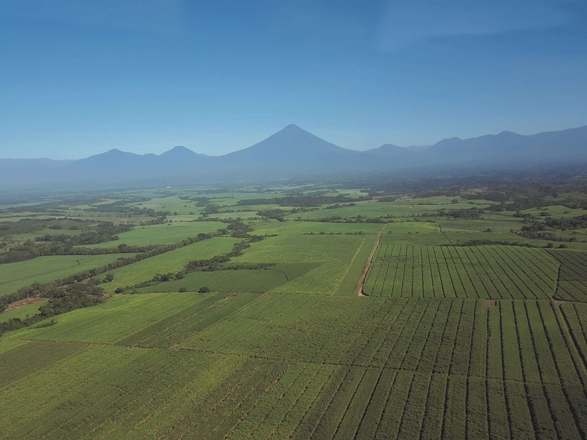
Guatemalan Sugarcane Agroindustry

Slide 4
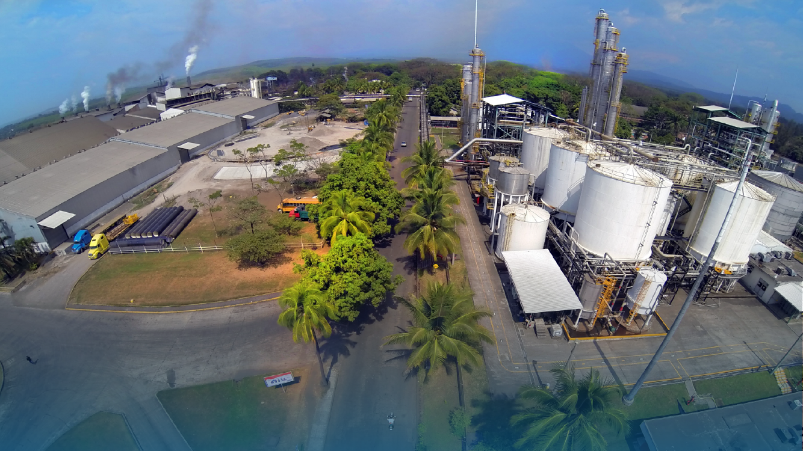
11 SUGAR MILLS
Concepción
Pantaleon
Palo Gordo
Madre Tierra
Santa Teresa
La Sonrisa
La Unión
Santa Ana
Magdalena
El Pilar
Trinidad

Slide 5
Development and Growth
Union Organization
Social Development
Investigation
and development
Export
Mitigation
and adaptation
to climate change
Innovation
1957
1990
1992
1994
2010
2022

Slide 6
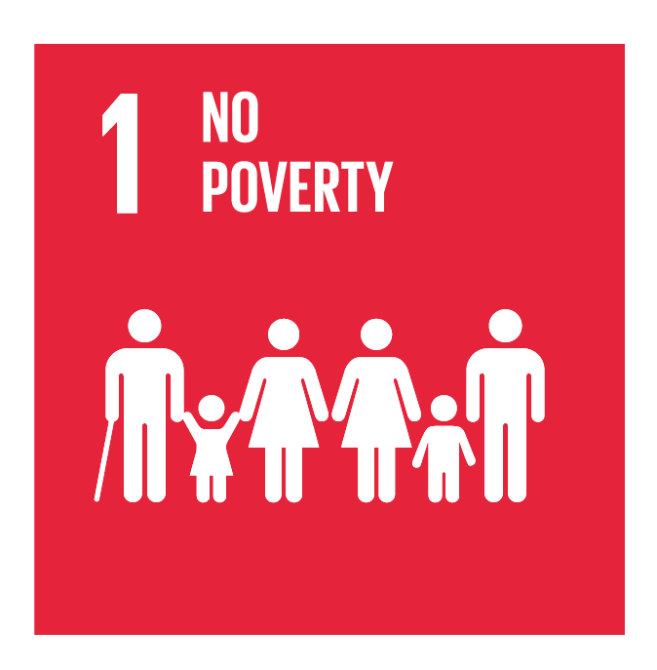
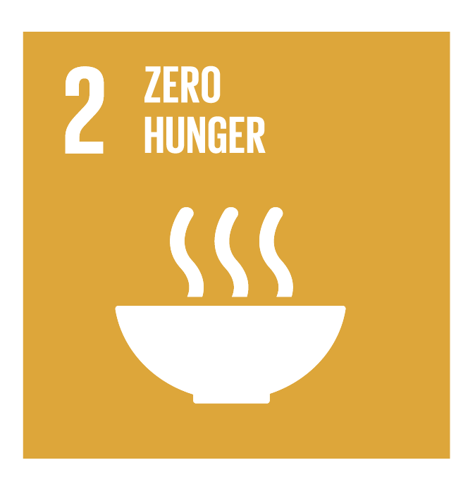
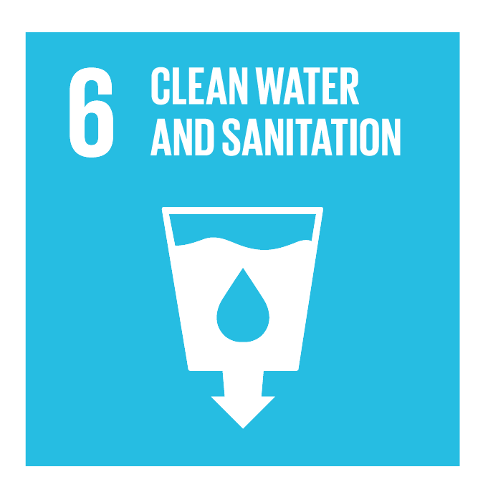
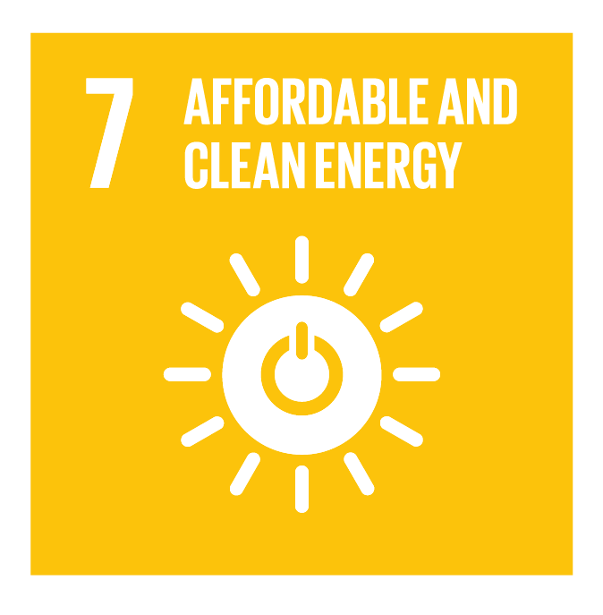
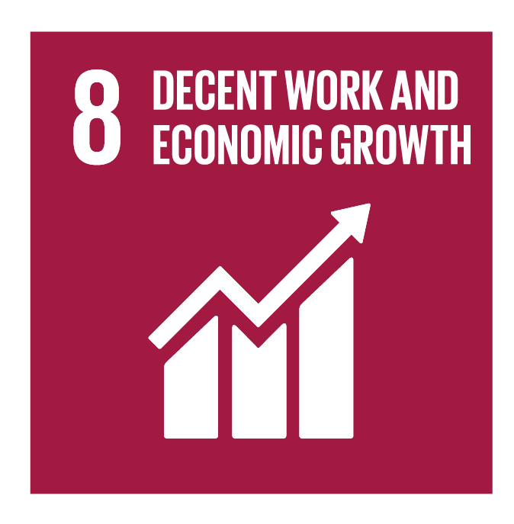
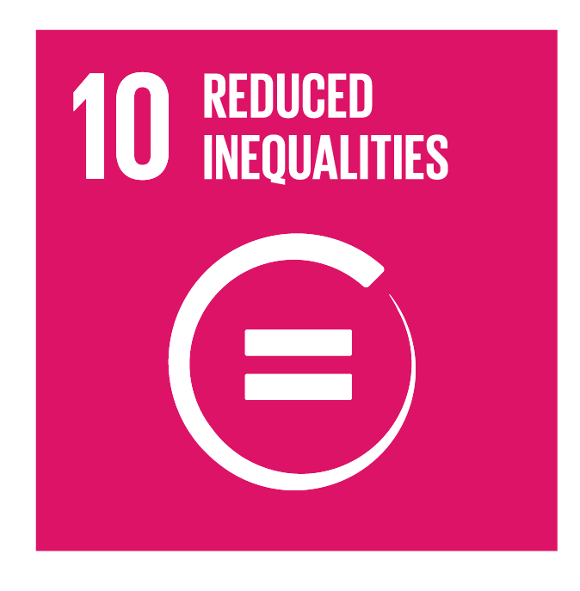
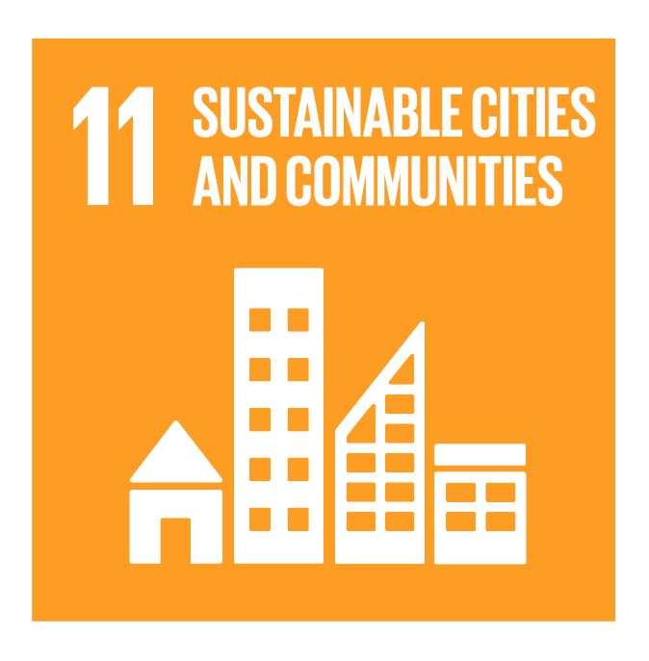
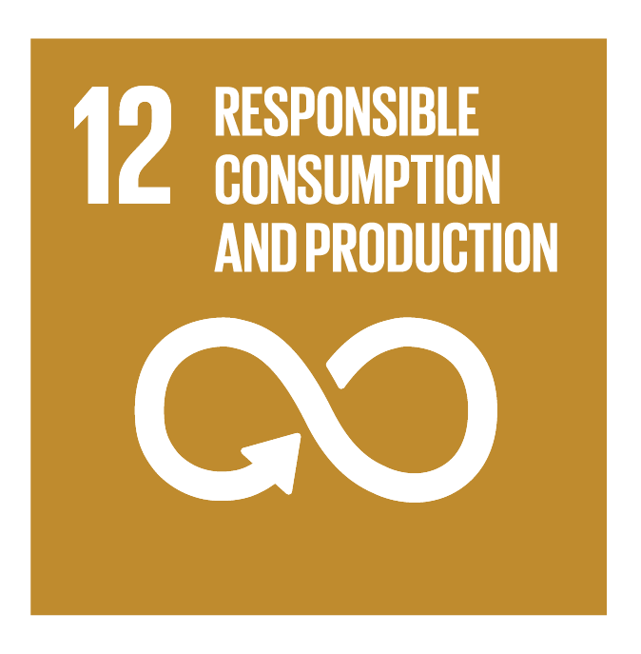
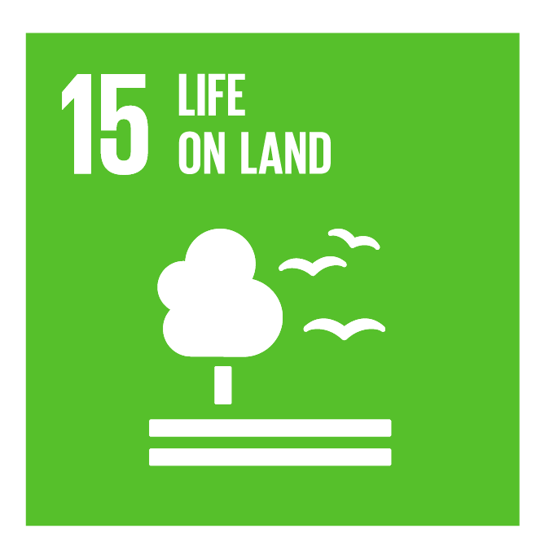
Asazgua is committed to promoting the implementation and achievement of the goals and targets of the 2030 Agenda.

Slide 7
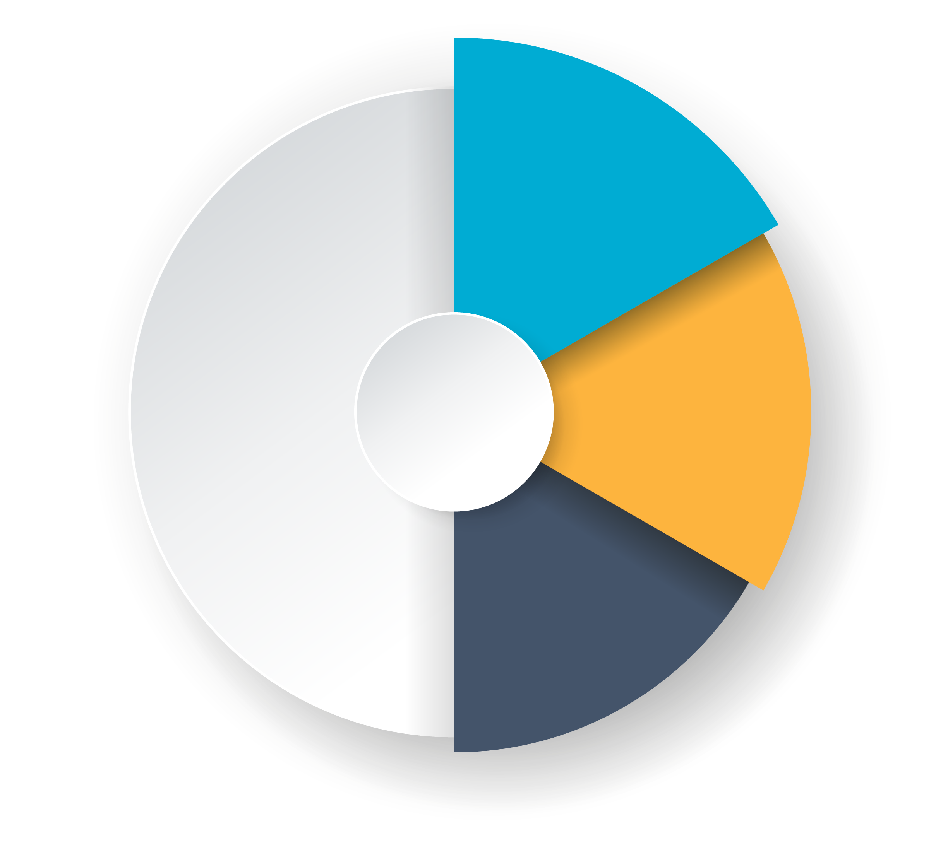
Our
strategy
Environment
Social
Governance

Slide 8
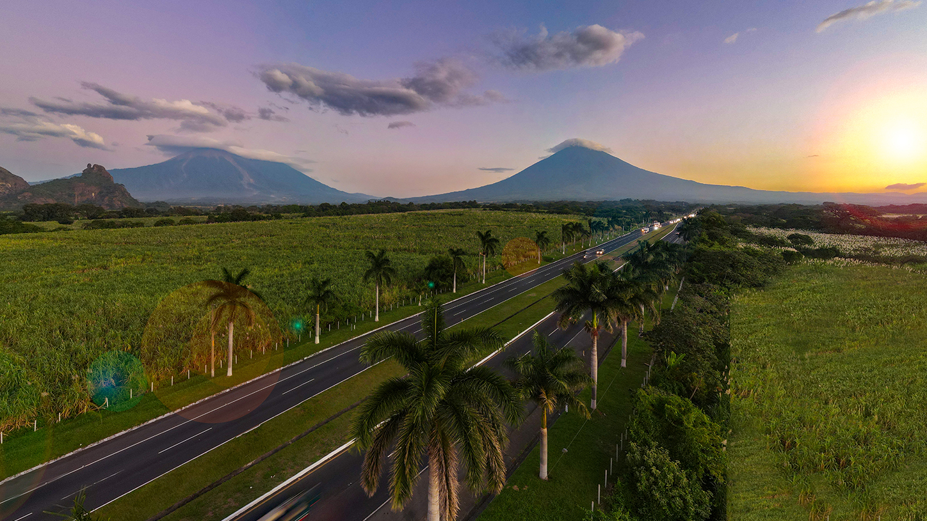
The Guatemala Sugar Agroindustry supports the cities and territories within its area of influence

Slide 9
Economic
Sustainable Cities and
Communities
Social
Environment

Slide 10
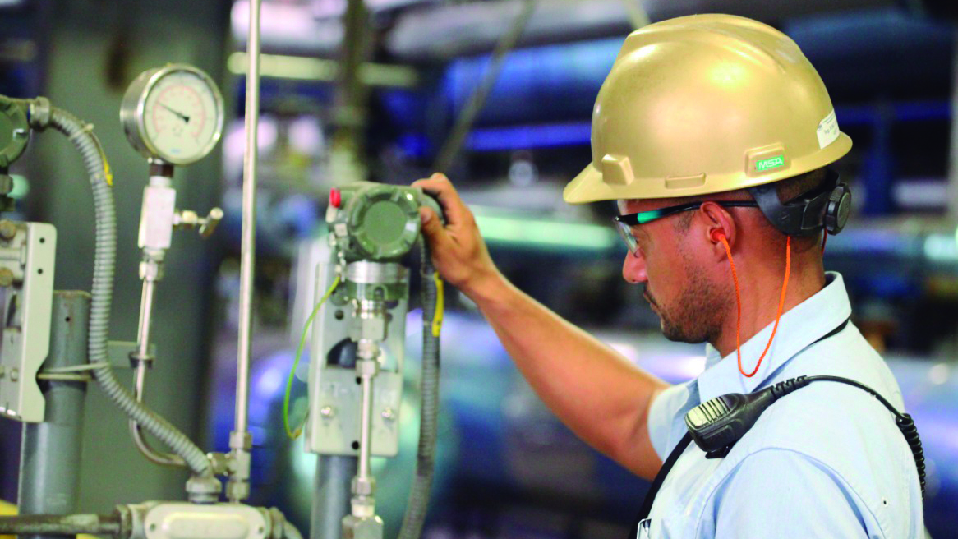
Sustainable Cities and Communities
Economic

Slide 11
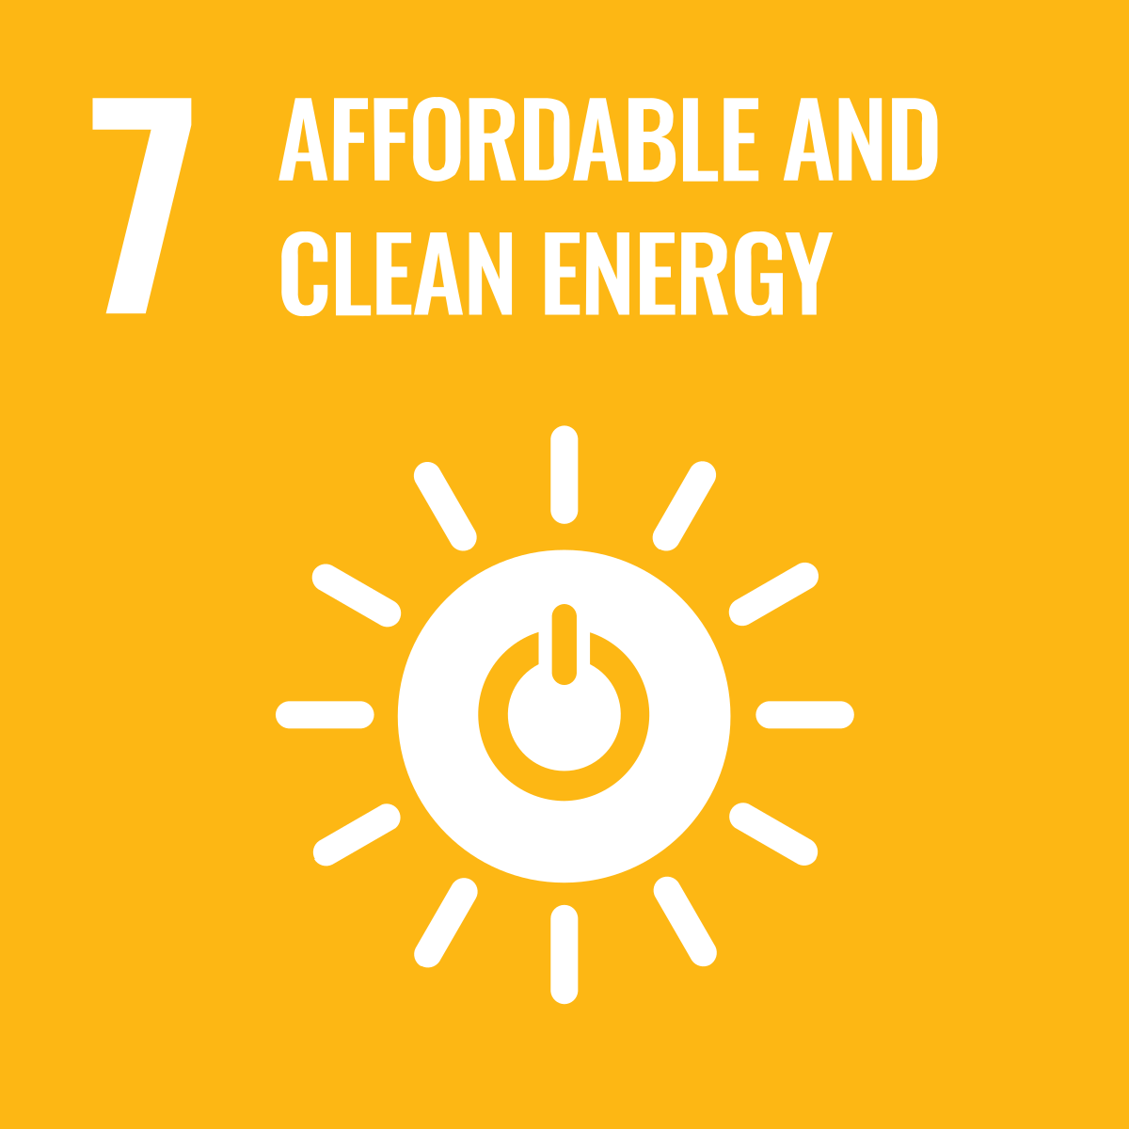
91%
of the electricity used by the sugar agroindustry for the 2021-2022 harvest season is generated using sugarcane bagasse.
Economic
Access to electricity: The role of The Sugar Agroindustry as a provider of renewable, reliable, and sustainable electricity to Guatemala
27% of the electricity generated by the sugar agroindustry was contributed to the National Matrix during the 2021 – 2022 harvest.
4 million tons of CO2
were prevented from reaching the environment.

Slide 12
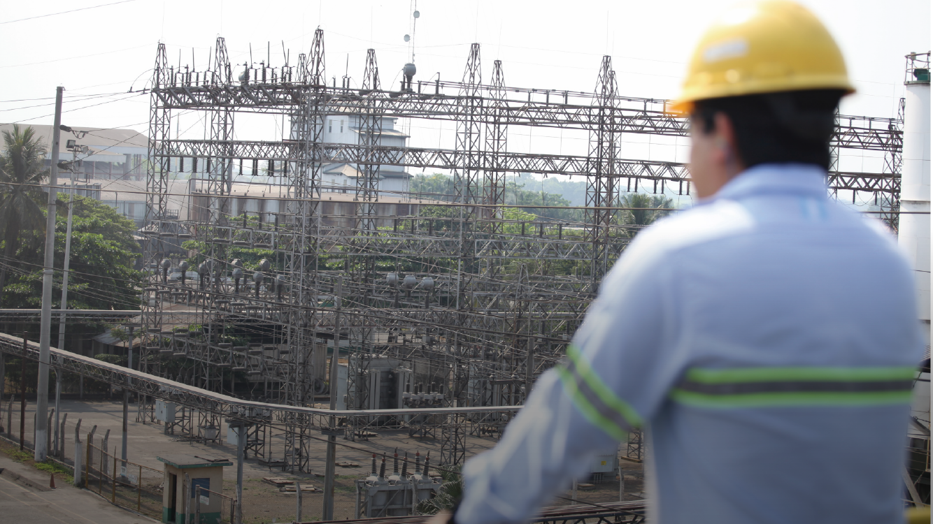
Today, power plants and related industrial infrastructure for electricity generation from sugarcane bagasse built by the Sugar Agroindustry contributes to the social, economic, and environmental sustainability of Guatemala
Economic

Slide 13
Expogranel is playing a key role in the successful exportation of sugar from Guatemala.
Economic

Slide 14
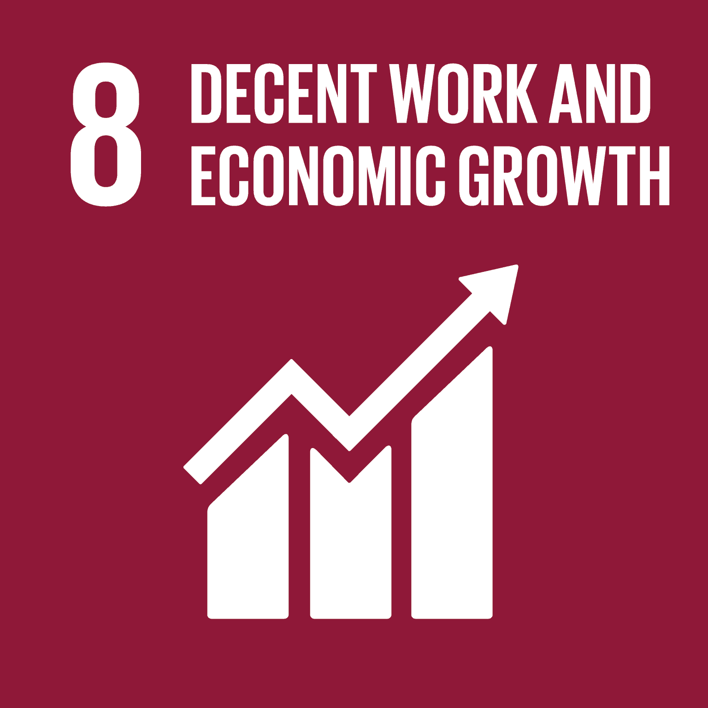
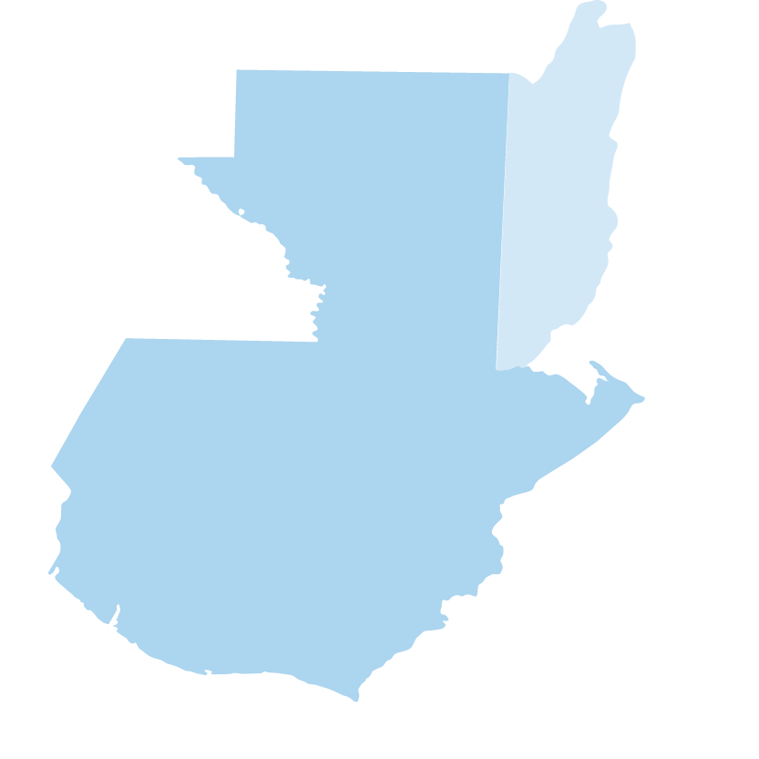
55,000
direct jobs
Economic
278,000
indirect jobs
Jobs and Economic
Development
More than 6,000 companies -small, medium and large-, are suppliers of goods and services
90%
of the country’s municipalities.
324,000
families depend on the Guatemalan Sugar Industry

Slide 15
Sustainable Cities and Communities
Social

Slide 16
Better Families Program
Social

Slide 17
Trained more than
532,000 women in Guatemala
and Honduras.
Social
Better Families
Program
Reduction of poverty and chronic child malnutrition by up to 7%.

Slide 18
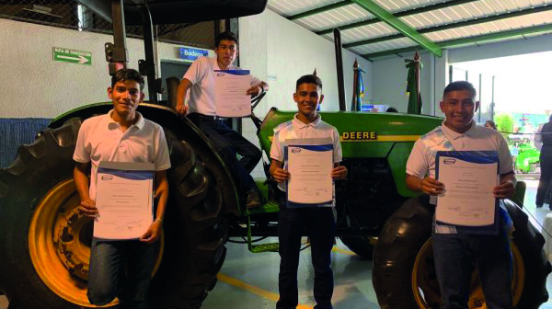
Program of Opportunities to Study (Scholarships)
Social

Slide 19
Provided
scholarships to over 2,700 students
Graduates of different careers that allow to find work in many areas of interest in the country.
Industrial Mechanics,
Automobile Electromechanics,
Industrial Electronics, Maintenance of hydraulic circuits, Computers, etc.
The program is open to students between
15 and 25 years old

Slide 20
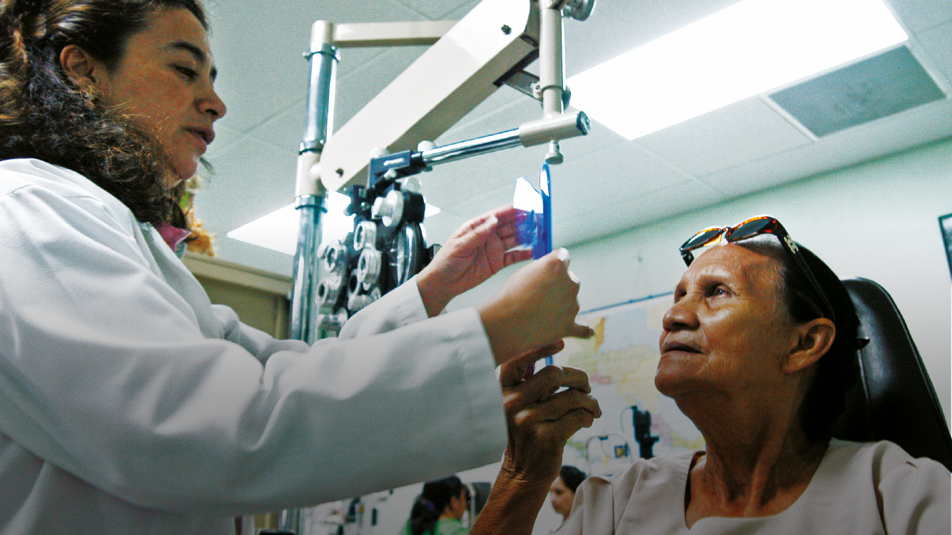
Fundazúcar Medical Clinic
Social

Slide 21
To over 45,000
patients to essential health services every year.
Social
5 medical specialties:
general medicine, pediatrics, dermatology, ophthalmology and odontology. It also provides pharmacy, laboratories and optic services.
Fundazúcar
Medical Clinic

Slide 22
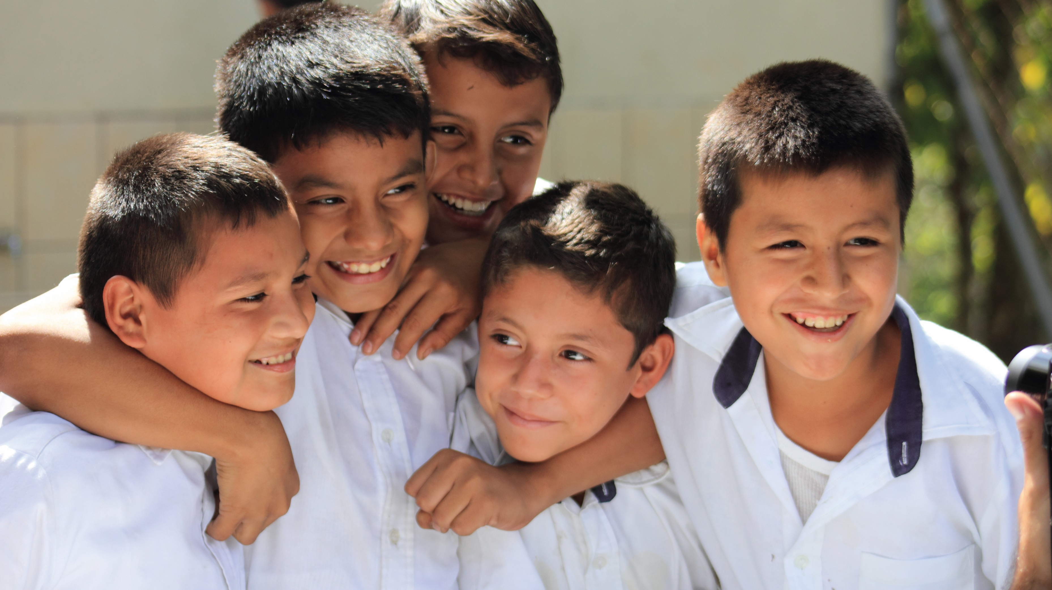
Fortification of Sugar with Micronutrients:
Vitamin A and Iron
Social

Slide 23
The Guatemala Sugar Agroindustry
started the fortification of sugar with vitamin A in 1975.
Since 2016 Fundazúcar in partnership with the Ministry of Health implements the innovative program “My Health First”.
After the fortification of sugar with vitamin A, the percentage of children with blindness was reduced from
26.2%
in 1965/1967
to 16%
in 1995/1996
And to 0.3%
in 2009/2010.
Notes:
Al final puede cerrar con:

Slide 24
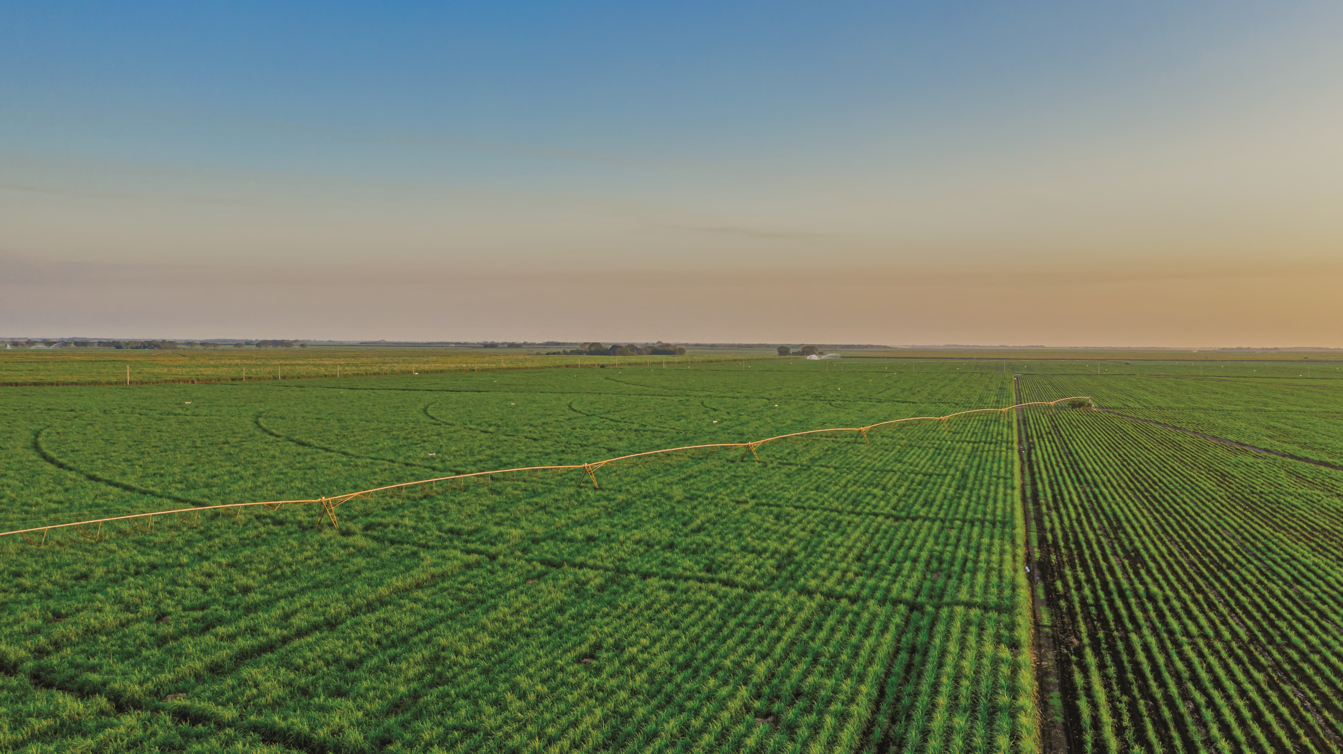
Sustainable Cities and Communities
Environment

Slide 25
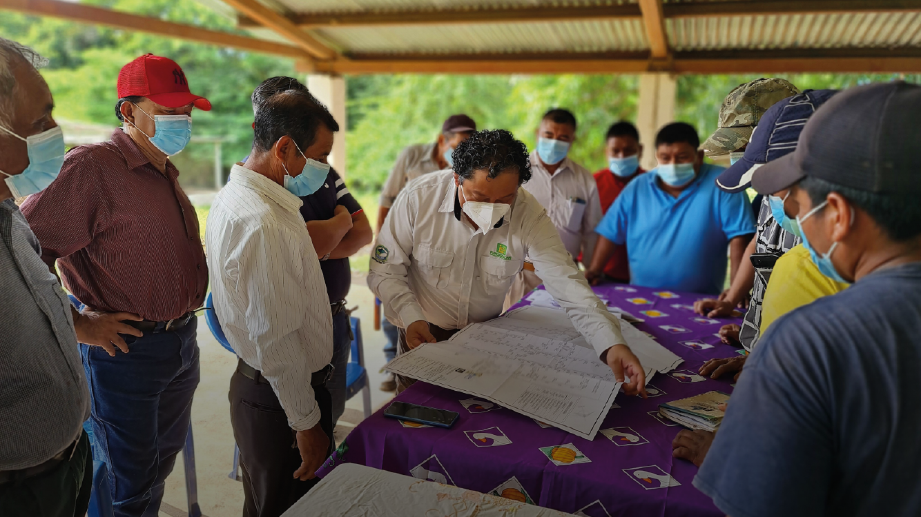
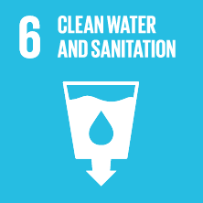
Water Supply and Wastewater: Water and sanitation
Environment

Slide 26
290
Infrastructure studies
Currently 12 new projects are being built and
45 already have approved funds.
Environment
Water Supply and Wastewater
129
have been enabled by the
Community management.

Slide 27
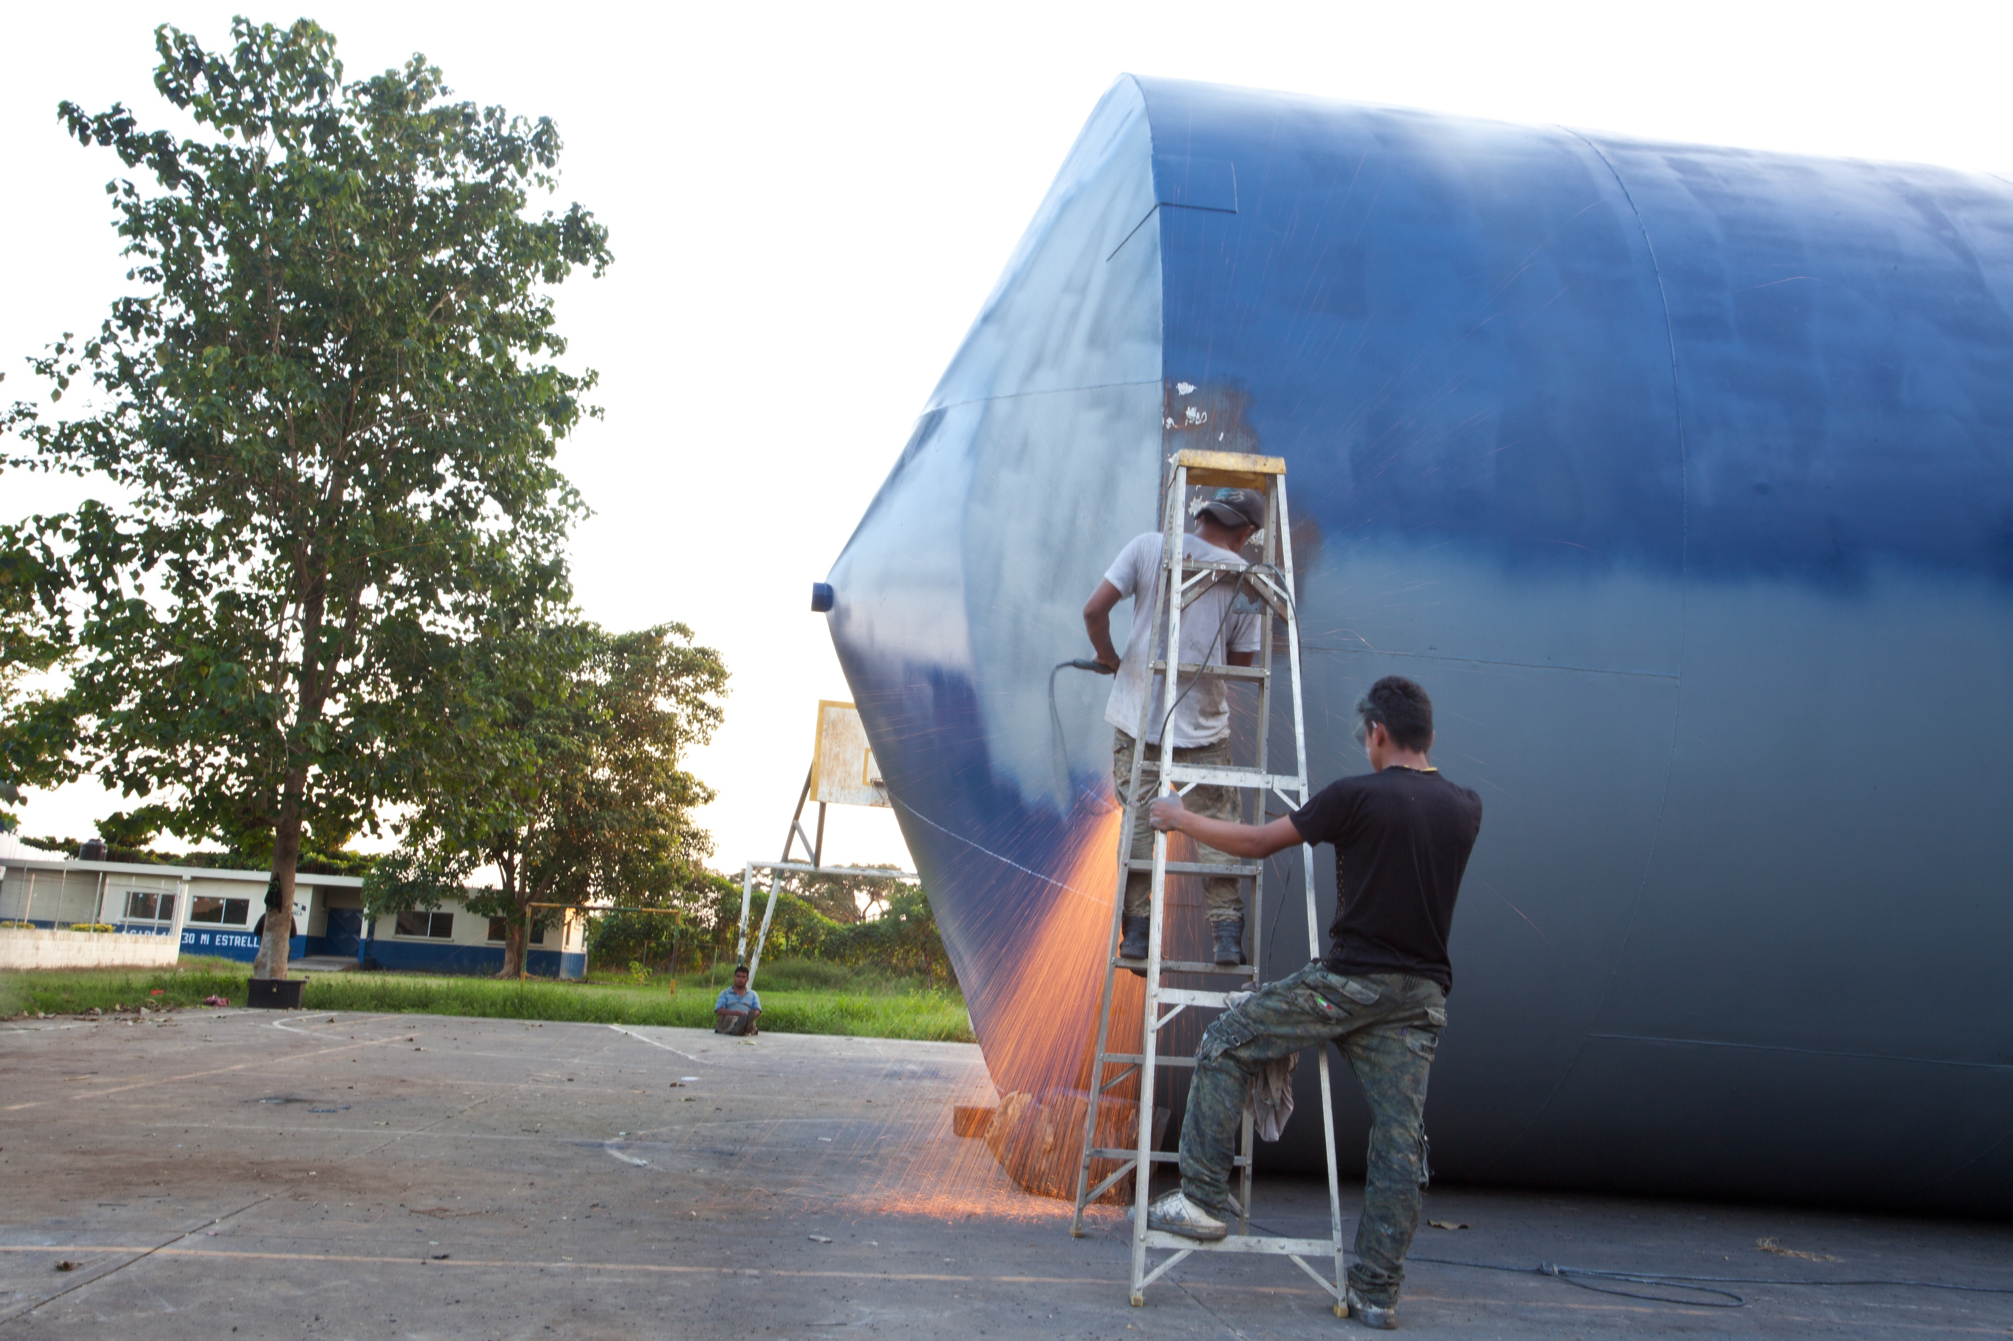
Environment
Support to communities and municipalities in the management of water and health including potable water systems (design and construction) through Fundazúcar.

Slide 28
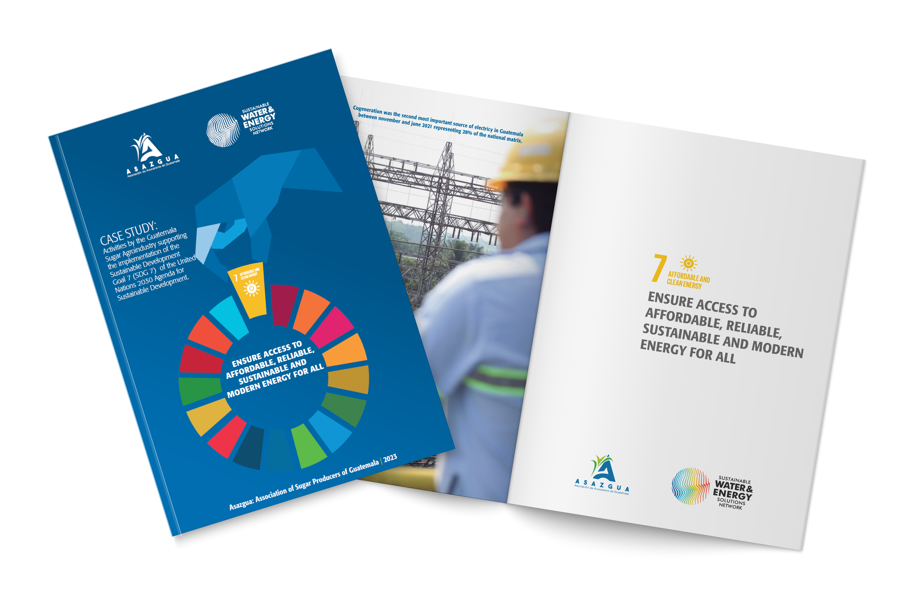
We understand our role as generators of opportunities and prosperity for millions of people in Guatemala.
Knows the contributions of the sector to the achievement of the Sustainable Development Goals

Slide 29
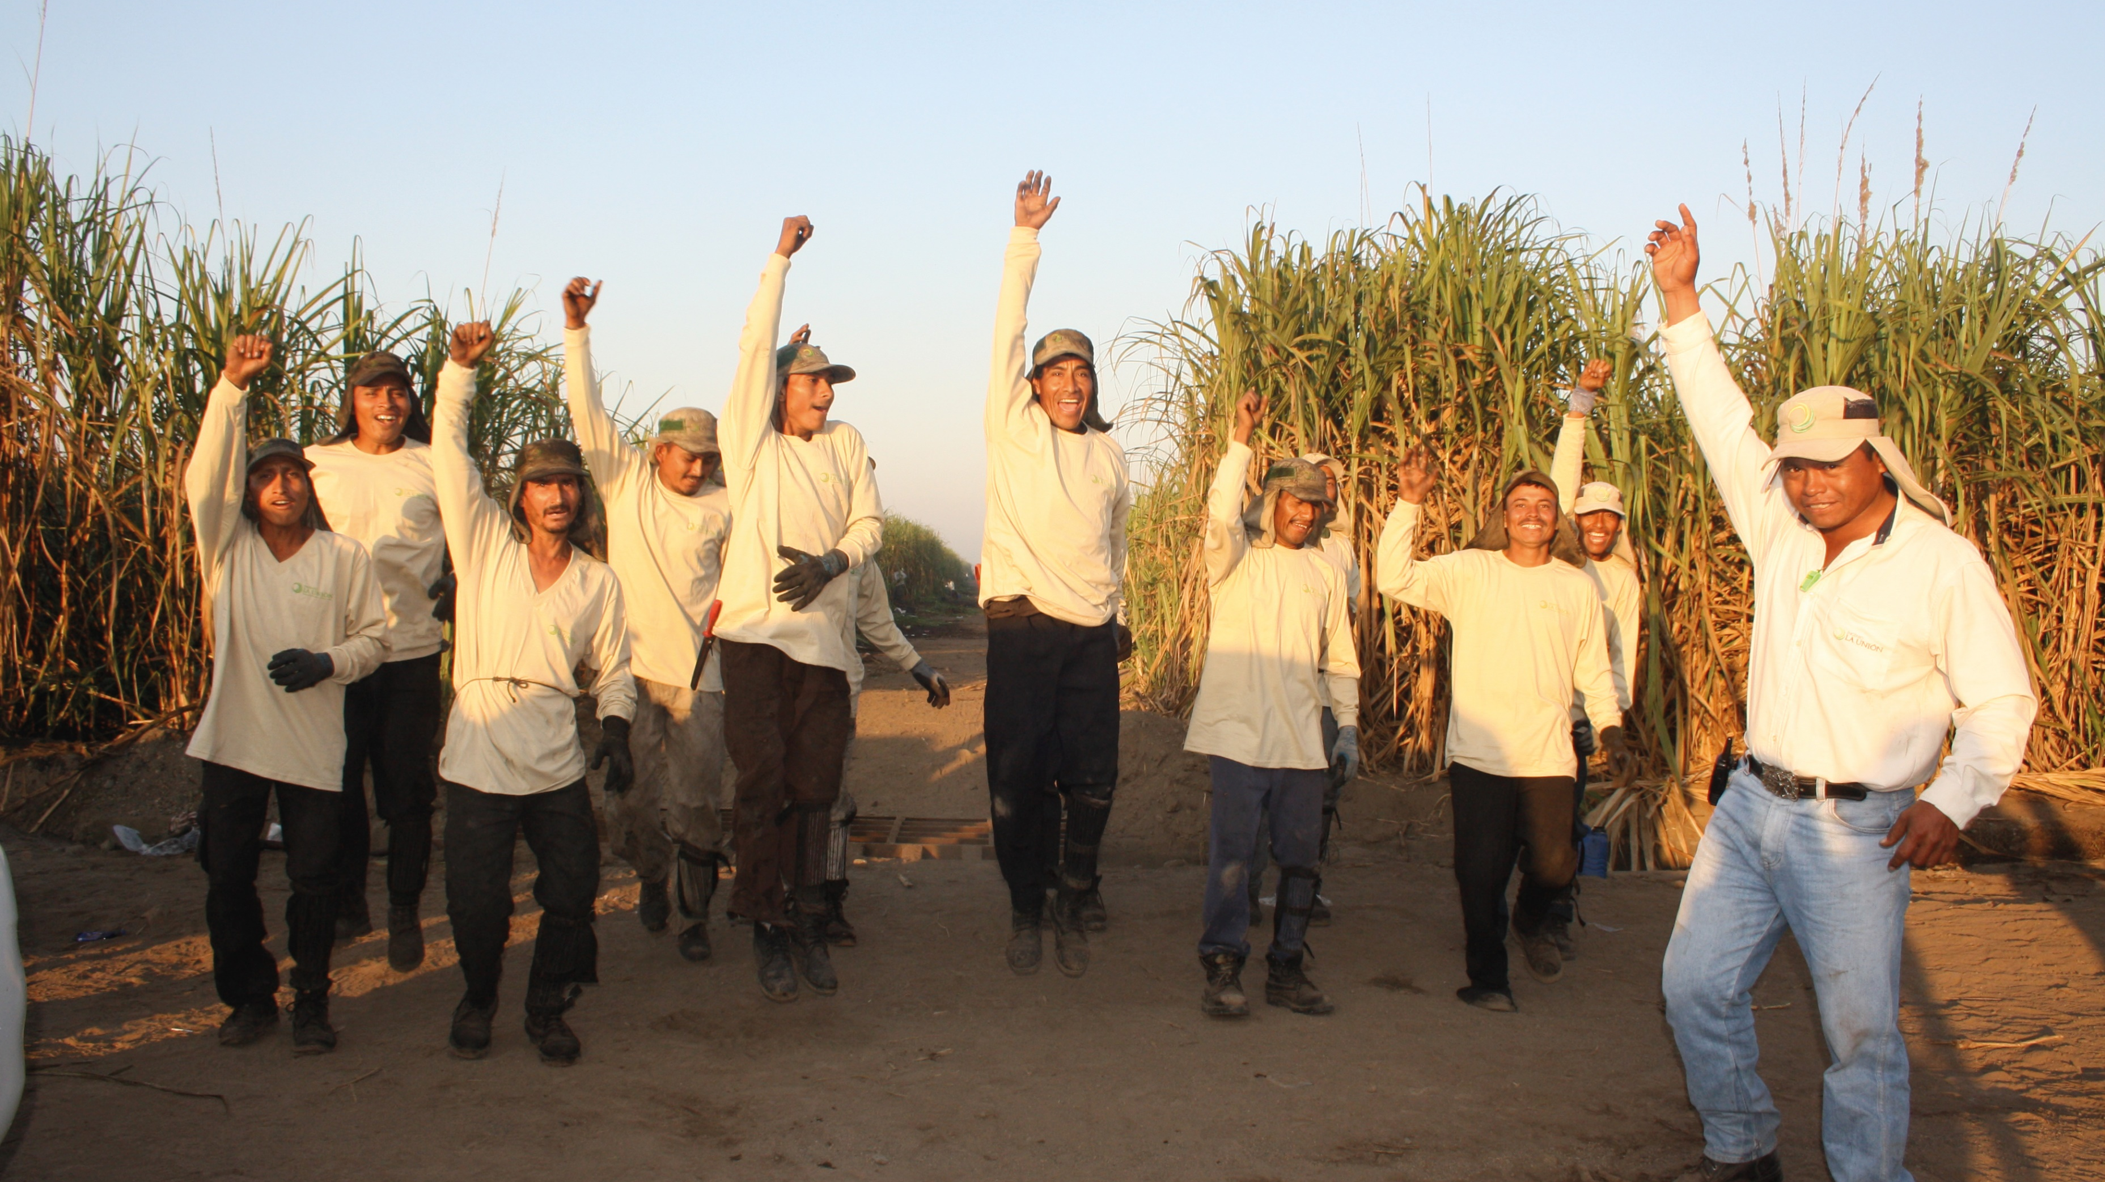
We are more than sugar We are energy for sustainable development
Thank you

