Slide 1
Lieke Wouterse
Staff member RAN
Working group Communications & Narratives (C&N)

Slide 2


Radicalisation Awareness Network (RAN)
European network of 5000 first-line practitioners who are involved in P/CVE
Established in 2011
Funded by European Commission
Key elements

Slide 3

Key elements & lessons learned
Realistic and measurable goal
Know the target audience in-depth
Message resonates with target audience
Use a credible messenger
Go where the target audience is
Clear, feasible and easy to do
Start M&E from beginning

Slide 4
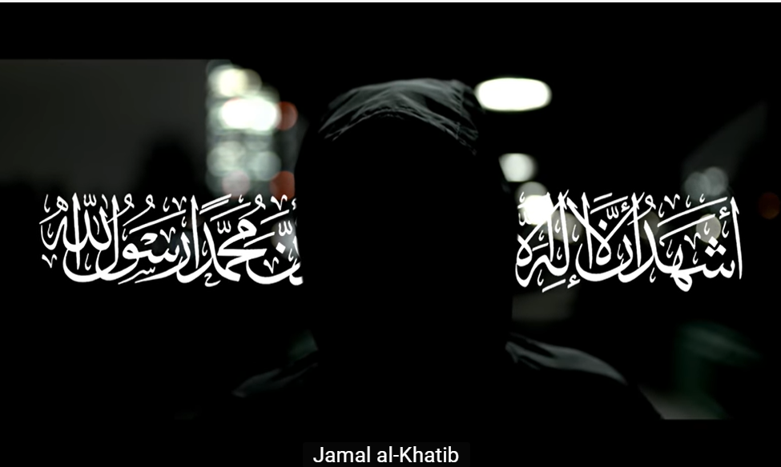
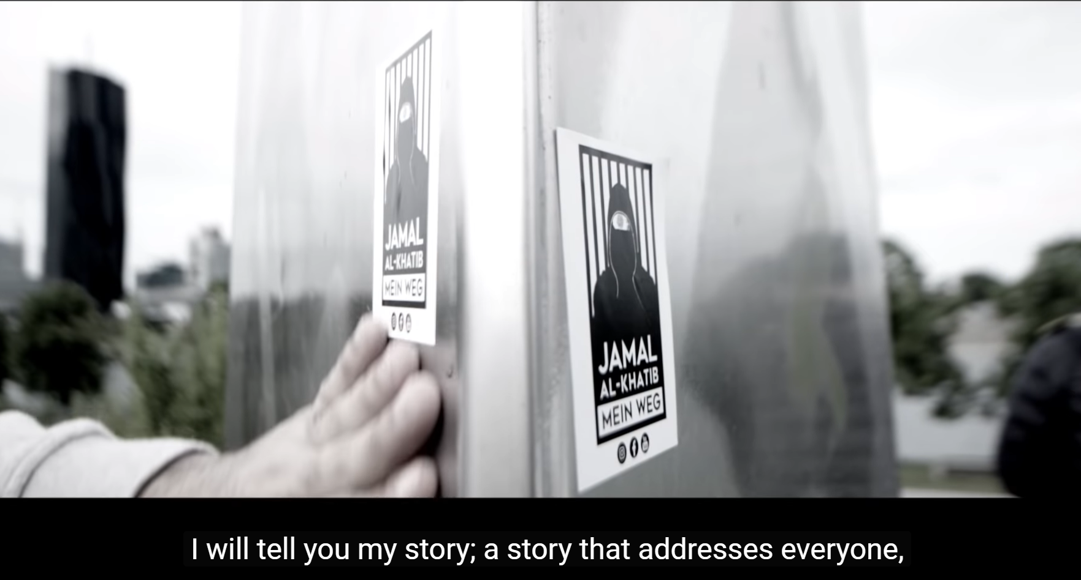
Examples of campaigns
Jamal Al-Khatib

Slide 5

Examples of campaigns
Donate the Hate

Slide 6
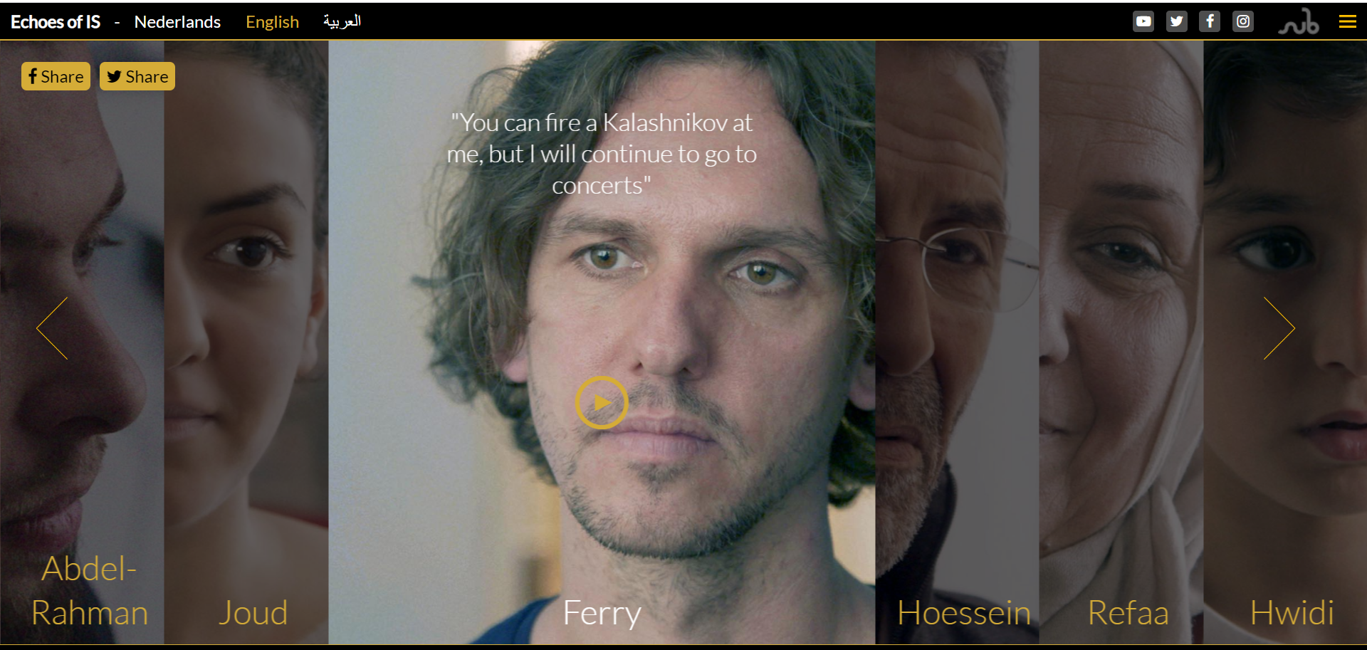
Examples of campaigns
Echoes of IS

Slide 7


Examples of campaigns
Dare to be grey

Slide 8
Recommendations
Local is key to change behaviour
Invest in Monitoring & Evaluation to build an evidence-base
Online and offline are hybrid concepts

Slide 9
Contact
Lieke Wouterse
L.wouterse@radaradvies.nl

