Slide 1

UN COUNTER-TERRRORISM COMMITTEE “COUNTERING TERRORIST NARRATIVES AND PREVENTING THE USE OF THE INTERNET FOR TERRORIST PURPOSES” OSCE Action Against Terrorism Unit 28 January 2020

Slide 2
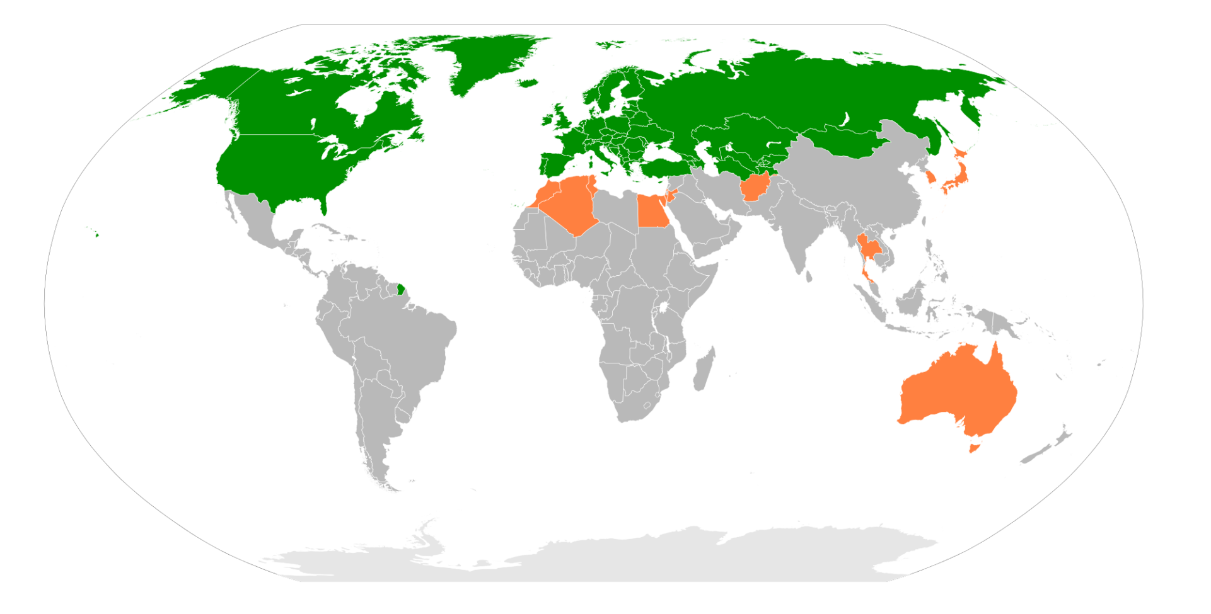

osce.org
OSCE

Slide 3

PCUITP: OSCE mandate
Key OSCE documents:
Ministerial Council Decision №3/04, Ministerial Council Decision № 7/06, Ministerial Council Decision № 10/08
OSCE Consolidated Framework for the Fight Against Terrorism (PC Dec 1063/2012)

Slide 4
HOW TO: «PREVENT AND COUNTER THE USE OF THE INTERNET FOR TERRORIST PURPOSES»?
MOST POPULAR ANSWERS:
Better Policing Skills to monitor, search, collect data, and cooperation with ISPs;
Fast removal of illegal content;
Enhanced Cybersecurity (Including E-Education, Responsible use of ICT);
Mobilizing whole-of-society approach;
Effective campaigns to counter terrorist narratives online.

Slide 5
PRIORITIES OF HOW TO: «PREVENT AND COUNTER THE USE OF THE INTERNET FOR TERRORIST PURPOSES»
MONTENEGRO
21 PEOPLE

Slide 6
PRIORITIES OF HOW TO: «PREVENT AND COUNTER THE USE OF THE INTERNET FOR TERRORIST PURPOSES»
UZBEKISTAN
42 PEOPLE

Slide 7
PRIORITIES OF HOW TO: «PREVENT AND COUNTER THE USE OF THE INTERNET FOR TERRORIST PURPOSES»
TAJIKISTAN
29 people.

Slide 8
PRIORITIES OF HOW TO: «PREVENT AND COUNTER THE USE OF THE INTERNET FOR TERRORIST PURPOSES»
KYRGYZSTAN
28 PEOPLE

Slide 9
PRIORITIES OF HOW TO: «PREVENT AND COUNTER THE USE OF THE INTERNET FOR TERRORIST PURPOSES»
UNODC+OSCE CENTRAL ASIAN WORKSHOP
21 PEOPLE

Slide 10
PRIORITIES OF HOW TO: «PREVENT AND COUNTER THE USE OF THE INTERNET FOR TERRORIST PURPOSES»
OSCE PEOPLE
ONLY ☺

Slide 11

PCUITP – NATIONAL TTXs
Moderated, scenario-based discussions on PCUITP – 3 Days;
Participants: decision makers, law enforcement, civil society, media, academia, youth, and the private sector;
Major Objective: to produce Actionable Policy Responses and Recommendations (APRR) (key word is “ACTIONABLE”).
APRRs are then forwarded to the policymakers for integration into grand Strategies/NAP on CT;

Slide 12
PCUITP – NATIONAL TTXs
Actionable Policy Responses and Recommendations:
Legal frameworks;
Public-private partnerships, collaboration with the global ICT industry, and developing capacities of key stakeholders;
Preventing through strategic communication, development of counter and alternative narratives and educational programmes.

Slide 13
PCUITP – NATIONAL TTXs
Key Findings:
Highly sensitive topic (striking balance between ensuring security and HR)
Need to promote Whole-of-society approach;
Lack of clear understanding on:
how to design effective communications campaigns,
the differences between Counter and Alternative Narratives;
what is message, the medium and credible messenger;
Campaigns bluntly promoting “correct interpretation of Islam” may be contrary to international human rights.
Alternative Narratives and Digital Citizenship perspective should be looked at more depth by the pS and integrated into grand strategies on CT

Slide 14
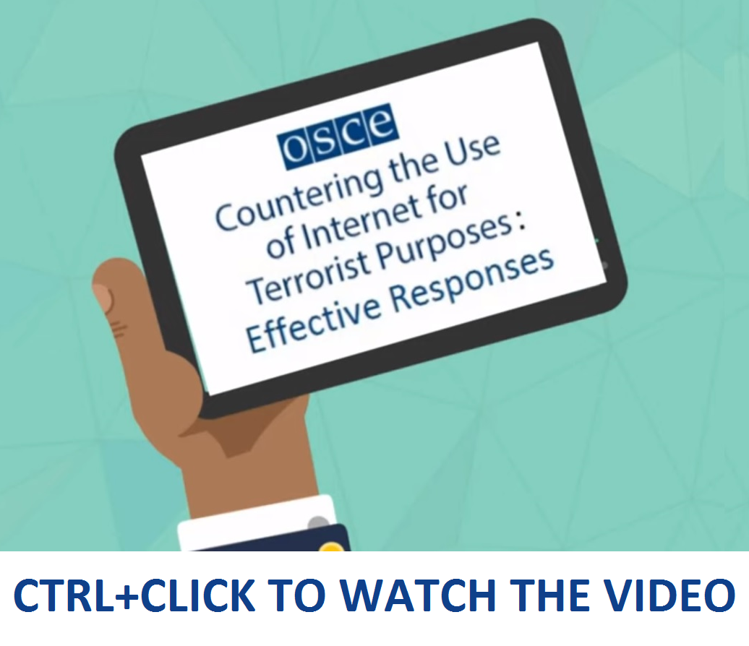
PCUITP – NATIONAL TTXs

Slide 15

OSCE E-Learning COURSE ON PCUITP

Slide 16

PCUITP HOW: Electronic evidence
PRACTICAL GUIDE ON COLLECTING ELECTRONIC EVIDENCE

Slide 17
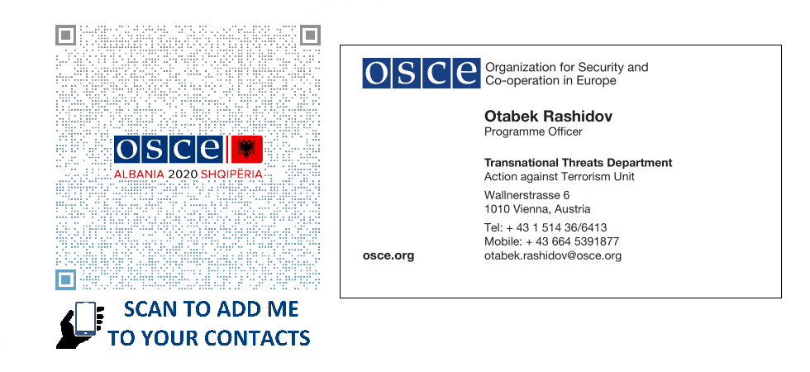

THANK YOU!

