Slide 1
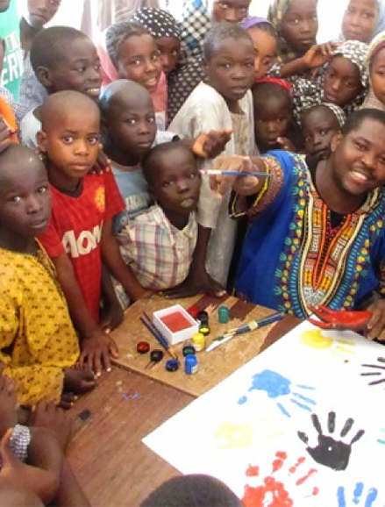
Countering terrorist narratives:
Update on research in support of UNSCR 2354 (2017) & the un counter-terrorism strategy
Dr. Kurt Braddock
28 January 2020

Slide 2
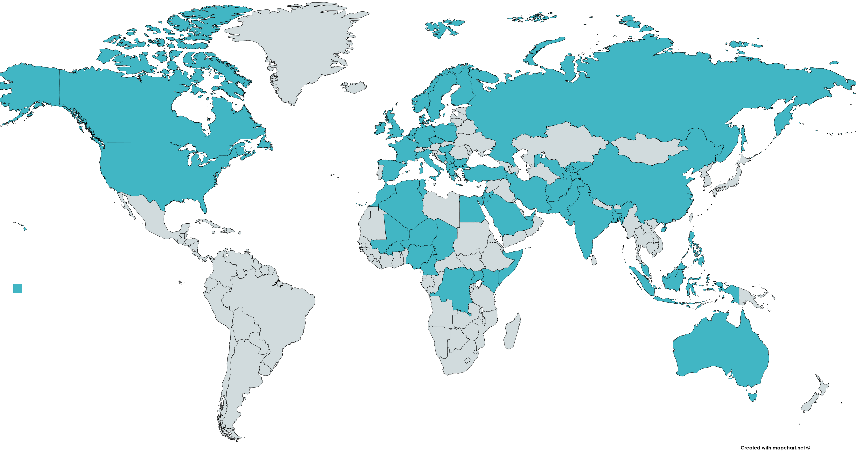
45+ Member States

Slide 3
Phase 1:
Synopsis of Current Efforts for Countering Terrorist Narratives
Current efforts target individuals at different phases of involvement
  Pre-radicalization
    Training and education about the dangers of violent extremism
    Cultivation of critical thinking skills, empowerment
    Front-line personnel
    Counter-narratives
  Radicalization and violent radicalization
    Referral and counseling
    Partnership between front-line personnel and security forces
    Emphasis on local context
  Engagement
    Securitization over prevention
    Support for loved ones of those affected by the radicalization processes
  Disengagement and De-radicalization
    Emphasis on narratives of former extremists
    Emphasis on disconnect between expectations and reality
    Provision of practical tools to reduce appeal of terrorist narratives

Slide 4

Phase 2:
Measurement and Evaluation of Efforts to Counter Terrorist Narratives
Vast majority of efforts for countering terrorist narratives go untested
Private sector/civil society vs. government efforts
Inordinate focus on (absence of) behavior

Slide 5

Phase 2:
M&E Tools and Recommendations
Ethical – all participants receive intervention
Allows measurement of intervention in the short-term and long-term
Real-world, real-time data to inform further program development
Employ quasi-experimental methods to evaluate the effectiveness of interventions that counter terrorist narratives

Slide 6
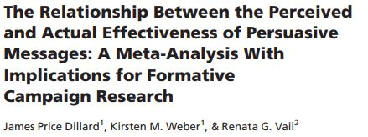
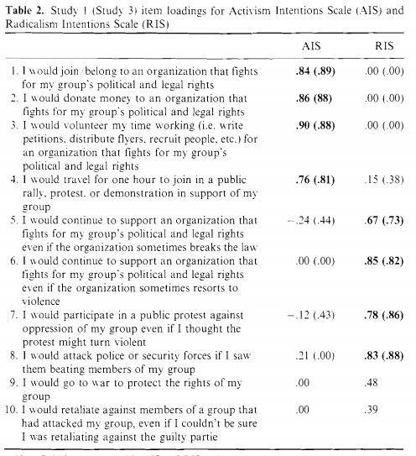
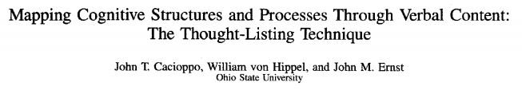
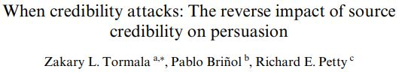
Phase 2:
M&E Tools and Recommendations
Leverage extant tools for measuring beliefs and attitudes in the VE context and other contexts
Notes:
Don’t focus solely on behaviors

Slide 7
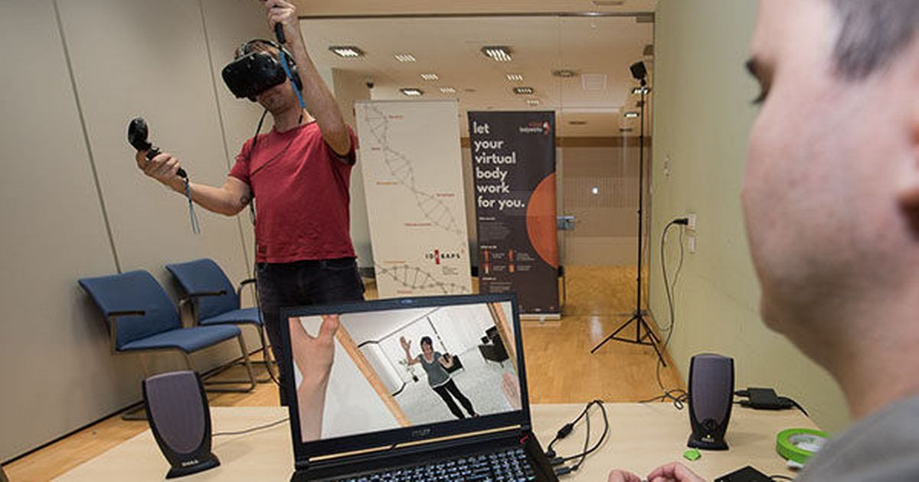
Phase 3:
Paths Forward for Member States
Immersive technology and virtual reality interventions
Gamification
Coordination with mobile developers
  Counter-narrative content
  Referral and counseling
  Educational program complement
Development of online platform to guide development of programs for countering terrorist narratives
Notes:
Example: Dar al-Ifta al-Misriyyah partners with media production companies to produce cartoons for kids that contain themes that renounce those in terrorist narratives

Slide 8



Contact
kurtbraddock@psu.edu
@KurtBraddock
kurt.braddock
Notes:
Please contact me if you are familiar with a program that has not been advertised in the popular media or for which there is little information available. I would very much appreciate feedback and input for this report (which will influence subsequent reports).

