Slide 1
Peacebuilding Fund’s Youth Promotion Initiative 2023
Webinar: YPI 2023 + Q&A
May 2023
https://www.un.org/peacebuilding/content/gypi-en
pbfgypi@un.org

Slide 2
Overview
Youth Promotion Initiative (YPI)
Eligibility Criteria
YPI 2023 Themes:
Theme 1: Fostering youth-inclusive political processes and promoting the political participation of diverse young people
Theme 2: Civic Space: Safeguarding and expanding civic space for youth participation including through local level infrastructures for peace
Good Practices & Lessons Learned
Resources
Q&A

Slide 3
Youth Promotion Initiative (YPI)
In 2016, the UN Peacebuilding Fund (PBF) launched the YPI to allocate peacebuilding projects promoting youth inclusion and participated
YPI supports UN Security Council Resolution 2250 and related resolutions.
YPI invested $128 million in 97 projects across 30+ countries so far, of which $23 million was invested in 2022.

Slide 4
Eligibility Criteria
The call for proposals contains a detailed list of review criteria and the timeline, available here.
Three types of proposals: 1) joint UN proposals, 2) joint UN-CSO proposals, and 3) CSO proposals. Required to be both gender- and age sensitive.
Gender marker 3 or 2 is required for YPI proposals, and at least 40% of the requested budget is to be allocated to national/local CSOs as implementing partners, in particular youth-led organizations.
Timeline: concept notes due by Friday,
June 9th through the website.

Slide 5
Who can apply?
UN Agencies, Funds and Programmes (AFPs) and Civil Society Organizations (CSOs)
UN Submissions
Max two proposals per initiative per UNCT (2 YPI and 2 GPI)
All UNCT and UN-CSO submissions must be endorsed by the RC (submission of signed cover letter)
Joint UN proposals
Grants between $800,000 and $2 million per project
2-3 UN partners as direct fund recipients per project
Joint UN-CSO proposals
Grants between $800,000 and $2 million per project
Max 2 UN partners and 1 CSO partner as direct fund recipients per project
CSO partners need to meet the eligibility criteria

Slide 6
Who can apply?
CSO Submissions
Maximum two proposals per initiative per organization globally (2 YPI and 2 GPI)
Grants between $300,000 and $2 million per project
Max one CSO as direct fund recipient per project and need to meet CSO eligibility criteria
Concept notes can be submitted by the CSO independently, and in the final approval stage of full project proposals RC/DSRSG/SRSG and government approval are required
All CSO applicants are recommended to reach out to the PBF Secretariat/Focal Points in the project country

Slide 7
CSO Eligibility Criteria
Formally registered as non-profit, for the duration of the proposed project in 1) the country where the headquarters is located and 2) the project country.
Required to receive a low-risk score in a HACT micro-assessment in the project country. The questionnaire such an assessment is based on can be found here for reference.
If already assessed, low-risk scores from Jan 2022 and onwards will be accepted.
If not yet assessed, for organizations invited to the second stage PBF will commission micro-assessments
UN reference or donor reference from the project country, attesting to satisfactory financial and programmatic management of a grant in the last three years.
In the second stage: CSOs will be reviewed regarding prevention of sexual exploitation and abuse (PSEA)

Slide 8
Gender Marker 2 vs. 3
Gender Marker 2 | Gender Marker 3
Advancing gender equality is a significant objective but not the principal reason to undertake this project. | The principle purpose of the project is to advance gender equality and women’s empowerment (GEWE) in the context of peacebuilding.
A GM2 project is a strongly gender mainstreamed project. | Gender equality is fundamental to the project design and the expected results.
30-79% of budget to GEWE | 80-100% of budget to GEWE
More information available in PBF Gender Marker Guidance here

Slide 9
Lessons learned
Main reasons for concept notes not being selected to the second stage in 2022:
Link to peacebuilding: Successful proposals were able to clearly articulate the link between the proposed interventions and the intended peacebuilding outcome
Gender / youth responsiveness: Successful concept notes placed this at the center of their proposal
Innovation: Successful concept notes articulated how and why their proposal was innovative
All applicants interested in applying are advised to reach out to the PBF Secretariat/Focal Point in the project country

Slide 10
YPS-responsive programming

Slide 11
Youth Sensitive
Specific realities, needs and aspirations of young people are identified and appropriately considered throughout the project cycle.
Youth Inclusive
Young people are given the right to participate, and their views and experiences are considered throughout the project cycle.
Youth Responsive

Slide 12
Aspects of a YPS-responsive programming
Context
What is the social, political and economic situation of young people?
How young people may experience life differently than other people?
Are there specific challenges or barriers hindering young people’s participation in society?
Are youth’s positive contributions to peace being included in the analysis?
Process
What are the opportunities for engaging young people and youth-led organizations? Can they engage as implementing partners?
What kind of support (operational, capacity, etc) might be needed to enable the full and meaningful participation of young people in the process?
How to ensure the process does not marginalize (even if unintentionally) certain groups based on their gender identity, race, ethnical or linguistic background, religious affiliation, disability status or other distinctions?
Are there any risks young people may be exposed to if they are perceived to be engaging in your initiatives? Are those risks gendered?
Content
What role will young people play in this process? Are they simply benefiting, or is there any opportunity for young people to lead the implementation of some of those initiatives?
How can we ensure that young people will also benefit from the peaceful outcomes/change the initiative aims to create?
Do we require a youth-specific activity in order to reach our goal? Or is it better to establish mechanisms to include young people in the overall processes?
If there is a separate youth-specific activity, how does that align with the overall ToC? How do we ensure that the gains from that youth-specific intervention contribute to overall peaceful outcomes?
If an “integrated approach” is adopted, how to ensure young people will not be marginalized, neglected or disregarded during the process?
A YPS programme must grounded in the local context and a specific youth- and gender-sensitive conflict analysis.
A YPS program should always include young people in the initiation, planning, implementation and evaluation of the program!
A YPS program does not necessarily need to have youth as the only beneficiary target group, but outcomes must also benefit young people.

Slide 13
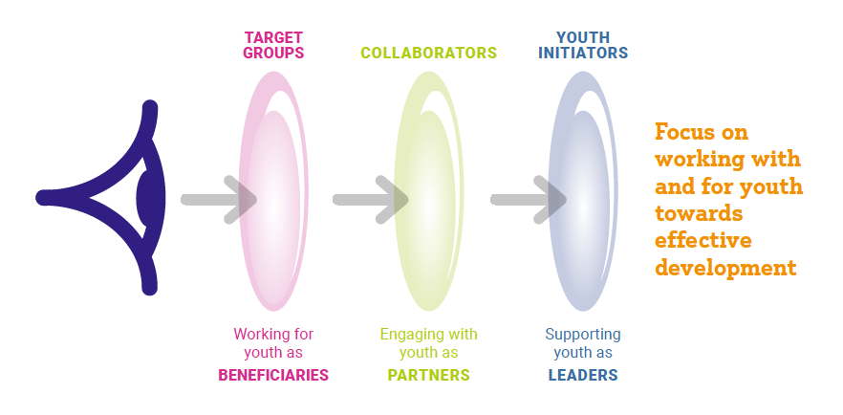
The three-lens approach to youth participation
Source: Youth, Peace and Security: A Programming Handbook

Slide 14
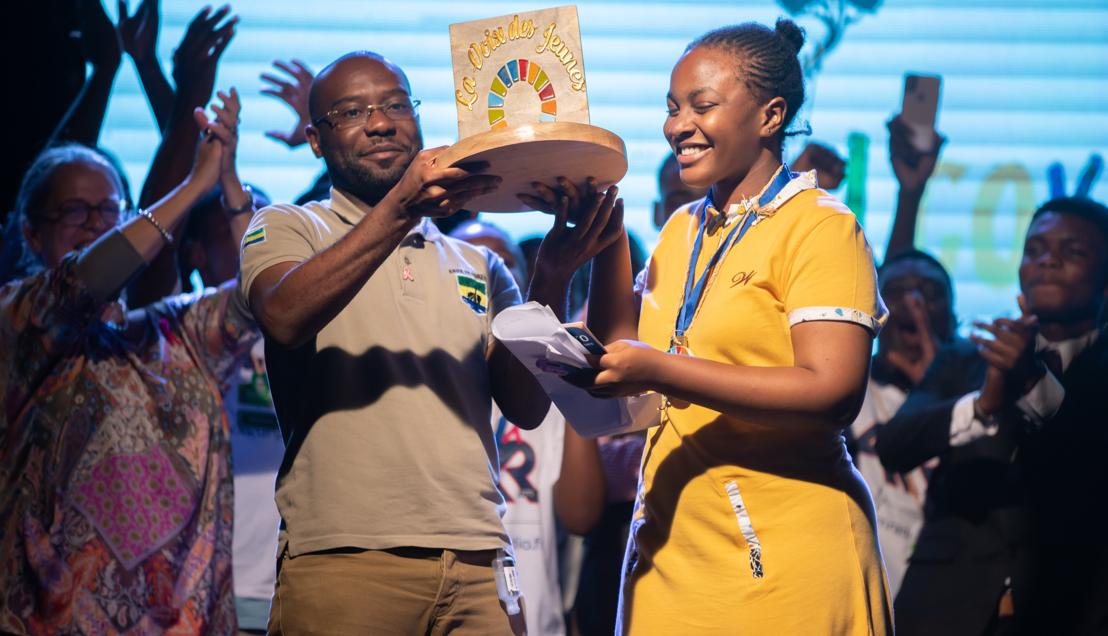
Theme 1: Fostering youth-inclusive political processes and promoting the political participation of diverse young people

Slide 15
Why this theme is a strategic priority
Key challenges:
Youth exclusion still embedded in legislative and policy frameworks, norms
(including harmful gender norms), behaviors and practices;
Need to improve political participation beyond numbers and representation;
Financial barriers and threats;
Institutional and organizational barriers;
Youth distrust in governance institutions and closing civic space for young people;
Unequal power structures;
Additional barriers in conflict-affected situations;
Lack of data collection on youth political participation.
However, young people’s participation in political and public affairs is:
A right;
An essential means to address the needs of young people and their communities;
A way to strengthen democratic governance and ensure inclusive political processes;
A necessity to achieve Sustainable Development Goals (SDGs), the Youth, Peace and Security Agenda (YPS), Inclusive Peacebuilding, and ensure that no youth is left behind.

Slide 16
Highlights from YPS resolutions & Progress Study…
UNSCR 2250 (2015) includes Participation as a key pillar and “Urges Member States to consider ways to increase inclusive representation of youth in decision-making at all levels in local, national, regional and international institutions and mechanisms for the prevention and resolution of conflict (…)”
The ‘Missing Peace’ Progress Study acknowledges youth as essential partners who are already meaningfully driving social and political change requires the following: • Invest in the capacity, agency and leadership shown by young peacebuilders. • Address the structural barriers limiting the meaningful inclusion of young people and ensure an enabling environment for the breadth of youth-led and youth-focused organizations and activities. • Partner with youth-led and youth-focused organizations as equal and essential partners for peace
UNSCR 2419 (2018) urges stakeholders to take young people’s views into account and facilitate their equal and full participation in peace and decision‑making processes at all levels
UNSCR 2535 (2020) emphasizes the “civic and political spaces” in which youth operate.

Slide 17
…and from Secretary-General’s Reports
S/2020/167: Core challenges remain, including structural barriers limiting the participation of young people and their capacity to influence decision-making; violations of their human rights; and insufficient investment in facilitating their inclusion and empowerment. While progress on including young people in public life, however, meaningful youth participation in the maintenance of peace and security remains a challenge. Many young peacebuilders report that their participation is not welcomed by the public or those in positions of power, pointing to an overall disregard for their work and, in some instances, their human rights, in particular true for young women. More needs to be done to create an enabling environment for young people in which they are seen and respected as citizens with equal rights, equal voices and equal influence.
S/2022/220: Profound challenges persist that concern meaningful participation of young people in decision-making. The “lockdown generation” showed an indomitable spirit of resilience and leadership in addressing today’s challenges. The accelerated digitalization of civic space and participation opportunities offered a chance for wider engagement and inclusion, while also presenting new protection challenges requiring urgent action. However, youth participation in formal political processes remains worryingly low. Voter turnout has dropped around the world, and young cohorts tend to vote less than older cohorts in many places. This reflects existing structural barriers and the erosion of trust in democratic institutions.

Slide 18
SG’s Call to Action for Human Rights (2020)
A transformative human rights vision:
Rights at the Core of Sustainable Development – Agenda 2030
Rights in Time of Crisis – Human Rights risk analysis and prevention
Gender Equality and Equal Rights for Women
Public Participation and Civic Space – Inclusion, Participation
Climate Emergency – Rights of Future Generations
Human Rights at the Heart of Collective Action – Human Rights institutions
New Frontiers of Human Rights – Human Rights online
Our Common Agenda (2021)
Need to better listen to and work with young people (also in line with Youth2030 Strategy). The “youth in politics” index proposed in Our Common Agenda could be used to track the opening of the political space around the world, which is clearly demanded by younger generation.

Slide 19
Policy and programming entry points (1/2)
Support efforts to expand the civic space and promote political participation for young people, including by better analysing risks and threats for youth, by encouraging youth activism and youth civic engagement, by amending policies and procedures, and by guaranteeing safety, human rights, and physical and mental health, including in the digital sphere.
Enhance youth political participation in formal processes – electoral processes, transition processes, youth representation in parliaments, youth councils.
Facilitate young people’s access to elected positions by supporting the alignment of the age of eligibility to run for office with the voting age and by supporting youth parliament simulations and youth leadership programmes.
Support youth participation in electoral observation.
Promote intergenerational dialogue on matters of peace and security.
Consider supporting the adoption of youth quotas and other temporary special measures
Support both youth mainstreaming and special efforts for the marginalized youth to be supported in their political participation.
Address discriminatory legislation, patriarchal structures and attitudes that limit young women’s political participation.
Support youth leadership in preventing violence, including electoral violence

Slide 20
Policy and programming entry points (2/2)
Accompany political party strengthening and inclusiveness and ensure direct youth political participation at all levels, including in cross-party dialogues on matters relating to peace
Promote peer-to-peer learning and networking opportunities for youth
Support the regulation of political finance, youth-led accountability and youth-led anti-corruption initiatives
Prioritize youth political participation in National Action Plans (NAPs)/roadmaps on YPS
Support youth-sensitive budgeting at all levels
Contribute to youth meaningful participation in decision-making as part of peace processes
Support youth meaningful engagement in deliberative processes
Promote youth participation in reconciliation processes and truth commissions
Support young people’s participation in peacebuilding fostering social cohesion in communities
Support further research, data collection and learning on young people’s exclusion from decision-making processes relating to peace and security
Partner with the media to address assumptions and influence narratives about the role of youth in politics

Slide 21
Theories of change
Young people’s influence in decision-making processes (responsive institutions, laws and policies)
Processes, practices and organizational cultures that support youth participation
Governance systems perceived as fair, and participation of all people perceived as a fundamental right
Redistribution: addressing inequalities
Recognition: respecting differences
Reconciliation: dealing with the legacies of the conflict
Representation: ensuring participation
Youth engaged in meaningful processes of building social cohesion in local communities
Bridge the gap between the diversity of young people including those marginalized or excluded.
Remove legal barriers to participation.
Power-holders value and are motivated to work with youth.

Slide 22
Examples of programmatic responses (PBF)
Sierra Leone: “Improving Women's Participation in Political Processes as Peacebuilding Ambassadors-Sierra Leone (DPPA, UNDP and UN Women)
Liberia: UNDP and UN Women Promoting Inclusive Political Participation and Elimination of Violence Against Women in Politics (UNDP & UN Women)
Enhancing Early Warning & Prevention to Counter Hate Speech and Incitement Ahead of the 2022 Elections in Kenya (UNDP & OHCHR)
Gambia: Women and Youth participation in decision-making processes and as agents of community conflict prevention (UNICEF & UNFPA)
Burundi, “Youth Lab: Supporting Youth Participation in Political Parties” (NIMD)

Slide 23
Additional examples of programmatic responses
UNDP youth and women’s political participation project in Maldives, offering targeted trainings for youth wings
UNDP and ILO “Empowering Youth as Agents for Peace and Social Cohesion in Solomon Islands (EYAPSCSI)” empowering marginalized young Solomon Islanders, particularly young women, to engage in decision-making and act as pro-active social entrepreneurs to address local sources of grievances
UN-Habitat and UNFPA Youth Political Empowerment Project in Somalia. Through intergenerational dialogues, awareness sessions, media campaigns, and leadership training, the project contributed to a significant increase in youth political participation in the South-West and Jubaland State Parliament.

Slide 24
Key considerations
Inclusion or participation is not about competition. The promotion of the political participation of young people is not meant to happen at the expense of others.
Young people themselves are not a homogeneous group and thus ensuring the inclusion of a diversity of young people is crucial; e.g. LGBTQI+ and young women.
The participation of young people in one area of politics supports a broader culture of inclusion. Youth contributions to building peace should be narrated beyond the political party, negotiation table or protest to ensure it furthers the socialization of young people as active contributors to the betterment of society.
Young people’s right to participation and protection in politics should be considered and prioritized from the outset and in each stage of politics, regardless of what forms it takes.
It is key to foster youth-inclusive political processes at all levels. The local level can provide an entry point for promoting youth participation in matters of peace and promoting trust between peoples and institutions.
It is not enough to raise awareness or train young people in mock institutions or programmes. While knowledge and experience are valuable, youth political participation can only be realized if youth truly get to participate themselves.

Slide 25
Key references (1/2)
UNDP & GCYPS Guidance note on youth inclusive political processes in the context of YPS (forthcoming)
UNDP, ‘Enhancing Youth Political Participation Throughout the Electoral Cycle’, January 2013
UNDP and European Commission – Joint Task Force on Electoral Assistance (2017), Youth Participation in Electoral Processes – Handbook for Electoral Management Bodies.
UNDP & EC E-learning Course on Youth Participation in Electoral Processes.
UNDP Sustaining Peace during Electoral Processes “SELECT” project (https://www.sustainingpeace-select.org/)
Inter-Parliamentary Union (2021), Youth Participation in National Parliaments.
National Democratic Institute (2018), Youth Political Participation Programming Guide.
Organisation for Economic Co-operation and Development (OECD) (2020). Youth and COVID-19: Response, Recovery and Resilience
United Nations Office of the Secretary-General’s Envoy on Youth, If I Disappear - Global Report on Protecting Young People in Civic Space, 2021
UNFPA, UNDP, DPPA/PBSO, FBA (2021), Youth, Peace and Security: A Programming Handbook

Slide 26
Key references (2/2)
Platforms
ACE Electoral Knowledge Network
Agora
Civicus
International IDEA Political Finance Database
IPU’s PARLINE Database
iKNOW Politics
Youth4Peace
SALTO participation and information tool
SELECT (Sustaining Peace during Electoral Processes)

Slide 27
SECRETARY-GENERAL’S PEACEBUILDING FUND: Promoting safety, security, and protection of diverse young people Safeguarding and expanding civic space for youth participation including through local level infrastructures for peace
Prepared by Civic Space Unit, OHCHR May 2023

Slide 28
WHAT IS CIVIC SPACE?
Civic space is the environment that enables people and groups – or ‘civic space actors’ – to meaningfully participate both on and offline in the political, economic, social and cultural life of their societies.
Civil society actors – including human rights defenders, women advocates, children, young people, members of minorities and indigenous people, trade unionists and journalists – need to be able to freely express themselves in full security and affect change peacefully and effectively.
A vibrant civic space requires an open, secure and safe environment, free from acts of intimidation, harassment and reprisals – both on and offline. Any restrictions imposed in this space must comply with international human rights law
See more in UN Guidance Note on Protection and Promotion of Civil Space
PROMOTION
PROTECTION
3 Ps FOR CIVIC SPACE
PARTICIPATION

Slide 29
2 IN 5 ARE NOT CERTAIN THAT THEIR PARTICIPATION IN ASSEMBLIES WILL NOT RESULT IN RETRIBUTION
1 IN 5 EXPERIENCED GOVERNMENTAL INTERFERENCE IN THE FUNCTIONING OF THEIR ORGANIZATION
1/3 EXPERIENCE BARRIERS TO ACQUIRING FOREIGN FUNDING.
FREEDOM OF ASSEMBLY & ASSOCIATION
1 IN 8 EXPERIENCED DIFFICULTIES IN ORGANISING OR PARTICIPATING IN PUBLIC ASSEMBLIES
1 IN 4 REPORTS UNDUE RESTRICTIONS
1/4 OF ORGANISATIONS NOT FULLY CAPABLE IN ENGAGING IN ADVOCACY ACTIVITIES FOR FEAR OF RETRIBUTION
3 OUT OF 4 ORGANISATIONS NEVER, OR RARELY PARTICIPATE IN SOLUTION FORMULATION AT LOCAL LEVELS
3 OUT OF 6 NEVER, OR RARELY PARTICIPATE IN SOLUTION FORMULATION AT NATIONAL LEVELS
2 OUT OF 5 BELIEVE THEY ARE MODERATELY ABLE TO / CANNOT INFLUENCE DELIBERATION PROCESSES
RIGHT TO PARTICIPATION
ACCESS TO INFORMATION &
FREEDOM OF EXPRESSION
2 IN 5 HAVE DIFFICULTIES EXPRESSING THEMSELVES FOR FEAR OF RETRIBUTION
1 IN 3 EXPERIENCE DIFFICULTIES IN ACCESSING INFORMATION FROM GOVERNMENT
Challenges of Youth in Civic Space
Source of data, see report on: The Shrinking Space for Civil Society and Its Impact on Young People and Their Organizations (coe.int)

Slide 30
Challenges of Youth in Civic Space
NON-RECOGNITION AS COMPETENT RIGHT HOLDERS & DISCRIMINATION BY AGE
LACK OF ACCESS TO FUNDING, RESOURCES OR SUPPORT
OVER DIGITALIZATION
CYBERBULLYING, ONLINE ATTACKS, THREATS ON SOCIAL MEDIA, ETC.
LACK EMPOWERMENT OF THEIR WORK AND KNOW LITTLE ABOUT PROTECTION
PERSECUTION AND CRIMINALIZATION BY AUTHORITIES AND INDIVIDUALS
LACK OF SENSITIZATION ABOUT YOUTH RELATED VULNERABILITIES, NEEDS & RISKS.

Slide 31
Youth Rights = Human Rights
Young people have same rights as other right holders, regardless of age.
Young people are part of civil society and have a role in it.
Young people can be civil society actors or human rights defenders.
Freedom from discrimination
Freedom of assembly and association
Health
Participation in public affairs
Housing
Education
Work
CIVIL SOCIETY ACTORS
Advocacy Groups/ Community Groups/
Faith-based Organizations/
Non-government or Non-profit Organizations/ Professional Associations/ Recreation, social or sports clubs/ Volunteer Organizations/ Charities/
Trade Unions/ Cooperatives/
Think Tanks/ Academic Institutions
Article 1, 1998 Declaration on Human Rights Defenders
Everyone has the right, individually and in association with others, to promote and to strive for the protection and realization of human rights and fundamental freedoms at the national and international levels.
Freedom of expression
https://www.youthforum.org/topics/youth-rights

Slide 32
Who has a role to protect the youth?
What can be done to strengthen the protection of youth in exercising their rights?
Youth
Increase Literacy on
Digital Security
Establish protection networks and form alliances
Civil Society Actors
States
Donors
United Nations
Training and Capacity Building on Protection
Strengthen mechanisms of monitoring & reporting
Ensure civic space is inclusive and non-discriminatory
Sample text
Sensitize the State and Public
Positive narratives and public support

Slide 33
Project examples
Kyrgyzstan, OHCHR, UNICEF & UNDP: Inclusive governance and shared identity for sustainable peace and development
Guatemala, UNFPA, OHCHR & IOM: NAK’B’IL: Juventudes mayas y mestizas organizadas contribuyendo a la construcción de sociedades inclusivas y la coexistencia pacífica en Huehuetenango.
Somalia, FAO & IOM; Promoting Inclusive Action in Peacebuilding (PIAP Initiative)
Madagascar, OHCHR & UNESCO: Support for the protection of young human rights defenders and peace builders, to improve social peace and community cohesion. Focuses on supporting and protecting young people and young human rights defenders
Burkina Faso, UNFPA, UNICEF & UNDP: Project to support the promotion and protection of young peace builders and human rights defenders in the Sahel, North and East Regions. Promotion and protection of young HR defenders and access to protection mechanisms.

Slide 34
Resources
www.un.org/peacebuilding/content/gypi
www.un.org/peacebuilding/fund
PBF GYPI Call for Proposals and Guidance Note
PBF Guidance Note on Youth and Peacebuilding
PBF Guidance Note on Gender Marker Scoring
UN Community Engagement Guidelines
YPS Handbook
The Missing Peace: Independent Progress Study on Youth, Peace and Security
A Global Study on the Implementation of United Nations Security Council Resolution 1325
Pathways for Peace: Inclusive Approaches to Preventing Violent Conflict

Slide 35
Q&A

