Slide 1
Peacebuilding Fund’s Gender Promotion Initiative 2022
Webinar: GPI 2022 + Q&A
May 2022
https://www.un.org/peacebuilding/content/gypi-en
pbfgypi@un.org

Slide 2
Overview
Gender Promotion Initiative 2022
Supporting institutional capacity
Do no harm
Engaging and co-designing project proposals with women’s organizations
Supporting and financing women’s civil society organizations
Q&A

Slide 3
Gender Promotion Initiative (GPI)
In response to Security Council resolutions 1325 (2000) and subsequent resolutions on Women, Peace and Security, the Peacebuilding Fund (PBF) launched its first Gender Promotion Initiative in 2011
Aims to support innovative approaches that promote gender equality and support women in peacebuilding
2021: Project list available here
The recordings and slides from the introductory webinars (including information on eligibility) are available here
.

Slide 4
Thematic Focus GPI
This year's GPI will focus on:
Supporting women’s civil society organizations, groups and networks in strengthening their institutional capacity for sustainable contribution to peacebuilding
Need to reach all criteria for PBF Gender Marker 3
Required to be both gender- and age sensitive
At least 40% to be allocated to national or local civil society partners, in particular women-led organizations
In addition, preference will be given to:
Joint UN-CSO projects, projects implemented by national CSOs and projects that demonstrate strong partnerships with women-led organizations.
To reach organizations working on the front lines of crises, innovative and trust-filled intermediary models, such as larger organizations acting as intermediaries are encouraged.
Reminder: deadline for submitting concept notes is June 6th

Slide 5
Project examples
Burundi, UN Women & AFSC: Strengthening the Women’s Mediator Network The network has handled more than 25,000 community-based conflicts and building on the achievements, this project is working to expand the peacebuilding impact by supporting its efforts in institution development.
Sri Lanka, SFCG: Young Women as Drivers of Peace: Providing 360° Support to Emerging Women Leaders Support emerging women leaders by putting the power to determine resource allocation and define success metrics in their hands, included a tailored mentorship and small grants program.
DRC, Fund for Congolese Women: Promoting Women’s Participation in Peacebuilding through Peace Huts Women-led organisation that support other grassroots women-led organizations in working through peace huts to resolve local conflicts
Liptako-Gourma region, Mercy Corps: Appui aux Initiatives Locales de promotion de la Paix Example of a project that includes a small grants facility to support local organisations.

Slide 6
Supporting institutional capacity
The 2021 PBSO’s Thematic Review on Gender-Responsive Peacebuilding confirmed that many women peacebuilders emphasize the need for more sustained capacity building support
Including in technical areas as financial management, grant writing, and monitoring and evaluation
Responding to this recommendation, the GPI seeks proposals supporting women’s civil society organizations, groups and networks to build their institutional capacity to undertake peacebuilding actions in a sustainable manner
This can for example include:
engaging in stakeholder mapping
supporting organizations with bottom-up needs assessments
supporting in filling identified capacity gaps and
working through small grants facilities

Slide 7
Protection and do no harm
Women peacebuilder and human rights defenders can face exclusion, marginalization, discrimination and violence due to their work.
Those facing multiple intersecting forms of marginalization face particular risks
Diverse types of protection may be needed
In order to achieve peace, it is essential that women peacebuilders and organizations have the opportunity to promote their work without fear of threats or reprisals
Consider and prevent the risk of of further exposing women peacebuilders and their organisations and the risk of them facing potential backlash due to the work
Do no harm and consider aspects around protection

Slide 8
Gender Marker 3
Gender Marker 3
The principle purpose of the project is to advance gender equality and women’s empowerment (GEWE) in the context of peacebuilding.
Gender equality is fundamental to the project design and the expected results.
80-100% of budget to GEWE
More information available in PBF Gender Marker Guidance here

Slide 9
Lessons learned
Main reasons for concept notes not being selected in 2021:
Link to peacebuilding: Successful proposals were able to clearly articulate the link between the proposed interventions and the intended peacebuilding outcome
Gender / youth responsiveness: Successful concept notes placed this at the center of their proposal
Gender does not equate women, but it is about the diversity of femininities and masculinities, power relations, attitudes, behaviors, norms and roles.
Avoid stereotyping
Focus on agency
Innovation: Successful concept notes articulated how and why their proposal was innovative

Slide 10
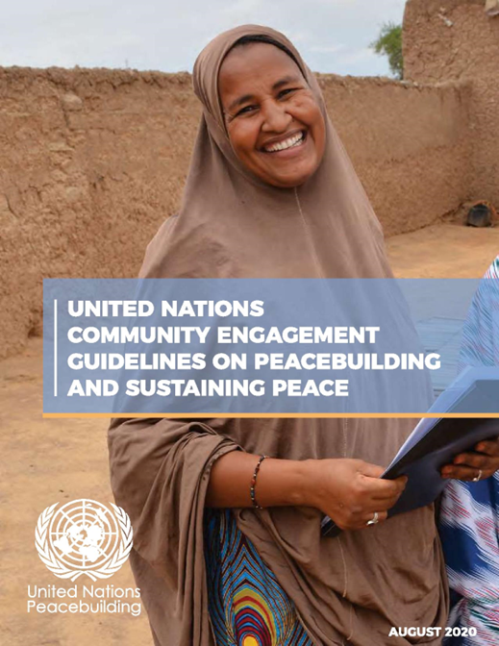
Engaging and co-designing project proposals with women’s organizations
Critical to switch approaches: approach women’s organizations not as beneficiaries or implementing entities, but as true partners
When to engage with women and women’s organizations?
Conflict analysis
Priority setting
Project design
Budget distribution
Project implementation
Monitoring/reporting/evaluation
How to engage with women’s organizations?
Transparent process to select core partner organization
Identify key women peacebuilders and women’s organizations to be engaged throughout the project
Ensure diversity of representation
Focus on meaningful participation
Ensure a Do no harm approach
Support effective women-led initiatives
Notes:
Local women and women civil society actors are essential actors for conflict prevention, peacebuilding and sustaining peace, contributing a wealth of experience, knowledge and expertise.
2016 Twin Resolutions on peacebuilding and sustaining peace (A/RES/70/262 and S/RES/2282) shifted the focus from crisis response to peacebuilding and sustaining peace through comprehensive and coherent approaches and strategic and operational partnerships including with civil society actors, especially women and youth-led organizations.
In order to promote meaningful inclusion through broader partnerships, the 2018 Secretary-General’s report on Peacebuilding and Sustaining Peace (A/72/707-S/2018/43) called for strengthened and systematized engagement with civil society, including women and youth groups and local communities at large.
GPI submissions will be reviewed against a set of criteria by the Project Appraisal Committee, an important one is the consultation and partnership with local actors.
The partnerships must be meaningful. In the context of co-designing the GPI proposal, it might be possible to rely on systematic and institutionalized engagement in some cases, but it is likely that you’ll be confronted with limited resources and time to engage with civil society. On the screen, we included a few guidelines that could help you identify when and how you can engage with women’s organizations.
An useful tool are the Community Engagement Guidelines (CEG) - a manual for UN actors operating in the field to engage meaningfully with civil society and provides concrete suggestions for doing that. The Guidelines also encourage risk-aware engagement, which is critical in many political contexts.

Slide 11
Typical pitfalls in engagement
Women are only considered beneficiaries and stakeholders, not actors and leaders
Women are consulted too late in the process
Only well-established women’s organizations are invited for a consultation or partnership
Lumping women and youth together, treating them as homogeneous groups
Generalizing statements around young men as perpetrators of violence and young women as passive victims
Notes:
We won’t have time to unpack all of the different challenges, but as a reminder we have included the most recurring pitfalls.

Slide 12
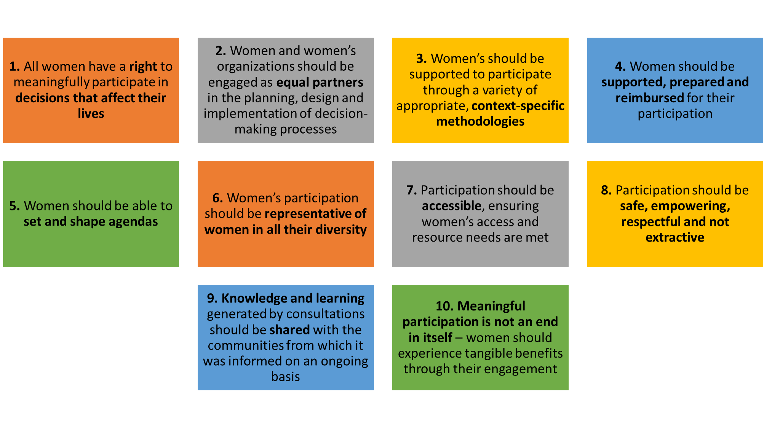
Beyond consultation: 10 principles for meaningful participation
Beyond Consultations tool (2019), GAPS, Women for Women International, Amnesty International UK, Saferworld and Womankind Worldwide
Notes:
Another useful tool to promote more meaningful engagement of women in fragile and conflict-affected states is the “Beyond Consultations” tool developed by GAPS, Women for Women International, Amnesty International UK, Saferworld and Womankind Worldwide.
Enables self-assessment of consultation practices and provides a best practice framework to ensure that women and women’s organizations are fully engaged in decision-making processes.
Self-assess the extent to which consultation practices, large or small, meaningfully engage women. The traffic light system helps scores progress when designing and delivering a consultation activity.

Slide 13
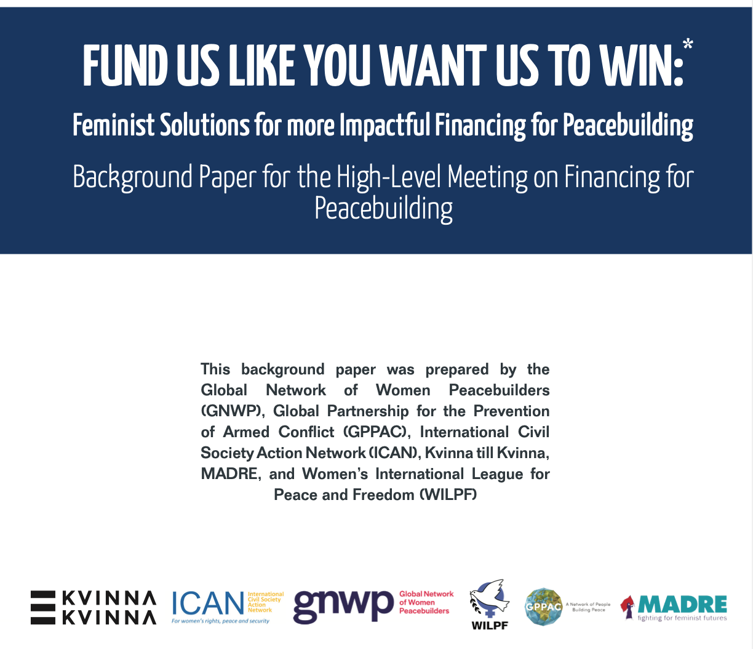
How to meaningfully support women peacebuilders?
Local ownership
Authentic partnership
Sustainability
Notes:
Based on the recent discussions on financing for peacebuilding, the international donors are looking at innovative avenues to transform the current system of peacebuilding financing to sustainably address the challenges faced by diverse women peacebuilders. This year’s topic of GPI is an ideal opportunity to pursue such a change. And in this it is important to consider points that specifically relevant to your roles as intermediary. We provide some concrete suggestions and examples in the joint paper and suggest that you really think strategically about how to best structure your project in a way that supports local ownership, establishes authentic partnership with all partners involved in the project and ensure that efforts support women beyond just funding with a broader set of skills, resources and tools that will support their work in long term. Now, we will unpack each element for your consideration:
Source: https://gppac.net/resources/fund-us-you-want-us-win-feminist-solutions-more-impactful-financing-peacebuilding

Slide 14
Local Ownership
Co-creation: ensure that all partners co-determine the direction of the project;
Bring in beneficiaries: provide flexibility to beneficiaries from the very early stages;
Participatory grantmaking: adapt participatory resource allocation strategies (esp. small grants); and
Plan ahead: encourage joint programming (but be mindful of time and resources).
Notes:
Concretely, this means working with local peacebuilders to understand what their priorities are… take time to listen … and ensure that they can work within the scope of the problem.
Think about beneficiaries in advance and ways to provide them with subsequent flexibility. Those who end up benefiting from services must be able to make a selections about where this project is going and how.
Local women peacebuilders must be able to directly influence financing priorities, allocations and planning and be at the center of partnership frameworks. [GNWP example and GPPAC example pp. 8-9]
Working jointly provides well-rounded results; however, at the same time, it requires time to coordinate roles, expectations.

Slide 15
Authentic partnerships
A shift from a narrative of “risk” to one that is based on “trust” in practice:
Designing and managing participatory resource allocation processes, promoting flexible financing instruments and modalities;
Conducting capacity-building needs assessments and then helping local organisations meet those needs;
Supporting adaptive monitoring and evaluation processes, including community-led determination of impact and encouraging clear and realistic goals;
Facilitating access to global, regional and cross-border expertise for local organisations; and
Prioritising long-term, trusting partnerships, rather than short-term collaborations between INGOs and local organisations for a specific grant process.
Notes:
Experiences of intermediary organisations such as GPPAC and GNWP, which manage grants or distribute money through small grants, confirm that it is possible - and necessary - to shift from a narrative of “risk” to one that is based on “trust.” In the past GPPAC’s experience with GYPI, it has proven to be possible to allocate all decision-making role to local peacebuilders for determining and shifting priorities, with intermediary organisations playing the role in ensuring that processes are run smoothly, provide needed global and regional spaces to amplify experiences and the space for reflection and learning is present.
Such an authentic relationship can be developed through:
The GPPAC’s Youth-By-Youth Small grants project is an example of participatory grant-making, which aims to involve young peacebuilders in the decision on fund disbursement. GPPAC’s Youth Peace and Security Working Group – composed of young peacebuilders – aids development of the YPS Small Grants scheme to support other young actors.
To circumnavigate the barriers for youth organisations to access financial support in the long-term, INGOs and youth-focused CSOs can establish sustainable, strategic partnerships with youth-led organisations, going beyond merely financial commitments to ensure a holistic provision of support. This includes providing a “package” of technical and networking support that can enhance their organisational capacities as well as providing access to key policy spaces without forcing them to operate as “adult” organisations. Funds coupled with joint advocacy engagement can amplify and provide space for multi-stakeholder learning, exchange and action.
Choose those with whom you already have or will have stable relationships and how broader reach to those who would not otherwise be able to benefit would be able to join the project. In this, it is important to work with networks that bring a variety of partners with diverse areas of expertise.
The principles of authentic partnerships into their funding modalities and ensure that any intermediary organisations they work with operationalise and apply these principles in their work with local peacebuilders as well. Take a step back.
(GNWP’s flexibility of funding example, p.12)

Slide 16
Sustainability
Utilise the “catalytic” role of the Fund;
Practice support that leads to broader sustainability (i.e., partnering with existing local and community structures);
Prioritise institutional capacity, including enhancing resources, skills and capacity to collect data and analyse results; and
Focus on bringing on board diverse partners.
Notes:
It is important to keep in mind that the Fund has specific purposes. In this sense, a catalytic purpose of the Fund could provide a good foundation to kick off additional opportunities and additional support for a specific action that would help to move broader strategies of women CSOs further. For example, working on supporting the NAP implementation at the country level, the grant can be used to support a set of specific activities that can help achieve the result but would not otherwise benefit from grants.
It is important to outline what structures are already there that could support good results.
Beyond projectisation, women CSOs need money the most for simply enabling themselves to strengthen their institutional capacities and have time to do actual work. The grants then to some extent can support additional stuff and training in a variety of areas.
Working with networks at the country level could be the key to support “non-usual suspects”, those who are under-resourced. What it does is allowing local communities to get on board with peacebuilding priorities.

Slide 17
Timeline
Stage 1: Concept notes
Online application portal opens: late May, 2 weeks before deadline
Deadline for the online concept note submissions: June 6
Review of concept notes and results: early July
Stage 2: Full proposals
Deadline for draft proposals for feedback: end of August
Deadline for final proposals: October
Results: November
Funds disbursement: December/January

Slide 18
Available support
Existing webinars on GYPI website:
Intro webinars in Eng, Fr and Es
Youth-inclusive peacebuilding
Gender-responsive peacebuilding
Conflict analysis and theory of change
Monitoring and evaluation
PBF Secretariat/Focal points in country (list will be shared with the slides)
GYPI website, including Call for Proposal in EN, ES and FR, Resources and Frequently Asked Questions
pbfgypi@un.org

Slide 19
Q&A

