Slide 1
UNJSPF Investments
19 June 2020

Slide 2
Long-term Real Return
4.32% as of 31-Dec-19 and 3.52% as of 31-Mar-20
4.10% as of 30-Apr-20
4.21% as of 31-May-20

Slide 3
Strategic Asset Allocation (as of 31 May 2020)
Asset Classes
Minimum (%)
Target SAA (%)
Maximum (%)
Benchmark
Portfolio
Weight** (%)
Weight (%)
Global Equities
30
45
60
57.4
55.2
Private Equity
4
9
15
4.9
4.9
Real Estate
5
12
15
7.4
7.4
Real Assets*
0
4
5
0.3
0.3
Subtotal (GROWTH ASSETS)
39
70
95
70
67.8
Global Fixed Income
10
29
40
29
28.8
Cash & Equivalents
0
1
10
1
3.4
Subtotal (NON-GROWTH
10
30
50
30
32.2
ASSETS)
TOTAL
100
100
100

Slide 4
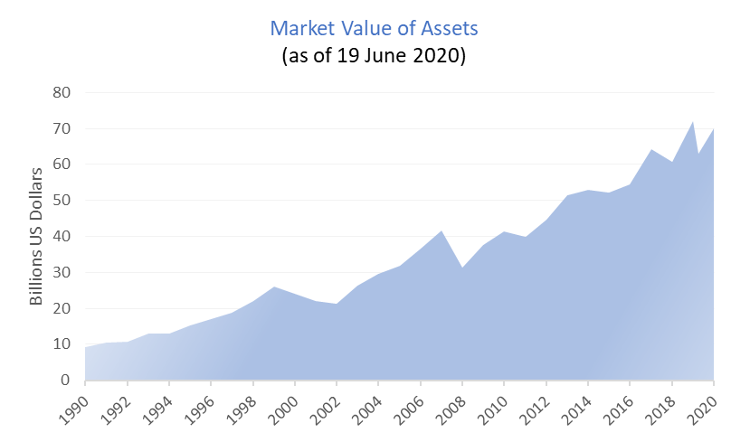
Market Value of Assets
US$72.0B 31-Dec-19,
US$63.1B 31-Mar-20,
US$66.9B 30-Apr-20,
US$68.6B 31-May-20
US$70.1B 19-Jun-20

Slide 5
Market Value of Assets
2007 US$41.7
2010 US$41.4
US$72.0B 31-Dec-19, or.
US$63.1B 31-Mar-20, 12.4%
US$66.9B 30-Apr-20, 7.0%
US$68.6B 31-May-20, 4.6%
US$70.1B 19-Jun-20, 2.7%
25%
2008 US$31.3

Slide 6
Weekly Fund Performance

Slide 8
Strategic Asset Allocation vs. Actual Portfolio
Strategic Allocation Target (%)
Actual Portfolio Weights (%)
Asset Class
SAA 2015
SAA 2019
30-Jun-19
31-May-20
Global Equities
58
45
56.9
55.2
Private Equity
5
9
4.7
4.9
Real Estate
9
12
6.9
7.4
Real Assets
4
0.3
Subtotal (GROWTH ASSETS)
72
70
68.5
67.8
Global Fixed Income
26.5
29
26.1
28.8
Cash & Equivalents
1.5
1
5.5
3.4
Subtotal (NON GROWTH ASSETS)
28
30
31.5
32.2
TOTAL (%)
100
100
100.0
100
SAA or Strategic Asset Allocation represents long-term asset allocation targets and ranges.
SAA 2015 - targets effective 1 August 2015, based on the 2015 ALM study, SAA 2019 - targets effective 1 October 2019, based on the 2019 ALM study and IPS approved on 6 August 2019.
Note:
Investments in Private Equity, Real Estate and Real Assets cannot be bought or sold at a short notice.
They are not affected by short-term asset allocation decisions, which are limited to public markets such as Global Equities, Global Fixed Income and Cash.

