Slide 1
Update on the UNJSPF AFICS New York Annual Assembly
Rosemarie McClean
UNJSF Chief Executive of Pension Administration
23 June 2020

Slide 2
2019 KEY FIGURES FROM THE UNJSPF FINANCIAL STATEMENTS
131,583 participants (+2.3%) and 79,975 beneficiaries+retirees (+1.6%)
USD 2.7 billion of periodic benefits (2.4 billion in 2018) /USD 2.69 billion of contributions from employers/staff
(2.7 billion in 2018)
Processing rate of initial separation within 15 business days is currently over 90% both in New York and Geneva

Slide 3
Benefit Processing Benchmark

Slide 4
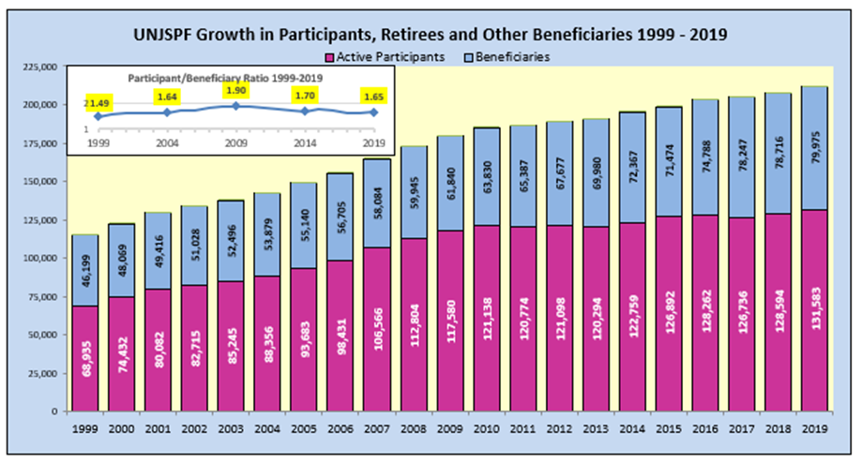
Number of Participants, Retirees, and Beneficiaries

Slide 5
IMPLEMENTATION OF THE 2019 UNGA RESOLUTION (1/5): SECRETARY OF THE PENSION BOARD
Secretary in place ad interim since January 2020
Office of the Secretary established (one P4 and one G6)
Separation of roles in Board committees’ secretarial functions temporarily agreed upon – to be endorsed by the Pension Board at its July session

Slide 6
IMPLEMENTATION OF THE 2019 UNGA RESOLUTION (2/5): RECRUITMENTS OF THE DEPUTY AND THE SECRETARY
Jobs advertised on the UN Careers website from 5 March - 24 April 2020 (Deputy) and from 21 April - 20 May 2020 (Secretary of the Pension Board)
The Succession Planning Committee is examining candidatures and will propose short lists to the Board
Board expected to proceed with the appointments at their July 2020 session

Slide 7
IMPLEMENTATION OF THE 2019 UNGA RESOLUTION (3/5): INDEPENDENT GOVERNANCE REVIEW
Process started in January following UN procurement rules and with the assistance of the UN Procurement Division
Selection made last Friday: Mosaic Governance Advisors

Slide 8
FUNCTIONAL REPORTING AND THE GENEVA OFFICE (1/2)
Effective January 2020, staff report to their functional leads
Renewed collaboration between the two offices – more regular exchanges and harmonizing practices including project work
Realignment of processes have commenced
Performance of the Geneva Office improving
Work still in progress
We are looking at moving the Geneva Office to the Palais des Nations in spring 2021

Slide 9
FUNCTIONAL REPORTING AND THE GENEVA OFFICE (2/2)
There is no downsizing of the Geneva Office
The Finance functions will be centralized in New York for better efficiency
Staff Members of the Finance unit will be reassigned to Geneva’s Client Service and Pension and Entitlement Sections
Front-line services to clients will be strengthened in Geneva as a result of this move.

Slide 10
THE FACIAL RECOGNITION PROJECT
Pilot project started after memo signed by WFP in February 2020, ICC is providing technical support.
The “Application (App)” has been developed and is currently being published in the relevant public application stores (i.e., Apple and Google).
Around 250 WFP retirees have been identified to volunteer as test-users of the new App.
A full-fledge test is ongoing since May 2020.
The results and lessons learned of this initiative will be reported to the UNJSP Board at its next session.

Slide 11
COVID-19 – Business Continuity
Fund prepared with business continuity plans and crisis management tools
All staff are working remotely - receipt/sending of mail and checks have been executed by essential staff from the office
Geneva Office’s Staff started its gradual return to the office as of 8 June in line with UNOG guidance
Staff have worked very hard to ensure continuity of service

Slide 12
COVID-19 – Impact on Operations
The Fund continues to be available on the phone or by email, only our walk-in services in New York and Geneva are closed
Despite remote work, performance has stayed at a high level – over 90% of new pension cases are processed within 15 business days
2019 Annual Statement for participants released mid-May

Slide 13
COVID-19 – Retirees and Beneficiaries
Pension payrolls have been processed on time in March, April and May
Cost-of-living adjustments (COLA) have been processed as usual in April
2019 Certificate of Entitlement (CE) suspensions are postponed to the June 2020 payroll – instead of May as in the previous years. First mailing of the 2020 CEs is now expected end of June 2020, instead of end of May

Slide 14
COVID-19 - Long and Medium-Term Impacts
In order to ensure business continuity, the Fund quickly switched to accepting certain documents (e.g. separation documents) in digital format
COVID-19 highlighted the need for digitalization, going paperless, without compromising the integrity of our controls
The situation and the need for speed modernization has greatly inspired the Strategy 2021-2023

Slide 15
THE STRATEGY 2021-2023: C.A.R.E.
Following a staff survey and a senior staff planning session, a renewed mission, vision, and value statements have been defined. We discussed the draft with all staff across the Fund
A three-year roadmap is being built, outlining impactful change within three strategic themes

Slide 16
C.A.R.E. stands for…
C – Client focused
A - Action oriented
R – Relations builder
E – Efficiency driven

Slide 17
Mission Statement
TO DELIVER:
A simplified client’s experience
The modernization of pension services
A strong, global partnership network

Slide 18
Vision
To be a pension fund that provides outstanding service globally
The ambition is to have, by 2023, a service-oriented Fund and the same high-quality services for all of our member organizations, participants, and beneficiaries wherever they may be.

Slide 19
Values
Integrity, Professionalism, Respect for Diversity
and
Innovation, Partnership, and Service
In these endeavors, we will be guided by the UN values as well as those we have identified as core to the transformation of the Fund.

Slide 20
The Strategic Pillars
Simplify the Client Experience: Client service and satisfaction will become the priority. This pillar will focus on key moments of service delivery to participants, retirees and beneficiaries, giving the tools to employing organizations to do their part. It will move the Fund to become a paperless organization.
Modernize Pension Services: Innovation, business transformation, including mapping the Fund’s value stream, testing robotic process automation and upscaling skills will be the backbone of the modernization.
Develop a Strong, Global Partnership Network: Becoming a data-driven organization and building partnerships with staff, member organizations, and decision makers/stakeholders, enhancing transparency and accountability will improve trust and confidence in the Fund.

Slide 21
Strategy – 2021 Budget Implications
The execution of the strategy requires that we add new skills, especially in the areas of business transformation, project management, and data analytics
More automation requires additional IT services
Efficiency gains from the efforts proposed in 2021 will result in better servicing of the Fund’s clients

Slide 22
Thank you!

