Slide 1

Education—Foundation for Innovation
Ritva Reinikka, Senior Fellow
Second UN LDC Future Forum
Helsinki 5 March 2024

Slide 2
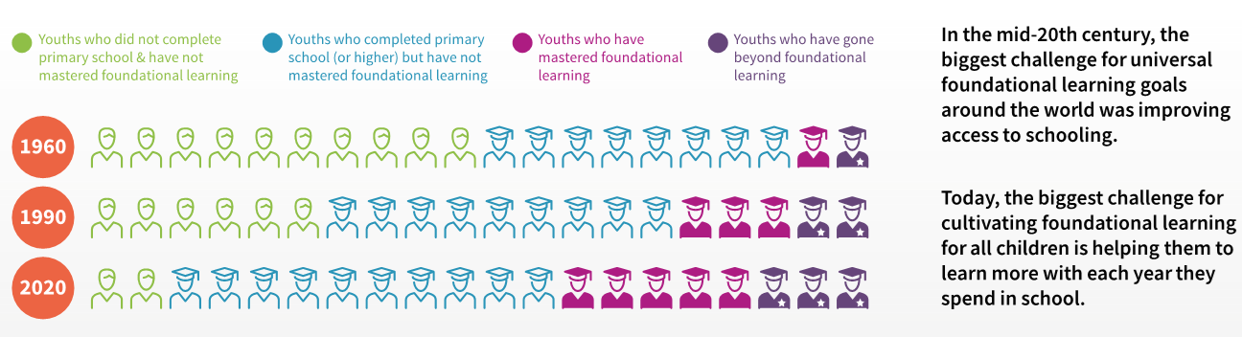
Access to schooling is a global success

Slide 3
Large gaps across regions and countries in the share youth reaching basic skills (akin to SDGs minimum learning level)
Notes:
SDG 4.1.1b minimum proficiency level
Source: S. Gust, E. Hanushek, and L. Woessmann. 2024. “Global universal basic skills: Current deficits and implications for world development. Journal of Development Economics. Vol 166 (1).
Based on microdata of international (PISA, TIMSS) and regional achievement tests (TERCE, SERCE, SACMEQ, PASEC) in 159 countries (mapped to common PISA scale).
At least two thirds of the world’s youth do not reach basic skills, ranging from 24% in North America to 89% in South Asia and 94% in SSA.

Slide 4

A diagnostic of the education system
Service Delivery Indicators
Learning outcomes in Nigeria’s best schools are worse than the outcomes in Kenya's worst schools
Best Schools
In top deciles of teacher presence, and subject knowledge, and in bottom decile of pupil/teacher ratio
Average schools
In 45th-55th percentile of teacher presence, and subject knowledge, and pupil/teacher ratio
Worst Schools
In bottom deciles of teacher presence, and subject knowledge, and in top ventile of pupil/teacher ratio.
Kenya
Nigeria
Uganda
(sd=19)
(sd=21)

Slide 5
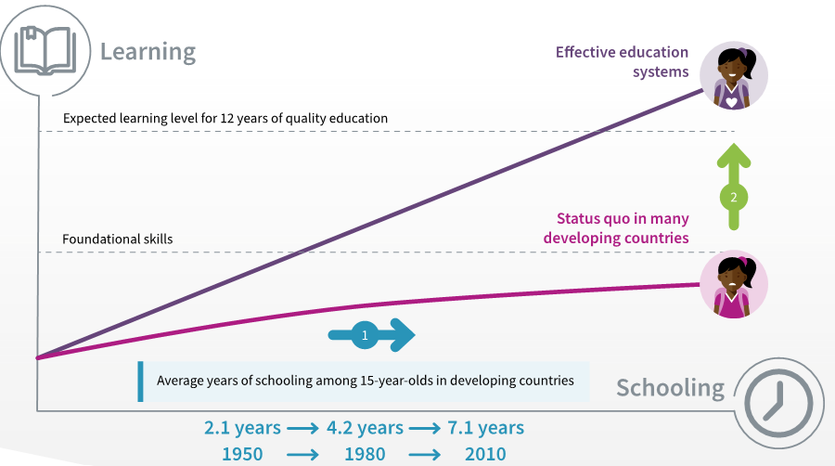
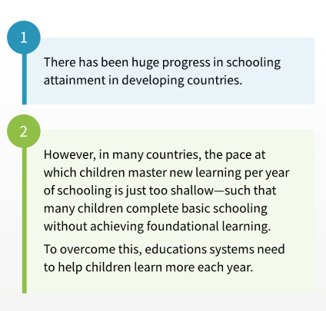
More learning per year of schooling is needed

Slide 6
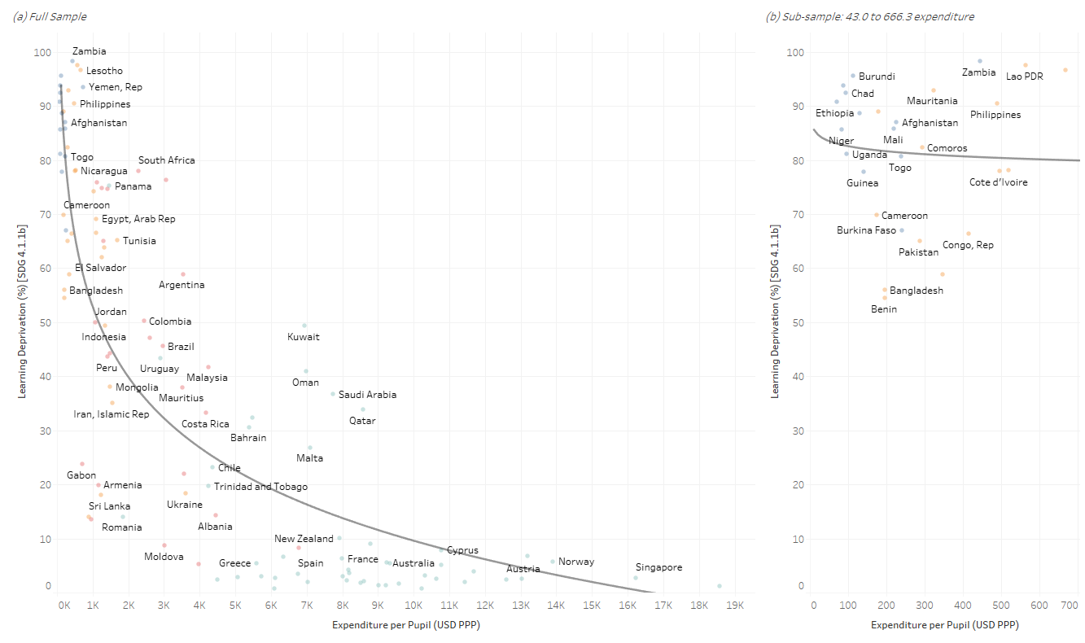
Finance—necessary but not sufficient
Relationship between learning deprivation and expenditure per pupil
Notes:
Source: Joao Pedro Azevedo, Chief Statistician, Deputy-Director Data and Analytics, UNICEF.
A clear negative and statistically significant relationship in which lower levels of learning deprivation are clearly associated with larger pupil expenditure.
However, a closer look a countries at a much narrower range of per-pupil expenditure, such as from USD40 to 700 (PPP), yield a very different picture ➔ the negative and statistically significant relationship disappears.

Slide 7
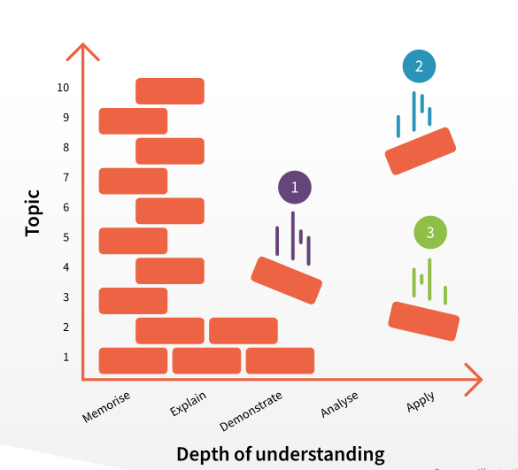
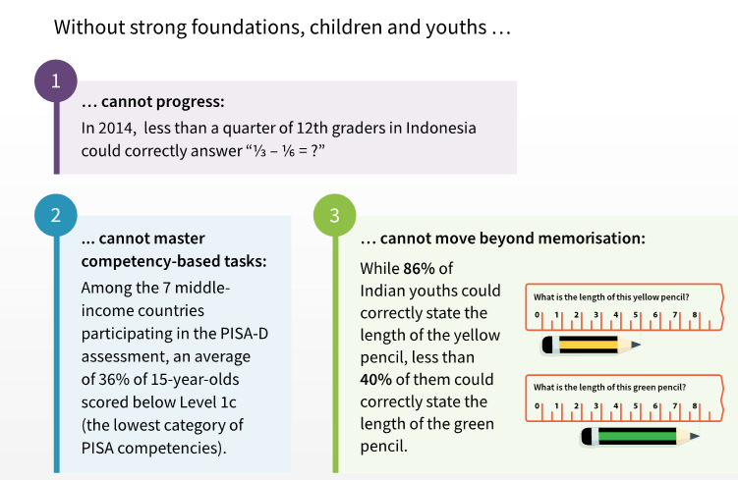
Foundational learning is key

Slide 9
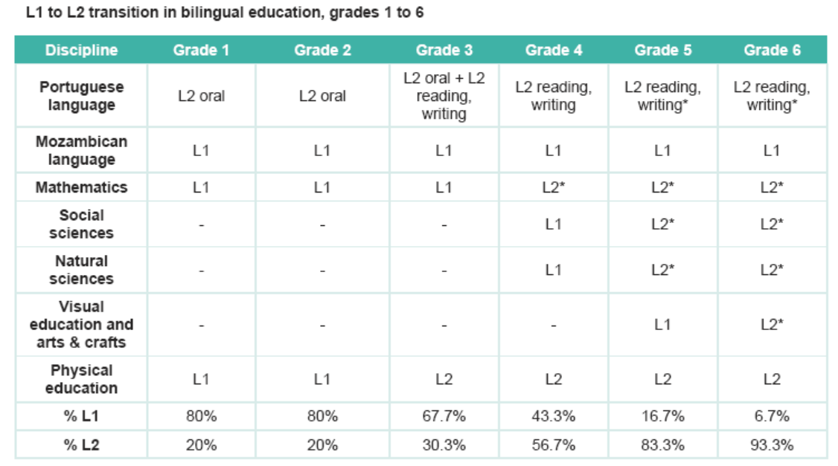
Curriculum shifted towards foundational learning in Mozambique (UNESCO)
Notes:
Spotlight on Basic Education Completion and Foundational Learning in Mozambique 2023.

Slide 10
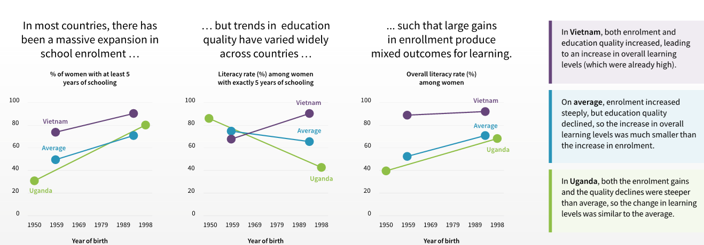
Trends in Foundational learning

Slide 11
Thank you!

