Slide 1

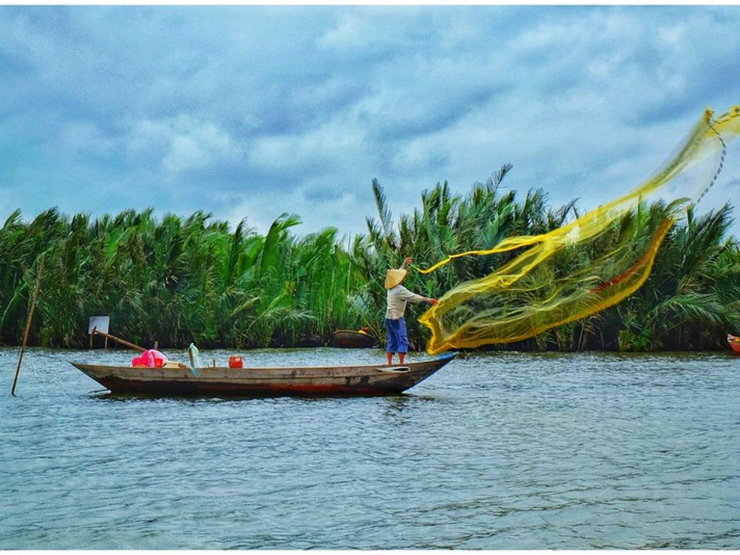


Blueprints for Success: Harnessing Blue Green Economies in Small Island Developing States
Therese Turner-Jones,
Director, Projects Department

Slide 2

Overview
CDB’s Support
Blue Co Caribbean Umbrella Coordination Programme
Unlocking Private Sector Potential
Hinderances to the Blue Economy
Table
OF CONTENTS

Slide 3
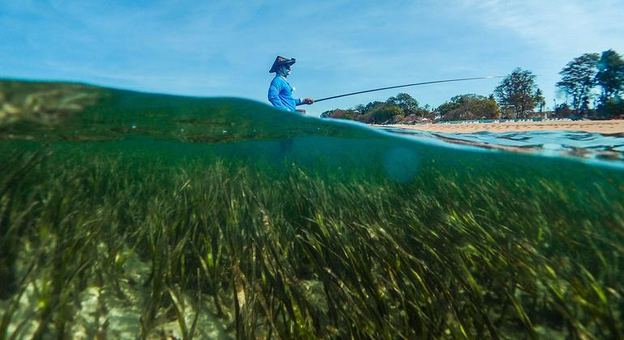
Overview
There is a financing and investment gap in this area
CDB is placing an increasing emphasis on supporting its Clients to invest in the transition toward a climate-resilient and sustainable blue economy.
Regarded as the least-funded SDG. SDG14 (Life below water) has received only 0.1% of global SDG funding from official development assistance (ODA) and only 0.56% of all SDG funding from philanthropies (2016–2020)
Notes:
Finance and financing mechanisms remain key, and should include policy mechanisms that improve available finance, payment for ecosystem services schemes, natural capital as public trade equities, debt swaps, blue and other sovereign bonds, and advances in financial technology.

Slide 4

CDB’S SUPPORT

Slide 5

Blue Co Caribbean Umbrella Coordination Programme
The Blue Co Caribbean Umbrella Coordination Programme is a new initiative that CDB is developing for submission to (and with direct support from) the Green Climate Fund.
The development of this regional programme is being supported by the countries in the region as well as many regional and international partners such as Conservation International, The Nature Conservancy, and the Caribbean Community Climate Change Centre.

Slide 6
Blue Co Caribbean Umbrella Coordination Programme
The Programme will place a particularly strong emphasis on mobilizing the private sector by supporting a series of sub-projects that promote innovative approaches to scaling up private investment in a resilient and sustainable blue economy.
The Programme is still under development but the sub-projects are being defined and designed and will aim to scale up efforts that have already started or are being tried in other regions
.
Notes:
Although the programme is still under development and the sub-projects are still being defined and designed, they will generally aim to scale up efforts that are already underway or have been tried in other regionsThat being the case, we can already highlight two important points that address some of the key guiding questions for this panel:

Slide 7

UNLOCKING PRIVATE
SECTOR POTENTIAL

Slide 8

Private Public Partnerships
To unlock the full potential of our regional private sector, the public sector must be able and willing to bear some of the risk
The public sector will not be able to singlehandedly finance the necessary investment needed to develop the Blue Economy and will therefore need to collaborate with the private sector. PPPs can be a power tool to support such transition, provided the necessary policy and legal environment are in place.

Slide 9



Caribbean Investment Window
Establishment of a Caribbean Investment Window’ under Conservation International.
Conservation International has established similar funds in other regions to provide impact-first debt and equity financing to small and medium enterprises that are actively supporting a climate-resilient blue economy, thereby assisting them to scale up their operations (and investment) in this space.

Slide 10

Caribbean Investment Window
The experience from other regions shows that the fund will first have to be capitalized with concessional resources (e.g. from GCF and CDB) but should be able to transition toward more commercial financing in subsequent rounds once a track record of successful investments has been established.
In such instances, concessional public sector funding can be used as a ‘bridge to bankability’ – but only if it is used strategically and the providers are willing to shoulder some of the risk.

Slide 11

Incentivizing private sector participation
identify PPP models that deliver revenues and returns while simultaneously supporting our blue economy objectives.
Under the agreed PPP arrangement, a modest portion of the revenues will be recouped by the firm, providing the resources needed to continue mapping additional plots and generating more offsets while also providing returns for investors.
most of the revenues will be channeled into a sovereign fund and used to support additional SDG-aligned investments in the country. These are the types of innovative PPP models that we should be considering and pursuing across the region.
Notes:
This is why the Blue Co programme will potentially support a new PPP model being launched in The Bahamas, through which the government and private actors have jointly established a new firm that will lead the country’s efforts to map its blue carbon assets and sell the associated Verra-certified offsets on voluntary carbon markets

Slide 12


Hindrances to the Blue Economy
When debt-service obligations are high, governments are unable to invest in Blue growth.
Local financial institutions perceive blue economy investment opportunities as risky.
UN recommends the following initiatives to support the delivery of blue economy initiatives:
Greater incentive-based private sector investment
Public -private partnerships (PPPs)
Venture capital Financing.

Slide 13
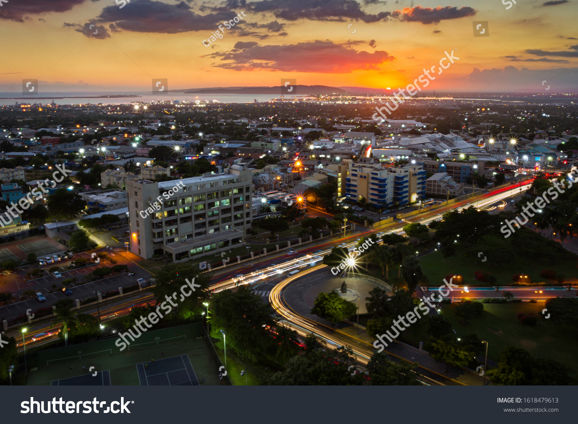


THANK YOU

