Slide 1
The Price of Inaction on Social Protection: Results from CGE Model Exercise for 27 Countries in Asia and the Pacific
Selim Raihan
Professor of Economics, University of Dhaka and Executive Director, SANEM
2 April 2025

Slide 2
Megatrends in Asia Pacific countries
Climate change
Demographic transition
Digitalization

Slide 3
Megatrends and Transmission Mechanism
Megatrend | Scenarios | Transmission mechanisms
Climate change | Global average temperatures rise by 1.5 degrees Celsius as of 2040. Global temperatures rise by 2 degrees Celsius as of 2040. | Capital productivity: The GTAP model applies a negative shock to capital stock productivity to replicate the annual GDP loss expected from global warming.
Demographic shifts, including ageing | Populations age in a healthy manner from 2020 to 2040, implying a relatively modest increase in total health care expenditures, taking into account the pace of ageing and adjusting for healthy ageing. Populations age in an unhealthy manner from 2020 to 2040, implying a significant increase in total healthcare expenditures, taking into account the pace of ageing with no healthy ageing adjustment. | Labour productivity: Without sufficient healthcare investment, aging populations and a declining demographic dividend reduce labor productivity, leading to GDP loss. The GDP loss in 2040 reflects the gap in expenditures needed to meet future health service demands.
Digitalization | Countries improve significantly their productive capacity in ICT (ICT Productive Capacity Index level) catching up to the regional average at least. This contributes to faster economic growth and higher incomes. Countries improve their productive capacity in ICT (ICT Productive Capacity Index level) in line with their recent trends which leads to the limited positive impact of digitalization on economic growth and higher incomes. | Capital and labour productivity: The loss in GDP under this scenario is driven by the lower level of productivity in labour and capital. The rationale behind this assumption is operationalized with cross-country growth regressions where high ICT capacity predicts higher income. Negative shocks to productivity in the GTAP model simulate this decline, aligning with regression-based GDP loss calculations.

Slide 4
A step-by-step approach to link results from the GTAP model to the household data of SPOT
Social Protection Online Tool (SPOT) Simulator: Detailed Household data.
Step 1: We use the GTAP version 11 database to make country aggregation so that 27 countries of the SPOT Simulator are mapped with the country classification from the GTAP 11 database.
Step 2: We apply a global comparative static Computable General Equilibrium (CGE) model, namely the GTAP model.
Step 3: The household-level microdata from 27 countries in Asia and the Pacific are meticulously organized to be integrated with the results of the Global Trade Analysis Project (GTAP) model. This integration enables detailed and dynamic poverty analysis using two distinct sets of results derived from the GTAP model. In the first step of the poverty calculation process, the GTAP model provides percentage changes in remuneration for five distinct categories of labor. These changes are applied to update the per capita income or expenditure figures for household members. The second step involves updating the poverty line income using the percentage change in the GDP deflator, which is also derived from the GTAP model.

Slide 5
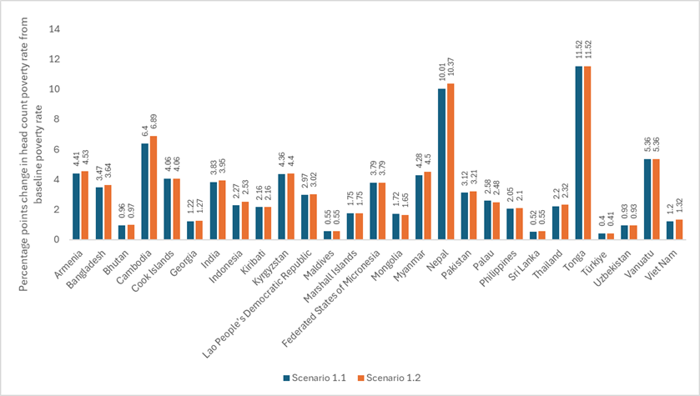
Climate change scenarios and headcount poverty
The number of individuals living in poverty is projected to increase substantially. Specifically, under Scenario 1.1, an additional 100.6 million people (or 3.3 percent of the total population in these 27 countries) are expected to fall below the poverty line. Under Scenario 1.2, this figure rises to 104.6 million people, representing 3.4 percent of the total population in 2040.

Slide 6
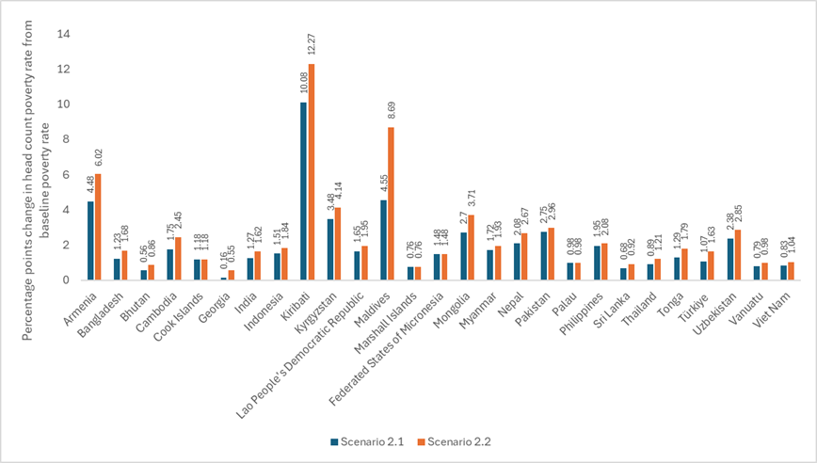
Demographic change scenarios and headcount poverty
Scenario 2.1—assuming healthy ageing—is expected to increase to 45.7 million people living in poverty, which represents 1.5 percent of the total population of these countries. In contrast, Scenario 2.2, which does not incorporate healthy ageing effects, projects a significantly higher increase of 56.1 million people in poverty, or 1.8 percent of the total population.

Slide 7
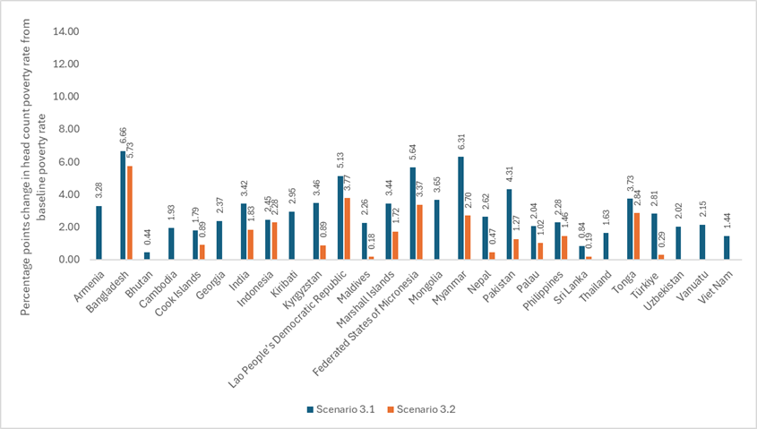
Digitalization scenario and headcount poverty
In the first scenario, which assumes significant advancements in ICT-related productive capacities, the projection shows that the number of people living in poverty across the 27 countries would increase by 53.5 million, or 1.8 percent of the total population in 2040. The second scenario, which assumes no significant enhancement in ICT productive capacities, the number of people living in poverty would rise by 105.5 million, or 3.5 percent of the total population in 2040.

Slide 8
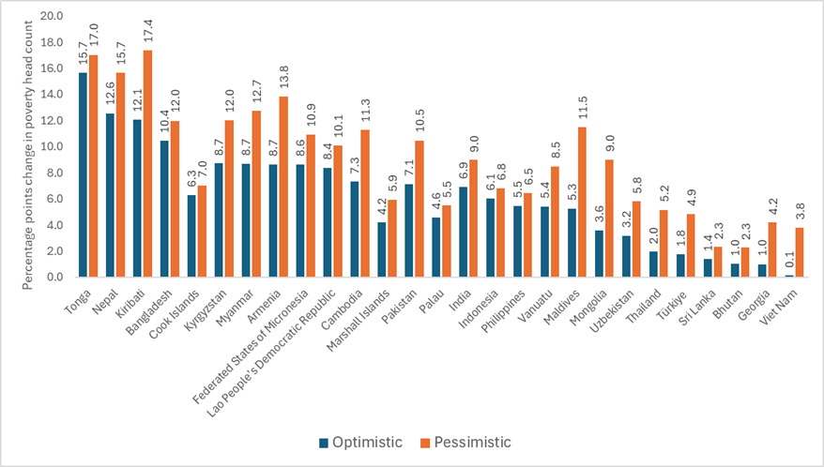
Change in Poverty Headcount Ratios in Asia and the Pacific amid three megatrends
The optimistic scenario predicts an increase of 199.8 million people living in poverty by 2040, which equates to 6.5 percent of the total population in these countries. In contrast, the pessimistic scenario foresees a more dramatic increase, with 266.1 million people expected to fall into poverty, representing 8.7 percent of the total population.

Slide 9
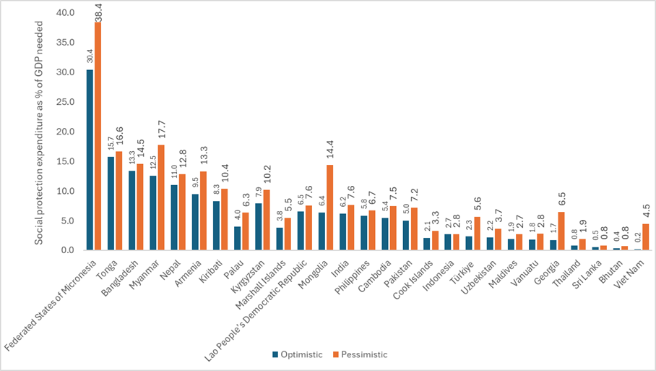
How much social protection spending would be needed to counter the rise in poverty?
If social protection expenditures do not increase drastically between 2024 and 2040, substantial additional resources will be needed to mitigate the combined negative effects of the three megatrends. On average, 6.2 per cent and 8.7 per cent of GDP will need to be mobilized and transferred to affected households if governments are to lift households out of poverty under the optimistic and pessimistic scenarios, respectively.

Slide 10
Conclusion
The paper underscores the urgency for governments to act decisively by enhancing social protection systems, investing in climate resilience, supporting healthy ageing, and embracing inclusive digitalisation.
It emphasizes that while the cost of inaction could be substantial by 2040, proactive investment in social protection now will reduce long-term costs and foster a more equitable and resilient future.
The key message is clear: Immediate action is crucial to prevent significantly higher costs and adverse effects in the future.

