Slide 1
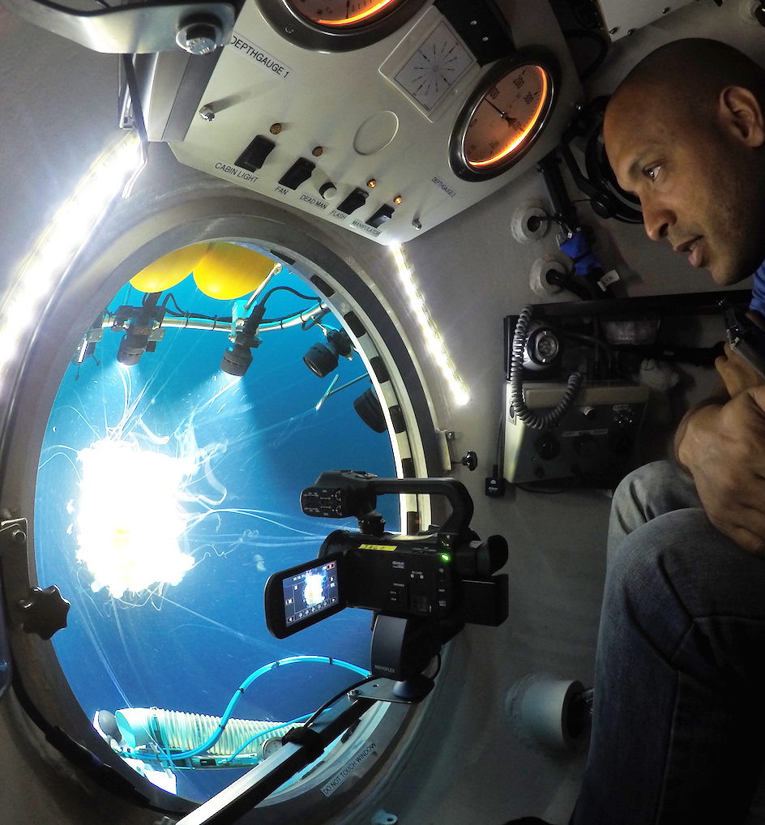
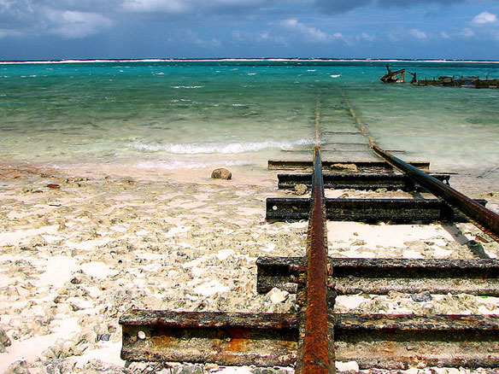
THE VULNERABILITY-RESILIENCE COUNTRY PROFILES
MS’ Comments Received and Suggested Ways to Address Them
27 June 2023

Slide 2
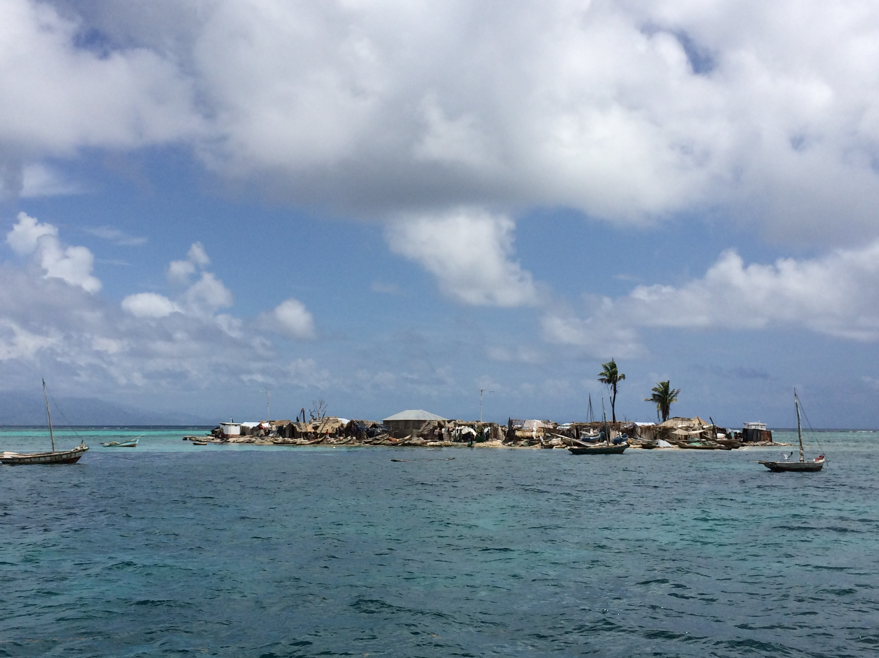
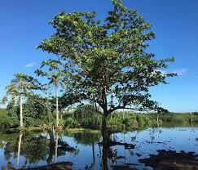
CONTENT
1. Reminder: Objectives of the VRCP
2. Overview of Comments received
3. Two main issues and Suggested ways to address them

Slide 3
OBJECTIVES OF THE VRCP
1/ Provide a detailed, multi-dimensional vulnerability and resilience characterization at national level.
2/ Articulate and recommend priority, integrated, and costed interventions for resilience building at national level.
3/ Enhance, inform, and contribute to the formulation, implementation, and monitoring cycle of National Development Planning Processes

Slide 4
VRCP MS’ Comments – Overview: - Received by Canada, Colombia, UK, USA, EU+MS, OACPS - Overall positive - Two Main Issues Raised – Strategic ones
=> Additional burden for SIDS
=> Additional burden for Custodian Body + Cost implications

Slide 5
Issue #1: Additional burden for SIDS
“At this stage we would like to indicate that the development of VCRP seems to entail a significant burden report and further reflections on how to minimize it would be welcomed”
“We would encourage being mindful of creating additional process and capacity requirements for SIDS”
“Developing quality VRCPs that achieve the intended goals will require technical expertise, resources, and data collection/analysis that many vulnerable countries do not have or that would be diverted from other national development initiatives.”
“…concerned about likely overlaps with the numerous existing country programmes, such as national development strategies, NDCs, and NAPs.”
=> MS’ Recommendations: Incorporation into existing plans and processes
“supportive of the idea raised during the consultation process to link vulnerability -resilience country profiles to National Sustainable Development Plans.”
“we propose that, in lieu of a separate country profile, vulnerability and resilience sections be formally incorporated into national sustainable development plans, or related existing processes noted below, on a voluntary basis for countries wishing to include them”
Our Recommended Response: While this is the approach suggested in the paper already, we will further underline it to make it clear that VRCP is not a stand-alone product and it should be integral part of existing national processes, particularly:
National Development Plans (NDPs)
Integrated National Financing Framework (INFF)
Voluntary National Review (VNRs)
“may be prudent to, in place of the proposed vulnerability-Resilience Country Profiles, consider a peer-to-peer learning and exchange mechanism (e.g., MVI Peer-to-Peer Review) to assess progress and the effectiveness of interventions and actions related or linked to the UN MVI framework and National Development Plans.”

Slide 6
Issue #2 : Additional burden for MVI Custodian body + Additional cost implications
“Adding this responsibility to the Secretariat while expecting them to fulfill their core functions would require additional resources and programmatic and budget implications”
“VRCPs require programmatic and development policy experts, already available elsewhere in the UN system”
“…cost implications for the listed “donor resources (…)” without any prior discussion with these sources”
“Alternatives to VRCP oversight and implementation”
=> MS’ recommendations: NO
Our own recommended response is two-fold:
1. A lean VRCP coordination team will be needed and hosted by the MVI Secretariat. The VRCP team and associated VRCP work (Secretariat level global coordination + country level national implementation) will follow two principles:
In order to optimize synergies and capitalize on existing know-how, and resources, the VRCP work would be substantially guided by the Independent MVI advisory & review Panel (cf. MVI governance arrangements) made of available and voluntary UN and IFIs experts already working on respective country profiles, vulnerability assessments and associated methodologies.
In order to secure financial resources required for VRCP global coordination and national implementation, consideration could be given to the feasibility of using extra-budgetary funding from interested partners or exploring other financing arrangements.
2. Underline that embarking on a VRCP will be country-led, strictly voluntary and that any support to be provided to countries willing to undertake a VRCP will be based on two conditions:
Countries need to be deemed vulnerable as per the determined MVI threshold (tbd)
Financial resources need to be available - expectations need to be managed from the outset.

