Slide 1
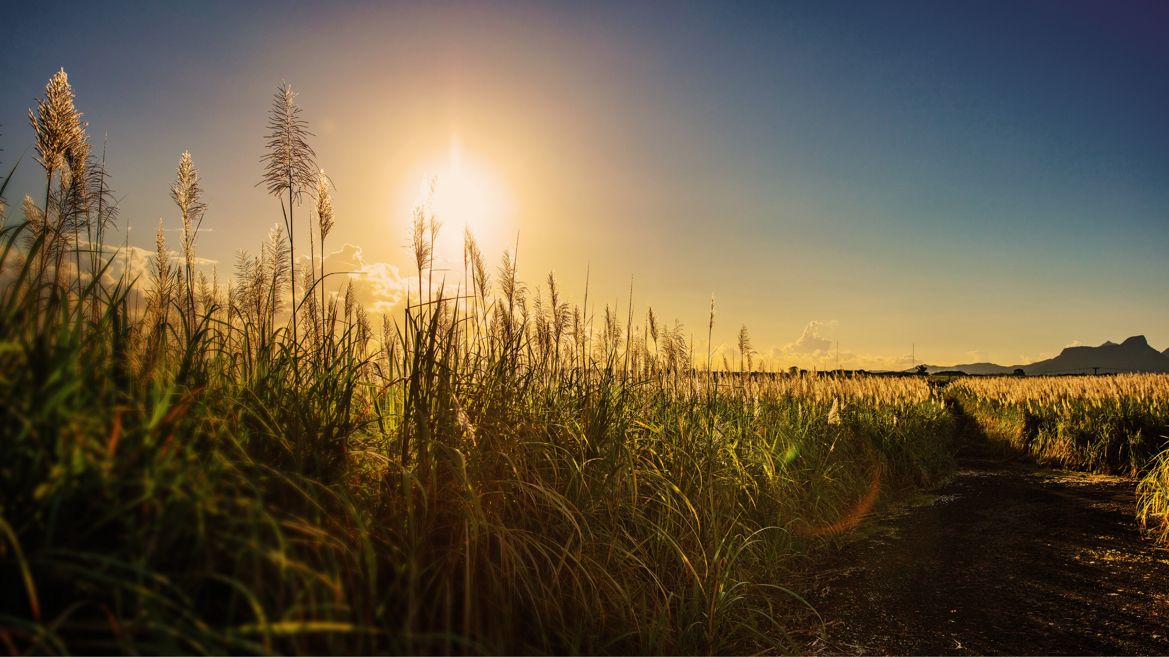







“Role of the Sugarcane Industry in the Green Economy Landscape of Mauritius as a SIDS”
Presented by: Rajiv Ramlugon - Group Chief Sustainability Officer
Date: 29 January 2024

Slide 2
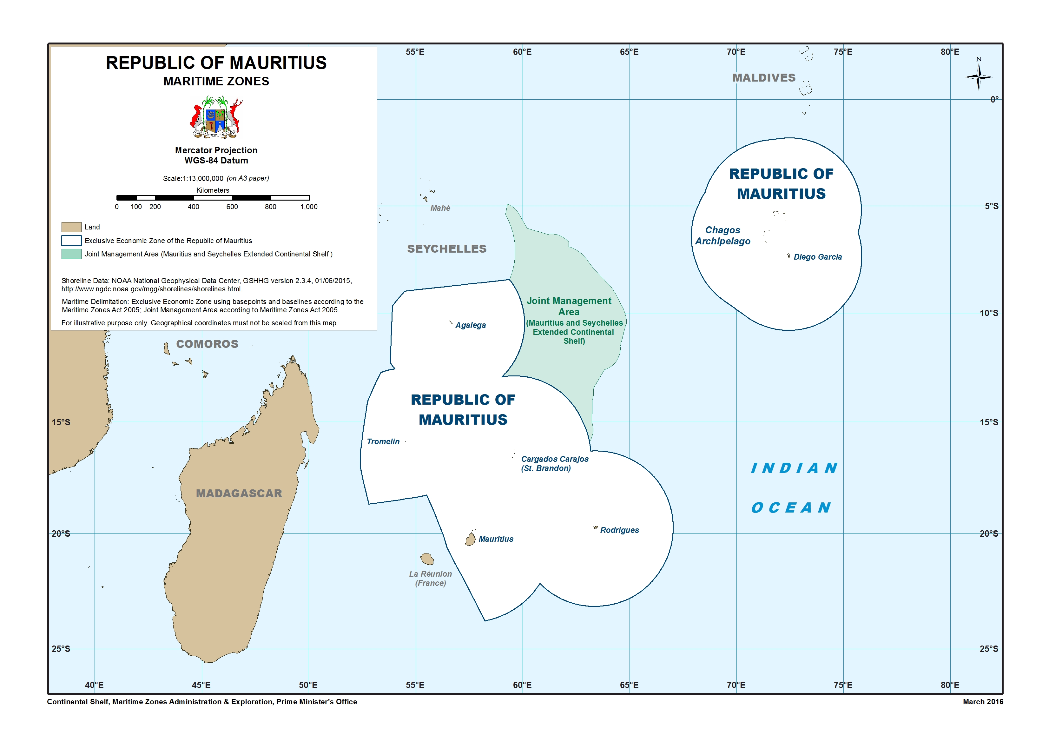
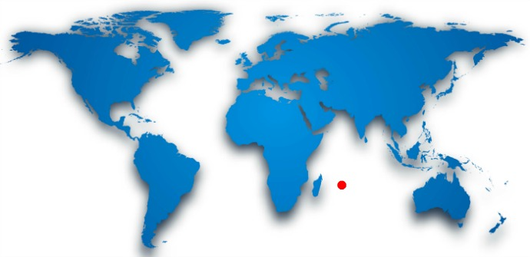
About Mauritius
Land Area: 2,040 Km²
EEZ Coverage: 2.3 million Km²
Population: 1.26 Million
GDP per capita: $12,700
Main Economic sectors: Textile, Tourism, Financial & Business services, ICT, Seafood processing, Agriculture.

Slide 3
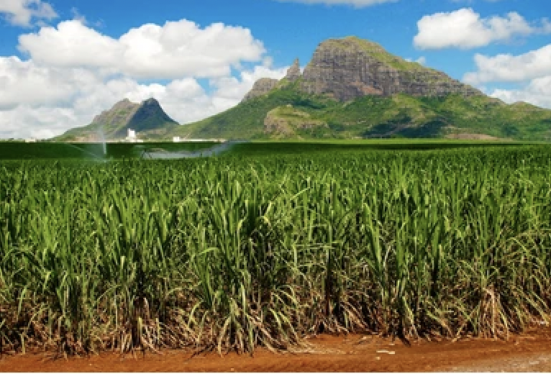
Sugarcane Sector in Mauritius
Oldest crop in the island’s history (nearly 4 centuries)
Backbone of the Mauritian Economy till 1980s
Current land area under sugarcane: 42,000 Ha
Annual Sugar production: 230,000 tons

Slide 4
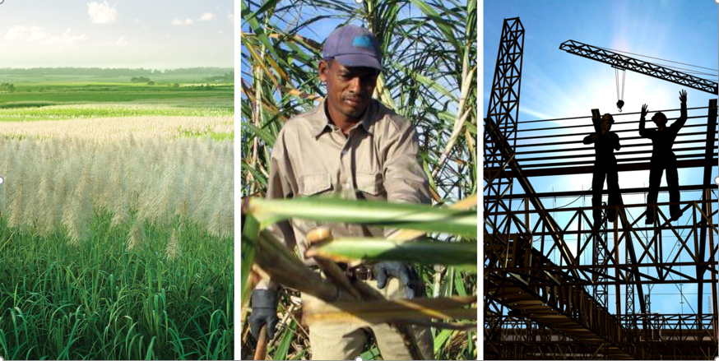
Challenges of the Sugarcane Industry
Economic: Open competition on the international market
Social: Labour scarcity, aging workforce
Environmental: Vulnerability to climate change risks

Slide 5

About Omnicane

Slide 6
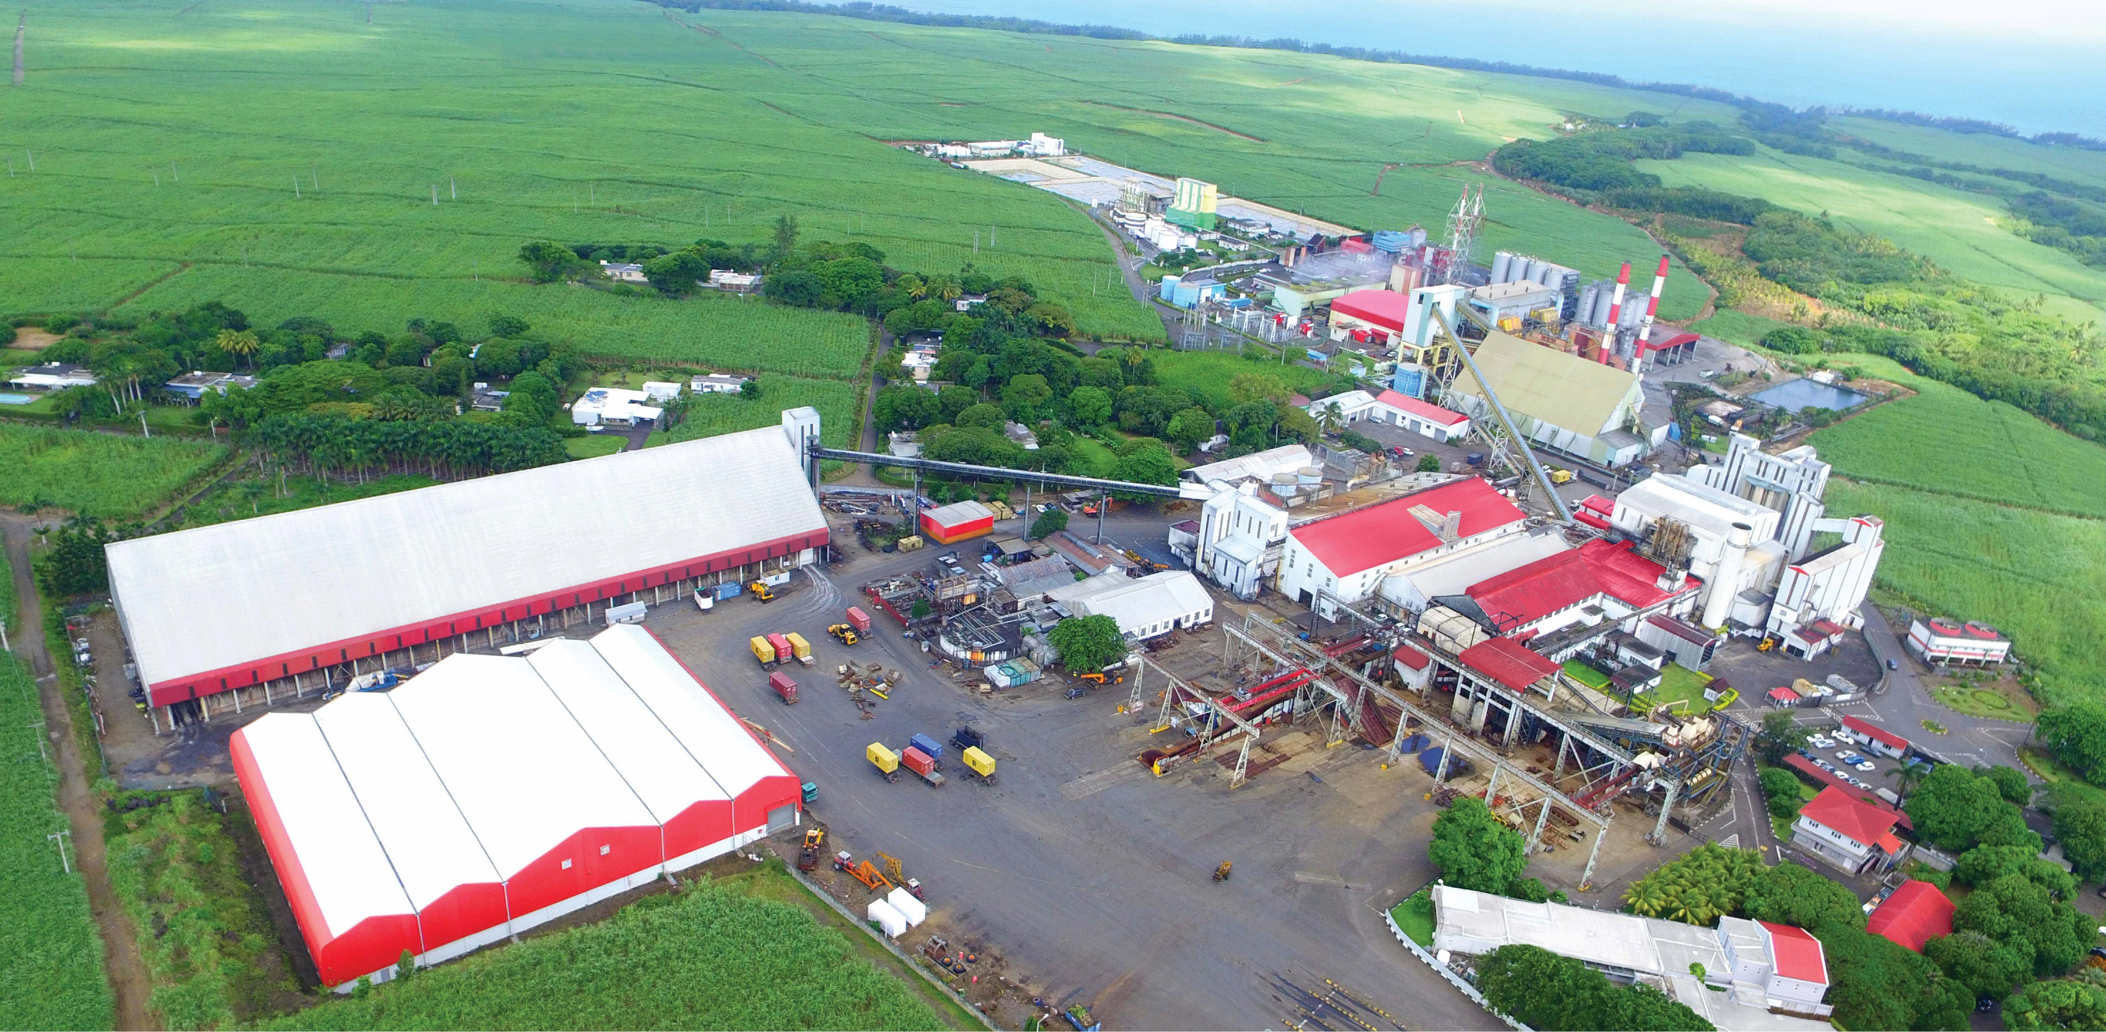
Our Unique Integrated Cane Cluster
The Cane Cluster comprises of:
  A 1.4 M tons capacity sugar mill
  A sugar refinery with an annual refining capacity of 250,000 Tons
  A 24M Lts capacity bioethanol distillery
  A bagasse/coal cogeneration plant of 90MW capacity
  Production of 30,000 Tons of green cement annually
  Production of 60,000 Tons of Bio-fertilizer
  Capture and processing of CO₂ for use in Beverage industry
  Direct Employment: 800
  Foreign Currency revenue for the country: USD 200 M/year

Slide 7
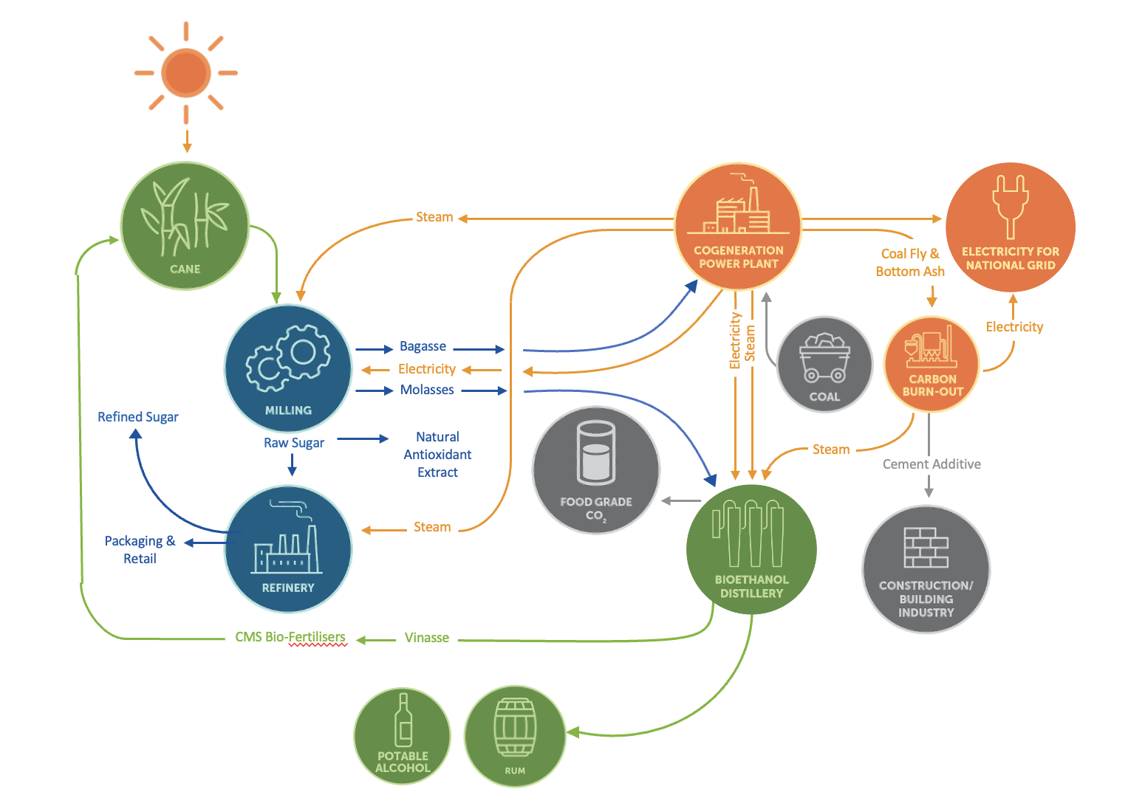

Our Unique Integrated Cane Cluster
We are in the Circular Economy Cycle based on the “Zero Waste” Model

Slide 8
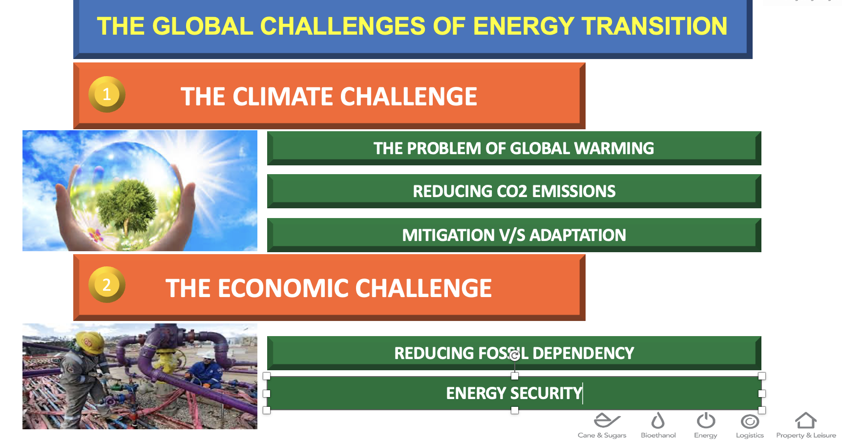
The Energy Transition Challenge

Slide 9
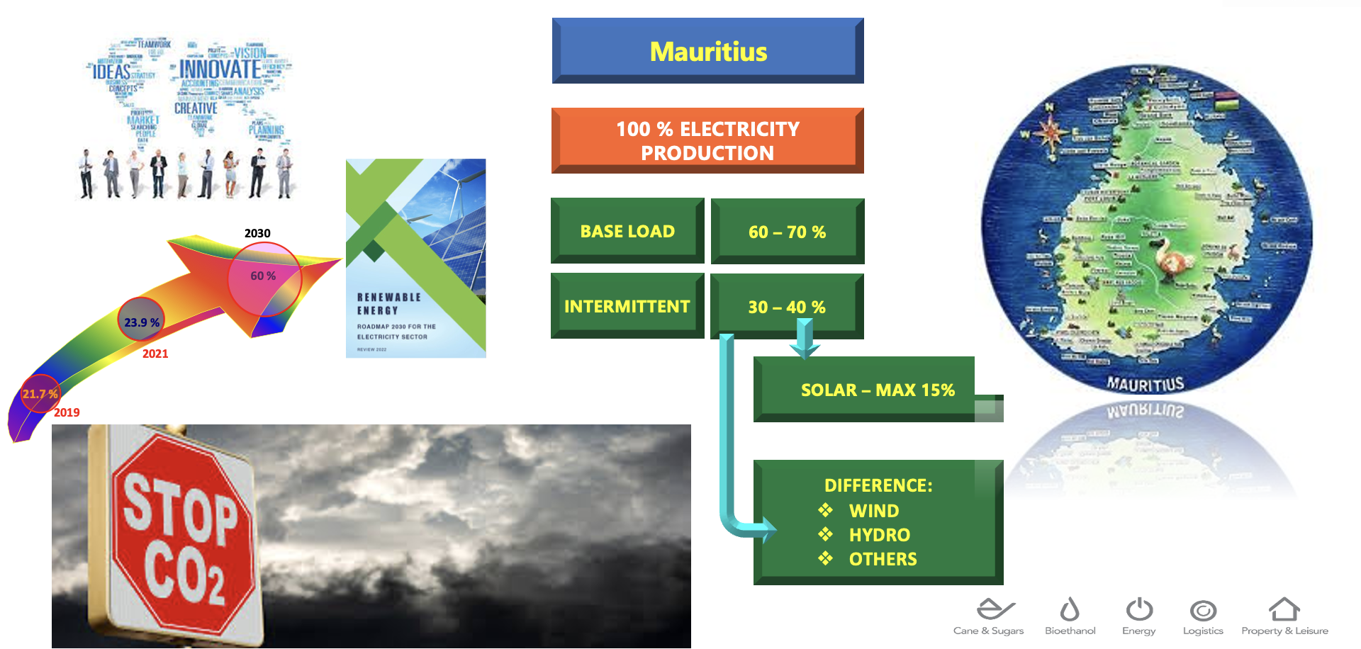
The Targeted Energy Mix for Mauritius

Slide 10
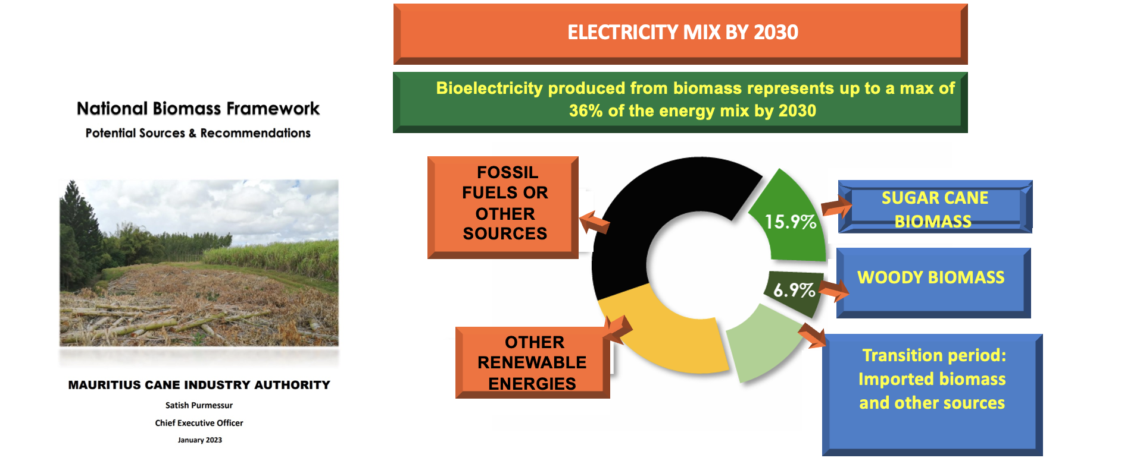
The National Biomass Framework

Slide 11
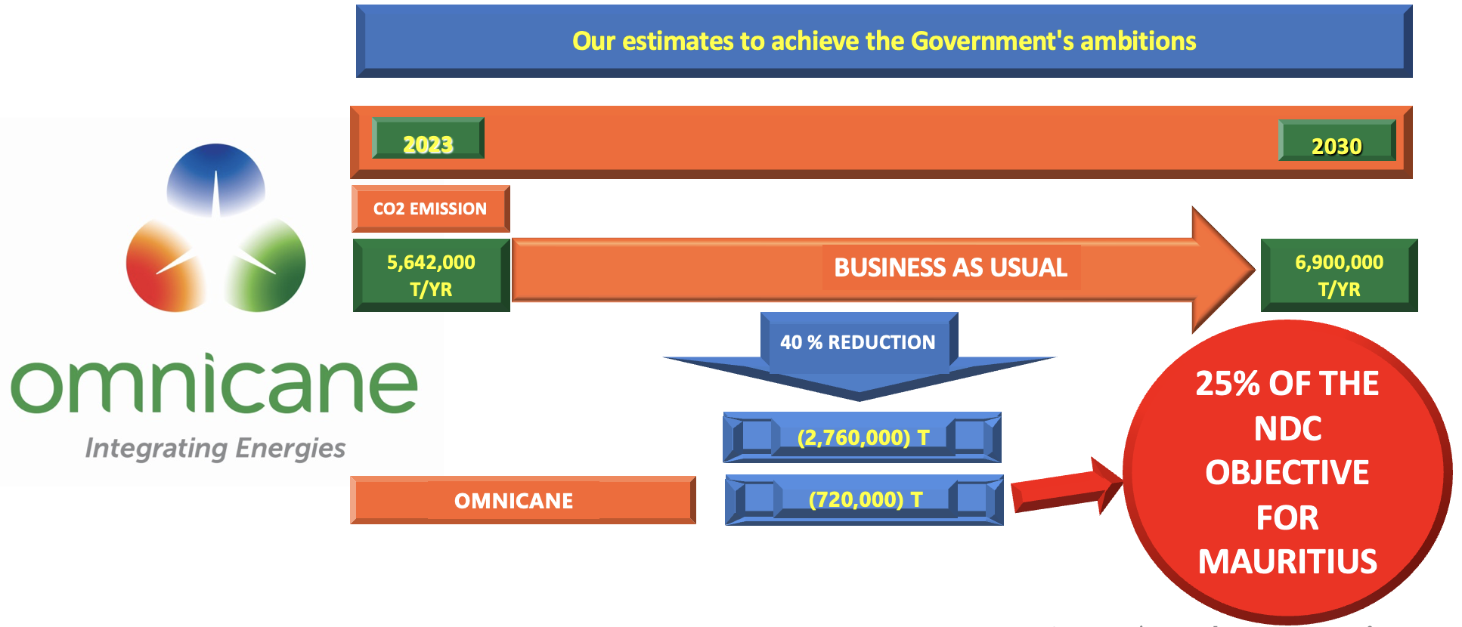
Omnicane’s Contribution to the Energy Transition Target

Slide 12
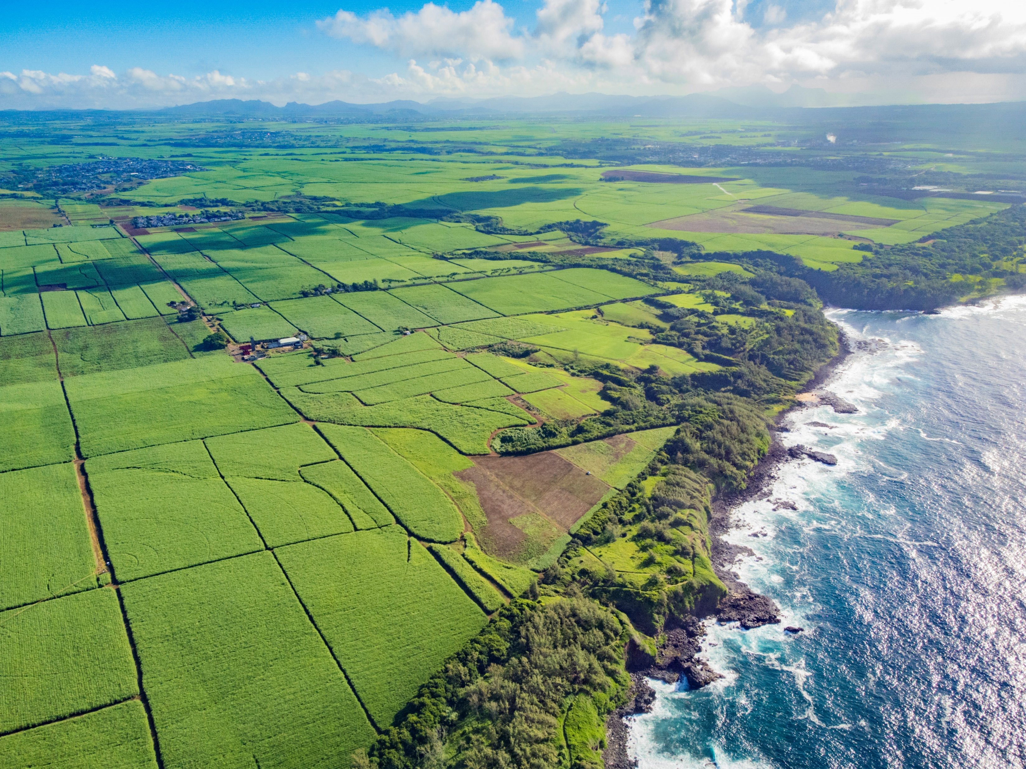
Thank You
Thank you!

