Slide 1
Blue-Green Roadmap for SIDS
A Strategic Approach for Sustainable Development in the Caribbean
DATE: NOVEMBER 6, 2024
Karolin Troubetzkoy
Webinar on Outcomes from the SIDS Global Business Network Forum 2024

Slide 2
KEY CHALLENGES: The “Big Ticket” Items
Climate Change Adaptation and Resilience: Building resilient infrastructure and developing risk management strategies.
Renewable Energy Transition: Investing in renewable projects and infrastructure to reduce fossil fuel dependency.
Coastal and Marine Conservation: Expanding marine protected areas and implementing sustainable fisheries.
Water Resources Management: Enhancing water conservation and addressing water scarcity and quality.
Sustainable Tourism: Promoting eco-friendly tourism and sustainable certifications.
Waste Management and Recycling: Establishing waste systems, reducing plastic pollution through bans and recycling.
Sustainable Agriculture and Food Security: Promoting resilient agriculture and local food production methods.
Infrastructure Development: Upgrading transport and urban infrastructure for energy efficiency.
Biodiversity Conservation: Protecting habitats like reefs and mangroves vital for biodiversity.
Education and Capacity Building: Strengthening sustainability-focused education programs.

Slide 3
KEY PILLARS FOR SUSTAINABLE PROGRESS

Slide 4
KEY ACTIONS TO DRIVE SUSTAINABLE PROGRESS
Key Requirement : All actions must be underpinned by science-based evidence.

Slide 5
Enhancing Governance and Coordination
“Big Ticket Items”: Identifying and focusing efforts on high-impact projects that require coordinated regional actions : Waste, Plastics, Circular Economies, Water, Renewables
Role of Government: Facilitating the creation of policy frameworks that support blue-green integration and enable effective PPP’s. Tax Concession Incentives for Blue-Green Initiatives.
Community Empowerment: Leveraging local knowledge and traditions in sustainability practices. Capacity Building, Empowering Local Initiatives, Community Meetings for Dialogue, Market Access and Networking
Matchmaking Platform: Connecting innovators with investors and community leaders to foster business opportunities.
Success Stories: Showcase examples of successful local initiatives to illustrate potential scalable projects. Continuous Learning and Improvement. Public Recognition. Awards.
Engaging Stakeholders and Implementing Strategies

Slide 6
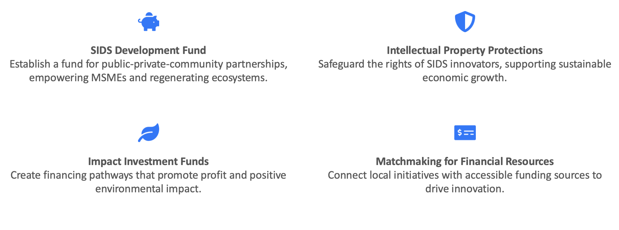
Funding and Financial Support Mechanisms
Easier Access to Grant Funding Capital and Intellectual Property Protections

Slide 7
Strategic Role of Conservation Trust Funds in SIDS
Conservation Trust Funds: Enabling Sustainable Development and Conservation
Sustainable Financing: CTFs provide sustainable, long-term financial support crucial for ongoing conservation efforts. They manage and allocate funds efficiently to maximize conservation outcomes.
Supporting Policy and Regional Integration: CTFs help align national strategies with regional conservation priorities, ensuring cohesive policy frameworks across SIDS. They enhance the implementation of international environmental agreements and regional biodiversity strategies.
Community Empowerment and Engagement: By funding local conservation initiatives, CTFs ensure community involvement and buy-in, essential for the success of environmental projects. They integrate traditional knowledge and practices in conservation efforts, respecting indigenous insights.
Facilitating Multi-Sector Collaboration: CTFs serve as platforms for collaboration between governments, NGOs, the private sector, and international donors, avoiding duplication and leveraging collective expertise for greater impact.
Driving Local and Global Impact: Through strategic funding and partnerships, CTFs help implement projects that address both local conservation needs and global environmental targets, including the '30x30' target to protect 30% of land and ocean by 2030.

Slide 8
Commitment and Collaboration
Strategic Importance: Breaking Silos Across Sectors.
Need for a cohesive public-private sector approach to Blue-Green Development in the Caribbean and across SIDS to accelerate progress irrespective of political changes.
Call to Action: Encourage stakeholders to engage with the roadmap and commit to collective action. Organize regional events to connect governments and the private sector within each SIDS region in a targeted manner, and to provide recommendations for governments to strengthen policies and their support to their local businesses
Monitoring and Evaluation: a detailed framework that outlines who will be responsible for monitoring, the metrics of success, and the frequency of evaluations would enhance accountability and effectiveness.

Slide 9
RECENT PUBLICATIONS
Soon published on CBF website:

