Slide 1
Webinar on Outcomes from the SIDS Global Business Network Forum 2024
‘Implementing the Private Sector Priorities in Support of the Antigua & Barbuda Agenda for SIDS’
6 November from 10-11.15 AM (New York time)
A public-private-community trust fund recommendation :
A Sport Tourism Development Fund for Youth and Community Engagement
Olivier Naria, Associate Professor, University of Réunion

Slide 2
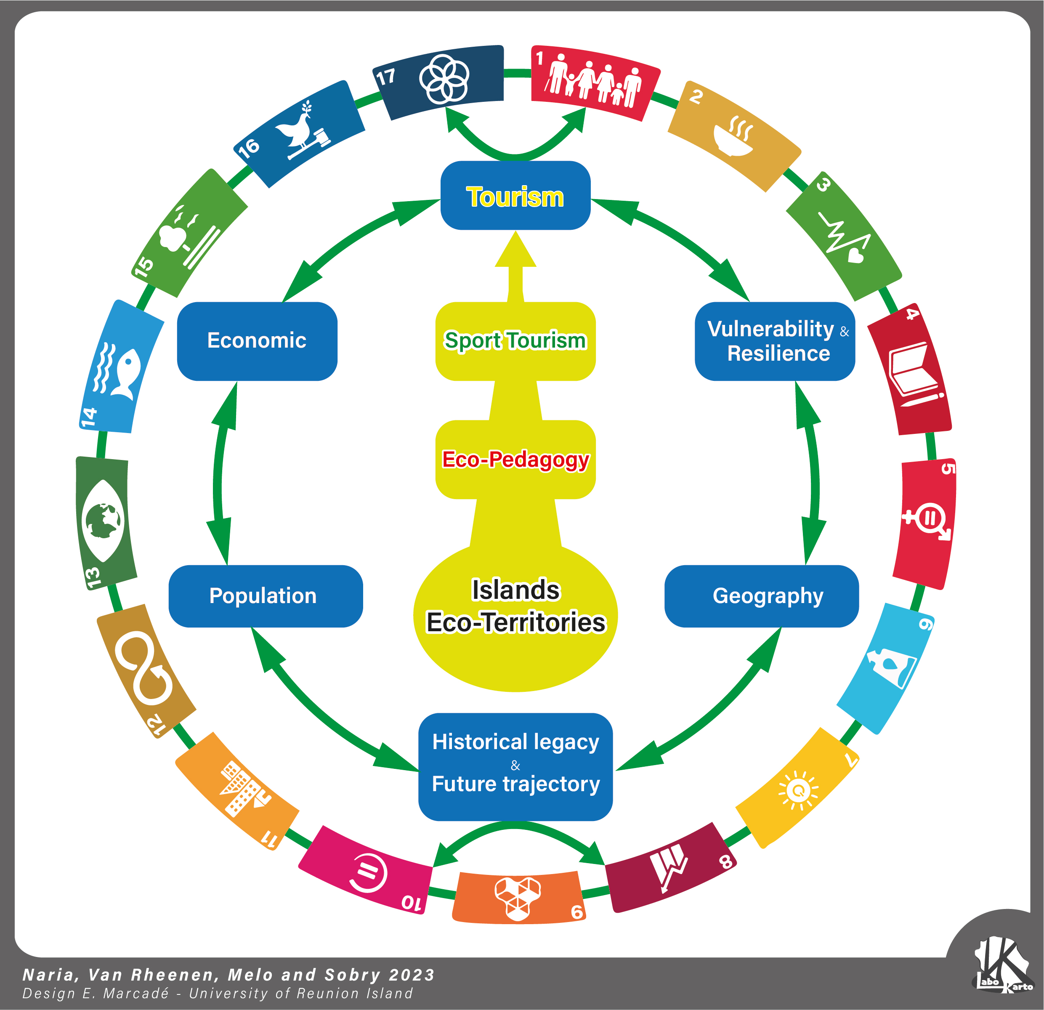
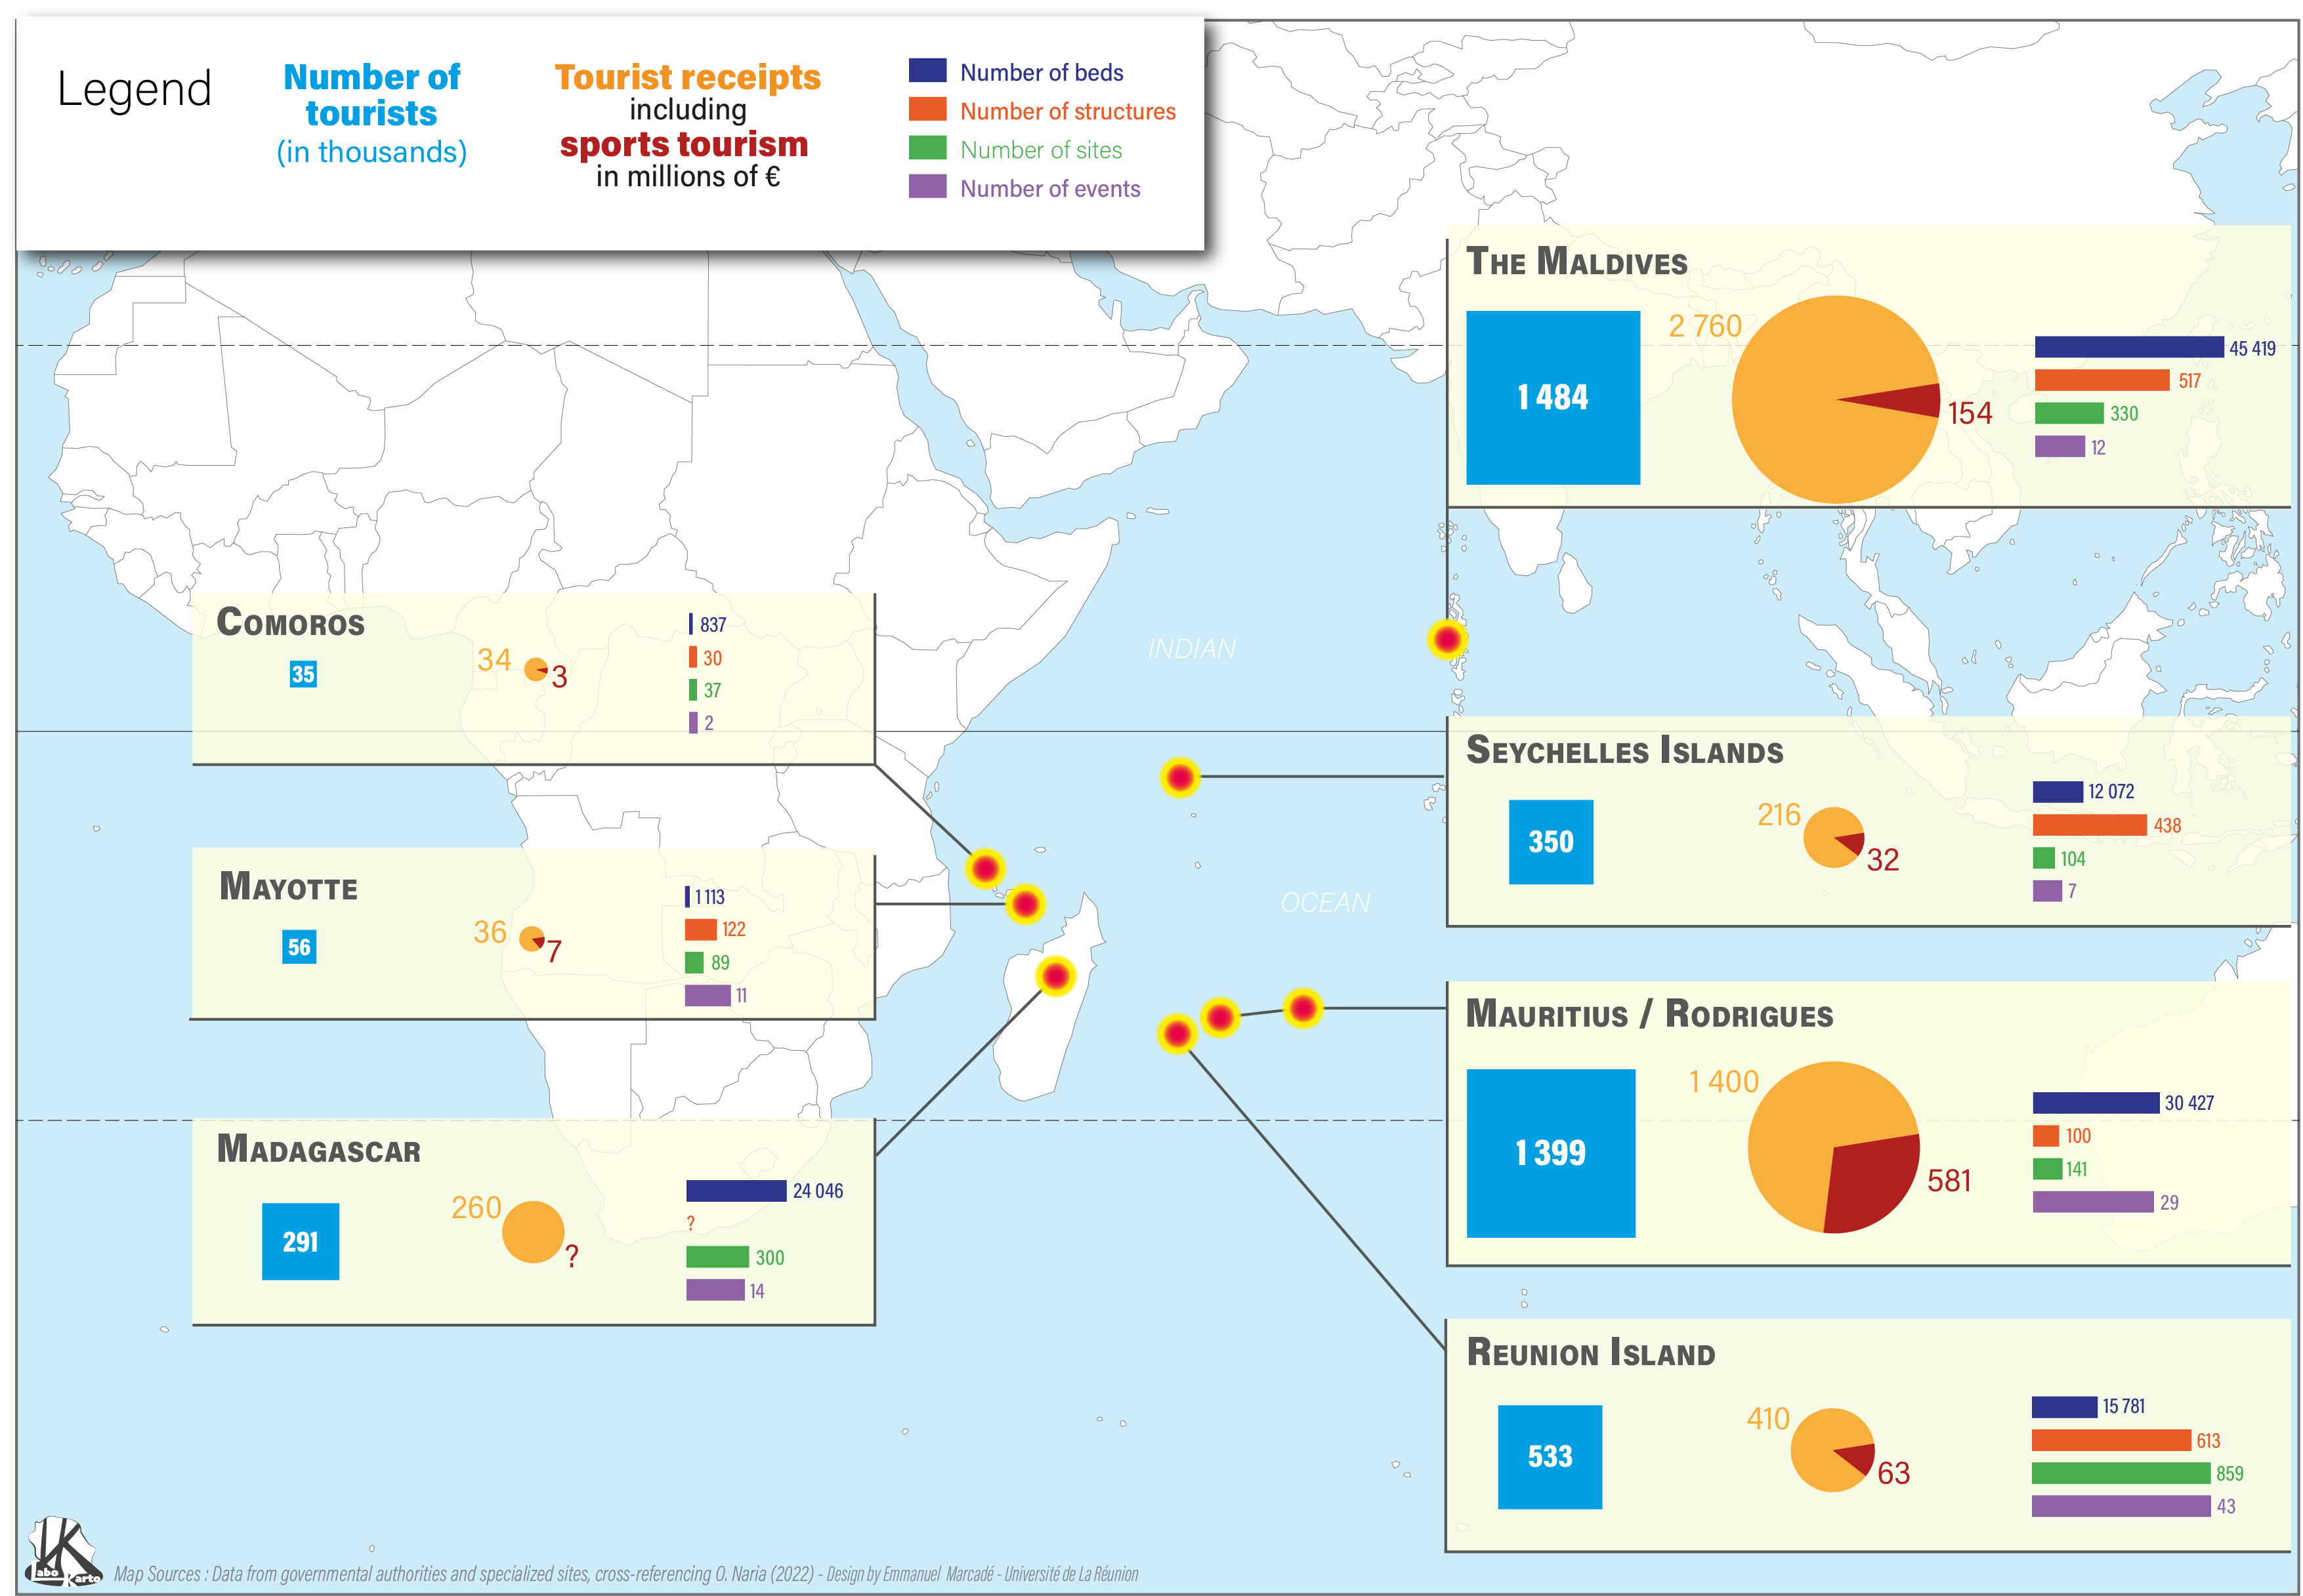
1-Key challenges and opportunities for a Sport Tourism Development Fund for Youth and Community Engagement
Research on sport tourism has globally ignored small islands destination (SIDS)
Sport tourism contribute to the emancipation of local communities, especially young people
Sport tourism foster inclusive economies to stimulate transformation and resilience

Slide 3
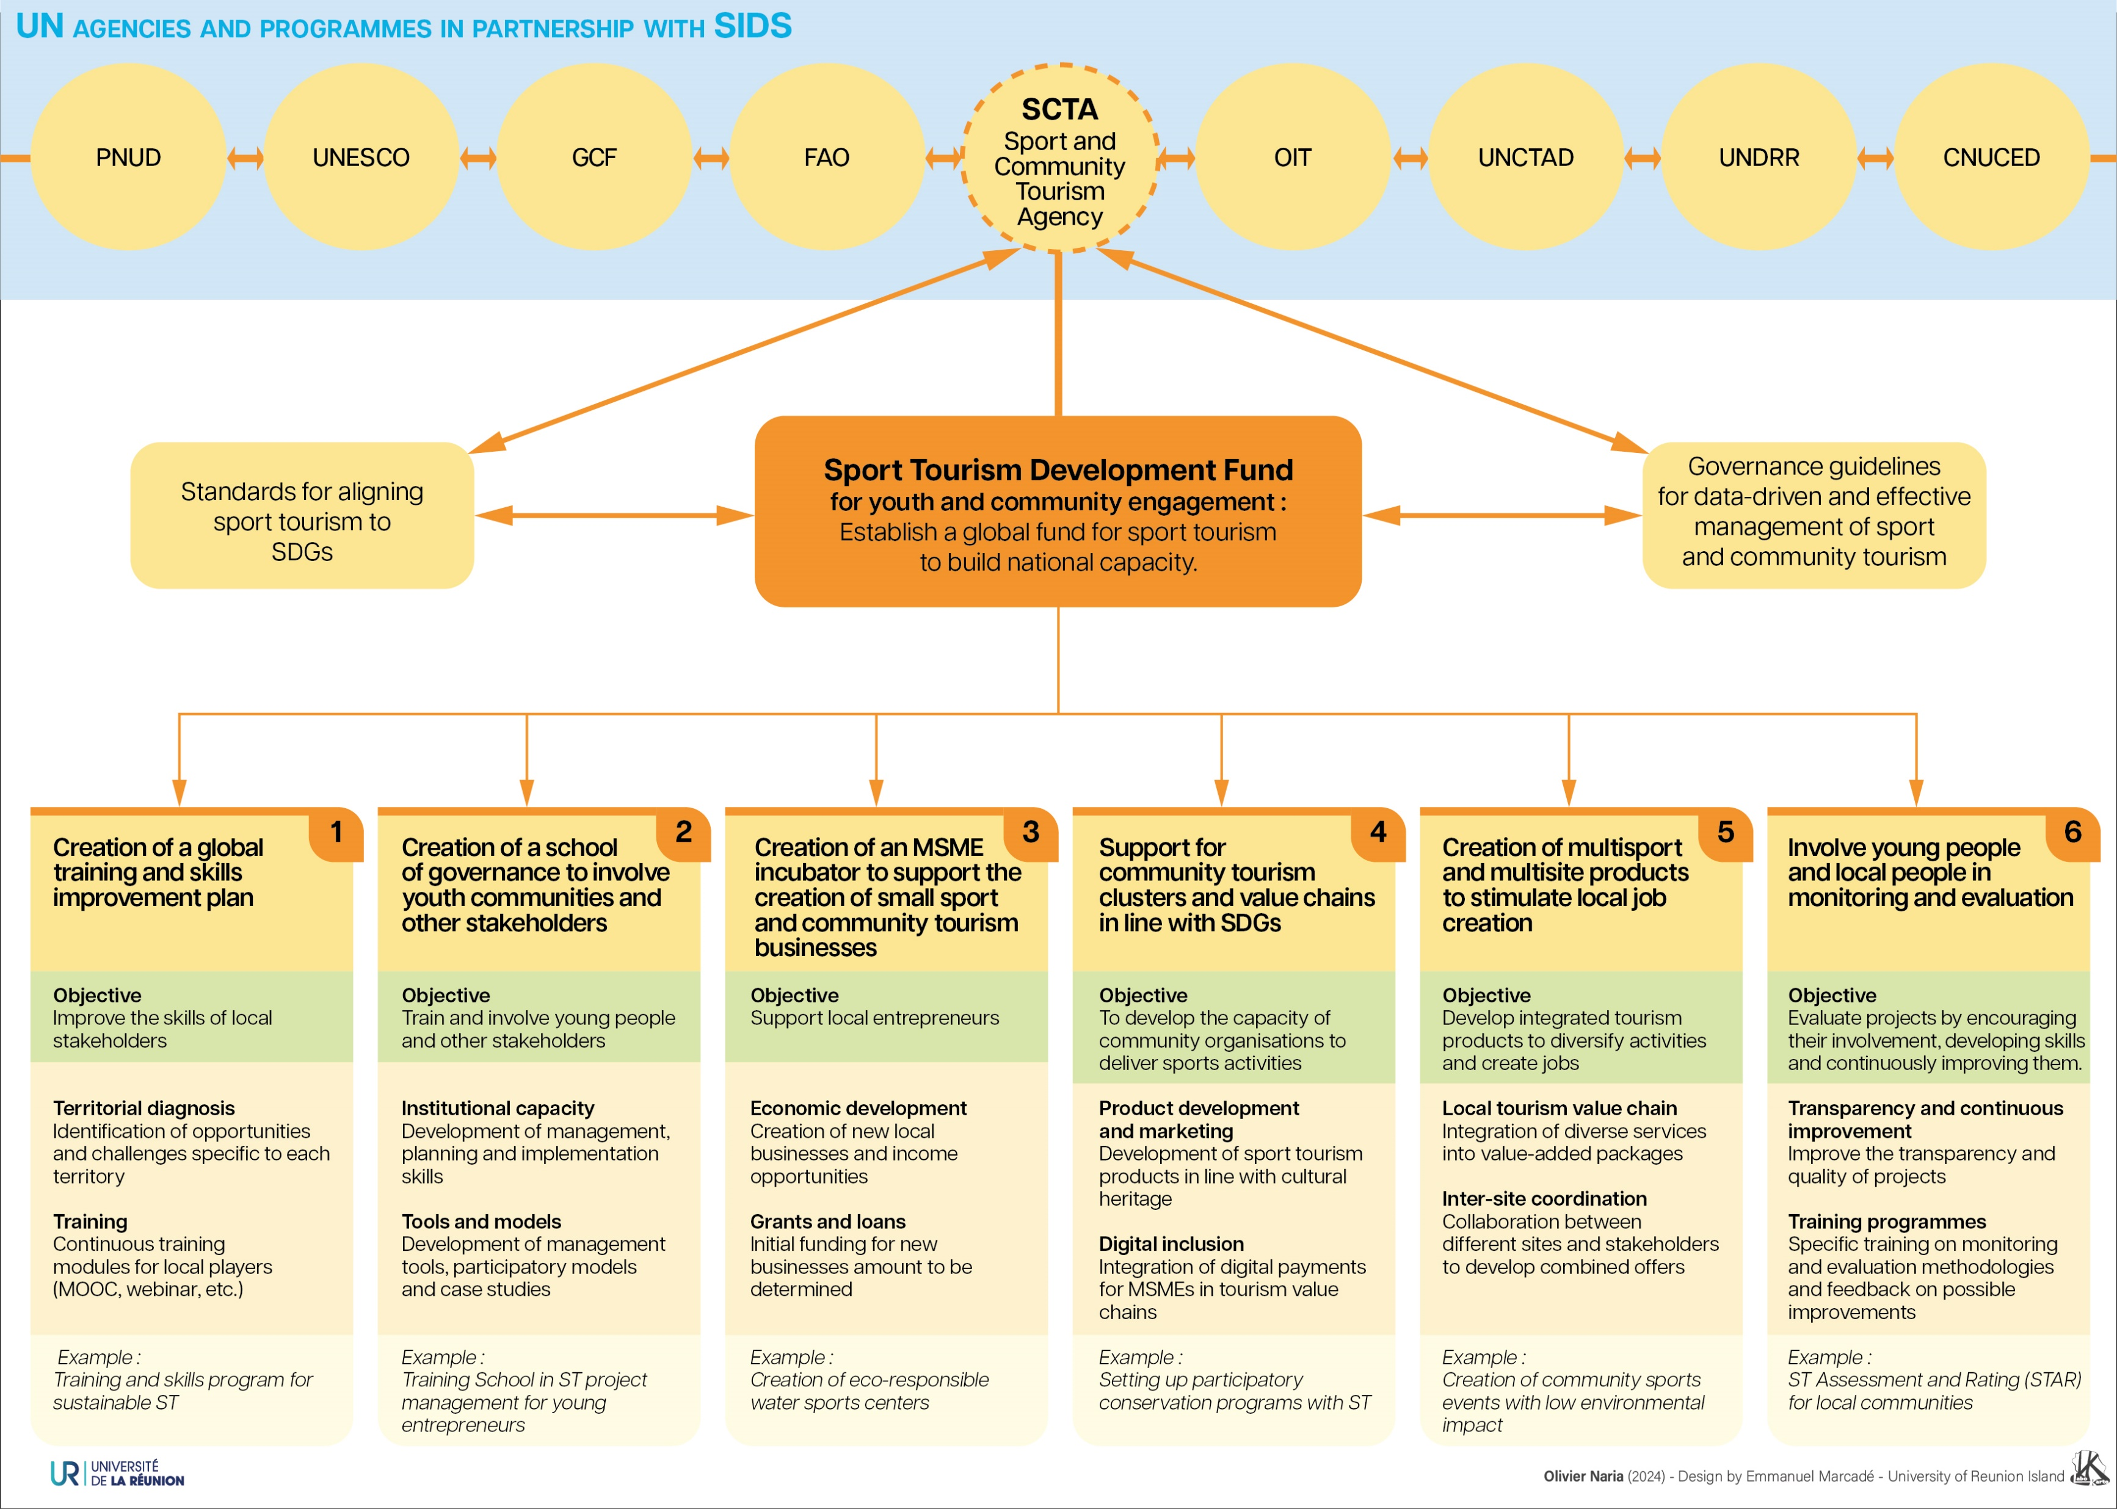
2- A Sport Tourism Development Fund for Youth and Community Engagement
Bertrand, Hamilton, 2024 ;
Van Rheenen and al, 2024.

Slide 4
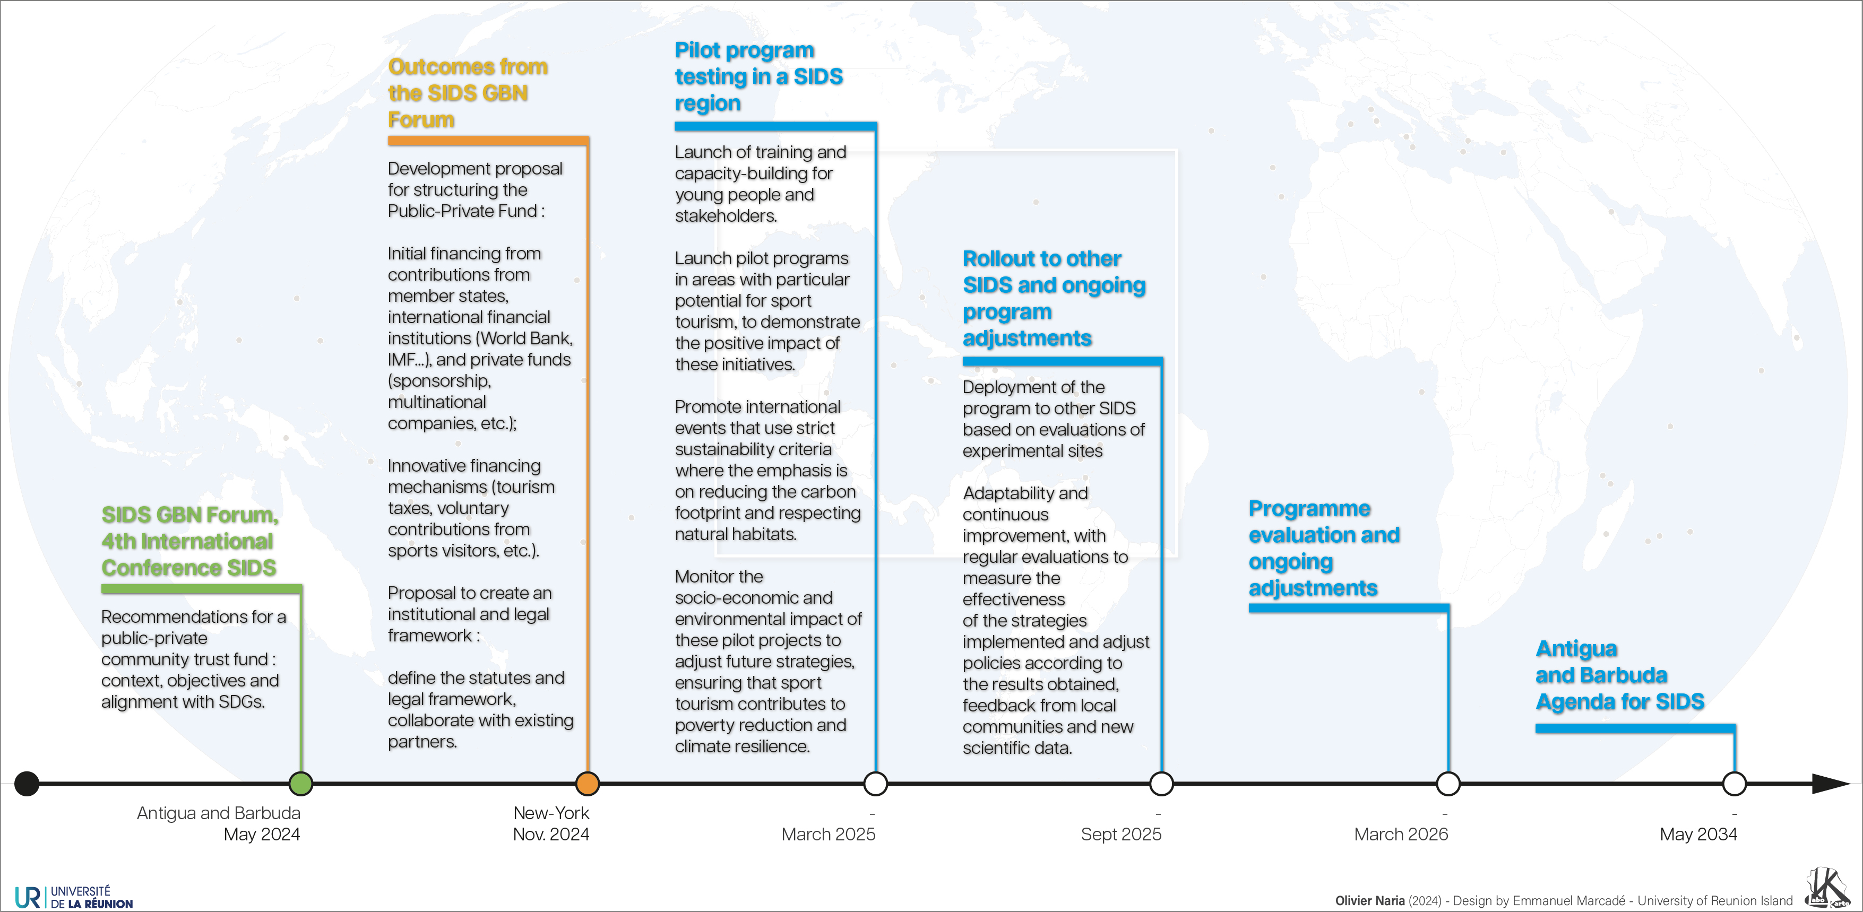
3-Proposed timetable for implementation

Slide 5
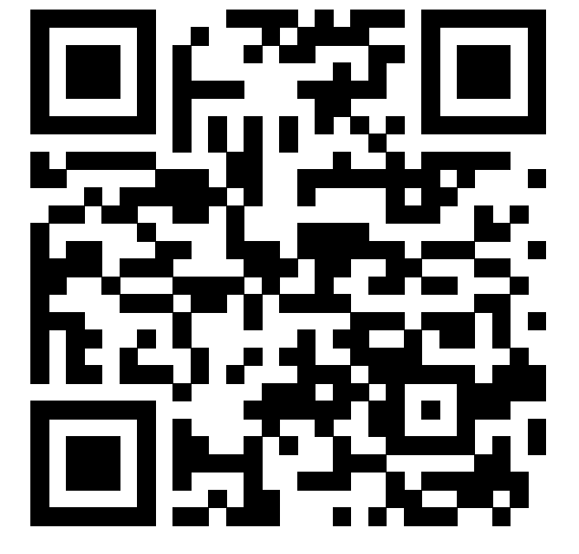
THE END
"The best way to predict the future is to create it."
Peter DRUCKER
Olivier NARIA
Associate Professor
University of Réunion Island
IRNIST
olivier.naria@univ-reunion.fr

