Slide 1

How LDCs can build resilient agrifood systems amid global geopolitical shocks, uncertainties and risks
Maximo Torero Cullen
Chief Economist
Food and Agriculture Organization of the United Nations (FAO)
Third LDC Future Forum, Thematic Session 1
1 April 2025

Slide 2








The basic risks/uncertainties for the agrifood systems
Input supplies (seeds, feeds, pesticides, fertilizer)
Production Yield/area risk
Trade exports
Prices Food inflation, WM prices
Logistics and infrastructure, Ports, roads, storage
Disease proliferation (ASF)
Food and
Water stress and climate change
1. Agriculture
Energy Inputs and biofuels
Debt, growth and exchange rates Land mines/Nuclear contamination
_{2.} Macro
Food
Migration and refugees
_{3.} Humanitarian
PRESENTAT ON WARSAW SMALL

Slide 3
TODAY

Slide 4







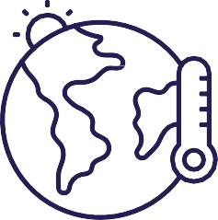
ECONOMIC INEQUALITIES
TODAY
CHRONIC HUNGER: 733 MILLION PEOPLE
(MID-POINT ESTIMATE)
FOOD INSECURE:
2.3 BILLION
PEOPLE (LACK REGULAR ACCESS TO FOOD)
UNAFFORDABLE HEALTHY DIETS:
2.8 BILLION
PEOPLE
281.6
MILLION PEOPLE IN ACUTE FOOD INSECURITY
CONFLICTS
CLIMATE
ECONOMIC CRISIS

Slide 5
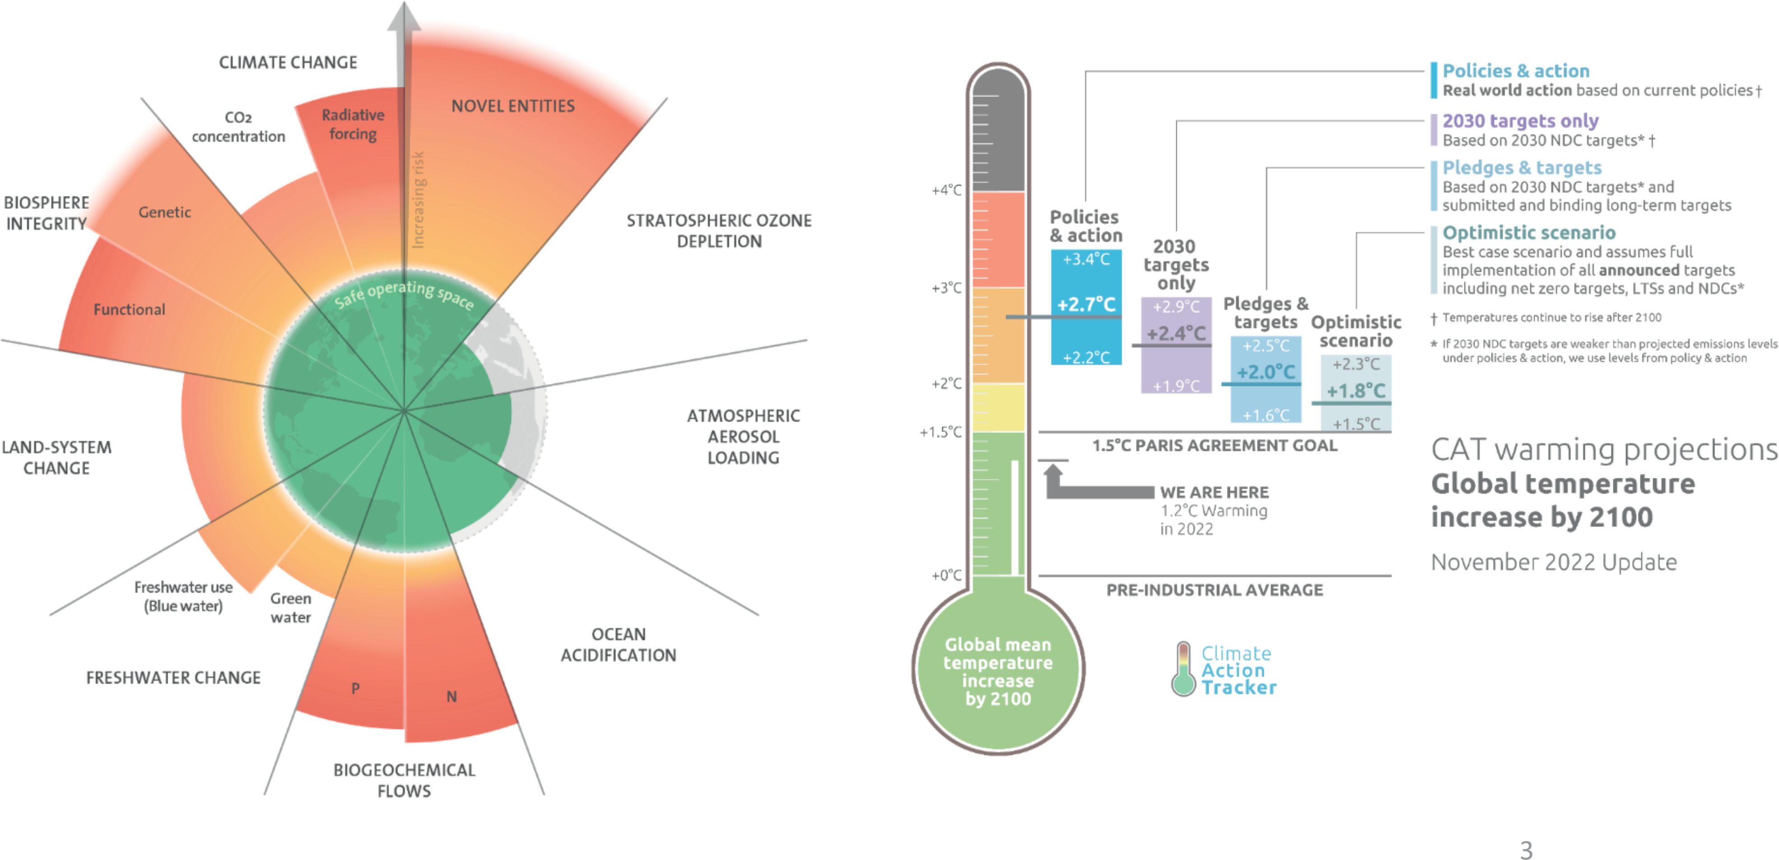
Planetary Limits in 2023

Slide 6
Planetary Limits in 2023
The biophysical dynamics are non linear:
The speed of problems are increasing (exponential trends) The systems have tipping points

Slide 7
Poverty levels for LDCs, LLDCs and SIDS

Slide 8
Least Developed Countries
Currently, 44 countries are designated as LDCs (Africa 32, Asia 8, Caribbean 1, Pacific 3)
One in three people in LDCs still live in extreme poverty, and the COVID-19 pandemic led to a rise in people living in poverty.
The agriculture sector employs over half the population, remains largely subsistence-based, with low productivity per worker having limited access to national, regional, and global markets.
Multiple structural challenges and constraints are exacerbated by climate change, growing debt burdens, dependence on commodities, and conflict.
LDCs account for 13% of world population but only about 1.3% of global GDP and less than 1% of global trade and FDI.
Almost half of the least developed countries are landlocked or small island countries
Source: Selected countries shown for which both extreme poverty rate and multidimensional poverty rate was available. Latest year available shown. World Bank Poverty and Inequality Platform & World Bank Global Monitoring Database
Source: Draft Doha Programme of Action for Least Developed Countries (A/CONF.219/2022/3). Fifth United Nations Conference on the Least Developed Countries; UN-OHRLLS, About Least Developed Countries [Accessed: March 2025]
Notes:
World Bank (2025), Poverty and Inequality Platform (version 20240627_2017_01_02_PROD) [data set]. pip.worldbank.org. Accessed on 2025-03-19
And World Bank, Global Monitoring Database (GMD), October 2024 - Multidimensional poverty headcount ratio (%) - An index that measures the percentage of households in a country deprived along three dimensions –monetary poverty, education, and basic infrastructure services – to capture a more complete picture of poverty
Multidimensional Poverty Measure Indicators and Weights:
Monetary
Daily consumption or income is less than $ 2.15 per person. 1/3
Education
At least one school-age child up to the age of grade 8 is not enrolled in school. 1/6
No adult in the household (age of grade 9 or above) has completed primary education. 1/6
Access to basic infrastructure
The household lacks access to limited-standard drinking water. 1/9
The household lacks access to limited-standard sanitation. 1/9
The household has no access to electricity.1/9

Slide 9
Landlocked Developing Countries (LLDCs)
There are 33 LLDCs, half of which are also classified as LDCs
Proportion of population in LLDCs below the extreme poverty line decreased from 27.3% in 2015 to 23.9% in 2019, but Covid-19 pandemic has pushed more people into extreme poverty
LLDCs face difficulties due to their remoteness, lack of territorial access to the sea, distance from world markets, and high transit costs
LLDC economies rely on a few key commodities and minerals, with large informal sectors, high unemployment, and low productivity. Most LLDCs are commodity exporters.
Source: Latest year available shown. World Bank (2025), Poverty and Inequality Platform (version 20240627_2017_01_02_PROD) [data set]. pip.worldbank.org. Accessed on 2025-03-19
Source: UN-OHRLLS, Landlocked Developing Countries Factsheet 2022, United Nations. [Accessed: March 2025]; UN-OHRLLS, About Landlocked Developing Countries [Accessed: March 2025]
Notes:
No multidimensional poverty rate is shown in this graph. This is because multidimensional poverty rates were only available for 17 out of 32 LLDC countries for which extreme poverty rate is available, and 8 of these were also LDC counties already depicted in the previous graph. For the 7 remaining, there was not that much of a difference between the two poverty rates.

Slide 10
Small Island Developing States (SIDS)
There are 39 SIDS, 7 of which are also LDCs
SIDS are isolated from world markets and are highly vulnerable to climate change and fragile ecosystems. They make up two thirds of the countries that suffer the highest relative losses – between 1% and 9% of their GDP each year, from natural disasters
Climate-change-related hazards have contributed to reduced agricultural production, reduced labour output, and increased dependence on food importation.
In terms of poverty rates, SIDS is a heterogeneous group. However, SIDS face some of the highest levels of vulnerability, as measured by the Multidimensional Vulnerability Index (MVI).
Source: Selected countries shown for which both extreme poverty rate and multidimensional vulnerability index score was available. Latest year available shown. World Bank Poverty and Inequality Platform & UN MVI Final Report (2024)
Source: OECD, Small Island Developing States (SIDS). [Link Accessed: March 2025]; Massa et al. (2023), Sustainable Development Report for Small Island Developing States; UN-OHRLLS, About Small Island Developing States [Accessed: March 2025]
Notes:
World Bank (2025), Poverty and Inequality Platform (version 20240627_2017_01_02_PROD) [data set]. pip.worldbank.org. Accessed on 2025-03-19
UN MVI Final Report (2024). High level panel on the development of a Multidimensional Vulnerability Index FINAL REPORT. https://sdgs.un.org/sites/default/files/2024-02/Final_MVI_report.pdf
Multidimensional Vulnerability Index (MVI) -is structured around two main pillars: structural vulnerability and lack of structural resilience. Each pillar comprises 13 indicators, totaling 26 indicators, encompassing three primary dimensions: economic, environmental (mainly climatic), and societal. More details here: https://sdgs.un.org/sites/default/files/2024-02/Final_MVI_report.pdf
Here we show MVI and not multidimensional poverty because the point is to show that though these countries have low poverty rates, they have very high vulnerability. Also, there are only 10 countries for which we have both extreme poverty rates and multidimensional poverty rates available.

Slide 11
Access to healthy diets and Prevalence of Undernourishment for LDCs, LLDCs and SIDs

Slide 12
Prevalence of undernourishment
Notes:
The SDG indicator used to monitor hunger is the prevalence of undernourishment.
After rising sharply from 2019 to 2021, global hunger has persisted at nearly the same level for three consecutive years, affecting around 9.1 percent of the population in 2023 compared with 7.5 percent in 2019.
It is estimated that between 713 and 757 million people in the world faced hunger in 2023. Considering the mid-range (733 million), this is about 152 million more people than in 2019.
Over one-third of people facing hunger in the world in 2023 lived in the LDCs – 257 million. The prevalence of undernourishment was highest in LDCs – 22.4% – followed by 19.3% in LLDCs (111 million people) and 16.8% percent in the Small Island Developing States (12.2 million people). It is worth noting, however, that many countries pertain to more than one of the groupings.
While hunger has risen steadily in recent years in the LDCs and SIDS, there are signs of possible improvement in the LLDCs, where the prevalence of undernourishment decreased slightly from 19.8% in 2022 to 19.3% in 2023. However, this is still equivalent to about 16 million more people than in 2019, before the COVID-19 pandemic.

Slide 13
Cost of a healthy diet
Notes:
Food prices rose throughout 2022, pushing up the average cost of a healthy diet globally to 3.96 purchasing power parity (PPP) dollars per person per day, up from 3.56 PPP dollars in 2021. Disruptions from the COVID-19 pandemic and the war in Ukraine contributed to significant increases in international food and energy prices, exacerbating inflationary pressures.
The Least Developed Countries had the lowest average cost of a healthy diet, and have experienced a more moderate increase between 2020 and 2022, compared to other groups.
In contrast, the Small Island Developing States (SIDS) had the highest cost in 2022, which is approximately 13% higher than that of the landlocked developing countries, 24% higher than the Least Developed Countries, and 19% above the global average.

Slide 14
Proportion of the population unable to afford
a healthy diet
Notes:
Focusing specifically on economic access to a healthy diet,
Updated and improved estimates show that more than one-third of people in the world – about 2.83 billion – were unable to afford a healthy diet in 2022.
Despite the increase in the average cost of a healthy diet, the number of people unable to afford a healthy diet in the world fell back to pre-pandemic levels in 2022, fuelled by an economic recovery from the pandemic that has, nevertheless, been uneven across regions and country income groups.
The situation worsened during the COVID-19 pandemic across all countries, with the most significant increase observed in the SIDS. In these countries, approximately half or more of the population could not afford a healthy diet in 2022.
In 2022, it is estimated that a healthy diet was out of reach for about 64.6% of people living in Least Developed Countries (720 million), and for 54.5% of the population living in land locked developing countries (301 million people). In Small Island Developing States (SIDS), nearly 48% of the population – equivalent to 34 million people – were unable to afford a healthy diet.

Slide 15
Import dependence and Import Bill of LDCs, LLDCs, and SIDS

Slide 16


Agricultural trade, LDCs
Net trade, selected commodities, average 2017-2022
LDCs face multiple and long-lasting impediment, with low level of economic transformation.
Most of the LDCs are in Africa and South Asia.
Overall, they are net importers of food and agricultural commodities with a trade deficit of over USD 4 billion during 2017-2022.
Main imported commodities are cereals (rice and wheat), vegetable oils (palm and soyabean oils), meat (mostly poultry) and dairy products (milk powders).
Cereal imports account for 30% of the total agrifood trade.
Main exported commodities are fruits and vegetables, cereals (rice), and fish and aquatic products.
Trade is rather concentrated. The LDC top 5 trade partners account for over 42% of the total agrifood imports. India and Thailand are the leading rice exporters to the LDCs.
Source: UN COMTRADE

Slide 17
[Add Image]
Agricultural trade, LLDCs
Net trade, selected commodities, average 2017-2022
LLDCs are a heterogenous group of countries, with most of them located in Central Asia and Africa and with differences in the level economic development and the availability of natural resources.
Overall, LLDCs are slightly net exporters of agrifood commodities. During 2017-2022, their net exports amounted to USD 720 million.
Main exported commodities are cereals (wheat), vegetable oils and fats (soybean and sunflower seed oil), fruit and vegetables (mainly from the central Asian countries) and meat (bovine meat).
Main imported commodities are cereals (rice, maize and wheat), vegetable oils (palm oil, soybean oil), meat (poultry) and dairy (cheese and butter).
Trade is rather concentrated. LLDCs’ top 5 trade partners account for about half of their overall agrifood trade. Especially the central Asian countries traditionally trade with the Russian Federation and Ukraine.
Source: UN COMTRADE

Slide 18
[Add Image]
Agricultural trade, SIDS
Net trade, selected commodities, average 2017-2022
SIDS are located in three geographic regions: the Pacific Ocean; the Caribbean Sea; and the Atlantic Ocean, Indian Ocean and Southeast China Sea.
Among SIDS are both high-income countries, such as Singapore, and least developed countries, such as Haiti
SIDS are net importers of agrifood commodities. Their trade deficit amounted to USD 4.8 billion during 2017-2022.
They rely heavily on imports for covering their needs for cereals (wheat, rice and maize), meat (esp. poultry), and dairy (esp. milk powders and butter)
They export mostly fish and aquatic products, alcoholic beverages (mainly rums), and tobacco
Imports are rather concentrated. However, both the trade partners and the concentration of imports differ among the SIDS:
  about half of the Caribbean SIDS’ imports come from the USA;
  about 1/3 of the Pacific SIDS’ imports are from Australia;
  the top 5 importers account for less than 40% of the total agrifood imports of SIDS in the Atlantic, Indian Ocean and Southeast China sea when excluding Singapore
Source: UN COMTRADE

Slide 19
WHAT IS NEEDED?
MAKE OUR AGRIFOOD SYSTEM MORE RESILIENT, EFFICIENT AND INCLUSIVE

Slide 20
MAKE OUR AGRIFOOD SYSTEM MORE RESILIENT

Slide 21
The resilience timeline

Slide 22



How to improve actions for resilience building?
Financing for Shock-Driven Food Crisis Facility
Mobilize resources at the right time
Reduce the cost for taxpayers through leveraging the capital markets
Increasing the efficiency of interventions through anticipatory actions
FSFC
DEALING WITH SHOCKS:
MOBILIZING RESOURCES AT THE RIGHT TIME AND USING THEM PROPERLY
Deploying the right resilience intervention in the right context
Systematic framework with contextualization
Typology of risks and interventions
Consistency between emergency, resilience and development framework
THE RESILIENCE TOOLBOX

Slide 23
MAKE OUR AGRIFOOD SYSTEM MORE EFFICIENT AND INCLUSIVE

Slide 24




The question is not if we need to improve agrifood systems, but how to do it in practice
Data, Science, Evidence, and state-of-the-art analytical tools
HOW?
Operational solutions at the global, regional and local scale for the right contextualization
Governance and institutional arrangements

Slide 25

Thank you

