Slide 1
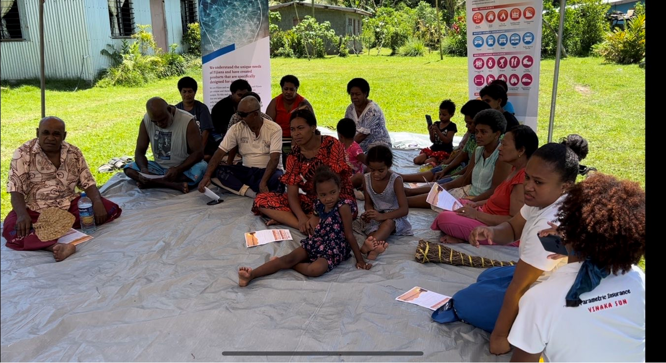
Preparatory Webinar for the SIDS Global Business Network Forum 2024
Presenter :
Tarlochan Singh Principal Officer
Sun Insurance Company Ltd

Slide 2
Preparatory Webinar for the SIDS Global Business Network Forum 2024
Leveraging Public-Private Partnerships (PPPs) for Resilience Building in SIDS from a SUN Insurance (Fiji) Perspective

Slide 3
Introduction
As it is well known that the
Small Island Developing States (SIDS) are a group of over 50 countries.
SIDS face a multitude of challenges due to their geographic isolation, limited financial resources, and vulnerability to natural disasters and climate change.
Building resilience to these threats is crucial for sustainable development.
Public-Private Partnerships (PPPs) offer a promising approach to mobilizing resources, expertise, and innovation.

Slide 4
Introduction
Sun Insurance, the only 100% locally owned General Insurance Company in Fiji.
SUN is committed to supporting PPPs for resilience building in SIDS.es and territories that are:
geographically isolated,
have small and vulnerable populations,
face unique challenges due to their:
small size,
limited resources,
exposure to natural disasters and climate change.

Slide 5
Key Challenges to Building Resilience in SIDS
Geographic isolation
Limited financial resources
Small populations and economies
Natural disasters and Climate Change
Human and cyber risks

Slide 6
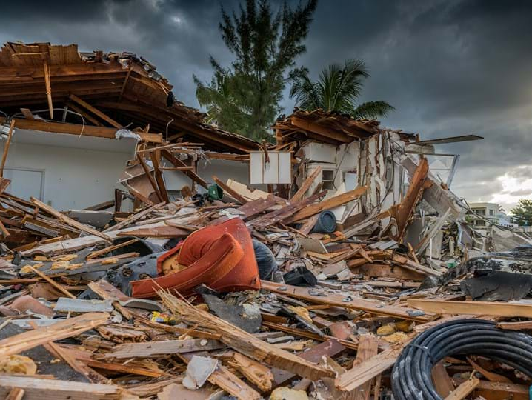
Other Challenges – Part I
Mind Set – looked at as an Expense rather than an Asset or Income Protection Plan
Lack Awareness & Understanding
People’s perception of Insurance – Combined effort needed to change this

Slide 7
Other Challenges – Part II – New Products
Unavailability/Lack of Data on making informed decisions and new products
Lack of Technical Expertise and training opportunities for Insurers.
Lack of Risk modelling for Fiji/South Pacific

Slide 8
Other Challenges – Part III – Reinsurance
Hardening Reinsurance Market
South Pacific is a small market for many Reinsurers thus getting Reinsurance is difficult.
Increased Reinsurance Costs

Slide 9
How PPPs Can Help Overcome These Barriers
Mobilizing private sector resources
Enhancing innovation
Sharing risks and responsibilities
Introducing the much-needed Insurance education

Slide 10
Successful Example of PPPs for Resilience Building in SIDS
In 2021 (piloted), Sun partnered with the United Nations Capital Development Fund (UNCDF) to provide first ever parametric insurance our farmers.
In 2023, SUN decided to take on this insurance cover and expand the options and limits and to offer to a wider community including farmers, market vendors, fisherman and others.

Slide 11
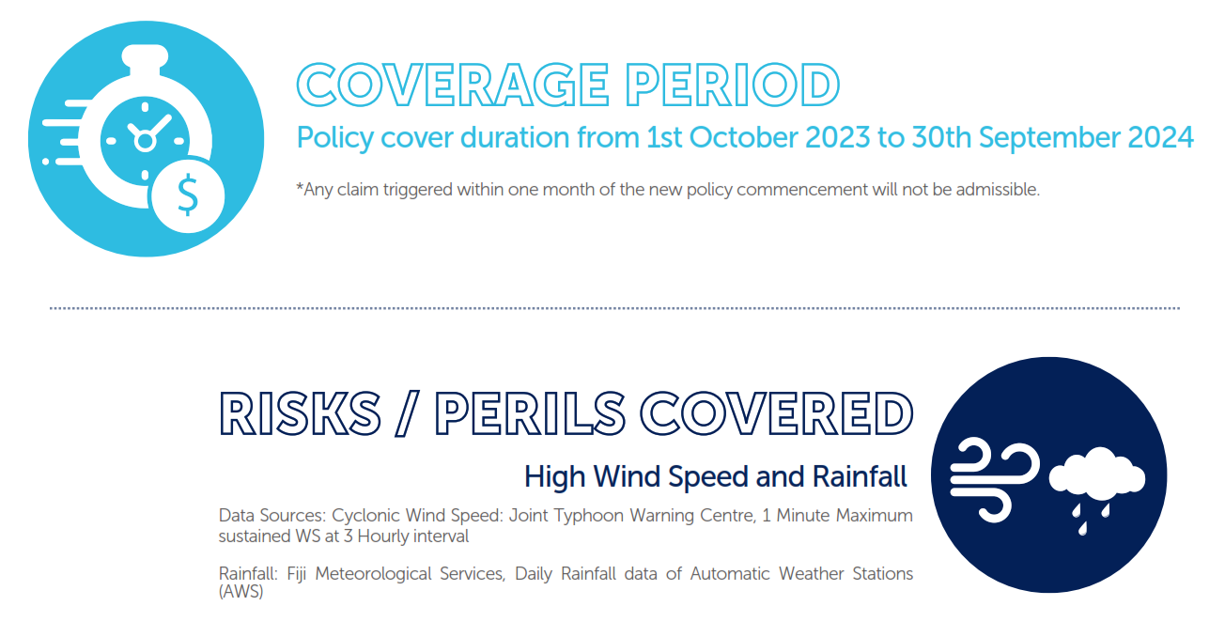
Successful Example of PPPs for Resilience Building in SIDS

Slide 12
Successful Example of PPPs for Resilience Building in SIDS
SUN has also launched the Pacific’s first anticipatory action pilot insurance scheme to provide Fijian farming groups with funds to better prepare for cyclones

Slide 13
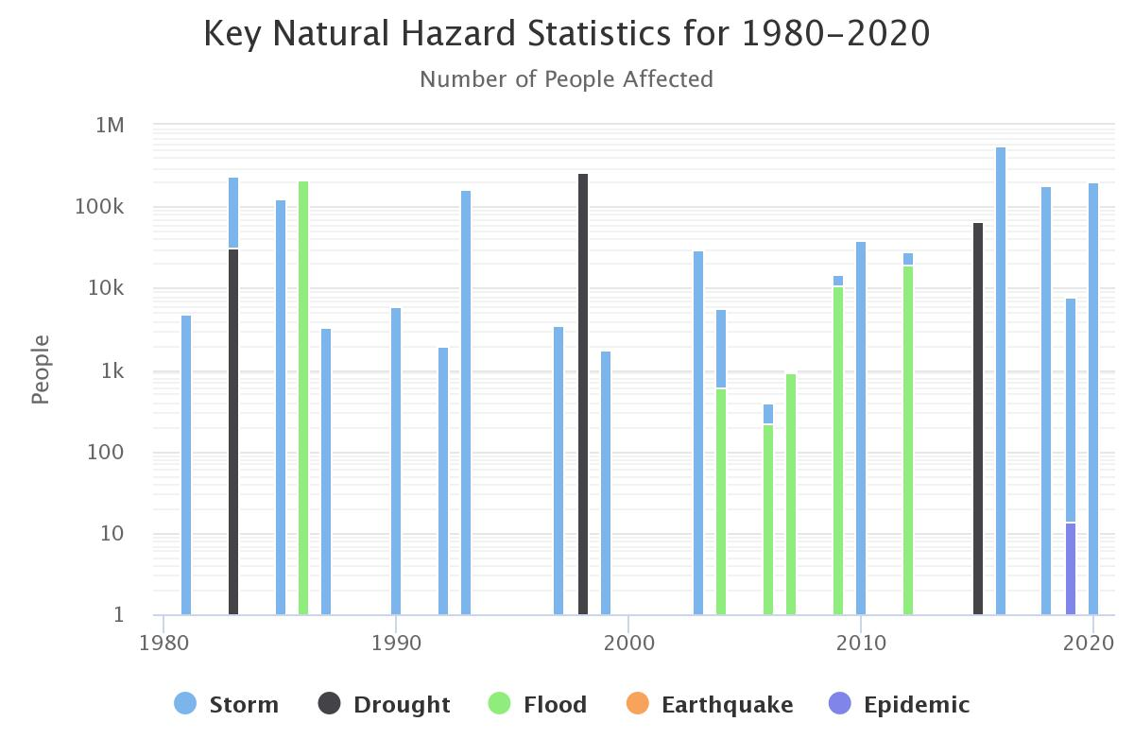
Fiji’s Events

Slide 14
Sun Insurance's Role in Supporting PPPs for Resilience Building in SIDS
Providing Insurance and Risk Management Expertise
Sharing Risks
Supporting Innovation with stakeholders to develop innovative insurance solutions tailored to SIDS' needs.
Alternative form of help in time of the Natural Disasters and Cyclones, via providing covers for the damages

Slide 15
Lessons from Existing Public-Private Resilience Strategies in SIDS
Strong institutional frameworks
Stakeholder engagement
Risk management
Monitoring and evaluation

Slide 16
Role of Different Stakeholders in Formulating PPPs
Governments
Private sector
Local communities
Insurance Companies
Civil Society Organizations (CSO’s)

Slide 17
Ensuring Long-Term Sustainability of Public-Private Resilience Strategies & Benefits of PPPs for Resilience Building in SIDS
Increased Access to Insurance
Enhanced Financial Protection
Promoted Innovation

Slide 18
Incentives for Private Sector Involvement
Clear regulatory environment
Risk-sharing mechanisms
Insurance based security
Market-based incentives
Recognition and awards

Slide 19
Engaging and Benefiting Local Communities
Community participation
Benefits-sharing mechanisms
Insurance diversification
Increased protection within the remote areas of Fiji

Slide 20
Ensuring Long-Term Sustainability of Public-Private Resilience Strategies
Regular monitoring and evaluation
Adaptive management
Continuous stakeholder engagement

Slide 21
SUN’s Other Initiative and Adaptation

Slide 22
SUN’s Initiative and Adaptation

Slide 23
Conclusion
Sun Insurance is committed to supporting PPPs for resilience building in SIDS through its expertise, risk-sharing capacity, and support for innovation. By working together, we can enhance the resilience of SIDS and their communities in the face of climate change and natural disasters.

Slide 24
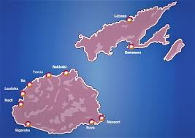
Vinaka!! Thank You!!

