Slide 1
Pacific Farmer Organisations
Building Back Better: Public-Private Resilience Strategies for Small Island Developing States
Kyle Stice – Executive Director

Slide 2
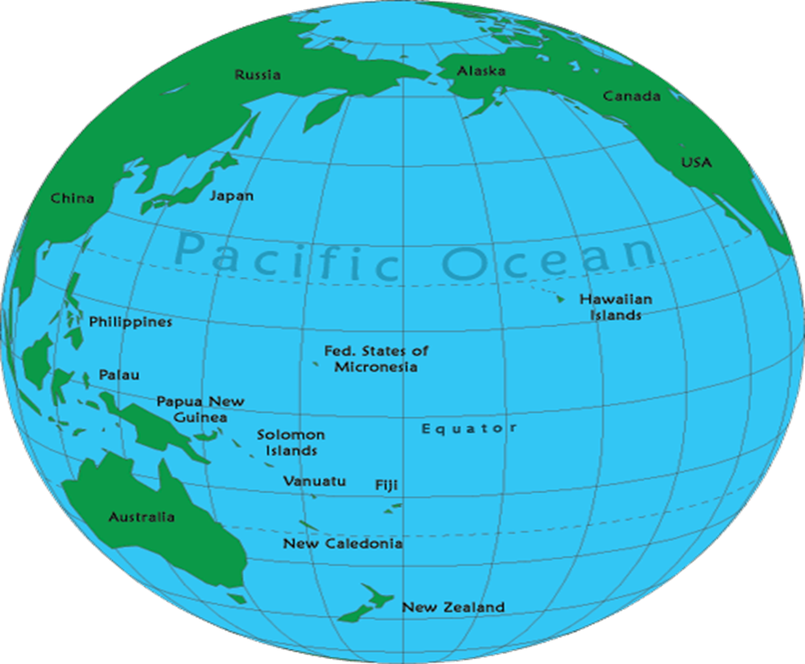
The Blue (and Green) Pacific Continent

Slide 3
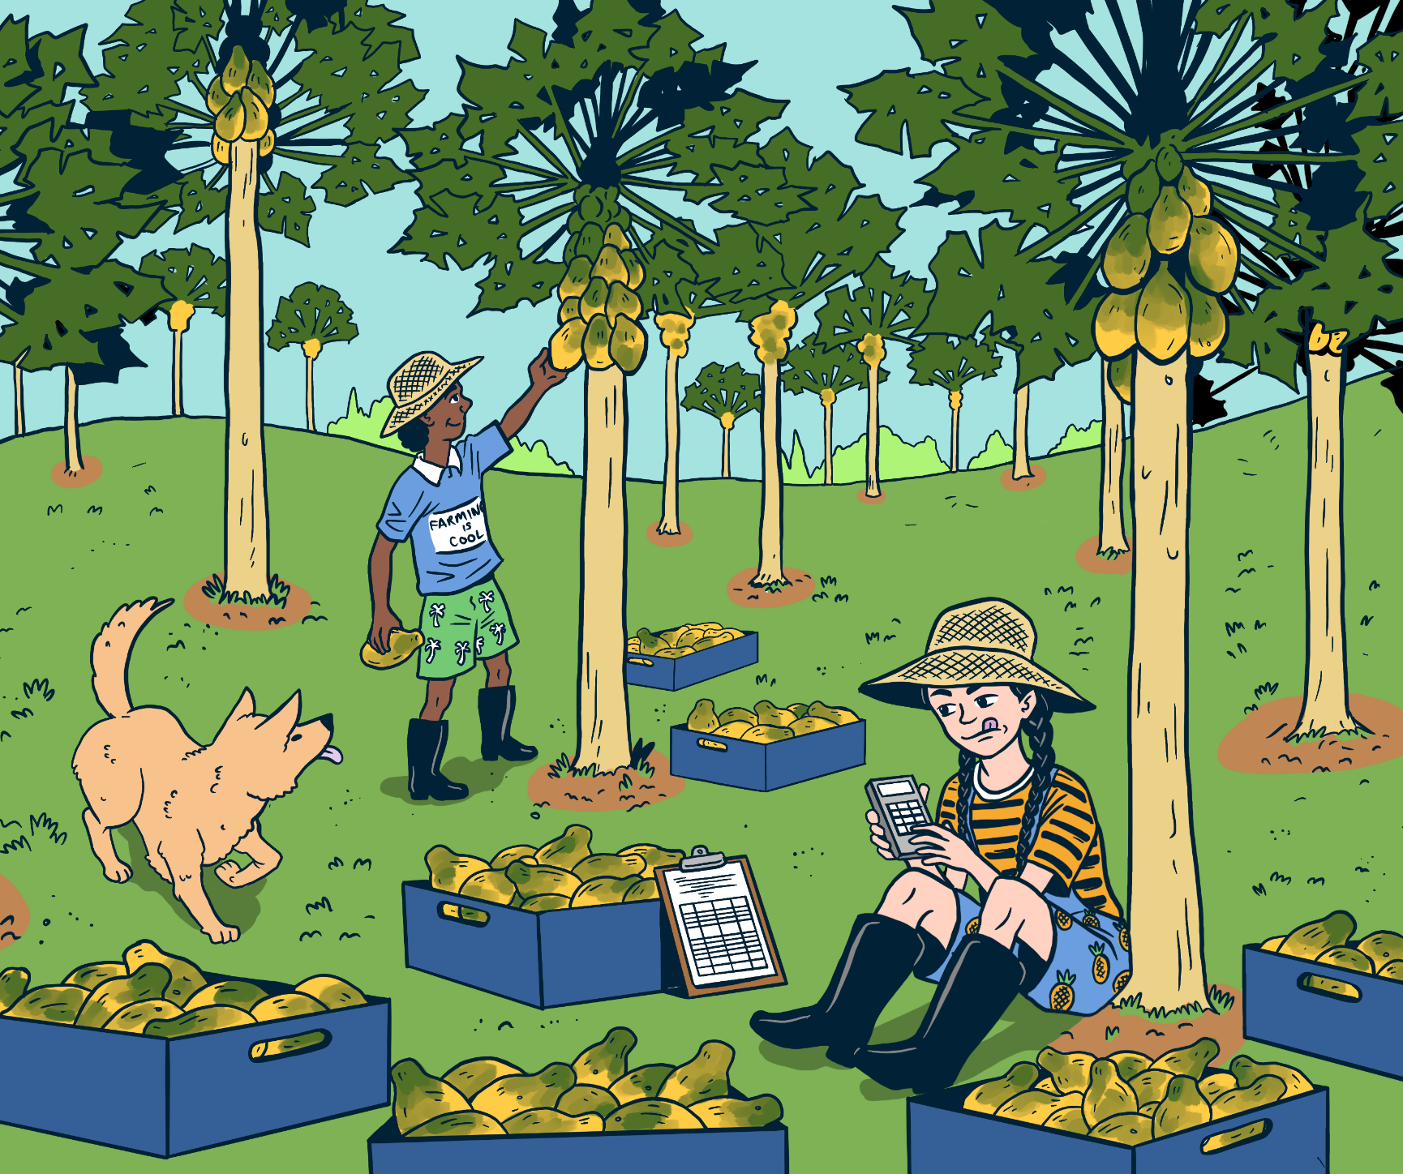
Context
According to the FAO, 3/4 of the Pacific population live in rural areas
Agriculture is the main livelihood of the majority (70%+) of the Pacific Islands population.
Approximately 95% of Pacific farmers are Family Farmers

Slide 4
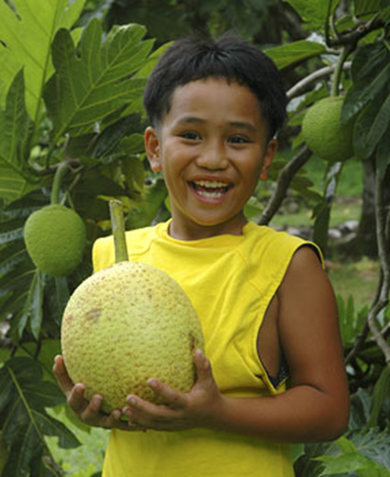
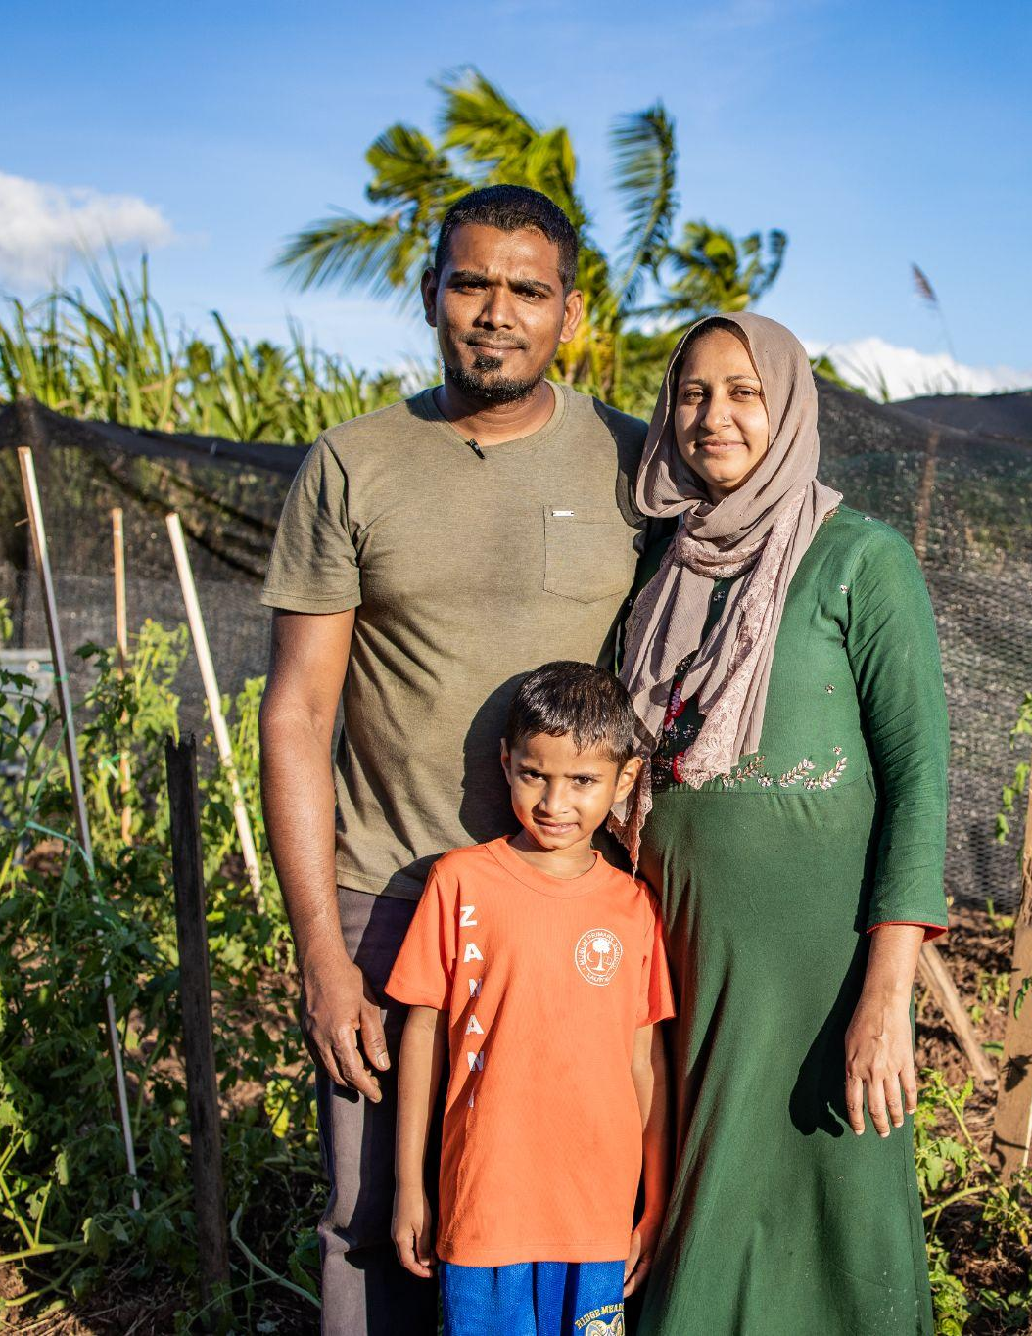
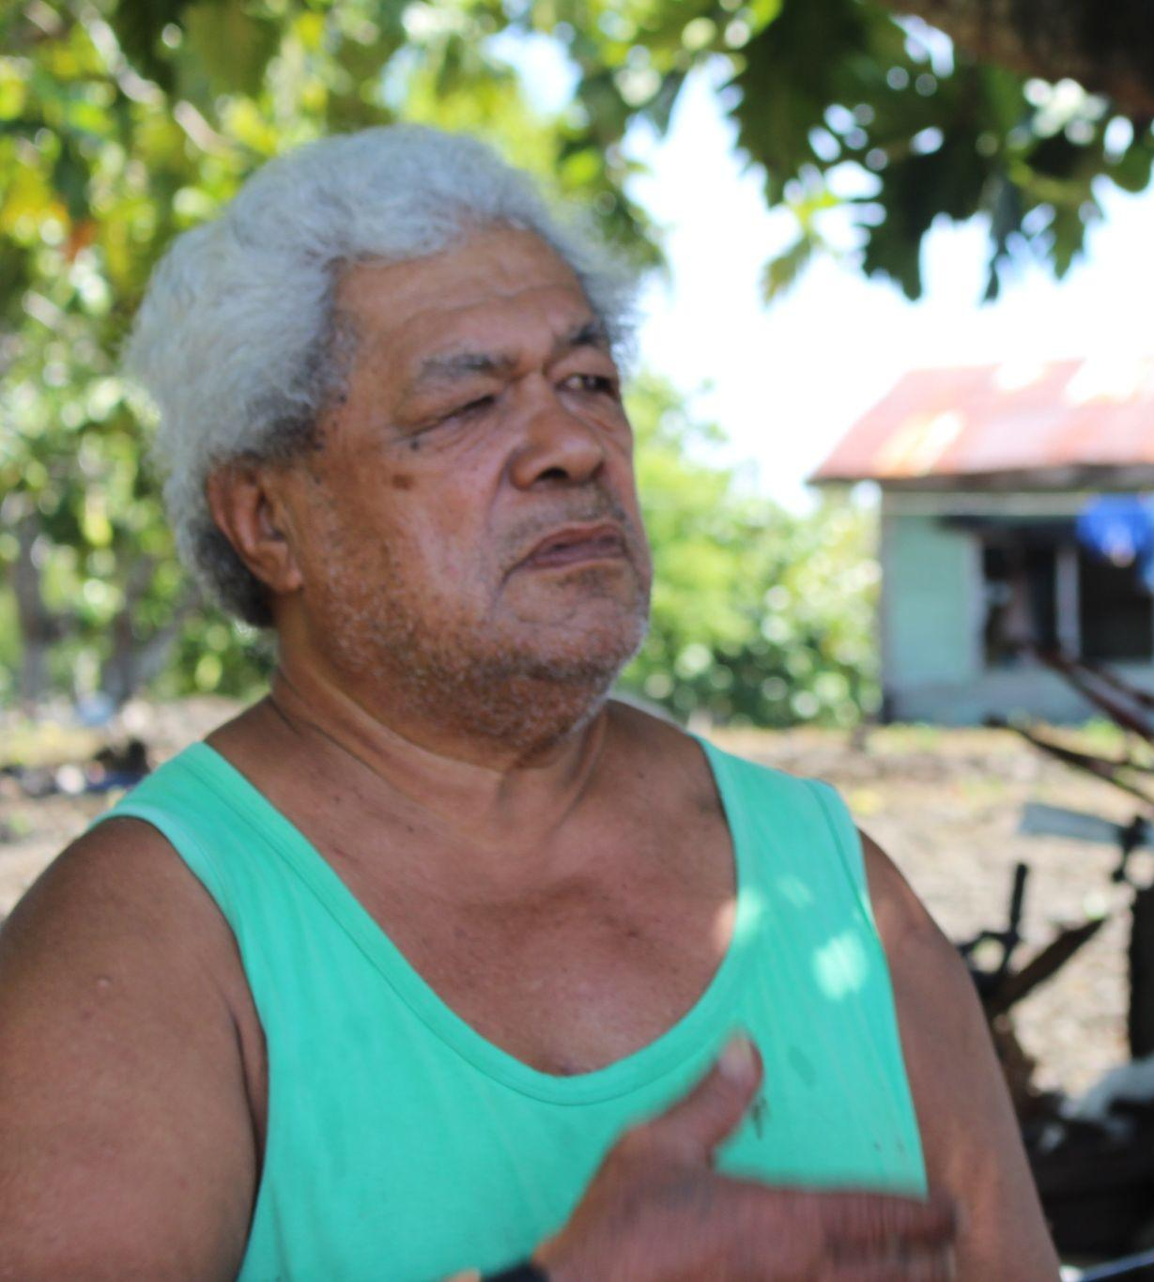
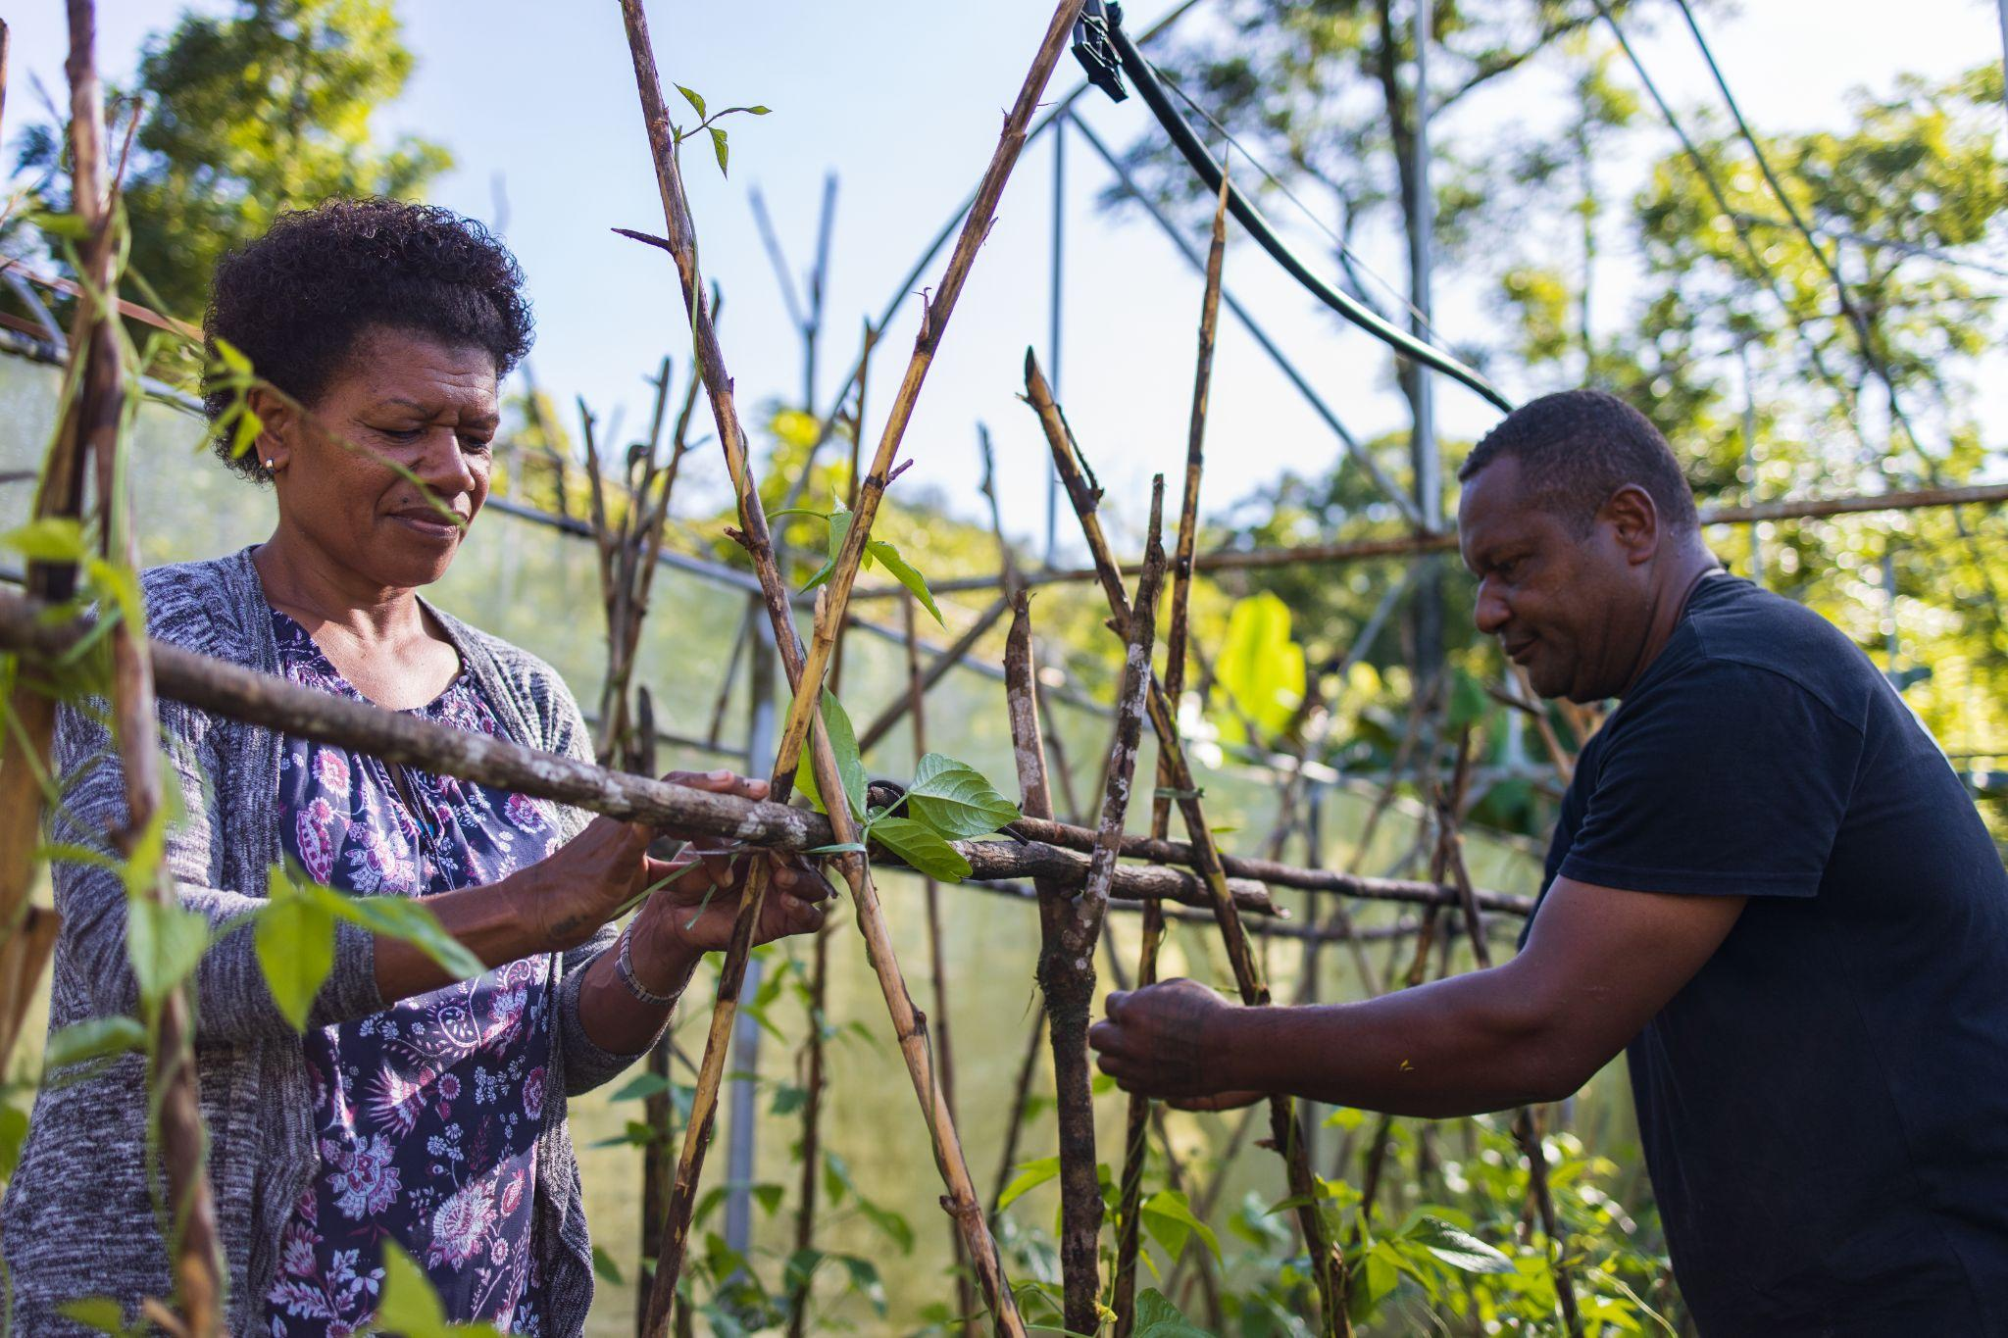
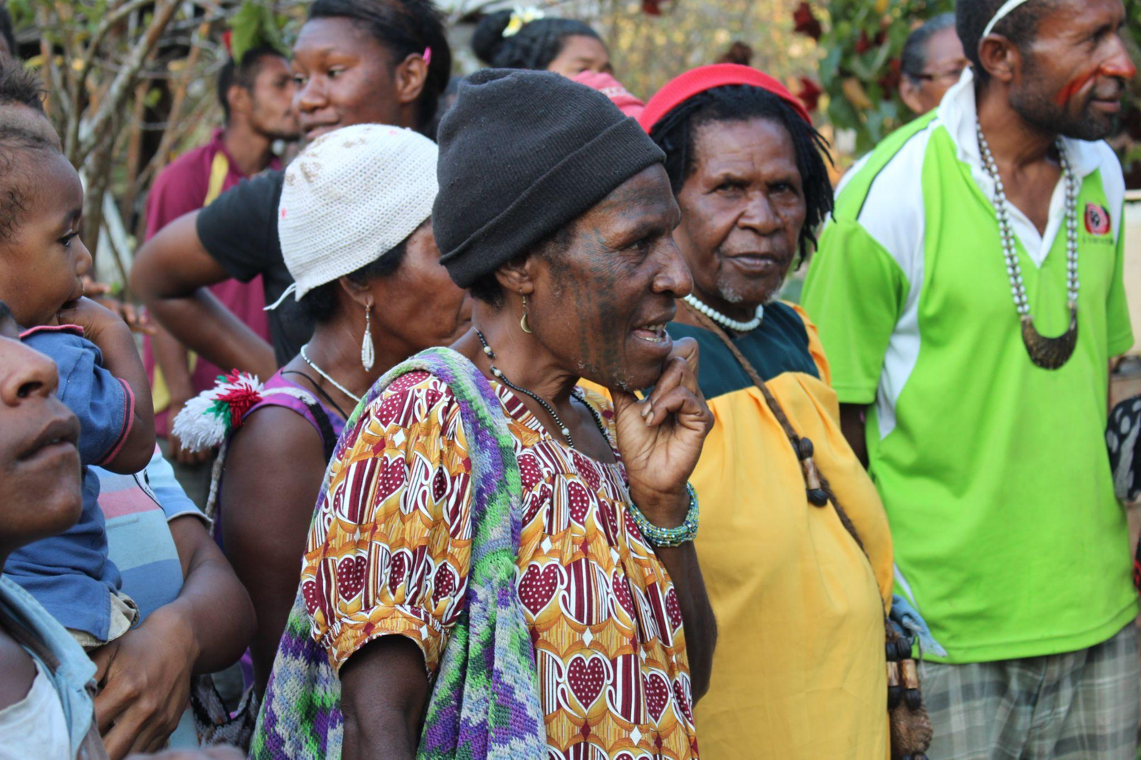
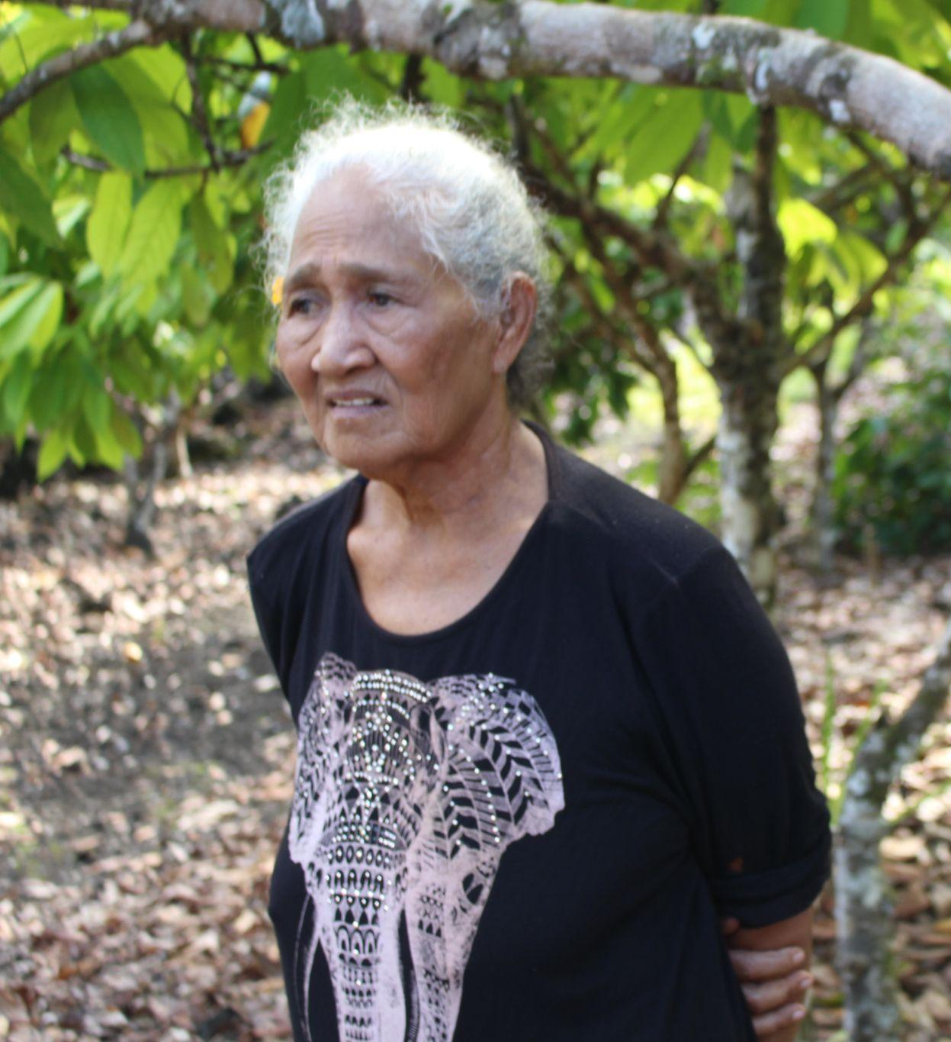
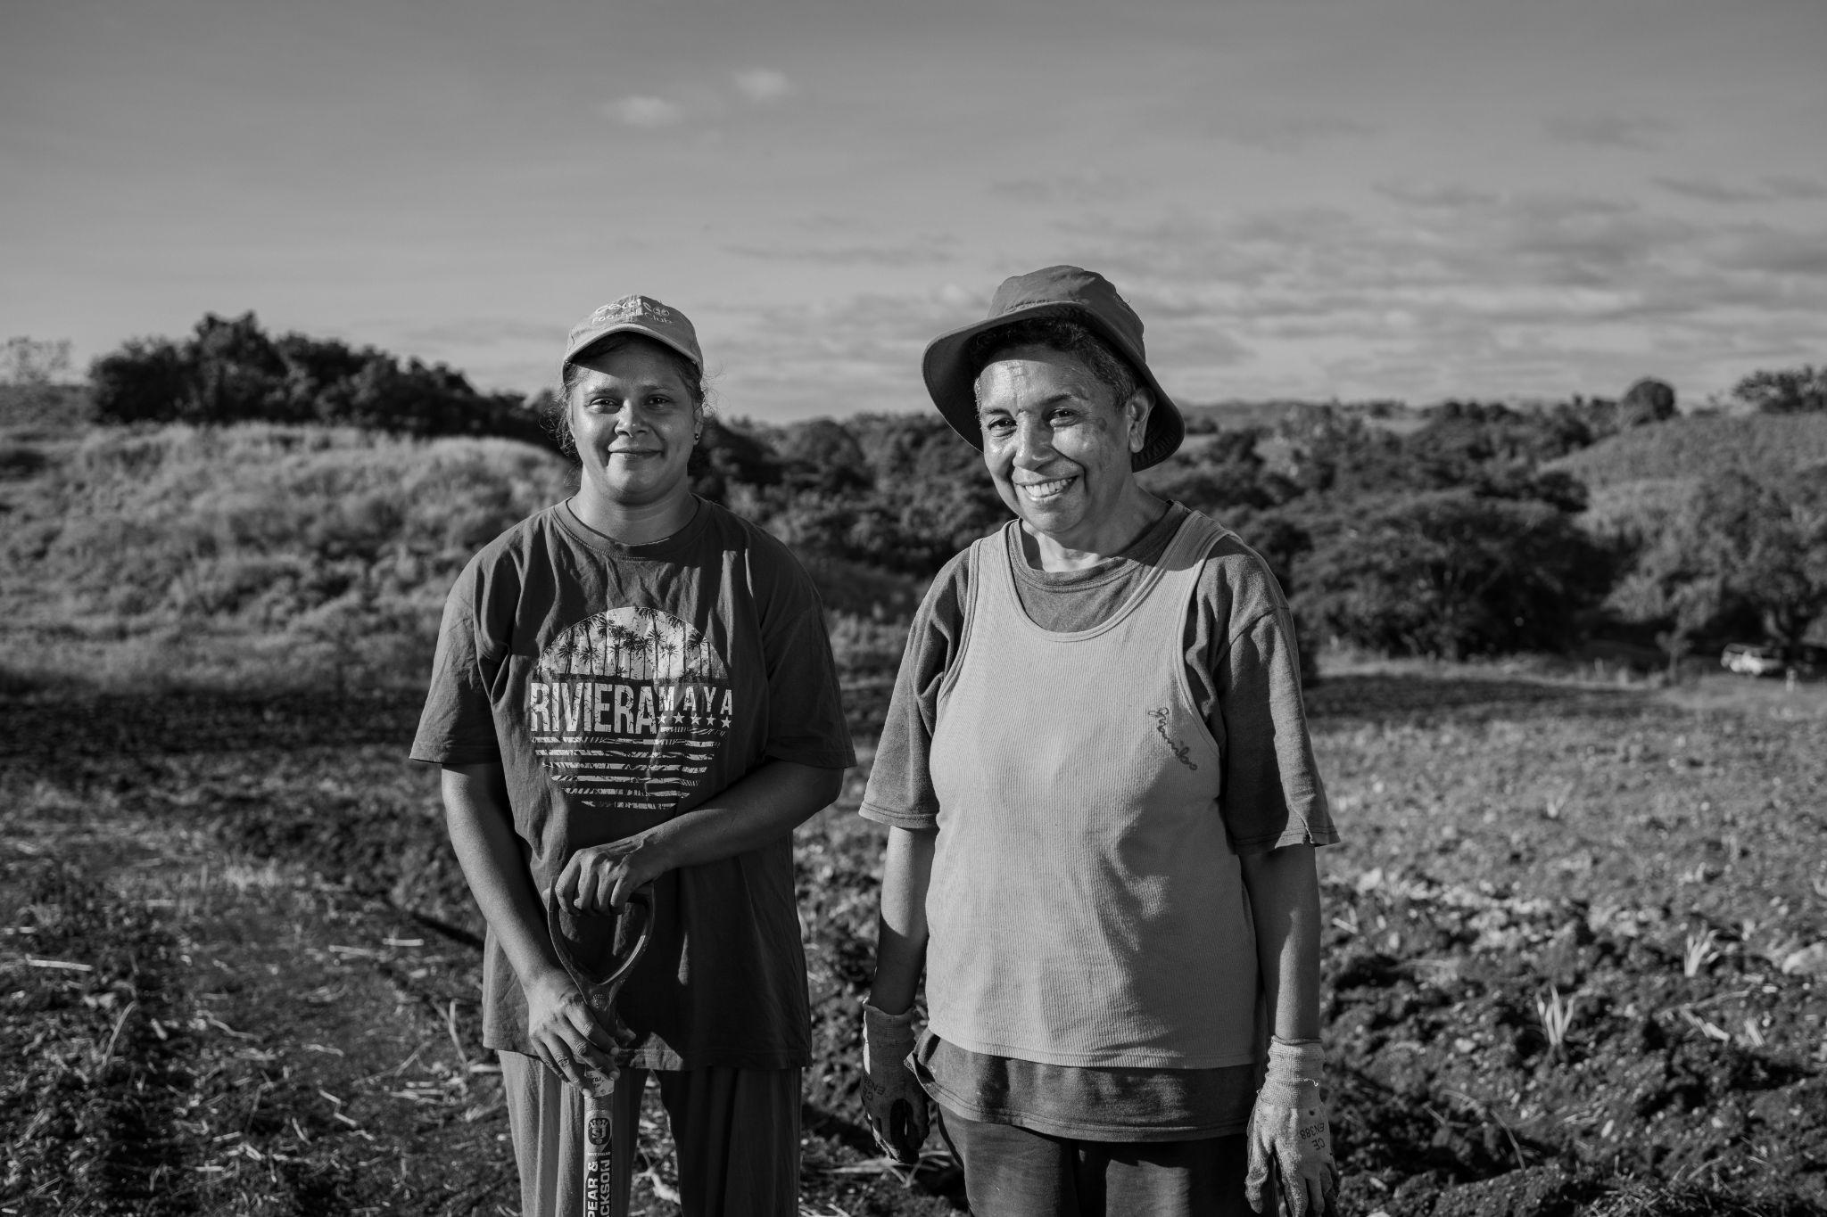

Slide 5
Threat Nexus for Pacific Island People
Climate Change
Rural
People (Farmers)
Food Security
NCD’s
Notes:
Nexus thinking is vital for Pacific Islanders because they face a web of interconnected threats: climate change, food security, and non-communicable diseases (NCDs). Climate change disrupts traditional farming, affecting food security and contributing to NCDs due to dietary changes. To address these challenges comprehensively, we must integrate efforts, developing policies that promote sustainable agriculture, health, and climate resilience, recognizing the interplay between these threats to protect the well-being of Pacific Islanders.

Slide 6
A Pacific Solution by Pacific People
Traditional Crops (staple crops, fruits, vegetables)
Improved Traditional Agriculture
Local Food Systems and Value Chain Development
Strengthening of local organisations to deliver local solutions

Slide 7
The Rise of Pacific
Farmer Organisations

Slide 8
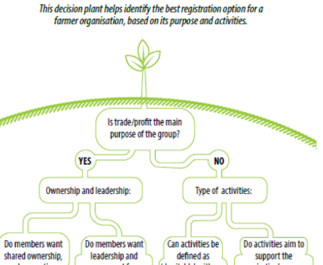
Who are Pacific Farmer Organisations?

Slide 9
Farmer Organisations are essential for…
Tapping into traditional knowledge and innovation
Providing key services
Amplifying the voice of rural people
Bridging the gap and extending the reach of government and development partners

Slide 10
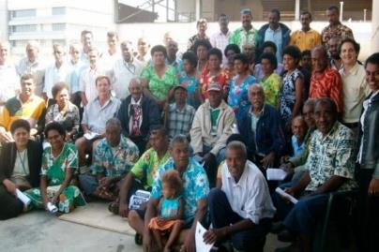
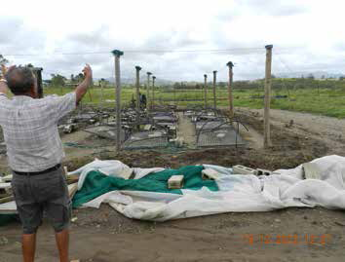
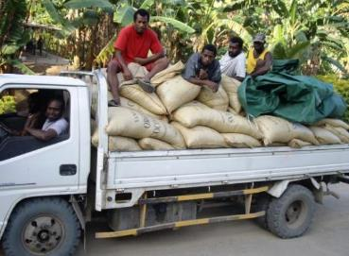
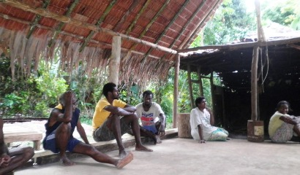
A membership based network of Farmer Organisations across 13 PICTs

Slide 11
our reach…
Membership in 13 PICTs - Fiji, Vanuatu, Solomon Islands, Tonga, Samoa, PNG, Cook Islands, Timor Leste, New Caledonia, RMI, Hawaii, Kiribati and FSM
Membership of 35 national farmer organisations
Linkages with approximately 350 local farmer organisations with a total membership of 90,000+ farmers

Slide 12
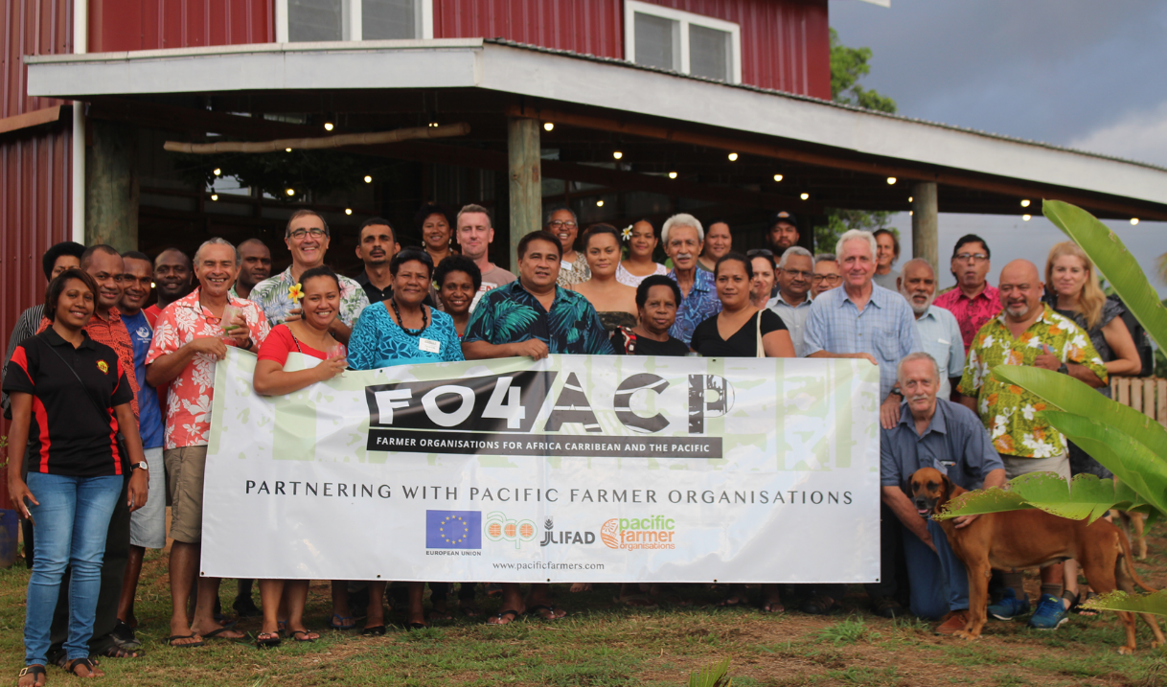

Slide 13
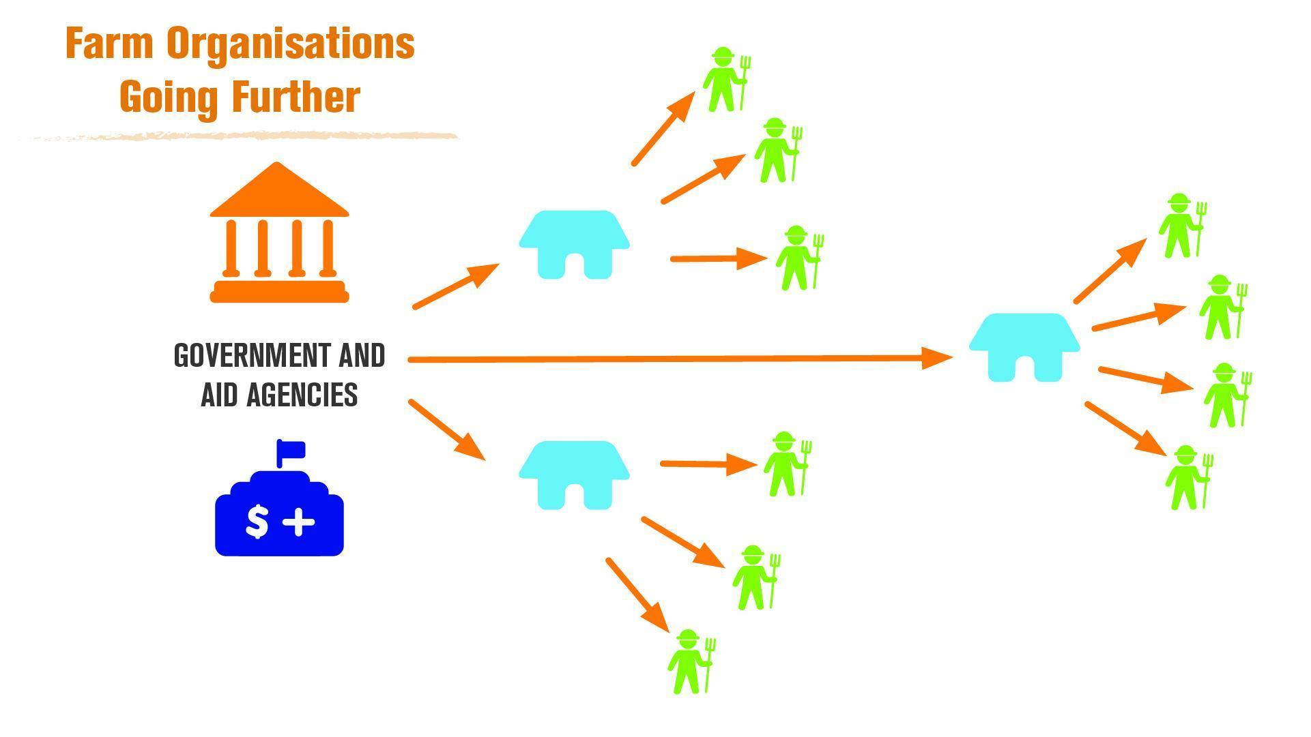

Slide 14
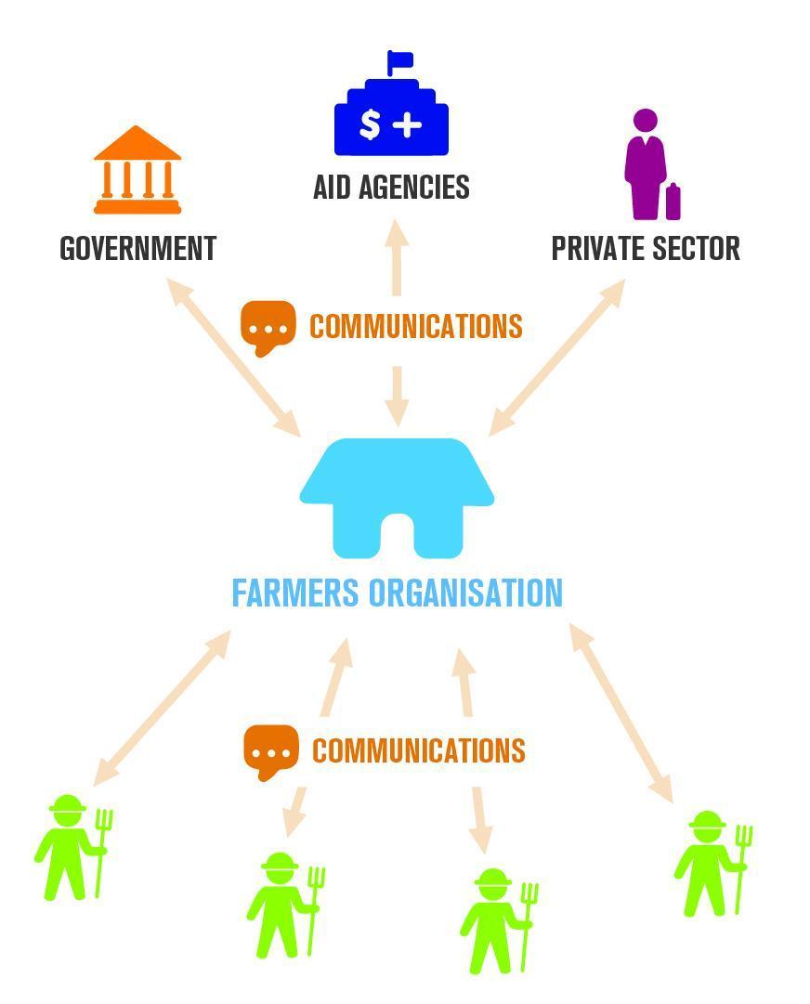
Farmer Organisations Improve the flow of information between rural people and government/development partners

Slide 15
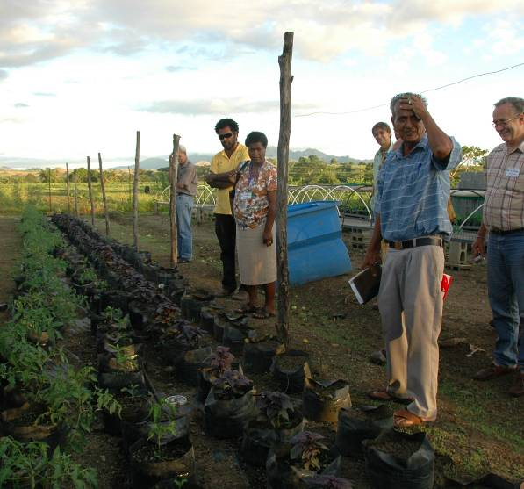
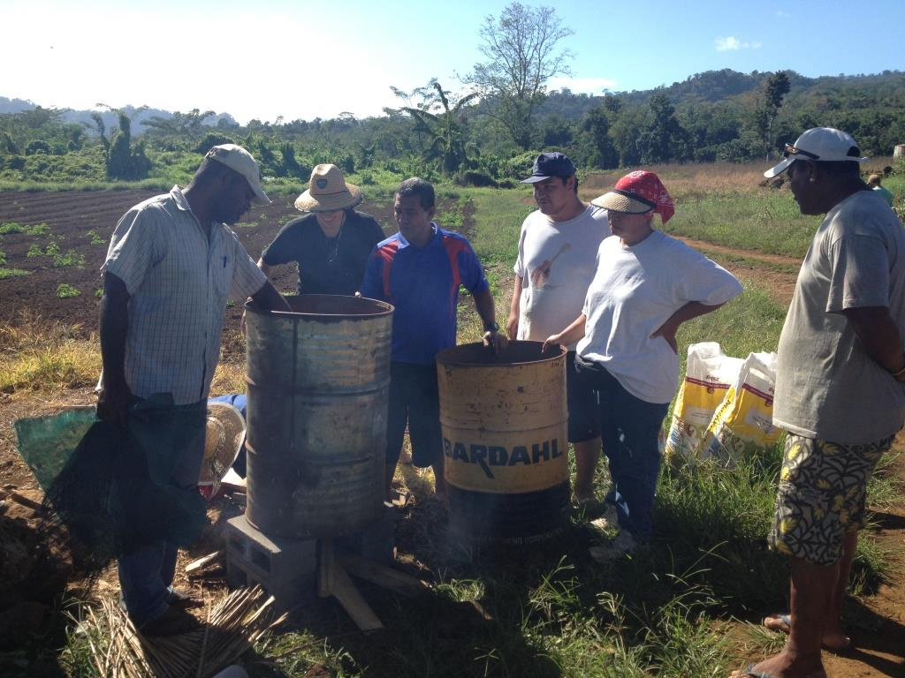
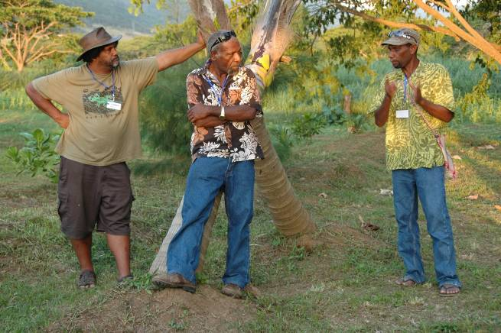
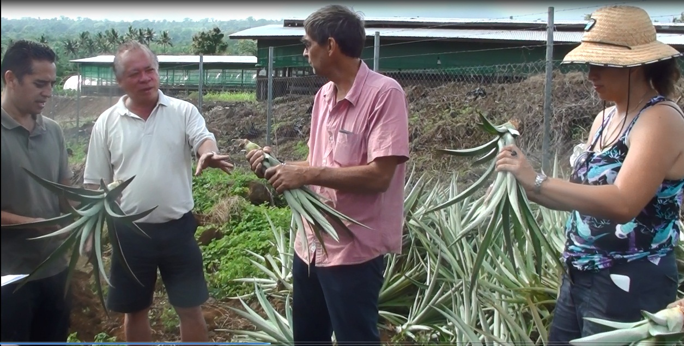
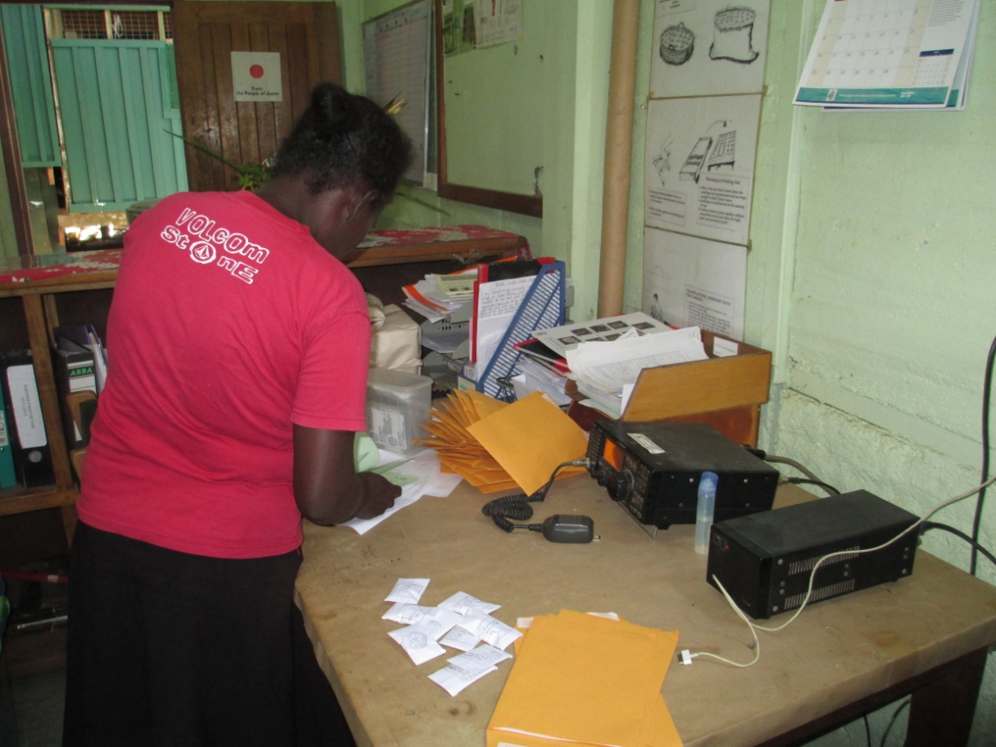
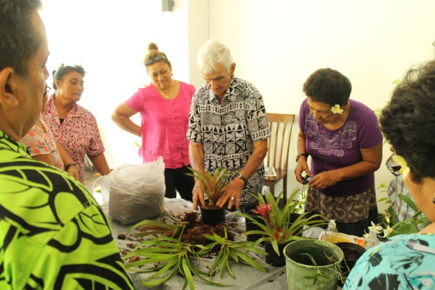
Local Solutions and Innovations Abound

Slide 16
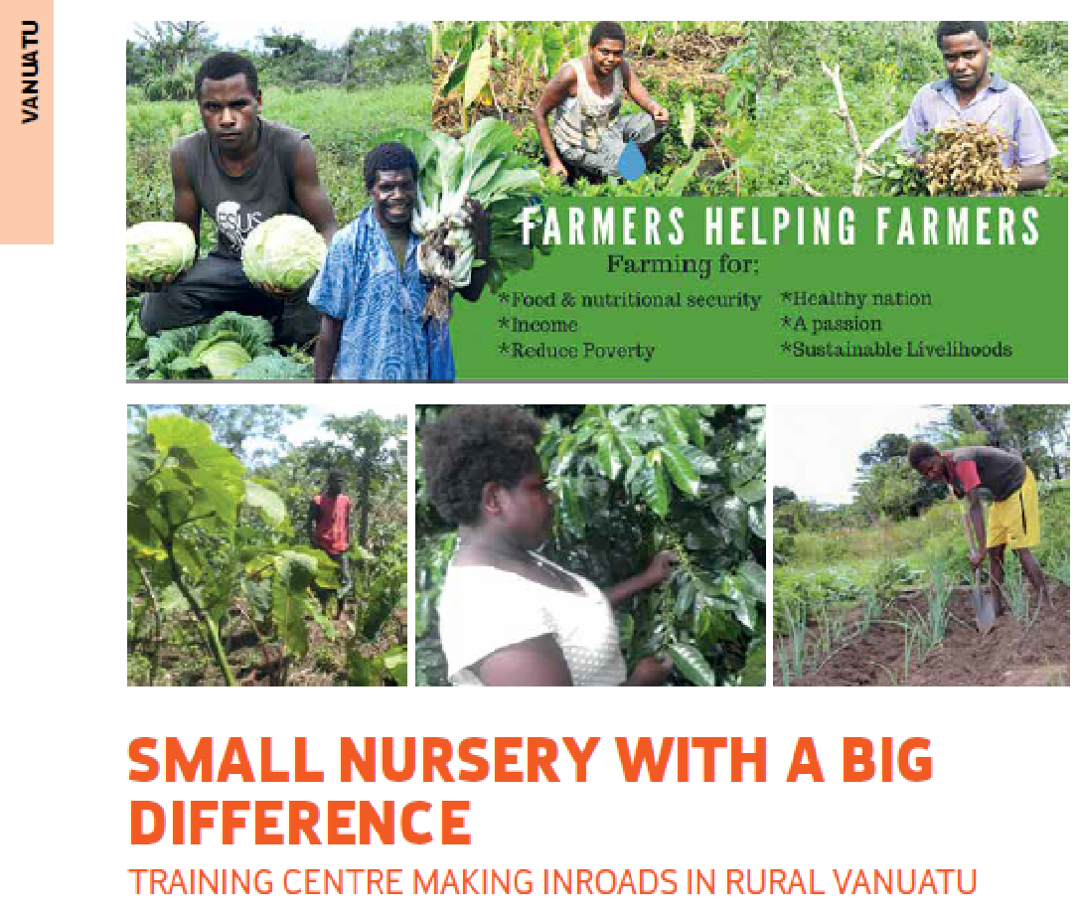
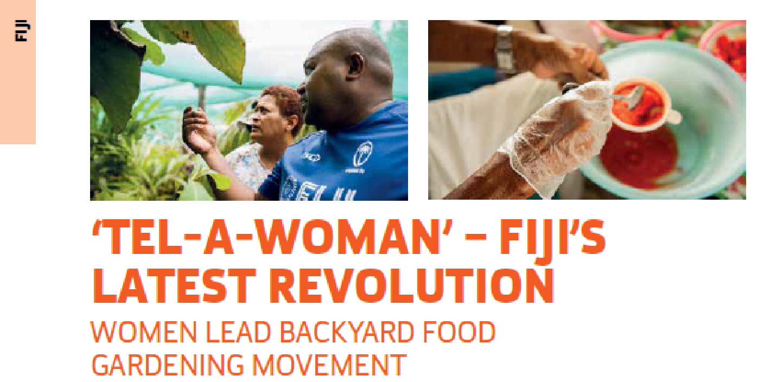

Slide 18
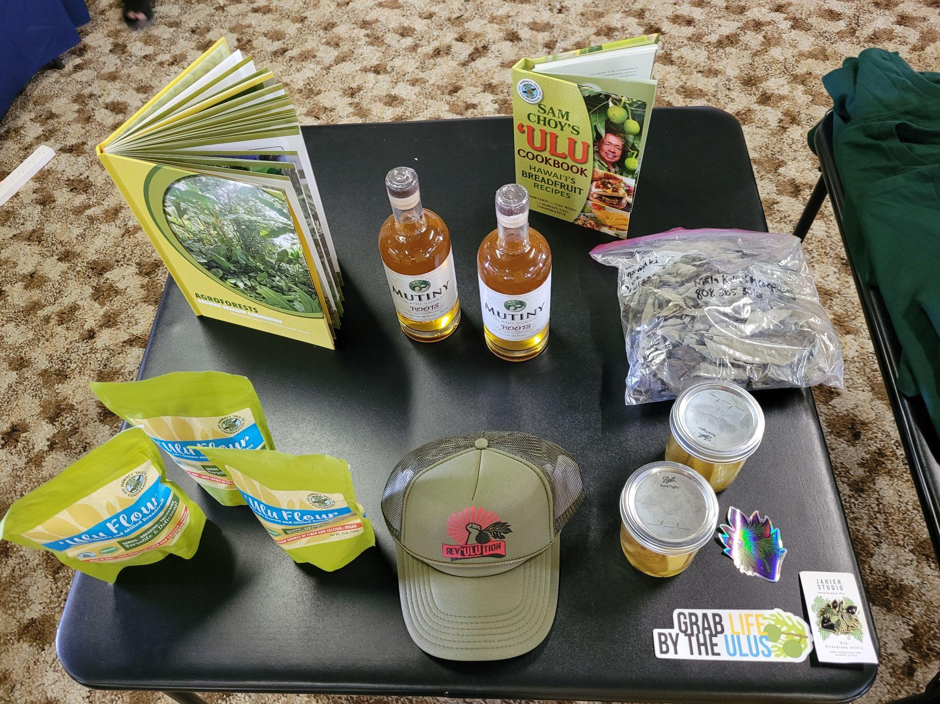
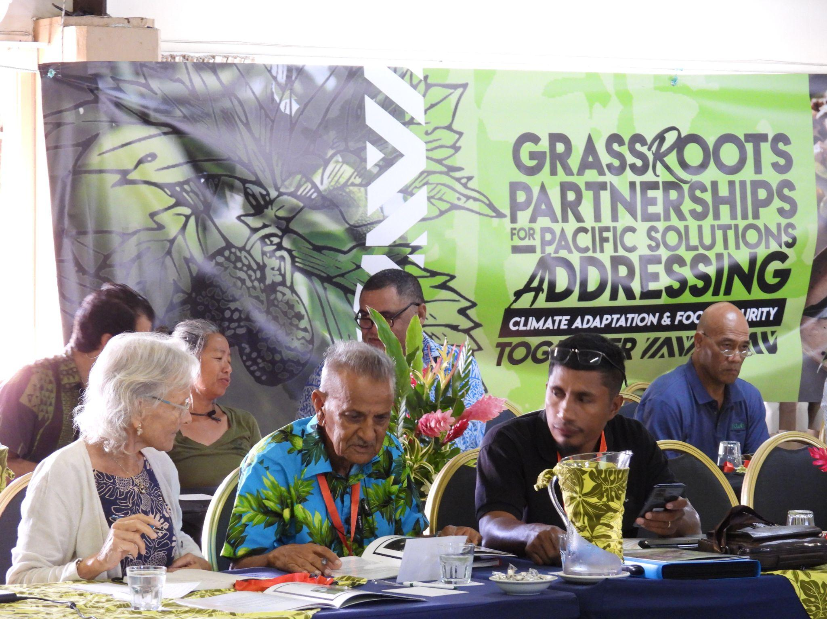
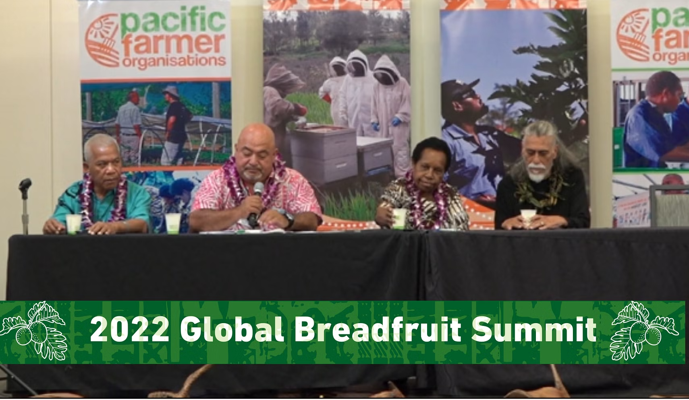

Slide 19
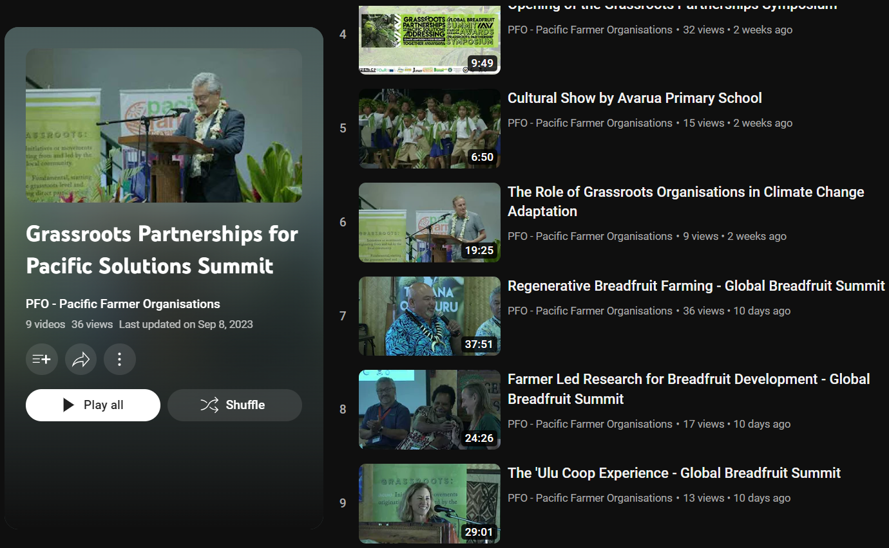

Slide 20
Farmer Organisations Connected Regionally and Globally Greatly Enhances Efforts

Slide 21
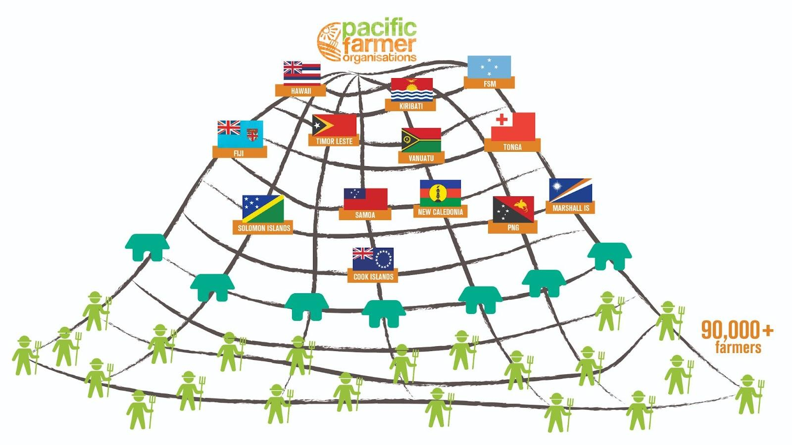

Slide 22
Call to Action
Prioritize Traditional Crops (staple crops, fruits, vegetables)
Value Traditional Agriculture Practices and work to enhance the,
Invest in Local Food Systems and Value Chain Development
Strengthen local organisations to deliver local solutions

Slide 23
www.pacificfarmers.com
Subscribe on the website
Follow us on facebook @pacificfarmers
Kyle Stice – Executive Director
manager@pacificfarmers.com
www.breadfruitpeople.com

