Slide 1
DPoA Implementation Status and Integration Tools in Africa Annual Meeting of National Focal Points of Least Developed Countries Intercontinental Lusaka, Lusaka, Zambia 31 March 2025
Oyebanke Abejirin
Officer-in-Charge, Development Planning Section
Macroeconomics, Finance and Governance Division
United Nations Economic Commission for Africa

Slide 2
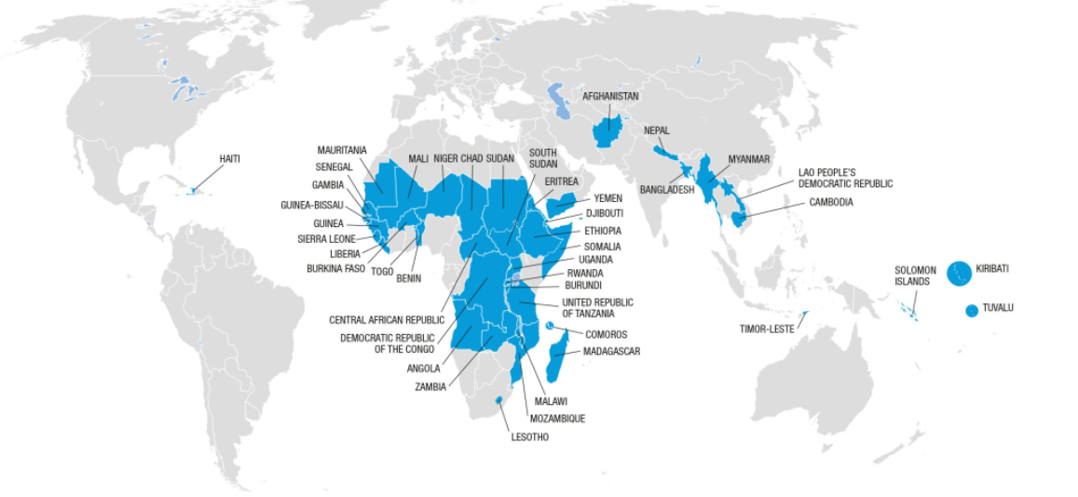




Global distribution of LDCs
Title
Title
44 LDCs globally, 32 (73%) in Africa making 9.8% of global population
Four African countries have graduated from LDC status:
Botswana
(1994)
Cabo Verde
(2007)
Equatorial Guinea (2017)
São Tomé and Príncipe (2024)
Notes:
The Doha Programme of Action for the Least Developed Countries for the decade 2022–2031 represents a new era of revitalized and reaffirmed commitments among these countries and their development partners
Least developed countries make up 15 per cent of the global population but only 1.4 per cent of global gross domestic product (GDP) and 1.1 per cent of international trade.
As of December 2024, there were 44 least developed countries, 32 (73 per cent) of which were African Handbook on the Least Developed Country Category: Inclusion, Graduation and Special Support Measures (United Nations publication, 2024).
To graduate from least developed country status, a country must meet two of the three criteria in two consecutive triennial reviews: Threshold of gross national income per capita; low human assets index and a high economic and environmental vulnerability index.
Djibouti and Senegal, having met the criteria twice, were recommended for graduation but requested a five-year extension for an orderly transition. Djibouti needs more time owing to its high vulnerability, and Senegal plans to use the extension to improve its human assets index score with help from development partners. T
he Comoros, meeting the criteria for the second time, had its graduation postponed to 2027 owing to vulnerability to global crises. Rwanda, Uganda and the United Republic of Tanzania met the criteria for the first time and may graduate if they meet them again in 2027.
Angola and Zambia no longer meet the graduation criteria.

Slide 3
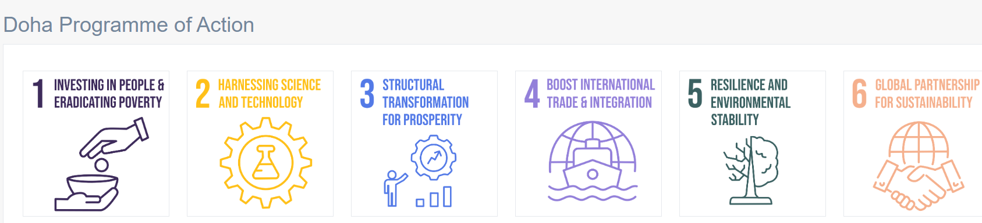
Doha Program of Action (2022 – 2031), 6 Focus Areas

Slide 4




Key Achievements
01
Births attended by skilled personnel: 61.8% (2015) → 75.7% (2023)
Infant mortality (per 1000 live births): 54.8 (2015) → 45.5 (2022)
Maternal mortality (per 100,000 live births): 498 (2015) → 438 (2020)
01
Improvement in gender parity in education - 0.87 at the tertiary level (2023), up from 0.64 (2015)
Improved gender equality in leadership – women in parliament at 23% in 2023, close to the global average (26.74%).
02
.Internet usage in African LDCs grew from 18.8% in 2018 to 32.2% in 2022, indicating progress in digital connectivity.
Mean manufacturing value addition as a % of GDP in African LDCs increased from 9.11% in 2018 to 9.86% in 2023.
03
Export product concentration index declined from 0.32 in 2018 to 0.27 in 2023, indicating progress towards export diversification.
Increase in electricity access from 38.5% in 2018 to 40.6% in 2022.
Notes:
Least developed countries everywhere, affected by global economic conditions, have experienced volatile economic growth in recent years.
After a downturn in 2020 owing to the COVID-19 pandemic, growth increased in 2021 and 2022 but then declined again in 2023 owing to the war in Ukraine, inflation, high interest rates and energy prices. Growth rates fell from 4.63 per cent in 2022 to 3.72 per cent in 2023 for least developed countries, and from 4.39 per cent to 3.61 per cent for African least developed countries
In addition, ongoing conflicts in Africa, which accounted for 53.8 per cent of global conflicts (98 out of 182) in 2022, continue to hinder socioeconomic development
African countries spent on average 4.8 per cent of GDP servicing debt, compared with 2.6 per cent on health and 4.8 per cent on education
23% of primary school-age children in African LDCs are out of school. Tertiary enrolment: 9.2% in 2023 (world average: 43.3%). Gender parity improving: 0.87 at the tertiary level (2023), up from 0.64 (2015)
An overarching improvement in health and mortality-related indicators
Infant mortality: 54.8 (2015) → 45.5 (2022) per 1,000 live births. Maternal mortality: 498 (2015) → 438 (2020) per 100,000 live births. Births attended by skilled personnel: 61.8% (2015) → 75.7% (2023)
The percentage of people using at least basic sanitation services rose from 28.89 per cent in 2015 to 34.45 per cent in 2022, with rural access at 24.12 per cent and urban access at 45.97 per cent. There are wide disparities among African least developed countries, with percentages ranging from 9.34 per cent to 66.91 per cent,
26.1% of youth in Africa are not in education, employment, or training (32.7% women, 20% men) . Youth literacy: 76.6% in African LDCs (global average: 92.7%). One in four young people in those countries cannot read or write basic statements, limiting potentials.
With regard to overall governance, the Ibrahim Index of African Governance shows a slight increase of 0.94 percentage points, from 44.6 in 2015 to 45.5 in 2023. Although some countries made good progress, 13 of the 32 African least developed countries showed a decline during that period

Slide 5


Key Achievements
04
Slight increase in ALDC’s export share to 0.65% from 2021 – 2023, from 0.61% from 2015 – 2020.
05
ALDCs received $10 billion in climate finance in 2022, an 83% increase compared to 2018.
06
. Remittances to Africa reached $100 billion in 2022, surpassing Official Development Assistance and foreign direct investment.
Notes:
Least developed countries everywhere, affected by global economic conditions, have experienced volatile economic growth in recent years.
After a downturn in 2020 owing to the COVID-19 pandemic, growth increased in 2021 and 2022 but then declined again in 2023 owing to the war in Ukraine, inflation, high interest rates and energy prices. Growth rates fell from 4.63 per cent in 2022 to 3.72 per cent in 2023 for least developed countries, and from 4.39 per cent to 3.61 per cent for African least developed countries
In addition, ongoing conflicts in Africa, which accounted for 53.8 per cent of global conflicts (98 out of 182) in 2022, continue to hinder socioeconomic development
African countries spent on average 4.8 per cent of GDP servicing debt, compared with 2.6 per cent on health and 4.8 per cent on education
23% of primary school-age children in African LDCs are out of school. Tertiary enrolment: 9.2% in 2023 (world average: 43.3%). Gender parity improving: 0.87 at the tertiary level (2023), up from 0.64 (2015)
An overarching improvement in health and mortality-related indicators
Infant mortality: 54.8 (2015) → 45.5 (2022) per 1,000 live births. Maternal mortality: 498 (2015) → 438 (2020) per 100,000 live births. Births attended by skilled personnel: 61.8% (2015) → 75.7% (2023)
The percentage of people using at least basic sanitation services rose from 28.89 per cent in 2015 to 34.45 per cent in 2022, with rural access at 24.12 per cent and urban access at 45.97 per cent. There are wide disparities among African least developed countries, with percentages ranging from 9.34 per cent to 66.91 per cent,
26.1% of youth in Africa are not in education, employment, or training (32.7% women, 20% men) . Youth literacy: 76.6% in African LDCs (global average: 92.7%). One in four young people in those countries cannot read or write basic statements, limiting potentials.
With regard to overall governance, the Ibrahim Index of African Governance shows a slight increase of 0.94 percentage points, from 44.6 in 2015 to 45.5 in 2023. Although some countries made good progress, 13 of the 32 African least developed countries showed a decline during that period

Slide 6
Growth of ALDCs broadly in line with LDCs globally and marginally above Africa’s growth
Annual real GDP growth, %

Slide 7
African LDCs are diverse group, with almost 1/3 LMICs (and 1/3 resource-rich)
Africa’s LDCs that are LMICs (03/2025)
Angola
Benin
Comoros
Djibouti
Guinea
Lesotho
Mauritania
Senegal
Tanzania
Zambia
Composition of Africa's LDCs, by income

Slide 8
Key challenge - Limited and Volatile Exports Dominated by Low-value Commodities
Export shares of African LDCs in global exports,
2015-2023¹
Export share in world export stabilized at 0.65% between 2021–2023, slightly up from 0.61% (2015–2020 average)
Exports are highly concentrated in low-value, primary, and resource-based products; only 2.6% are medium-to-high-technology exports.
[1] United Nations Conference on Trade and Development, “Merchandise trade matrix, annual,” UNCTADstat (accessed on 15 October 2024).

Slide 9
Depleted fiscal space squeezes out financing for development
Fiscal deficit as a share of GDP by country group
Debt-to-GDP ratio by country group
Note: Data from IMF World Economic Outlook (Oct, 2024); Median values are reported. 2023 and 2024 include IMF-estimated country values while 2022 and before are actual data.
Note: The values are calculated based on the IMF (2025). Somalia and Libya are excluded from the African LDCs and non-LDCs lists, respectively, due to a lack of data.

Slide 10
Insufficient climate finance hinders resilience building
Climate finance mobilized by developed countries to African LDCs, 2010–2022¹
African LDCs face barriers to building climate resilience due to limited access to finance and technology.
Developed countries pledged $100 billion annually in climate finance for developing nations, yet only 13% reached LDCs in 2022.
African LDCs received $10 billion in 2022, with 67% directed to climate adaptation efforts, insufficient to meet African NDCs with an estimated need of $277 billion.
[1] Organization for Economic Cooperation and Development, Creditor Reporting System (accessed on 17 October 2024).

Slide 11
Low human capital assets is a key weakness with 1 in 4 youth unable to read or write basic statements
Literacy rate, youth total (% of people ages 15-24)

Slide 12
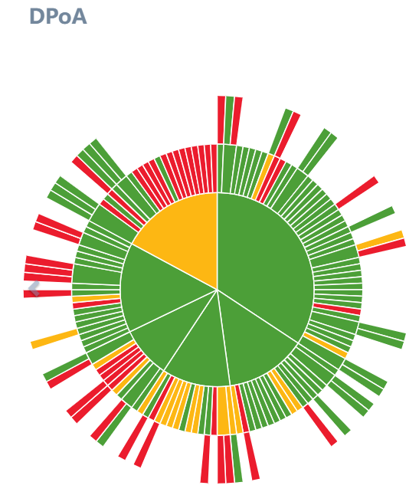
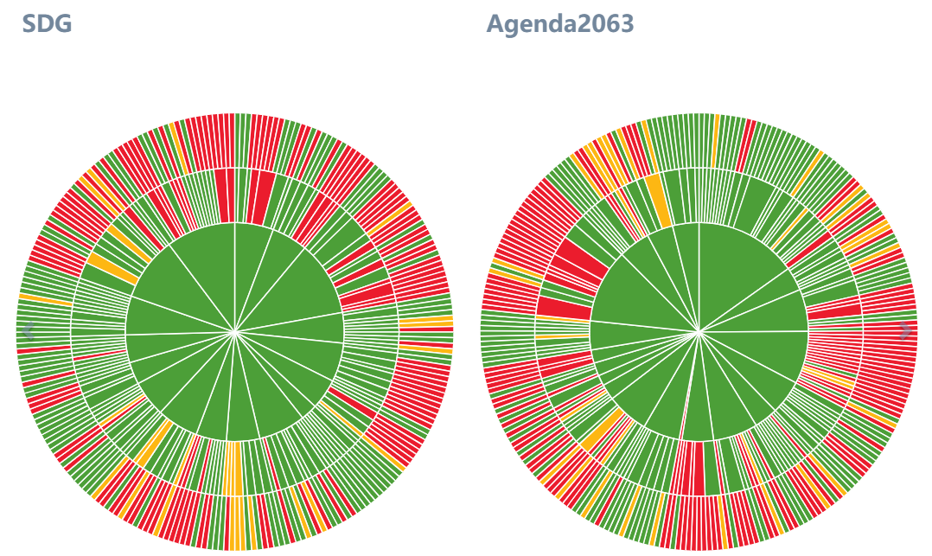

Integrated Planning and Reporting Toolkit
IPRT (Integrated Planning and Reporting Toolkit) is a web-based planning tool that digitalizes National Development Plans to facilitate performance tracking and domestication of the DPoA, SDGs and Agenda 2063

Slide 13
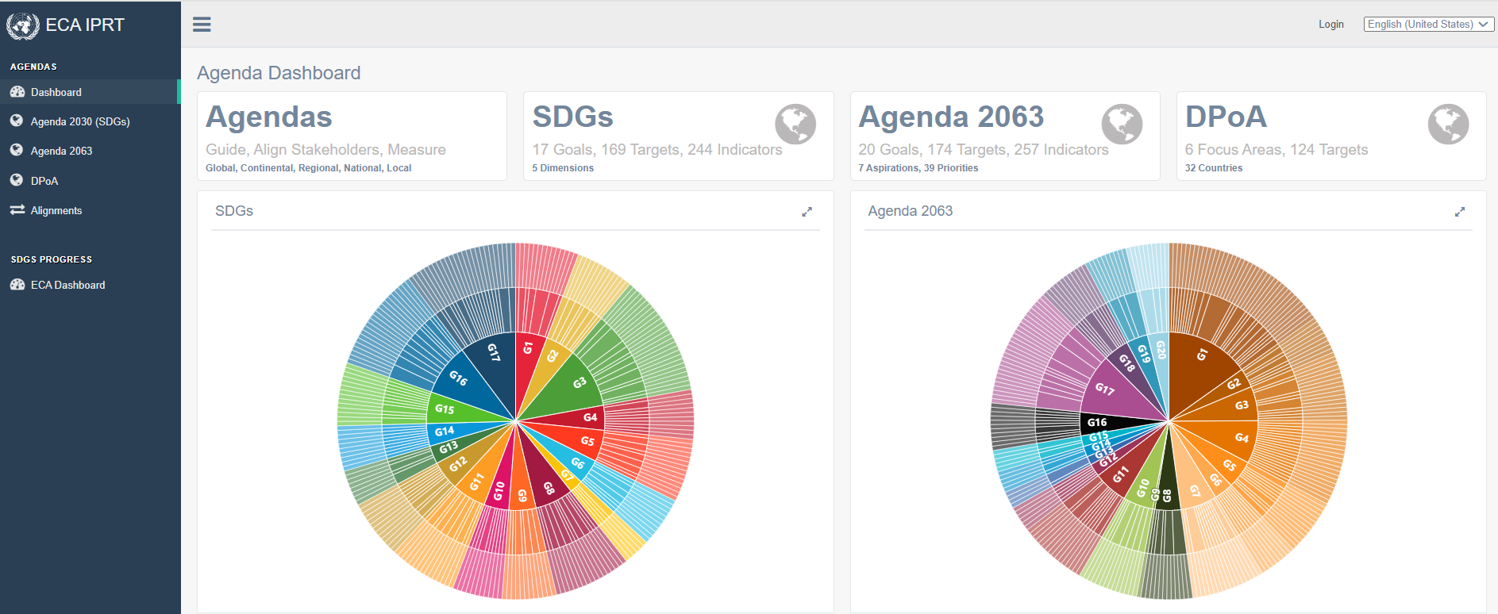
IPRT enables understanding of the agendas, their similarities and differences
IPRT enables understanding of the different agendas
An integrated approach to implementing the SDGs | A2063 | NDPs
IPRT.UNECA.ORG

Slide 14
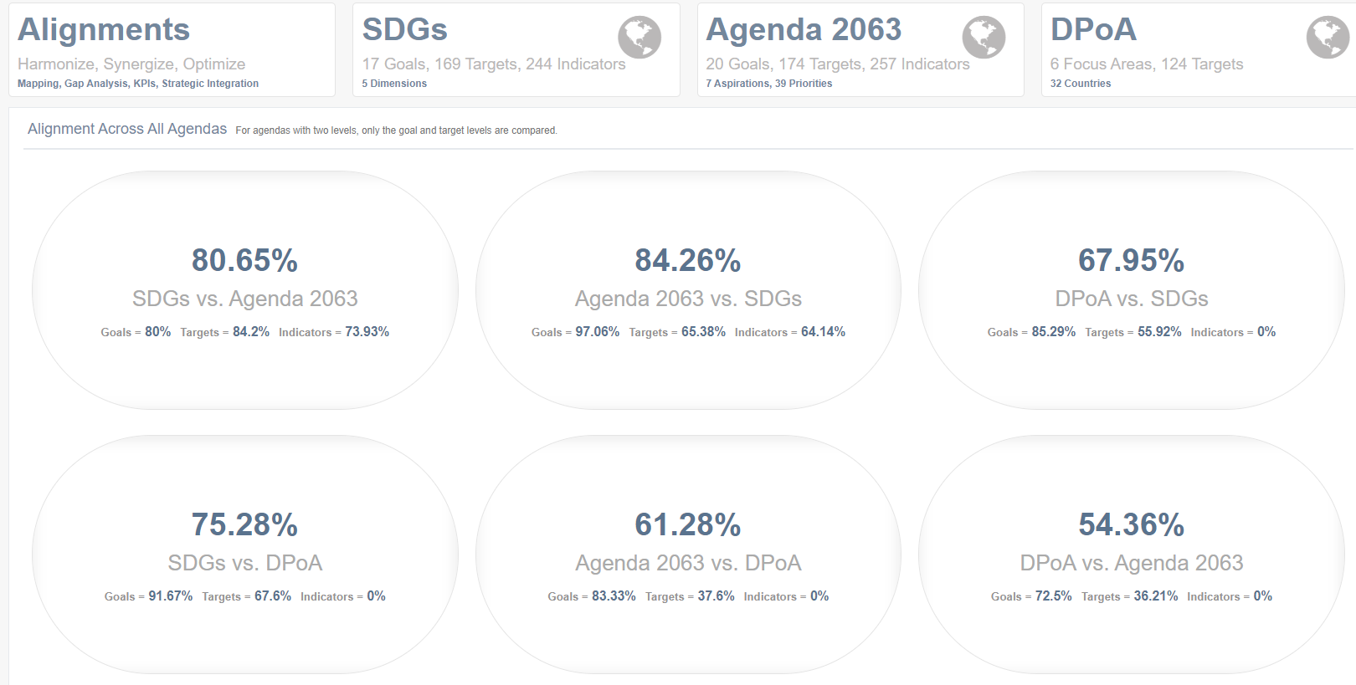
IPRT enables understanding of the different agendas
Relationship between the Agendas
An integrated approach to implementing the SDGs | A2063 | NDPs
IPRT.UNECA.ORG

Slide 15
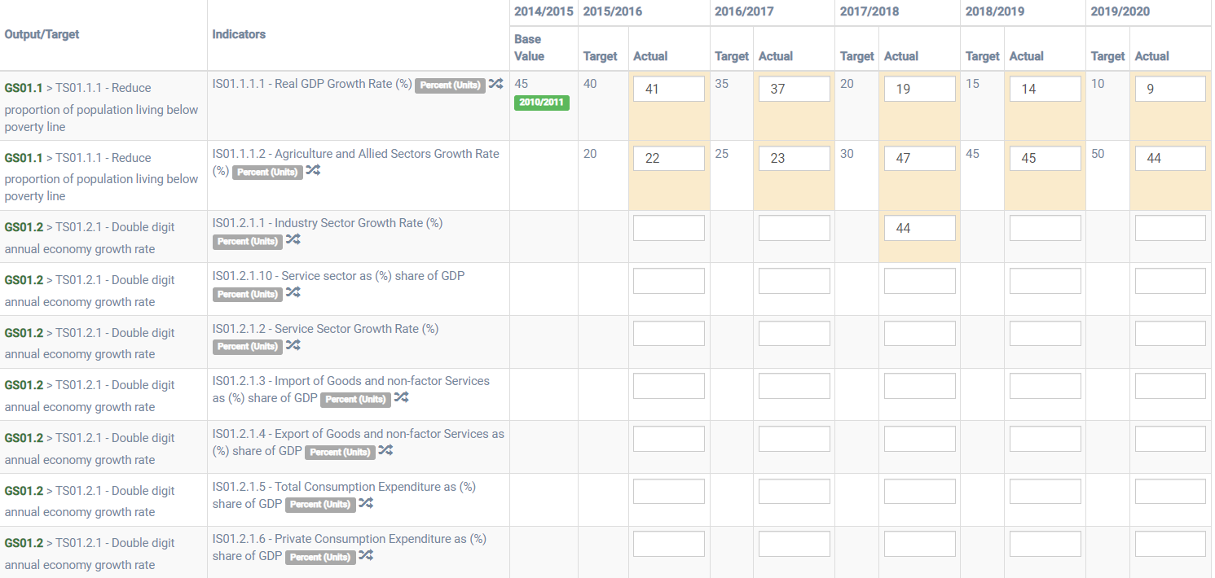
IPRT enables tracking of development priorities

Slide 16
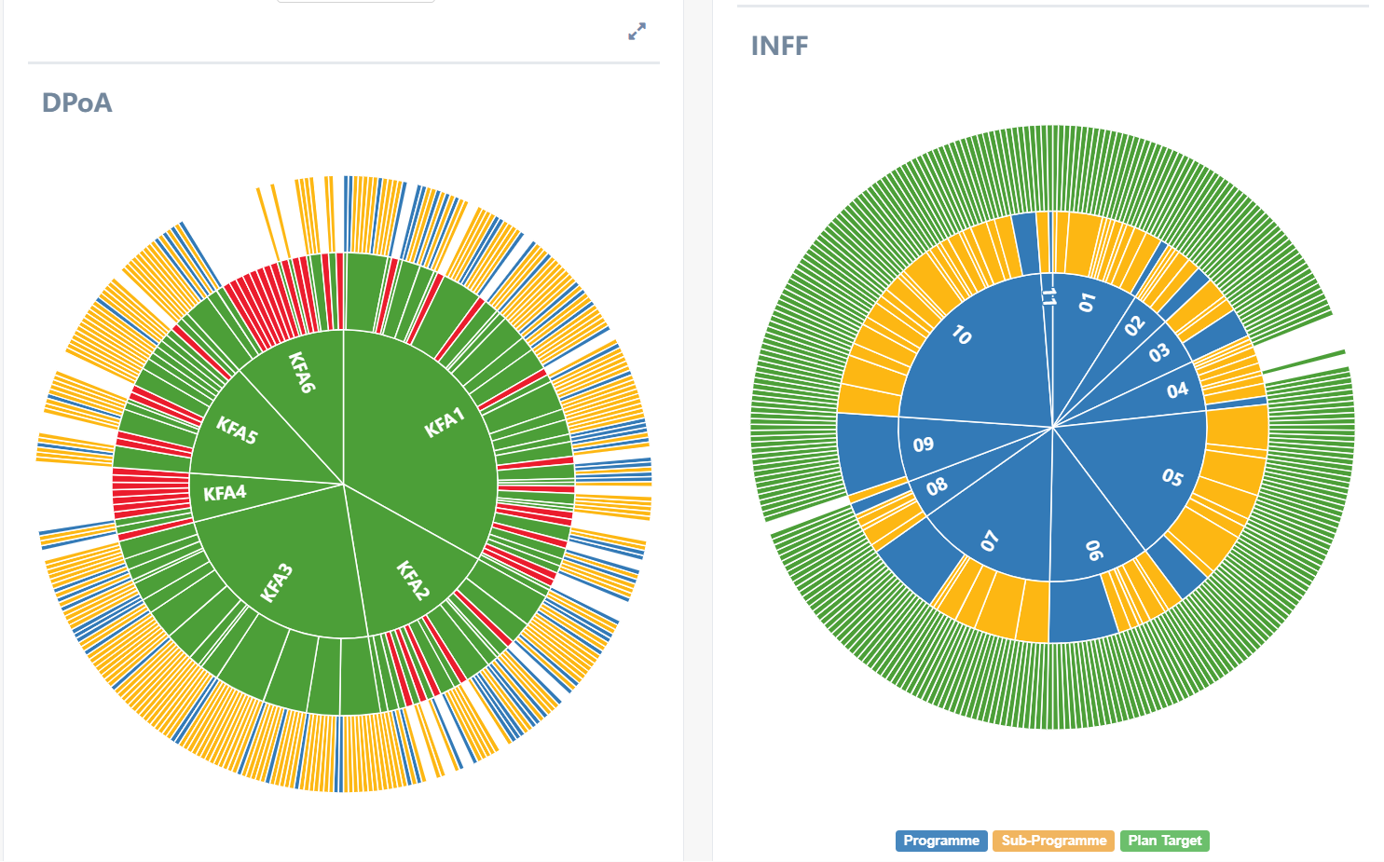
IPRT links financial programs to the DPoA and NDPs

Slide 17







Integrated Planning and Reporting Toolkit
7 Countries have used the IPRT to align their national development plans to the DPoA at the goal, target and indicator levels
Countries have varying levels of alignment of their Plans with the DPoA
DPoA alignment ranges from 50.15% to 83.89%
Averages of the three agendas:
Fig 3: NDP Alignment with DPoA, SDGs and Agenda 2063
DPoA: 70.22%
Agenda 2063: 71.26%
SDGs: 79.96%
Source: iprt.uneca.org, retrieved 30 March 2025

Slide 18
THANK YOU!

