Slide 1










ABOUT KACIFIC
Founded in 2013, Kacific is backed by a group of investors with experience in global telecommunications and infrastructure.
Singapore's home- grown satellite operator
WORLD CLASS BUSINESS PARTNERS
Key contributor in the Space Telecomm
Sector of Singapore
Kacific 1 was launched in 2019, addressing the need for affordable and universal broadband access in Asia Pacific.
High Throughput Satellite (HTS) payload
Transmitting over high-powered Ka-band
56 spot beams place capacity over selected islands and land mass
Gateways in Australia,
The Philippines, & Indonesia

Slide 2

KACIFIC1
COVERAGE
Directing capacity to the places where it’s most needed
American Samoa
Bangladesh
Bhutan
Brunei
Cook Islands
East Timor
Fiji
French Polynesia
Guam
Indonesia
Kiribati
Malaysia
Micronesia
Myanmar
Nepal
New Zealand
Niue
Northern Mariana
Papua New Guinea
Philippines
Samoa
Solomon Islands
Tonga
Tuvalu
Vanuatu

Slide 3
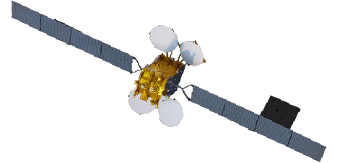


THE FUTURE ROADMAP: KACIFIC 2
Kacific's latest next-gen HTS satellite, Kacific2, is expected to start operational in 2027. It features advanced beam management and software-defined satellite (SDS) capabilities.
Kacific-2
13+
Uzbekistan
Tajikistan
Countries
Nepal
Bhutan
Afghanistan
Laos
Philippines
7.2B
Pakistan
India
Bangladesh
Papua New Guinea
Thailand
Cambodia
Malaysia
Population Covered
Pacific Islands
Indonesia
Sri Lanka
1TBPS
K-1 currently served markets
New Zealand
Total Addressable Demand
K-2 planned target markets

