Slide 1
To what extent do donors take into account the structural characteristics of LDCs when allocating their resources?
03.04.2025
Lusaka, Zambia
Matthieu Boussichas & Sosso Feindouno,
Researchers, Ferdi
Roundtable discussion with practitioners on monitoring the DPoA implementation
LDC-V Monitor

Slide 2
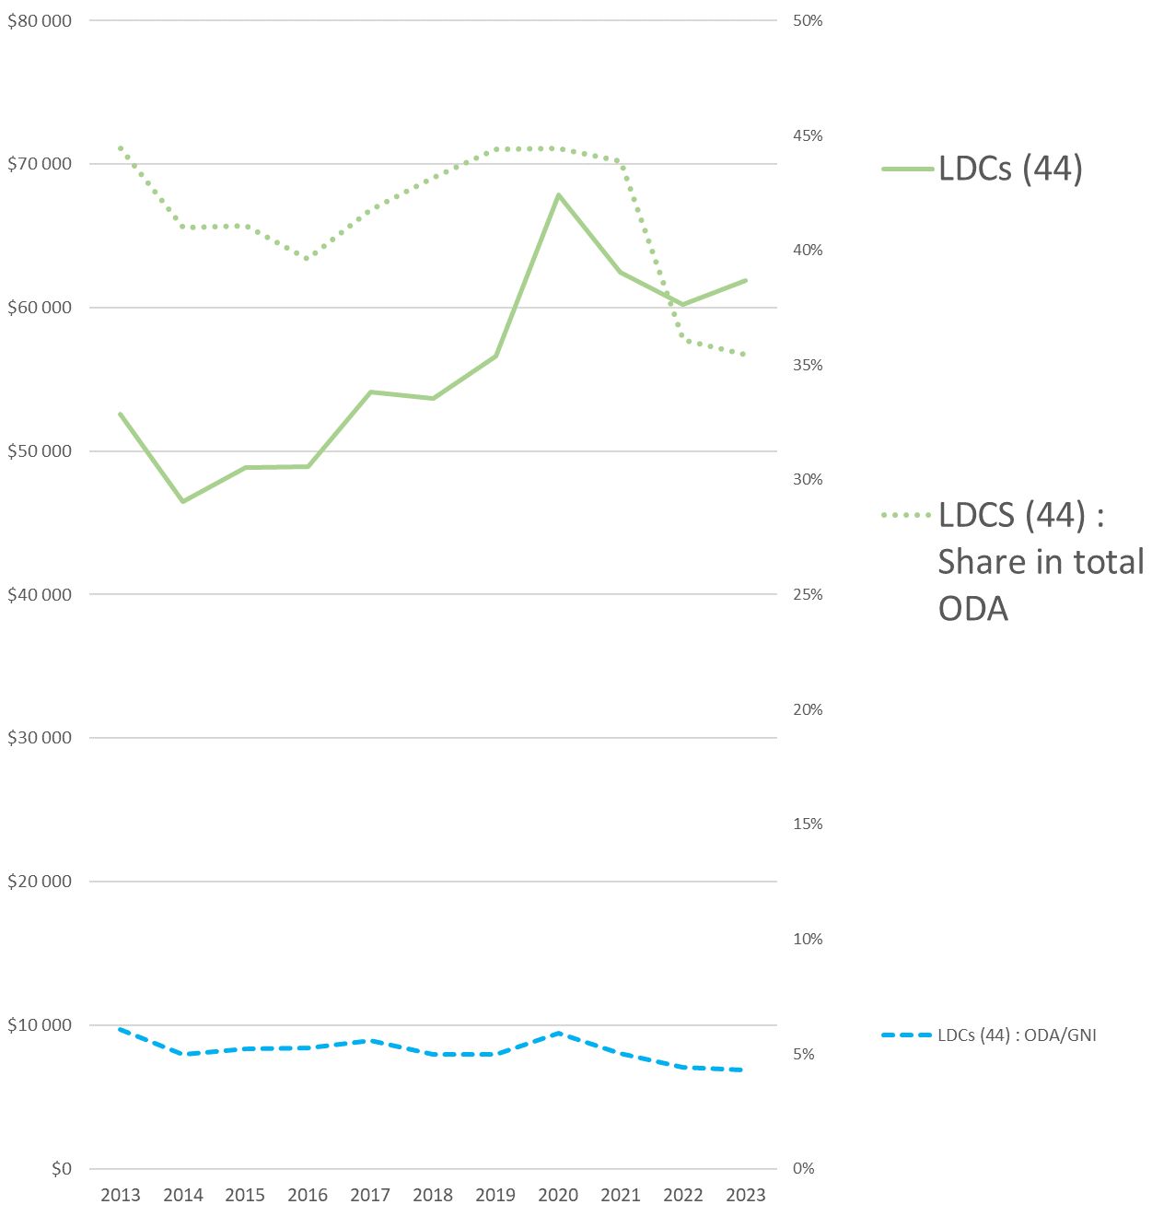
Trends in aid to LDCs and Share of LDCs in international aid

Slide 3
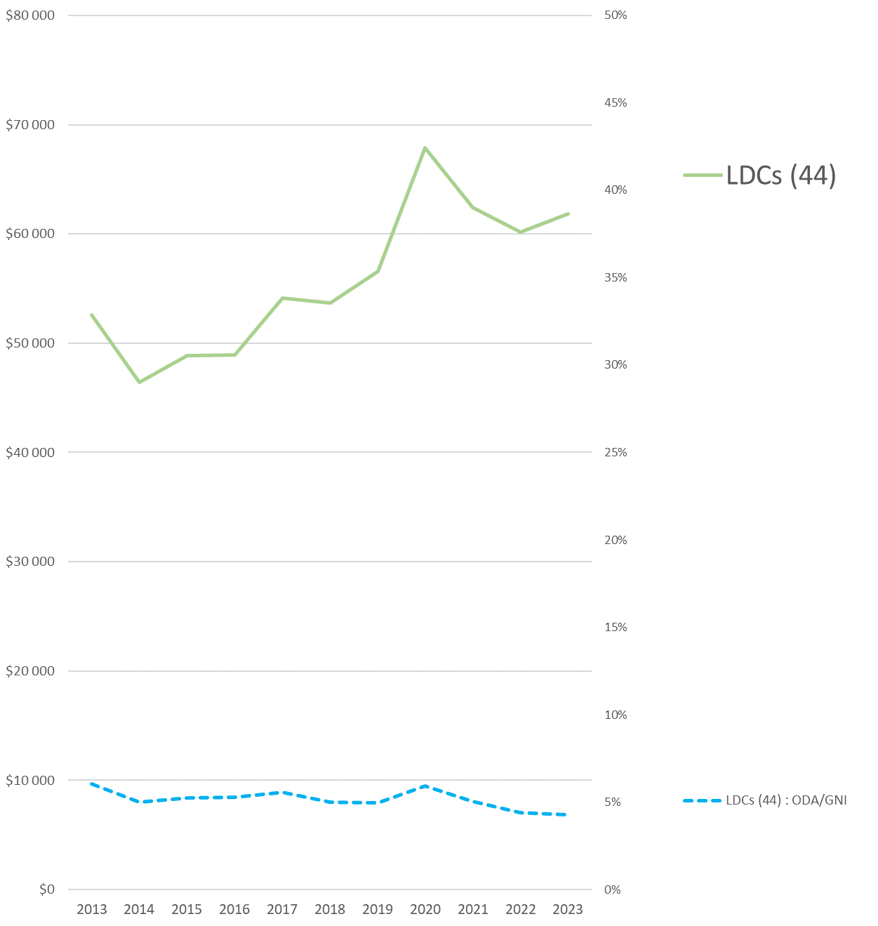
Trends in aid to LDCs and Share of LDCs in international aid
1971 – 2019 : Econometric estimation of the effect of category membership on the amount of aid received:
Does not show a differential effect between LDCs and non LDCs
Has it changed since then?
What is the Impact of Covid and the War in Ukraine?
Covid : Increase of the international support
BUT
War in Ukraine:
Sharp drop in the volume of ODA to LDCs

Slide 4
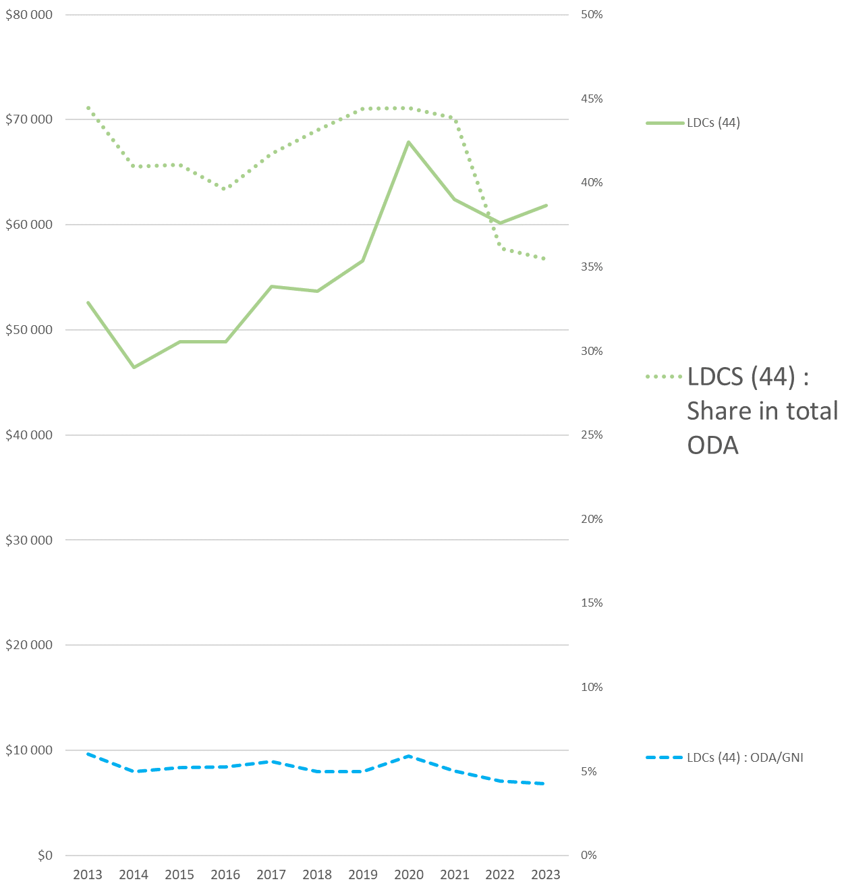
Trends in aid to LDCs and Share of LDCs in international aid
1971 – 2019 : Econometric estimation of the effect of category membership on the amount of aid received:
Does not show a differential effect between LDCs and non LDCs
Has it changed since then?
What is the Impact of Covid and the War in Ukraine?
Covid : Increase of the international support
BUT
War in Ukraine:
Sharp drop in the volume of ODA to LDCs
Sharp drop in the LDCs share in global ODA

Slide 5
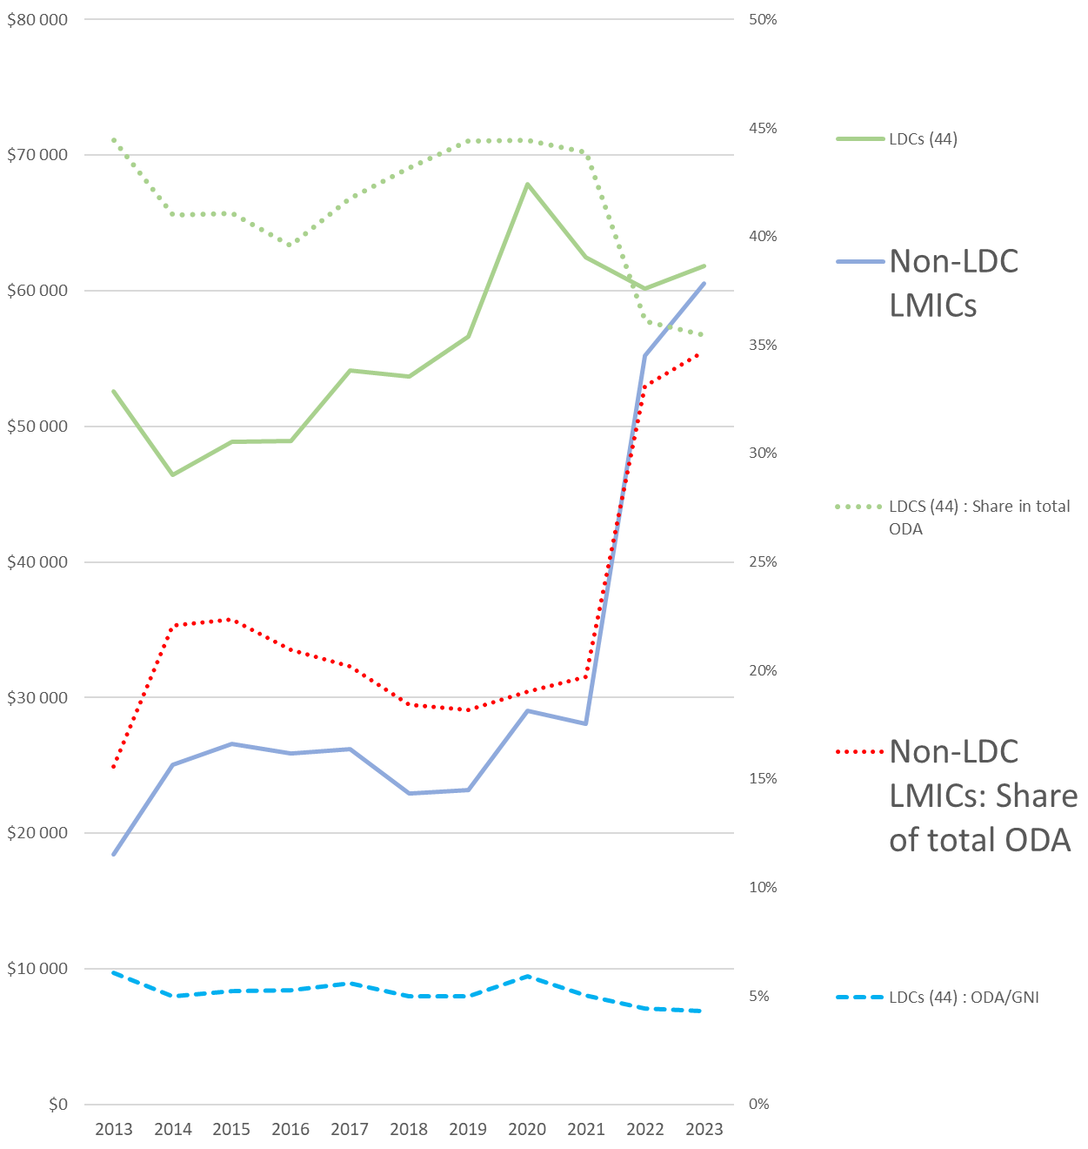
Trends in aid to LDCs and Share of LDCs in international aid
1971 – 2019 : Econometric estimation of the effect of category membership on the amount of aid received:
Does not show a differential effect between LDCs and non LDCs
Has it changed since then?
What is the Impact of Covid and the War in Ukraine?
Covid : Increase of the international support
BUT
War in Ukraine:
Sharp drop in the volume of ODA to LDCs
Sharp drop in the LDCs share in global ODA
With a strong increase of ODA to LMICs (Ukraine)

Slide 6
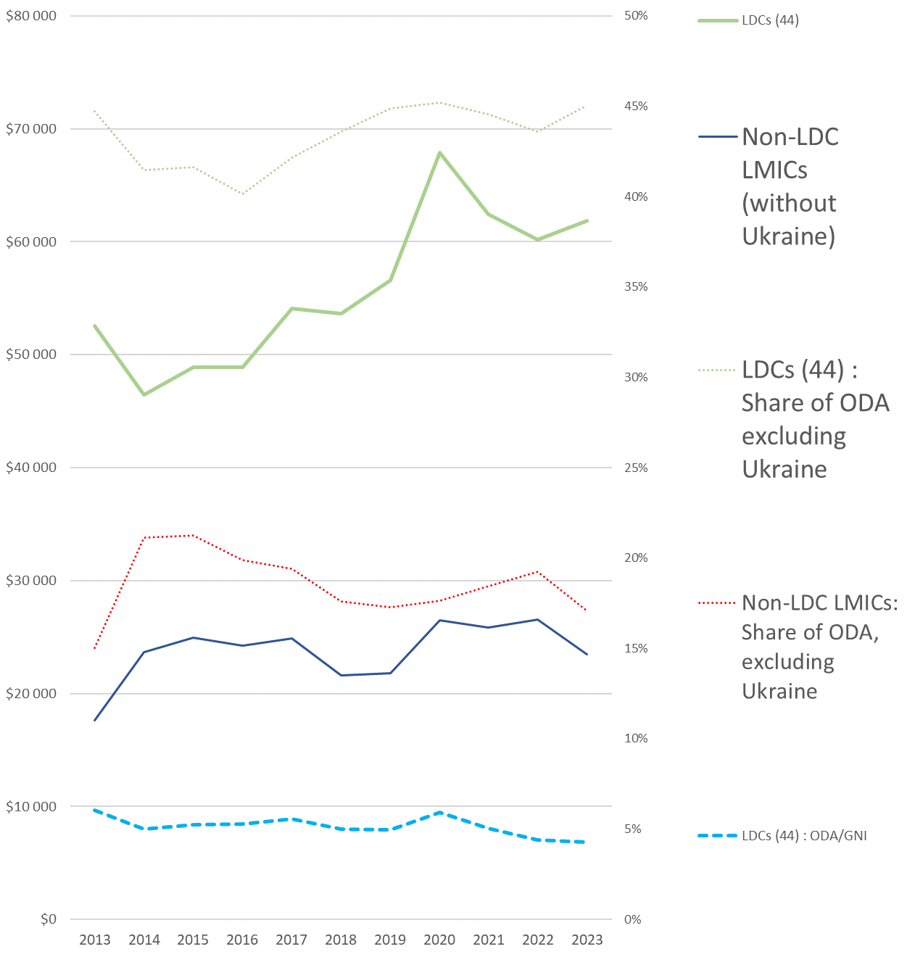
Trends in aid to LDCs and Share of LDCs in international aid
1971 – 2019 : Econometric estimation of the effect of category membership on the amount of aid received:
Does not show a differential effect between LDCs and non LDCs
Has it changed since then?
What is the Impact of Covid and the War in Ukraine?
Covid : Increase of the international support
BUT
War in Ukraine:
Sharp drop in the volume of ODA to LDCs
Sharp drop in the LDCs share in global ODA
With a strong increase of ODA to LMICs (Ukraine)
If we exclude aid to Ukraine from the analysis:
→ The share of ODA to LDCs still falls,
→ while ODA to LMICs nevertheless rises

Slide 7
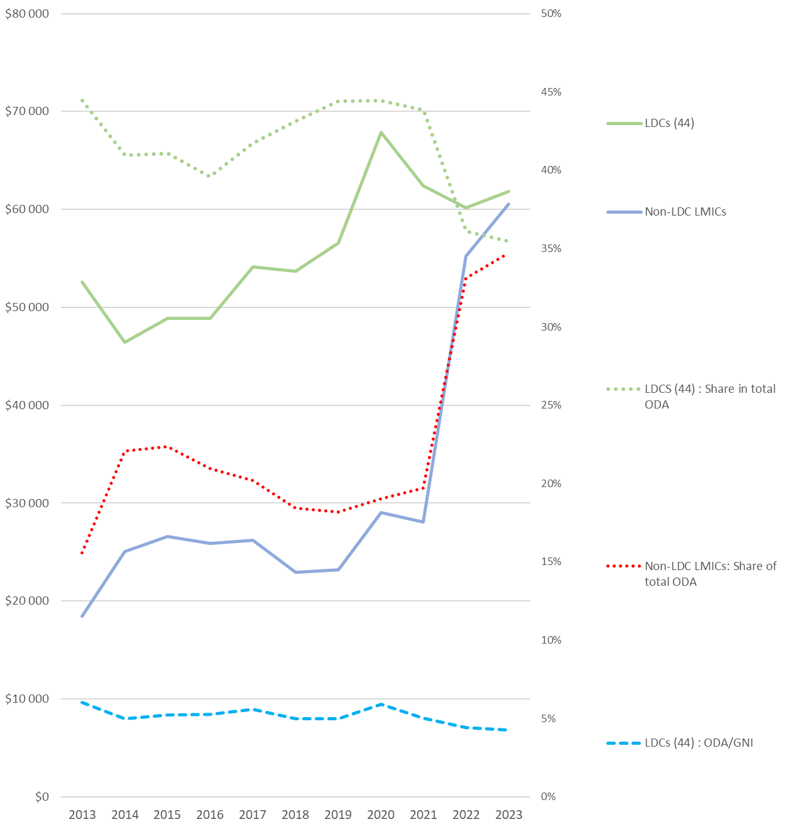
Trends in aid to LDCs and Share of LDCs in international aid
1971 – 2019 : Econometric estimation of the effect of category membership on the amount of aid received:
Does not show a differential effect between LDCs and non LDCs
Has it changed since then?
What is the Impact of Covid and the War in Ukraine?
Covid : Increase of the international support
BUT
War in Ukraine:
Sharp drop in the volume of ODA to LDCs
Sharp drop in the LDCs share in global ODA
With a strong increase of ODA to LMICs (Ukraine)
If we exclude aid to Ukraine from the analysis:
→ The share of ODA to LDCs still falls,
→ while ODA to LMICs nevertheless rises
Slight shift in support from LDCs to LMICs
Strong crowding-out effect of ODA to Ukraine on ODA to LDCs

Slide 8
Increasing aid to LDCs through better recognition of the MVI by donors?
Average vulnerability : LDCs > non LDCs
With MVI : Average vulnerability of LDCs / Average vulnerability of other developing countries = 1.08.
This ratio is even 1.16 if we use an improved IVM on which Ferdi is working (FSVI)
But, until now, vulnerability is not fully taken into account by donors :
Ferdi analysis of donors' sensitivity to vulnerability:
= Econometric estimation of the marginal selectivity of donor’s support
Results :
- Multilateral donors are taking greater account of structural vulnerability in their allocations
- BUT not for IDA and ADF
➔ this would probably be the case for IDA and ADF if they used an index such as the MVI

Slide 9
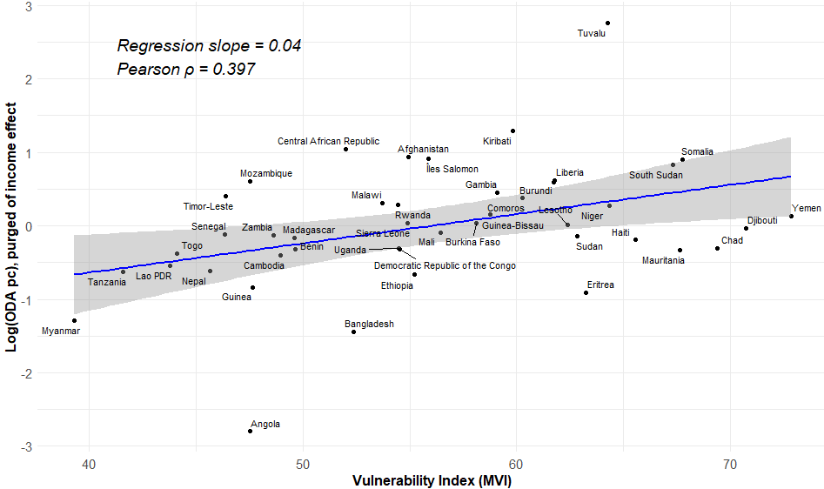
What about the LDCs ?
Correlation between the aid received by LDCs and their structural vulnerability

Slide 10
Conclusion
International support : stagnating and threatened
An option : Convince Donors to introduce an Vulnerability index as MVI among their criteria for allocating their concessional resources.
The effect should be positive for LDCs, since :
LDCs are on average more vulnerable than other countries
Donors' awareness of vulnerability can be improved (IDA and the ADF).
It will make it easier to distinguish between countries according to their degree of vulnerability, thereby making the allocation fairer and more appropriate.

