Slide 1
DRR and the Draft Articles on the Protection of Persons in the Event of Disasters
Ms. Toni-Shae Freckleton – Chief, UNDRR NY Office
5 October 2023

Slide 2
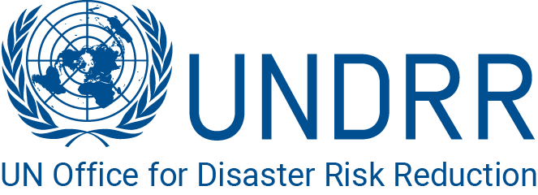
Impact of Disasters
Number of persons affected by disasters per 100,000 people
  1,092 in 2005-2014
  2,034 in 2013-2022
Annual costs of disasters (2015-2021)
  Above U$330 billion
  (estimated to be significantly undervalued)
Annual number of critical infrastructure destroyed/damaged (2015-2022)
  102,628 infrastructure units

Slide 3
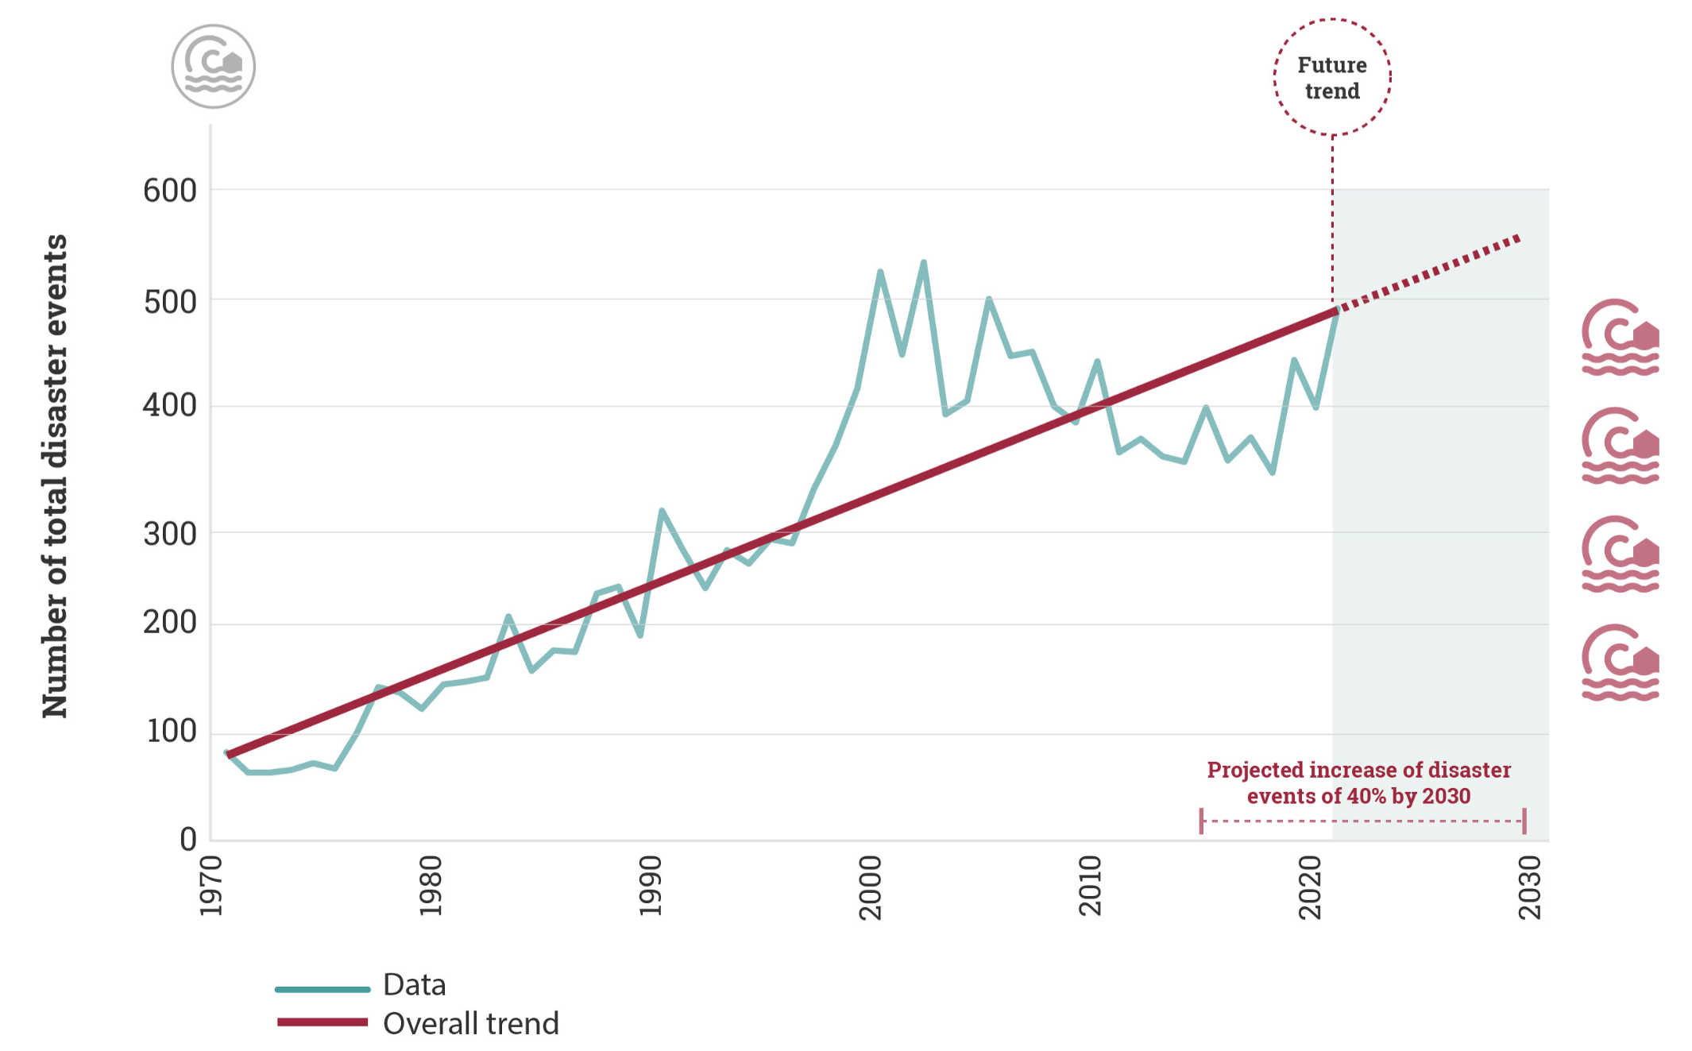
Number of disaster events 1970–2020 and projected increase 2021–2030
Source: UNDRR analysis based on EM-DAT (CRED, 2021)

Slide 4
The case for DRR
Nothing sets back development like a disaster.
Disaster risk reduction efforts are the bedrock to minimize the impact of disasters.
Disaster risk reduction costs are only 5-10% of response and recovery costs and will save lives and livelihoods.

Slide 5
Sendai Framework
Paragraph 5
It is urgent and critical to anticipate, plan for and reduce disaster risk in order to more effectively protect persons, communities and countries, their livelihoods, health, cultural heritage, socioeconomic assets and ecosystems, and thus strengthen their resilience.”
Paragraph 19a
Each State has the primary responsibility to prevent and reduce disaster risk, including through international, regional, subregional, transboundary and bilateral cooperation.

Slide 6
DRR Legislation
Number of countries with national disaster risk reduction strategies:
  From 55 in 2015 to 126 in 2022
Report on the Midterm Review of the Sendai Framework (A/77/640):
  Need for legislative and regulatory frameworks that support disaster risk reduction governance
  Progress has been primarily confined to high-income countries

Slide 7
Political Declaration of the Midterm Review of the Sendai Framework (A/RES/77/289)
26. We call upon States to strengthen comprehensive disaster risk governance, taking into account their national circumstances, needs and priorities, including by:
(c) Ensuring that disaster risk governance is supported by legal and regulatory frameworks, policies and plans at all levels that reflect responsibility to reduce disaster risk, including through risk-informed decision-making and investments as well as regulations for land-use and urban planning and building codes, as needed;
31. We recognize the need to implement integrated and inclusive economic, structural, legal, social, health, cultural, educational, environmental, technological, political, financial and institutional measures that prevent and reduce hazard exposure and vulnerability to disasters, increase preparedness for response and recovery and thus strengthen resilience.

Slide 8
UNDRR’s work on legal frameworks
Practical toolkit for parliamentarians
  In collaboration with the Inter-Parliamentary Union, offering specific actions that parliamentarians can take
Support to legislative reviews
  Working alongside regional partners and the IFRC
  Mainly supporting countries in the Pacific region (including Fiji, Kiribati, Samoa, Tonga and Vanuatu)

Slide 9
Draft Articles
Article 2 - Purpose
The purpose of the present draft articles is to facilitate the adequate and effective response to disasters and reduction of the risk of disasters, so as to meet the essential needs of the persons concerned, with full respect for their rights.
Article 9 – Reduction of the Risk of Disasters
1. Each State shall reduce the risk of disasters by taking appropriate measures, including through legislation and regulations, to prevent, mitigate, and prepare for disasters.
2. Disaster risk reduction measures include the conduct of risk assessments, the collection and dissemination of risk and past loss information, and the installation and operation of early warning systems.

Slide 10
Thank you!
Toni-Shae Freckleton
Chief, UNDRR New York Office
toni-shae.freckleton@un.org

