Slide 1
Protection of Persons in the Event of Disasters Isabelle Granger Lead, Disaster Law and the Auxiliary Role

Slide 2
More frequent and larger disasters
Notes:
Jonas to present

Slide 3
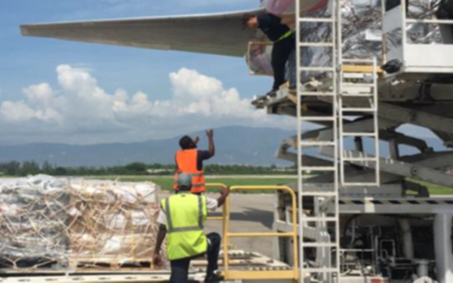
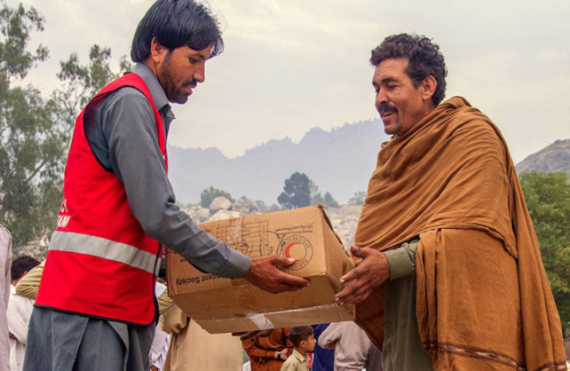
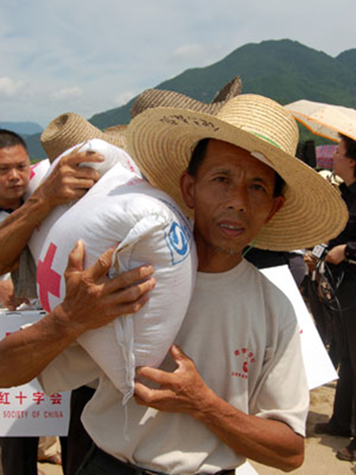
International cooperation to save lives

Slide 4
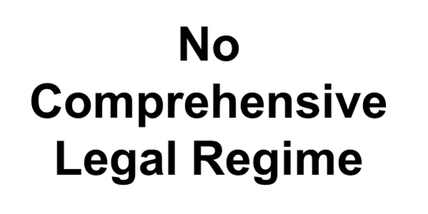
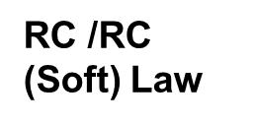
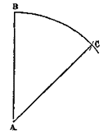
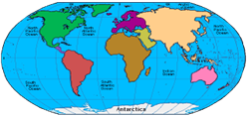
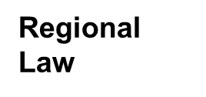

Slide 5
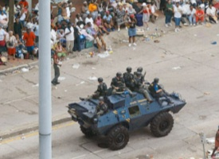
Some “sectoral” treaties on disaster response
Kyoto Convention (1973)
Istanbul Convention (1990)
Tampere Convention (1998)
Food Asst Convention (2012)
Convention on Maritime Traffic (1965)
Nuclear Accident Convention (1986)
Int’l Health Regs
(rev 2005)
Chicago Convention, Annex 9 (2004)
Framework Convention on Civil Defense (2000)
Safety Protocol (2005)

Slide 6
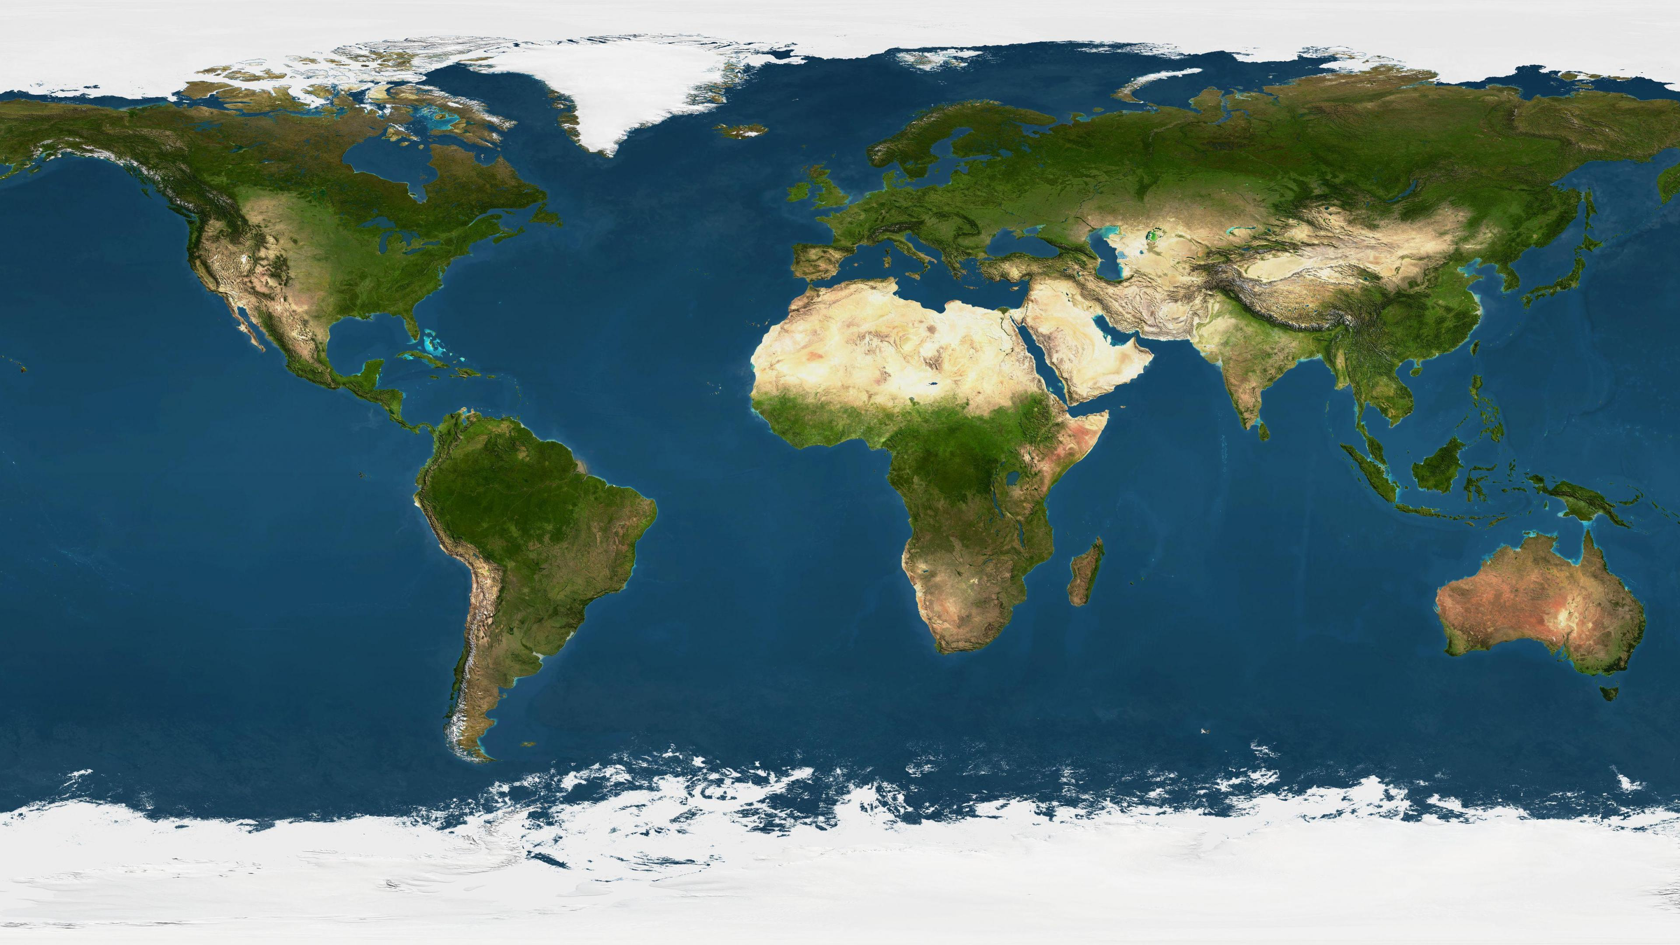
Regional Law

Slide 7
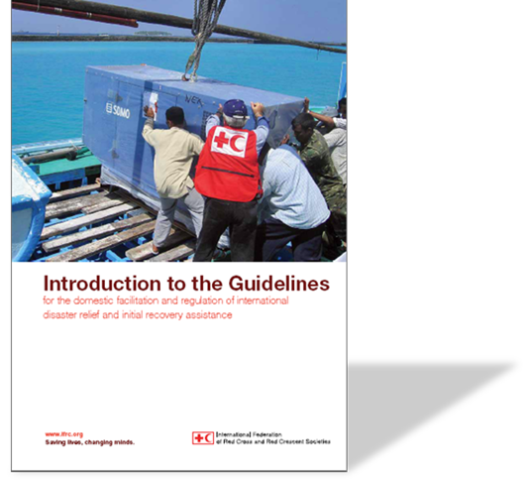
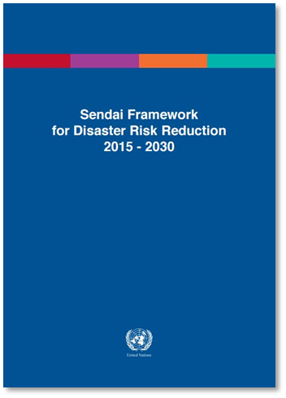
Soft Law and Standards

Slide 8
Common legal problems (DAs 11, 12, 13, 17)

Slide 9
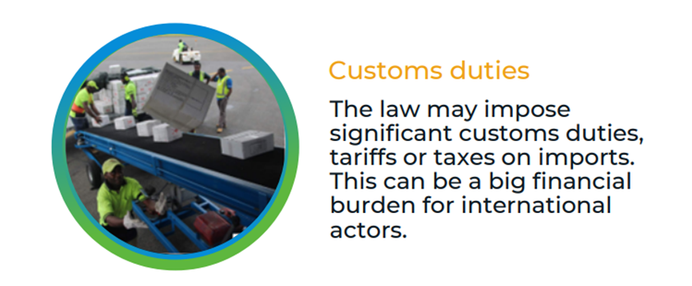
Common legal problems (continues): (DA 8, 15, 16)

Slide 10
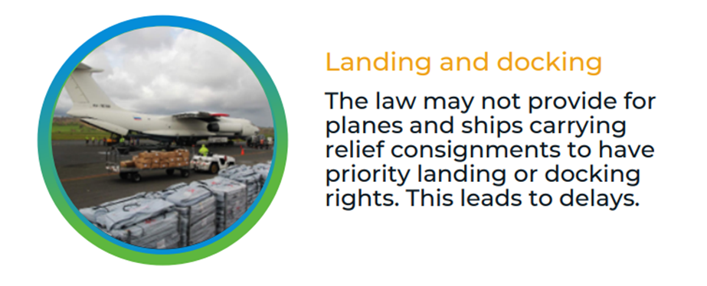
Common legal issues (continues): (DAs 8, 15, 16)

Slide 11
Common legal problems (continues): (DAs 8, 15, 16)

Slide 12
Common legal problems (continues): (DAs 8, 15, 16)

Slide 13
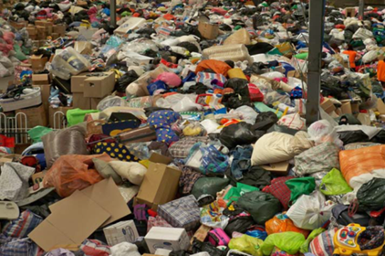
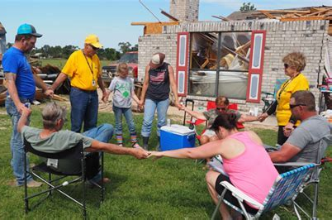
Quality and accountability (DAs 6, 14)

Slide 14
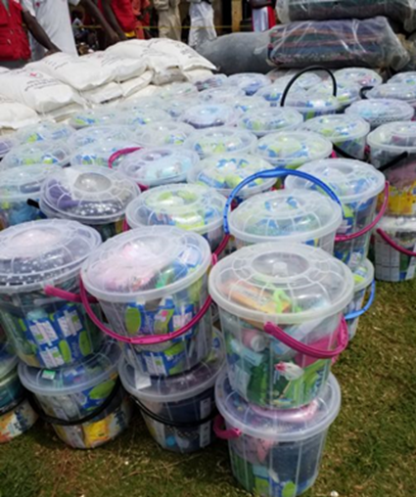
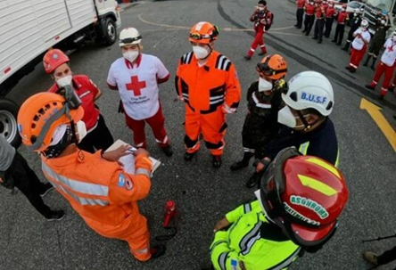
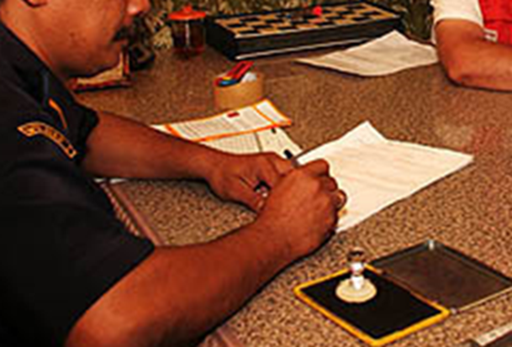
Conditions on the provision of ext. assistance (DAs 6, 10, 14, 15)
Quality and accountability
Selection of qualified actors
Legal facilities

Slide 15
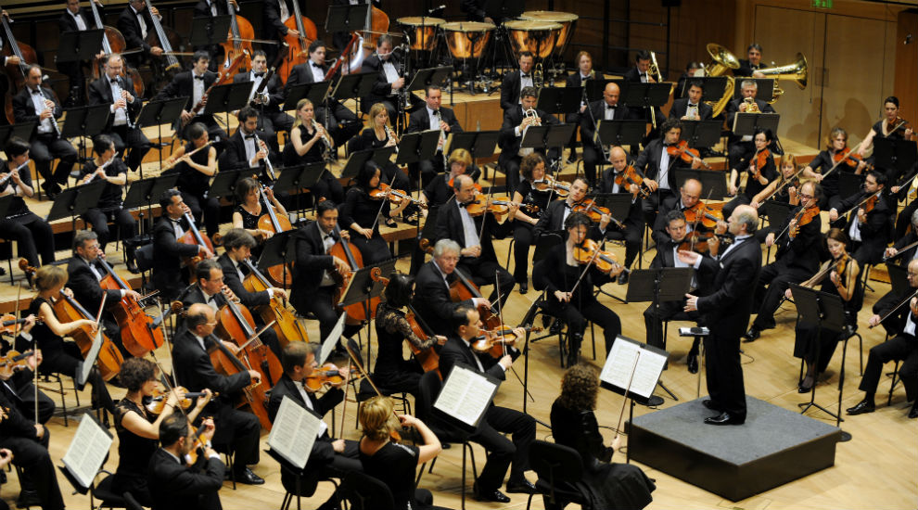
Conclusion

Slide 16
Thank you
© International Federation of Red Cross and Red Crescent Societies, Geneva, 2019.
Any part of this presentation may be cited, copied, translated into other languages or adapted to meet local needs without prior permission from the International Federation of Red Cross and Red Crescent Societies, provided that the source is clearly stated. Requests for commercial reproduction should be directed to the IFRC Secretariat at secretariat@ifrc.org
All photos used in this presentation are copyright of the IFRC unless otherwise indicated.
This presentation was written and developed by the IFRC Disaster Law Programme and produced in Oct 2023.
This presentation and relevant resources are available on FedNet at fednet.ifrc.org
For more information, please see our web site at www.ifrc.org/dl or contact us at disaster.law@ifrc.org.

