Slide 1
Frontiers for Development Cooperation
Robert Chambers
Institute of Development Studies, Sussex at the Development Cooperation Forum, 10 July 2014

Slide 3
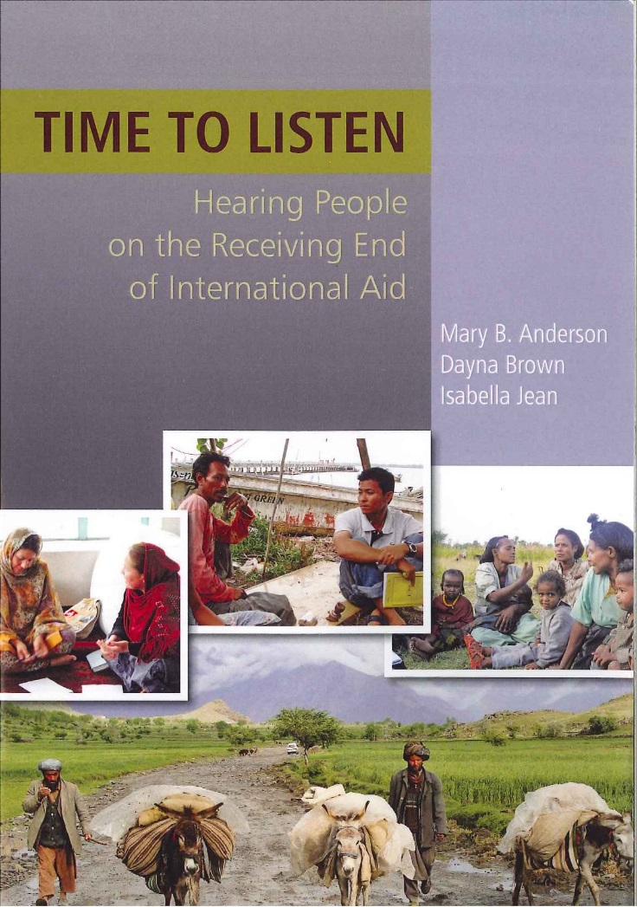
Time to Listen

Slide 5


Slide 7
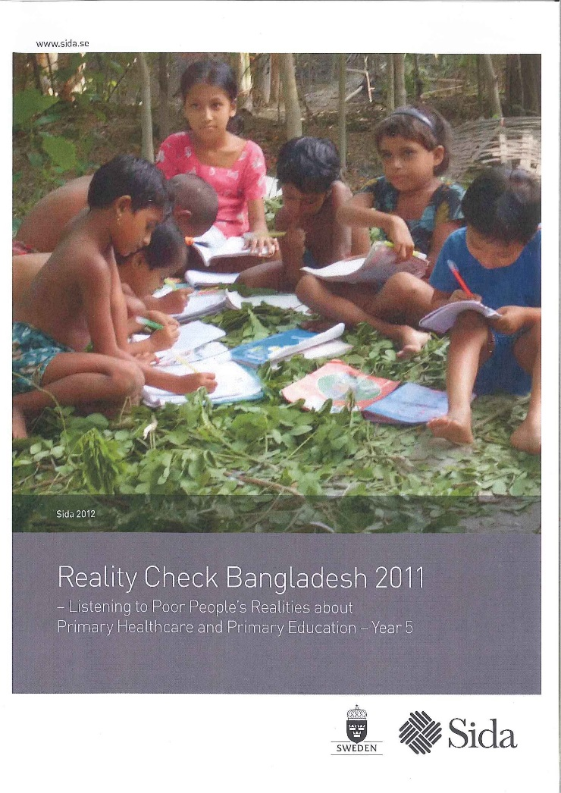
REALITY CHECKS SO FAR IN BANGLADESH, INDONESIA, NICARAGUA, MOZAMBIQUE, GHANA, NEPAL…. with potential to serve all our countries in the world for post-2015
www.reality-check-approach.com

Slide 9
ASK THEM!
LISTEN!

