Slide 1
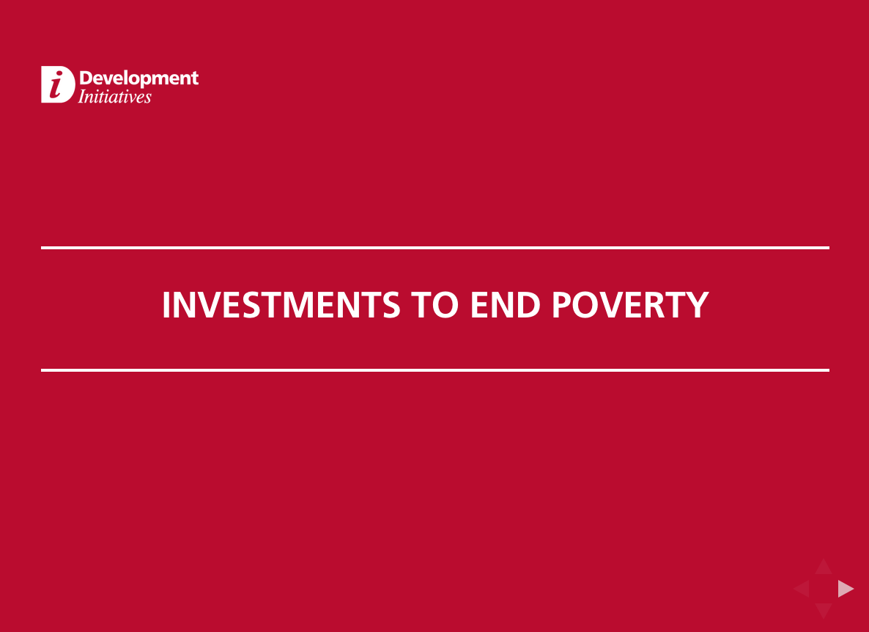
Presentation by Judith Randel to 2014 DCF
Data for this presentation is taken from the Investments to End Poverty report which can be downloaded, along with the data, from:
http://devinit.org/report/investments-to-end-poverty/

Slide 2
Questions for this session
Why do we need more and better ODA?
How do we ensure aid goes where it is most needed?
What roles will ODA have to play in future?
How do we leverage other resources?

Slide 3
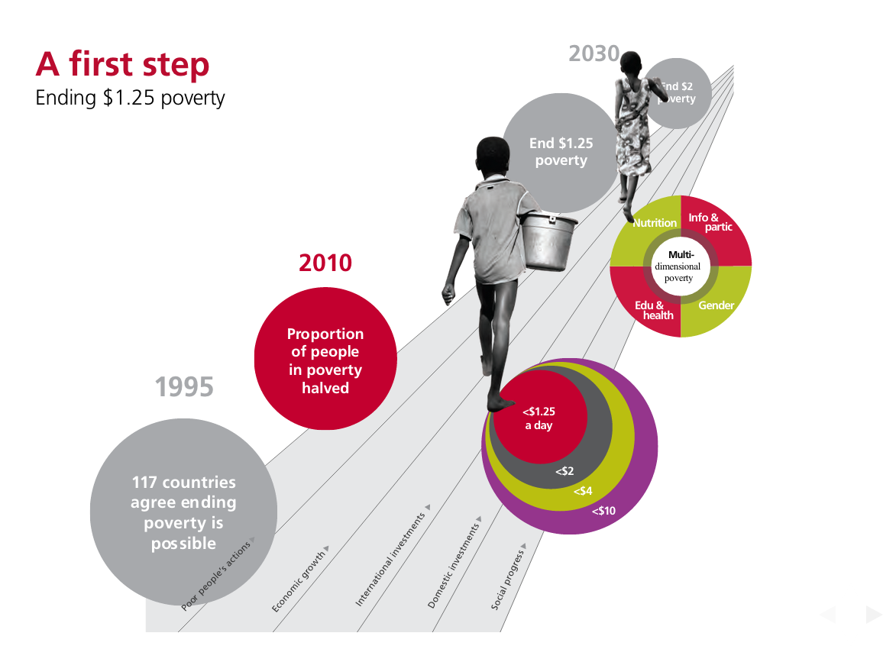
Ending extreme poverty and promoting social progress

Slide 4
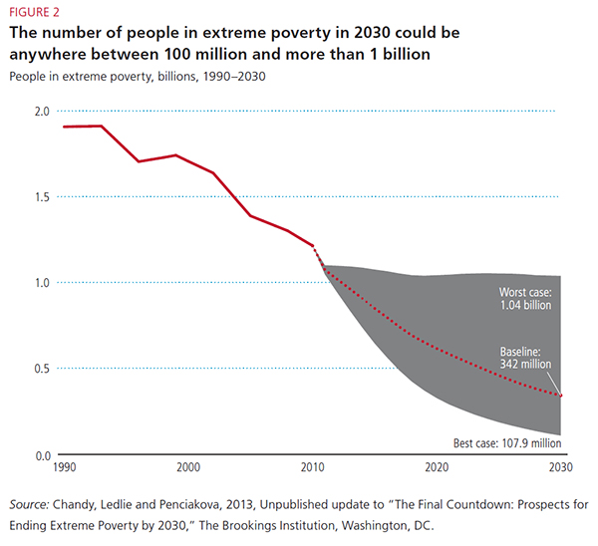

Slide 5
So policies really matter –and domestic policies are the most important
If nothing changes it will be 2080 before poverty is eradicated
Choices about equity and growth matter
But resources matter too – not only more resources, but better- and used together to get more value

Slide 6
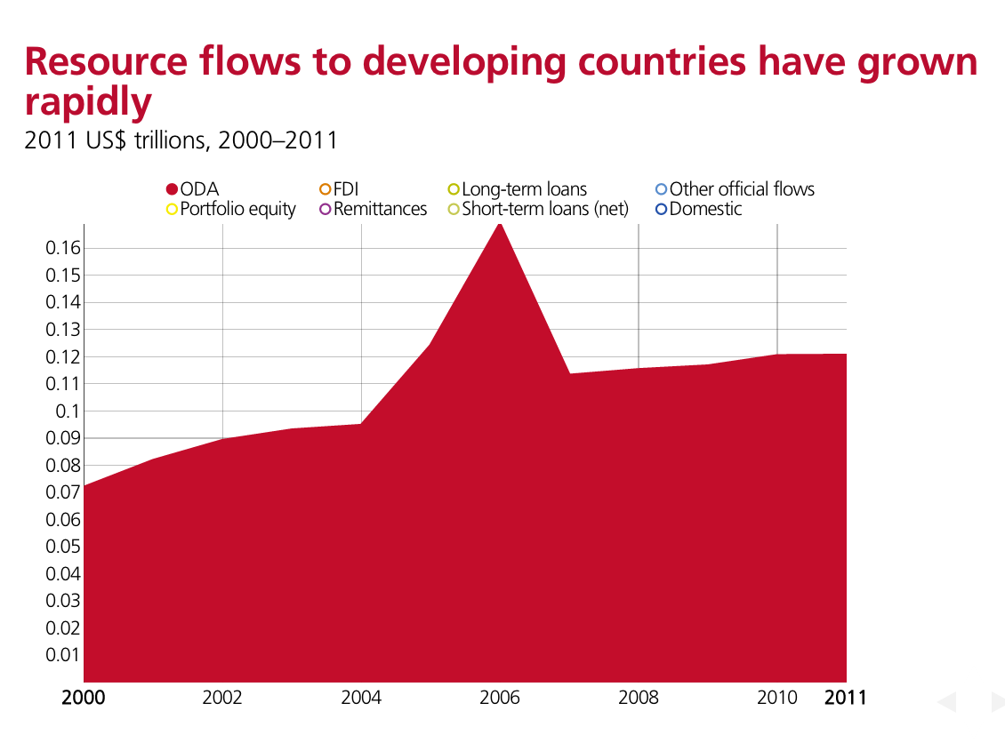

Slide 7
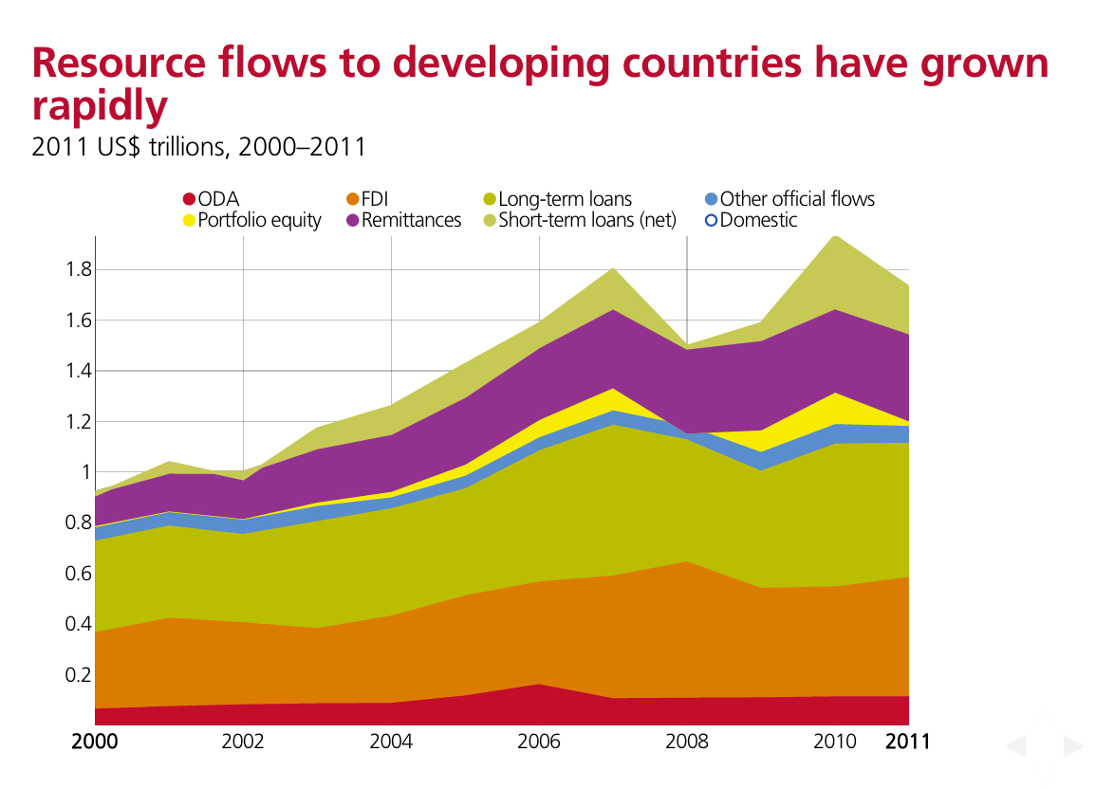

Slide 8
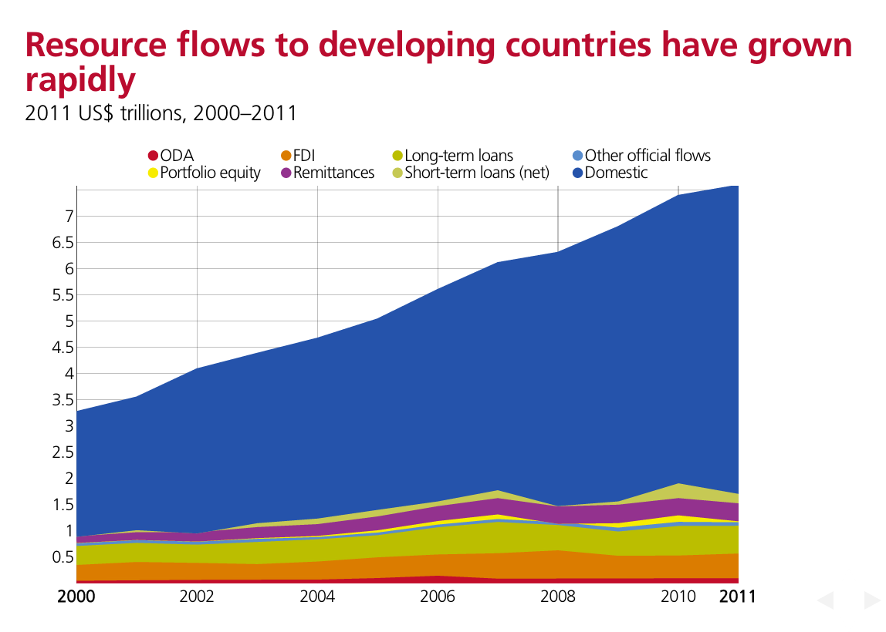

Slide 9
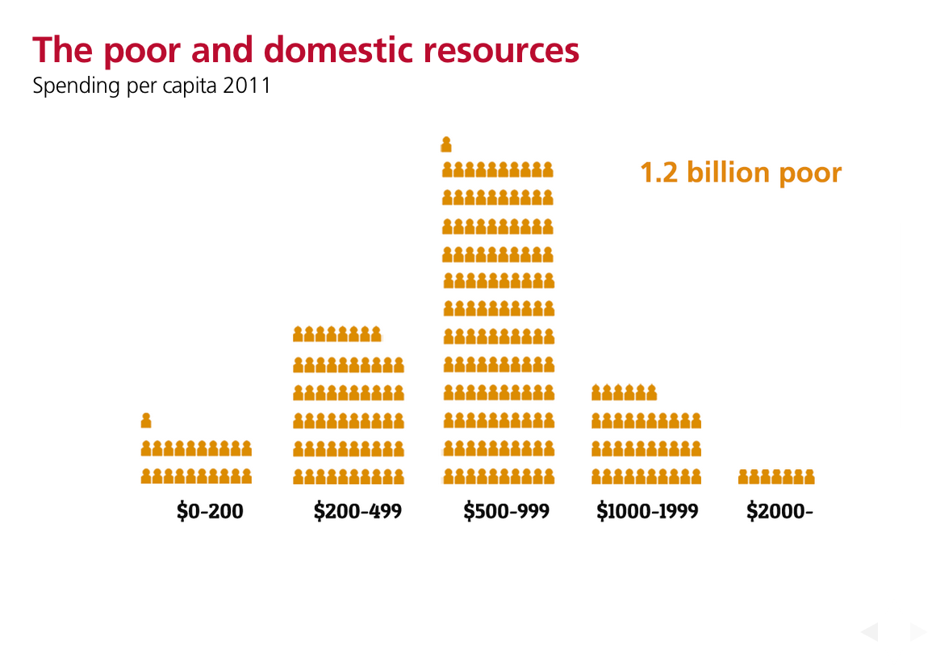

Slide 10
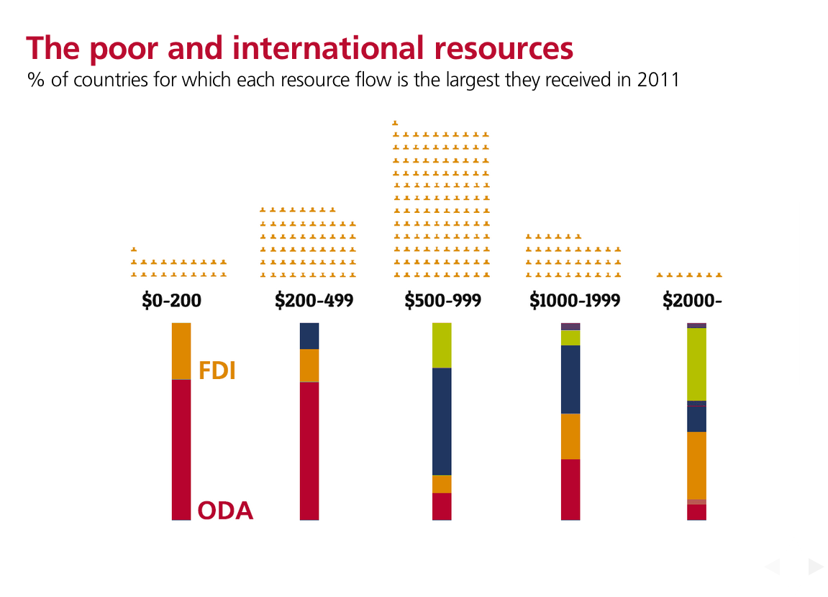

Slide 11
So ODA is essential to countries with high incidence of poverty and low domestic resources
In many countries, even the most optimistic estimates of growth-with-equity cannot generate enough resources to achieve poverty eradication by 2030
But poverty persists in better off countries too – ODA and international cooperation are needed alongside domestic resources

Slide 12
So, how do we get aid to where it’s needed?
Focus on Who benefits and When
Reform the purpose of aid for the post 2015 era to deliver impact on the bottom 20% of the global population - leaving no one behind
Make improvements in the incomes and wellbeing of the bottom 20% a new benchmark of progress given as much attention as GNI growth (which doesn’t always benefit the poorest)
Harness other resources to achieve broader global goals – first step transparency & visibility

Slide 13
We need much, much better data: to allocate resources effectively, you have to know who is poor and how their lives are changing
Of 49 countries in sub Saharan Africa,
  6 have no survey data at all
  21 are using data which is more than 7 years old.
Sub-national, disaggregated data linked to resource allocation is essential:
  Zambia has grown at more than 7.5% a year for the last decade – poverty has increased

Slide 14
But the big question is about how we harness the 92% of international resources that don’t come from aid - alongside domestic resources

Slide 15
Re-inventing International Cooperation for the next 15 years; ODA will remain important to end poverty; harnessing all resources essential to deliver the goals for all.

Slide 16
About Development Initiatives
Our vision is the end of absolute poverty by 2030.
Our mission is to empower and enable people to make evidence-based and data-informed decisions that deliver more effective use of resources for poverty eradication.
info@devinit.org

Slide 17
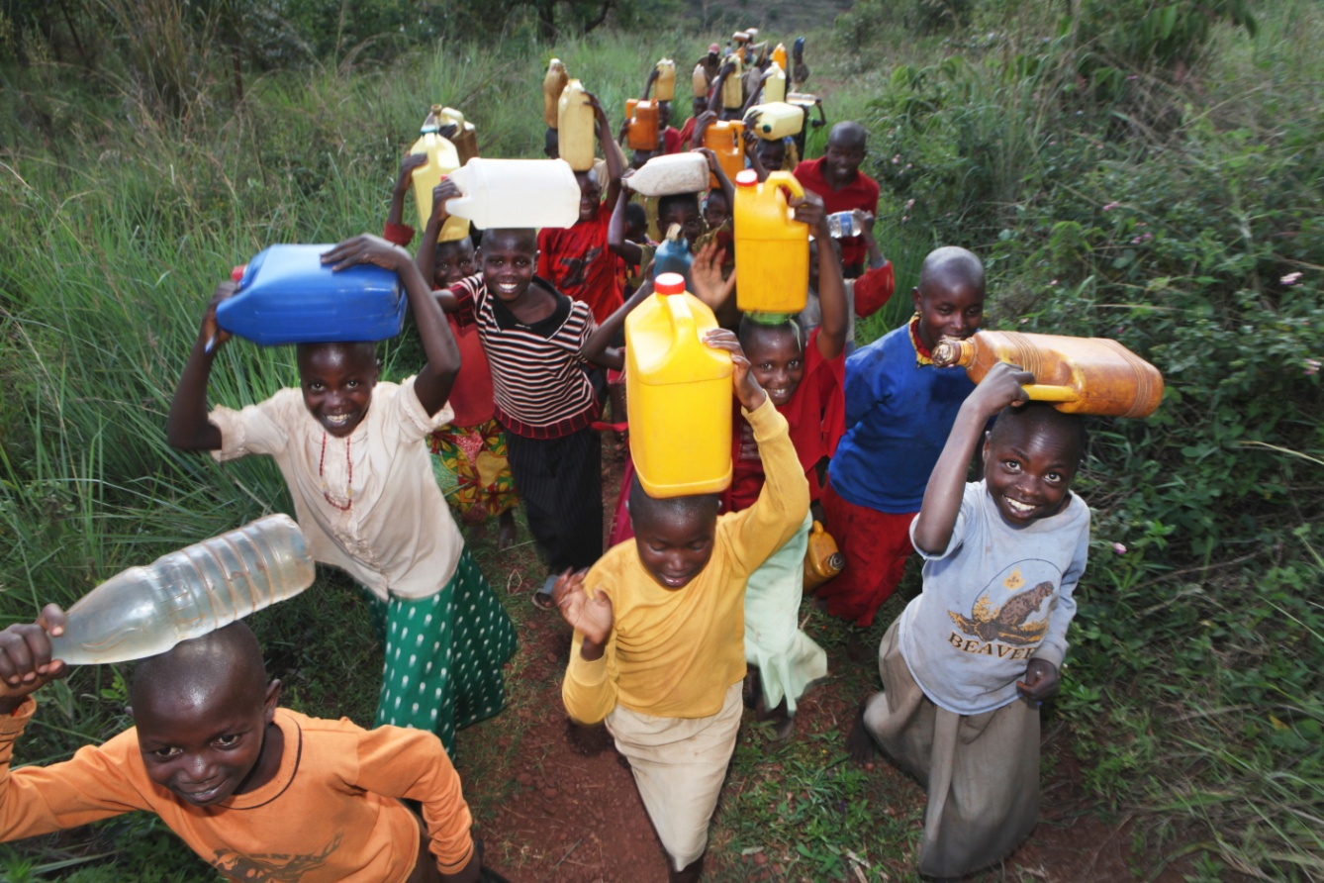
Please contact us at
Development Initiatives
©Ton Koene
For collaboration on data, development finance and poverty eradication
Judith.randel@devinit.org

Slide 18
Thank you
www.devinit.org
Judith.randel@devinit.org
Development Initiatives
594 Broadway, Suite 207
New York, NY 10012, USA

