Slide 1
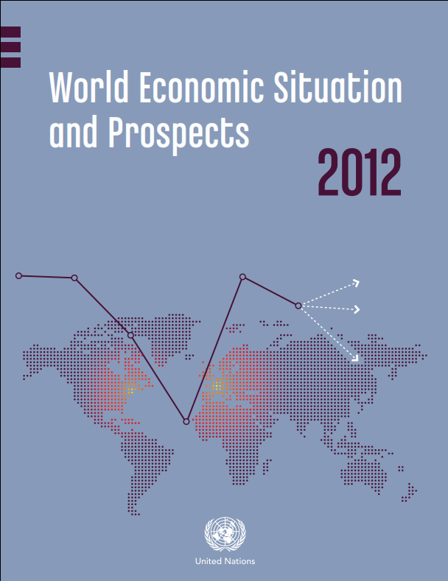
WESP Update per Mid-2012
Darkening skies over the world economy
New York, 7 June 2012
Jomo K.S. & Rob Vos
United Nations www.un.org/esa/policy

Slide 2
Main messages
Global economic slowdown
  Much of Europe has entered recession
  Considerable slowdown worldwide
  Jobs crisis continues
High risk of dangerous downward spiral
  Escalation of euro area crisis poses global threat
  Risk of sharp rise in global energy prices and heightened commodity price and capital flow volatility
Breaking out of the vicious cycle
  Coordinated efforts needed to shift away from self-defeating fiscal austerity and towards renewed stimulus
  Redesign fiscal policies to more directly support job creation and green growth
  Coordinate monetary policy and accelerate financial sector reforms
  Enhance development financing

Slide 3
A synchronized global slowdown
3
Notes:
3

Slide 4
Developed economy vicious cycle
Low growth trap
High unemploy-ment
Deleveraging by firms and households
Financial sector fragility
Fiscal austerity & sovereign debt risk

Slide 5
The jobs crisis continues – unemployment rising in euro area
Unemployment rates in developed regions
(percentage of labour force, seasonally adjusted)

Slide 6
Weakness in developed countries is spilling over to developing countries
Weakening trade growth
  Global slowdown also starting to affect South-South trade
Ongoing exchange rate and capital flow volatility
  Deleveraging (especially by European banks) and flight to safety
  Capital outflows from emerging countries
  Depreciation pressure on some emerging country currencies
Continued commodity price volatility
  Large oil price swings over the first half of the year
  Downward pressure on industrial metal prices

Slide 7
Sluggish growth in developed economies, recession looms for Europe
Notes:
7
7

Slide 8
Growth in most developing regions slowing
8
8
Notes:
8
8

Slide 9
How to avert a new global
recession?
  Need to address all four major weaknesses simultaneously
  Requires fundamental policy shift:
  Coordinate fiscal policies to provide new short-term stimulus, focus on fiscal sustainability for medium term
  Redesign fiscal policy and align with structural policies for job creation and green growth
  Coordinate monetary policy to stem currency and capital volatility and accelerate financial regulatory reform to address financial fragility
  Ensure adequate development finance

Slide 10
Dealing with the growth and jobs crisis through sustainable global rebalancing
GDP growth (in per cent)
Europe, Japan & other developed economies
Transition &
developing economies
United States
China and India
Scenario
Baseline
Transition & other
developing economies
10

Slide 11
Dealing with the growth and jobs crisis through sustainable global rebalancing
Employment ratios (per cent of working age population)
Europe, Japan & other developed economies
Transition &
developing economies
United States
Scenario
China and India
Baseline
Transition & other
developing economies
11

