Slide 1
The new OECD framework on financing for sustainable development
By José Antonio Alonso

Slide 2
ODA: definition
Official flows provided by donors to countries and territories on DAC list of recipients and multilateral development institutions:
Administered with the promotion of economic development and welfare of developing countries as its main objective
Concessional in character (the threshold was traditionally defined in 25% with a discount rate of 10%)

Slide 3
Recent changes 1
From face values to “grant equivalent”
Thresholds of concessionality and discount rate have adapted to recipient countries´ levels of income
For bilateral loans to the official sector this implies a grant element of at least:
45 % - LDCs and other LICs (d.r. 9 %)
15 % - LMICs (d.r. 7 %)
10 % - UMICs (d.r. 6 %)

Slide 4
Recent changes 2
2.- The 2016 HLM, OECD/DAC agreed to modernize the ODA reporting directives on peace and secutity expenditures
3.- DAC reviewed criteria for registering internal expenditures related to the settlement of refugees (during their first year)

Slide 5
Recent changes 3
4.- Instruments for private sector: the 2016 HLM OECD/DAC decided that the concessional official support in providing private sector instruments (PSIs) should be counted as ODA, while the flows themselves should be counted as TOSSD.
There two main agreements:
Two approaches are admitted: a) institutional-specific; b) instruments-specific
To be counted as ODA, PSIs need to have development of recipient countries as primary objective and to provide finance that is additional to existing flows
There is a debate around the criteria for registering PSI: i) What to measure (facial flows or grant equivalent); ii) how should the grant equivalent be calculated?; iii) should a threshold of concesionality be required?
Equity investment: Exante or expost grant equivalent?
Export credits: Should be counted as ODA?
Guarantees: Should be counted as ODA? How?

Slide 6
Two remarks
The process seems to be promoted by the donors attempt to expand the perimeter of ODA (particularly in the case of the measures in support of the private sector) sometimes at the costs of loosening constitutive criteria of ODA
There is a significant deficit of transparency in the process, which makes difficult for recipient countries or civil society to participate in the discussion

Slide 7
TOSSD WORKING DEFINITION
Total Official Support for Sustainable Development
includes all officially supported resource flows to promote sustainable development at developing country, regional and global levels with the majority of benefits destined for developing countries, including those resources that support development enablers or address global challenges.
Notes:
Development of TOSSD was a call of the Addis Abeba Agenda for Action, in order to track the implementation of the 2030 Agenda for Sustainable Development.
The TOSSD concept is being shaped by the DAC in broad public consultation with key stakeholders such as development finance providers, academia and Civil Society Organisations.

Slide 8
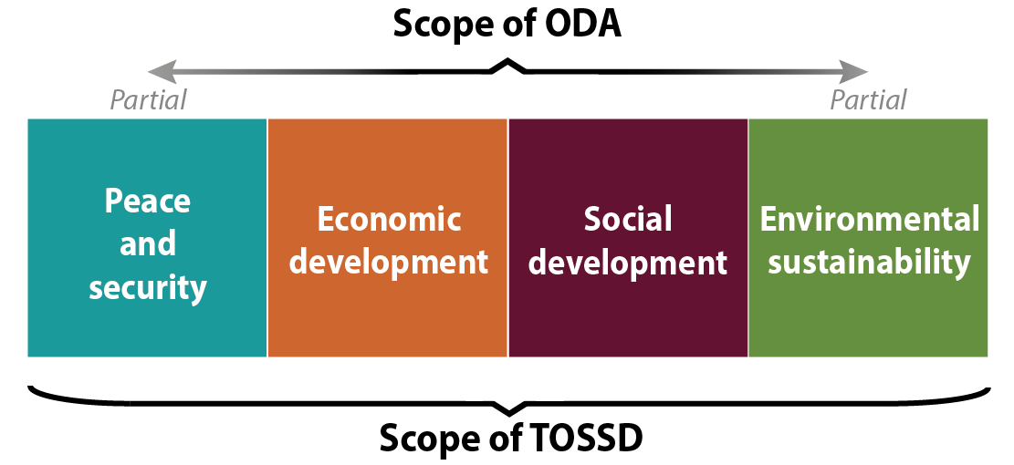
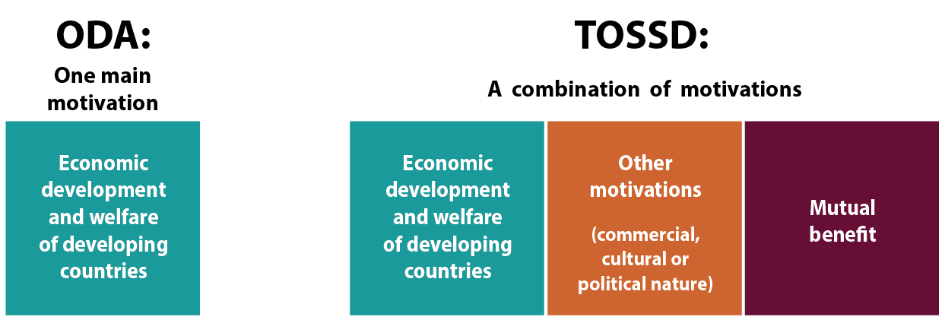
TOSSD: A larger purpose
Larger purpose
All providers of development finance
Broader motivations
Notes:
It is important to stress that TOSSD will not replace ODA measure
No TOSSD targets or commitments will be established.

Slide 9
Two perspective for measuring
Providers perspective: all resources, including in donor expenditures and resources for supporting development enablers and global challenges (that probably are not transfered to developing countries)
Recipients perspective: only those resources that are effectively transfered to developing countries
These two perspectives are not equivalent

Slide 10
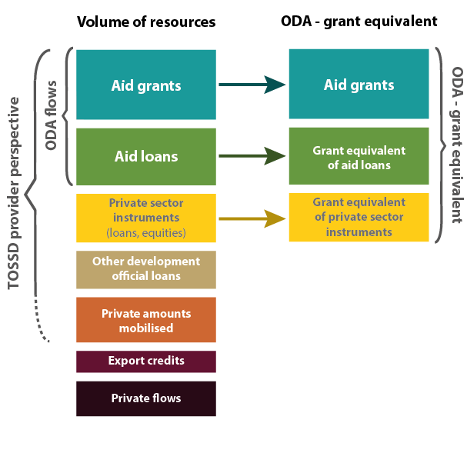
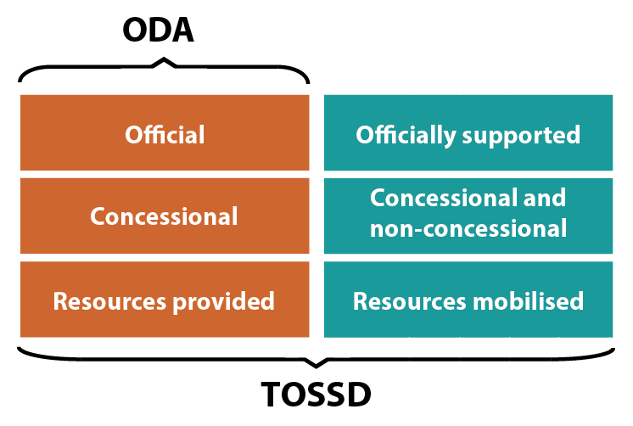
Other differences between ODA and TOSSD
Framework for monitoring the
MoI of the 2030 Agenda
Larger volumes
Flows vs. Grant Equivalent
Notes:
TOSSD also includes measurement of private resources mobilised (direct mobilisation)
In the future, it could incorporate estimates for indirect mobilisation

Slide 11
Regarding private funds
TOSSD tries to register the mobilization effect (directly and indirectly) of official interventions (private resources mobilized by official support)
This is in line with the purpose of using official funds as a mean for mobilizing (or leveraging) private resources
It is difficult to understand why private resources should be counted in a category that is named Total Official Support

Slide 12
Two additional problems
Transparency and participation: the level of participation of recipient countries, new providers and NGOs in the process of defining TOSSD has been low
Governance: if all providers are to be considered, the governance plattform should be moved from the OECD to a more inclusive forum (ECOSOC)

Slide 13
Next steps
An Informal Task Force is going to be established in March 2017
In 2018 a first draft on TOSSD reporting procedures will be produced and presented at the UN Statistical Commission
At the end of 2018 a second draft on TOSSD reporting procedures will be presented
In 2019 data on TOSSD will be collected and presented at the HLPF

Slide 14
Some remarks
Even if the process of reviewing the framework of develpment financing is justified, the proposal of TOSSD is deceptive:
If it wants to bring together all providers, important actors have not been involved in the process
If it wants to improve transparency of development cooperation providers, merging sources in a single concept is not the best solution
If it wants to facilitate developing contries to clearly know their sources of financing, the distinction between provider and recipient perspectives (counting in-donor expenditures) is questionable

Slide 15
CDP in 2016
Three elements were incorporated in our report
1:- All resources counted as DC should be oriented to promote the 2030 Agenda and in accordance with countries´ priorities
2.- Only cross-borders transfers should be counted (not in-donors expenditures)
3.- Private and public resources should be counted separadly

Slide 16
CDP in 2017
Should the CDP express the desire to be involved in the process?
The CDP should remind that the main purpose of the process is not to aply the principle of “the more the better” in terms of resources counted, but to increase the level of transparency and accountability of the providers, and to facilitate devolping countries a more clear vision about their development financing sources. In that sense we could:
Defend that only one approach (the recipient perspective) should be maintained
Declare that even if understandable that donors want to know their contribution to global challenges (and in-donor costs), this should be register separately
In the same line, even if understandable that donors want to know private resources mobilized by official funds, this should be counted separately.
Confirm thatit is not clear why this approach should lead us to a new measure of development cooperation rather than a clarification and better measurement of the different areas of development finance (beyond ODA) separately considered
Reiterate that ECOC should be involved in the process (perhaps with the technical contribution by the OECD)

