Slide 1
Graduating and Graduated Countries: Lessons learned in developing productive capacity
Matthias Bruckner
CDP Secretariat
CDP 19th plenary meeting
20-24 March 2017

Slide 2
Background
Why?
CDP chose topic at Plenary in 2016, follow up to 2016 theme
Identify actual policies and strategies chosen
New topic?
Who?
Inputs from CDP Sub-group (Dzodzi, Keith, Le Dang, Onnalena, Rashid, Tea, Vitalii)
CDP Secretariat (Dan, Marcia, Matthias, Roland); Tes Teffachew (ex-UNCTAD)
How?
Inputs, consolidated paper, EGM, revised paper
“It cannot be over-emphasised that what development implies for the developing countries is not simply an increase in productive capacity but major transformations in their social and economic structures.”
CDP Report to ECOSOC
1970

Slide 3
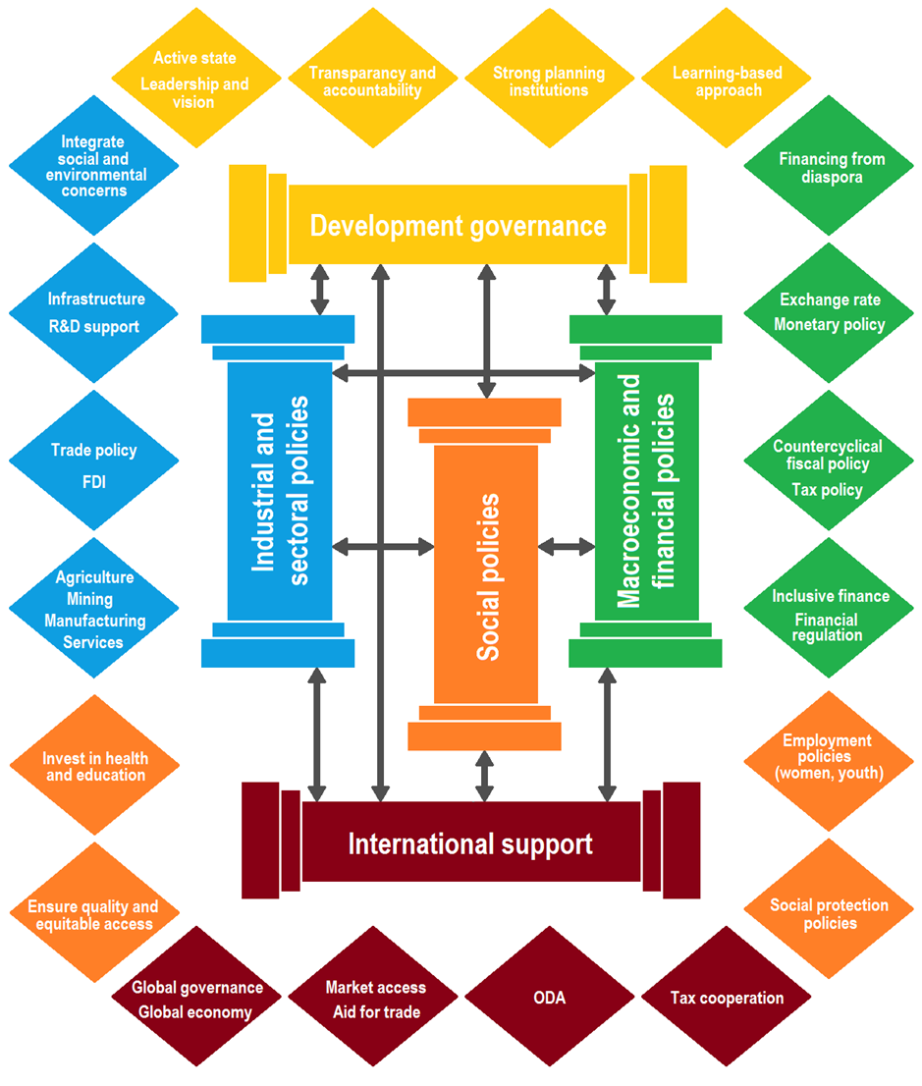
CD Framework on expanding productive capacity for achieving the SDGs

Slide 4
Productive capacity and poverty eradication
Building productive capacity and poverty eradication intrinsically linked
Decent jobs
Productive capacity
Structural transformation
Poverty eradication
Social protection
Economic growth per se insufficient
Policies in all five elements of framework needed
Advantage of CDP framework
Link increasingly known, but what policies?
Eradication of poverty requires focus on countries where problem is most severe: LDCs

Slide 5
Graduation pathways
Graduation requires generating income (GNI pc), building human assets (HAI) and/or reducing economic and environmental vulnerability (EVI)
Graduation related, but not identical to building productive capacity for sustainable development
Pathway I: Rapid growth through resource extraction. Small progress in HAI and EVI
Pathway II: Economic specialization and investments in human assets
Pathway III: Investment in human assets and (often slow) structural transformation
Pathways are no choice variable

Slide 6
Main lessons - Pathway I
Angola, Equatorial Guinea
Oil drives rapid economic growth
Human assets remain very low, vulnerability high
Weak development governance is key constraint
Insufficient reinvestment of resource rent
Public expenditures misaligned with priorities
Risk of overinvestment in infrastructure
Budget rules and wealth funds work only if backed by strong governance
Vicious cycles: Resource dependence feeds weak governance and reduces urgency for diversification away from resources
Scope for industrial and sectoral policy limited (Dutch disease,…)

Slide 7
Main lessons - Pathway II
Landlocked: Botswana, Bhutan
SIDS: Cabo Verde, Maldives, Samoa, Vanuatu, Solomon Islands
Income channeled into building human assets
Vulnerability remains high; exogenous
Good development governance main factor
Absence or restoration of conflict critical
Economic specialization: natural resources or tourism
Only some diversification, but difficult
Small linkages and employment effects
Persistent inequalities
Policies for harnessing external sources of finance for investments
FDI, ODA, bilateral agreements, remittances

Slide 8
Main lessons - Pathway III
Larger economies: Bangladesh, Ethiopia, Rwanda
State-led development
Slow structural transformation
Development governance built after war and conflict
Active State, ensuring coordination of economic activities
Agriculture and rural areas first
Successful capital accumulation
Innovative social services delivery
Trade preferences can work, but require basic capacities, ‘right’ market conditions and domestic policies

Slide 10
Moving the work forward
Feed into UN process (HLS/HLPF/IPoA)
Wider dissemination (see later this week)
Utilize for capacity development
UN DESA and beyond (EIF,…)
Utilize for related work
UNCTAD productive capacity indicators
Others

Slide 11
Thank You
Contact: Matthias Bruckner
Committee for Development Policy Secretariat
Department of Economic and Social Affairs
United Nations
email: brucknerm@un.org
http:// www.un.org/en/development/desa/dpad

