Slide 1
Country monitoring –
Angola, Equatorial Guinea,
Samoa, Vanuatu
Daniel Gay
CDP Secretariat
CDP 19th plenary meeting
20-24 March 2017

Slide 2
Monitoring timeline
Date | Angola | Equatorial Guinea | Samoa*** | Vanuatu
Dec 2016 | Country report (graduating) | Country report (graduating) | Country report (graduated #3) | Country report (graduating)
Mar 2017 | CDP monitoring | CDP monitoring | CDP monitoring | CDP monitoring
Jun 2017 |  | Graduation**
Dec 2017 | Country report (graduating) | Country report (graduated #1) | Country report (triennial review #1) | Country report (graduating)
Mar 2018 | CDP monitoring | CDP monitoring | CDP monitoring | CDP monitoring
Dec 2018 | Country report (graduating) | Country report (graduated #2) |  | Country report (graduating)
Mar 2019 | CDP monitoring | CDP monitoring |  | CDP monitoring
Dec 2019 | Country report (graduating) | Country report (graduated #3) |  | Country report (graduating)
Mar 2020 | CDP monitoring | CDP monitoring |  | CDP monitoring
Dec 2020 |  |  |  | Graduation****
Dec 2020 | Country report (graduating) | Country report (triennial review #1) | Country report (triennial review #2) | Country report (graduating)
Feb 2021 | Graduation*
Mar 2021 | CDP monitoring | CDP monitoring | CDP monitoring | CDP monitoring
Dec 2021 | Country report (graduated #1) |  |  | Country report (graduated #1)
Mar 2022 | CDP monitoring |  |  | CDP monitoring
Dec 2022 | Country report (graduated #2) |  |  | Country report (graduated #2)
Mar 2023 | CDP monitoring |  |  | CDP monitoring
Dec 2023 | Country report (graduated #3) | Country report (triennial review #2) |  | Country report (graduated #3)
Mar 2024 | CDP monitoring | CDP monitoring |  | CDP monitoring
Dec 2026 | Country report (triennial review #1) |  |  | Country report (triennial review #1)
Mar 2027 | CDP monitoring |  |  | CDP monitoring
Dec 2029 | Country report (triennial review #2) |  |  | Country report (triennial review #2)
Mar 2030 | CDP monitoring |  |  | CDP monitoring

Slide 3
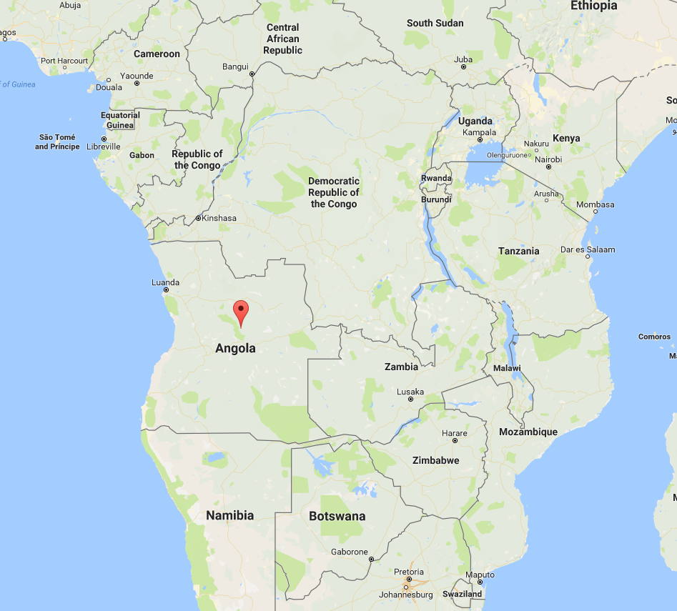
Angola
Graduates 2021
Sustained high income despite low oil prices.
High inflation.
Deteriorating current account
Human assets improving but still at very low levels.
Smooth transition strategy process underway.

Slide 4
Angola: progress against criteria

Slide 5
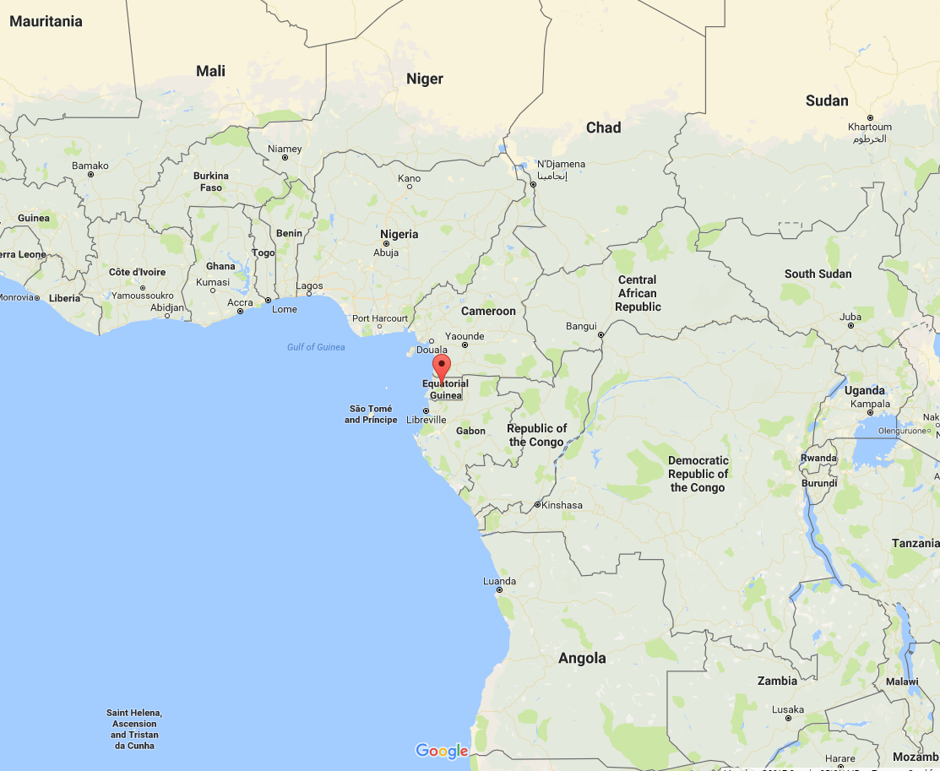
Equatorial Guinea
Graduates June 2017
Upper middle income despite low international oil prices.
Recent decline in current account deficit
Recovery in fiscal deficit
Limited diversification
Slow improvement in human assets.
Limited impact of graduation expected
No smooth transition reporting as yet

Slide 6
Equatorial Guinea: progress against criteria

Slide 7
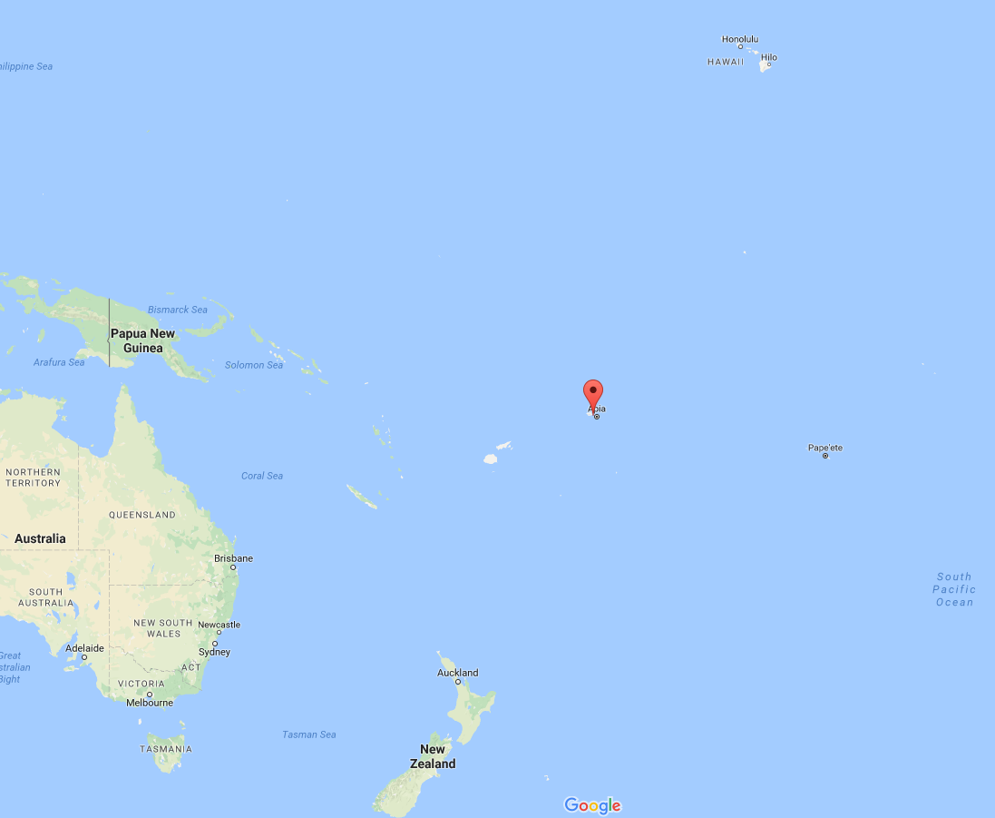
Samoa
Graduated 2014
Slowing growth and high vulnerability.
Growth projected to stagnate
Receiving smooth transition support on:
  Trade (Everything But Arms and Enhanced Integrated Framework)
  Development financing (Least Developed Countries Fund).
Smooth transition report submitted to CDP

Slide 8
Samoa: progress against criteria

Slide 9
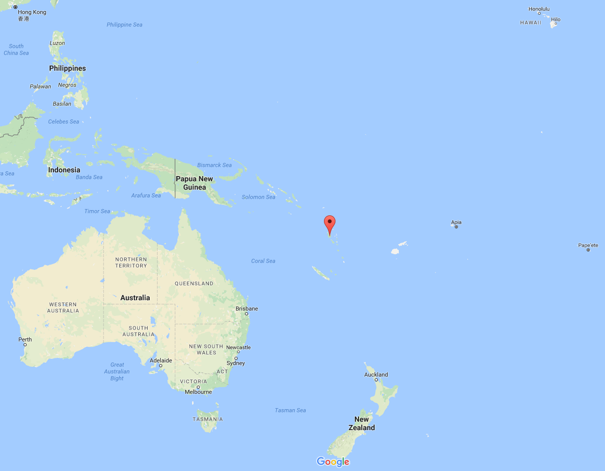
Vanuatu
Graduates 2020
Income growth recovering from impact of the cyclone – tourism, agriculture, infrastructure
Budget deficit projected to reach 10 % GDP in 2016 and 17 % in 2017 due to expenditure caused by cyclone-related current and capital spending on infrastructure
Economic vulnerability remains high.
Government needs to start negotiation with trading partners on preferential market access.

Slide 10
Vanuatu: progress against criteria

Slide 11
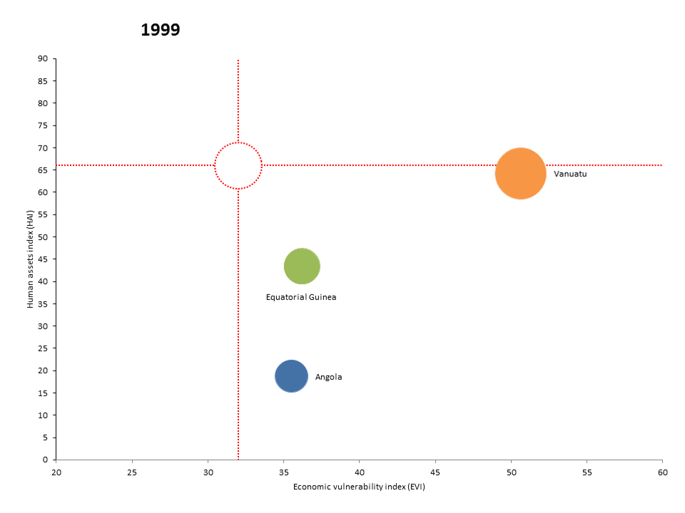
All four countries: progress against LDC criteria, 1999-2017
Human assets
index
Economic vulnerability index

