Slide 1









SPECIAL REPORT
LAUNCH OF THE WORLD POPULATION AGEING HIGHLIGHTS 2020 REPORT - LIVING ARRANGEMENTS OF OLDER PERSONS
KAROLINE SCHMID, Ph.D.
Chief, Fertility and Population Ageing Section, Population Division
UN DESA
Notes:
Ladies and Gentlemen, colleagues and friends
It is an honor and a pleasure to be here with you on this virtual platform to celebrate the 30th Anniversary of the IDOP and to introduce to you our forthcoming publication on population ageing, the World Population Ageing Highlights 2020 Report that focuses this year on living arrangements of older persons.
We the PD would like to express our appreciation for this ongoing partnership with the NGO Committee on Ageing and for providing us again with an opportunity to launch our latest report on population ageing on this important day.
I also would like to take a short moment to thank the team in the PD for getting this work off the ground and through the finishing line and want to particularly acknowledge the work on the substantive chapters of the report by Ms. Yumiko Kamiya and Ms. Nicole Mun Sim Lai.

Slide 2
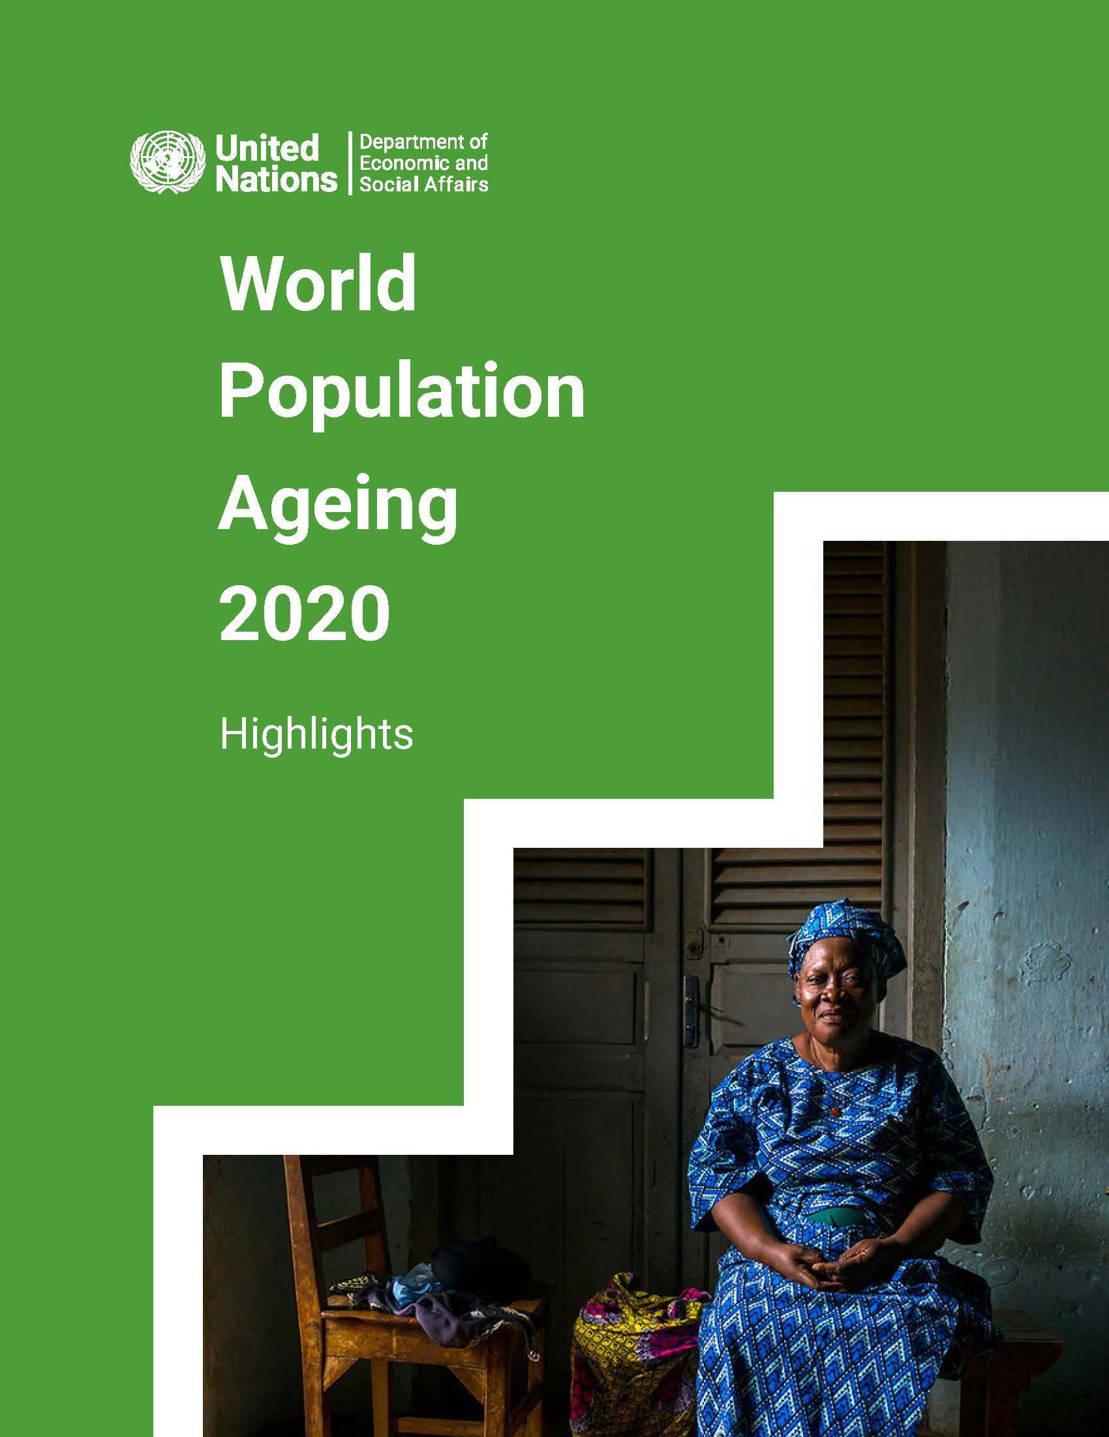

Slide 3
This year’s World Population Ageing Highlights 2020 – Living arrangements of older persons presents:
Key findings from the ‘United Nations household and living arrangements of older persons database 2019’;
Provisional insights into analysis of COVID-19 morbidity and mortality risks faced by older persons;
Summary & policy recommendations;
Annex tables for selected variables.
lick to add text
Notes:
This years world population Ageing highlights 2020 on living arrangements of older persons has three main chapters:
The first chapter presents the key findings of the analysis of the UN household and living arrangements database that provides data on older persons living arrangements at the global level that we released at the end of 2019
We then present provisional insights into our analysis of available data on Covid-19 morbidity and mortality of older persons
We conclude with a summary and a set of policy recommendations and provide a set of annex tables for selected variables discussed in the report

Slide 4
Key findings from the database:
Slow changes from co-residence towards independent living’; but quick adjustments of living arrangements in times of crisis;
Older persons in the more developed world live more often independently (alone or with spouse); whereas
Older persons in the less developed world live with at least one child or with the extended family;
Older women tend to: - Live more often alone; - Be poorer than older men; - Take more often care of grandchildren in skip-generation HHs.
lick to add text
Notes:
What are the key findings from the 2019 database?
The data show that households and living arrangements of older persons globally change only slowly from living in multi-generational households towards more independent living;
But we also see that living arrangements can change quickly in times of crisis to respond to the needs of family members & kin: such examples are the uptick in multi-generational households in Europe and Northern America as a response to the 2008 economic crises or the increase in skip-generation households in SSA to take care of orphaned grandchildren during the HIV/AIDS epidemic.
We also found that older persons in the more developed world live more often independently
Whereas older persons in the less developed world are more often found to live with a spouse and at least one child or with the extended family;
Our analysis also finds gender differences
older women live more often alone than older men
Older women are often poorer than older men
And older women care more often for grandchildren in skip-generation households

Slide 5
First results analysis COVID-19 morbidity & mortality:
Covid-19 death follows similar age patterns as general mortality with considerable variation across countries;
Main determinant: extent to which countries have been able to control the spread of the disease;
Frailty is a key factor: risk of death increases with age and comorbidities;
Living arrangements matter for contracting COVID-19 and for dying from it: - Nursing home residents experience high risks of infection and mortality; - Living independently reduces the infection risk.
lick to add text
Notes:
The second chapter presents the first results of the analysis of available data on Covid-19 morbidity and mortality of older persons
We found that Covid-19 mortality follows similar age patterns as general mortality with considerable variation across countries;
We also found that the main determinant for COVID-19 morbidity and mortality is the extent to which countries have been able to control the spread of the disease
The data show that frailty is a key factor in this regard with the risk of death increasing with age and existing comorbidities;
Looking at living arrangements of older persons and their susceptibility to Covid-19 we found that Living arrangements matter for contracting COVID-19 and for dying from it:
the data show that Nursing home residents experience high risks of infection and mortality;
-and that Living independently reduces the infection risk.

Slide 6
Summary and conclusion
The composition of households and people’s living arrangements have important consequences for the wellbeing of families and individuals, including older persons.
Understanding and recognizing the importance of living arrangements of older persons for the socio-economic as well as the physical and mental well-being is critical to inform and guide policy-making in support of older persons and their families to implement the 2030 Sustainable Development Agenda.
lick to add text
Notes:
Our analysis of the households and living arrangements of older persons clearly demonstrates that Living arrangements of older persons DO matter for the socio-economic as well as physical and mental health and well being of older persons;
We also want to call on governments, civil society and academia to acknowledge the importance of living arrangements of older persons for policy and programme formulation and implementation, particularly with a view to implement the 2020 Sustainable Development Agenda and to achieve the Sustainable Development Goals

Slide 7
THANK YOU
The report can be accessed on the Population Division website:
www.unpopulation.org

