Slide 1
Update - LDC graduation platform
Daniel Gay
CDP Secretariat
CDP 19th plenary meeting
20-24 March 2017

Slide 2
Rationale
Three countries identified for graduation
Up to six more identified for first time next year
Up to 14 LDCs potentially in pipeline over next decade
Uncertainty surrounding graduation process
Demand for information and support

Slide 3
What will the platform be?
A website detailing data, timeline and
best practice for LDC graduation
Specialised according to country
Divided into ‘before’, ‘during’ and ‘after’ graduation phases
Sections will include:
Country data and progress
International support measures
Incorporation of productive capacity into graduation strategy
Best practice on graduation
Potential activities
What do to after graduation

Slide 4
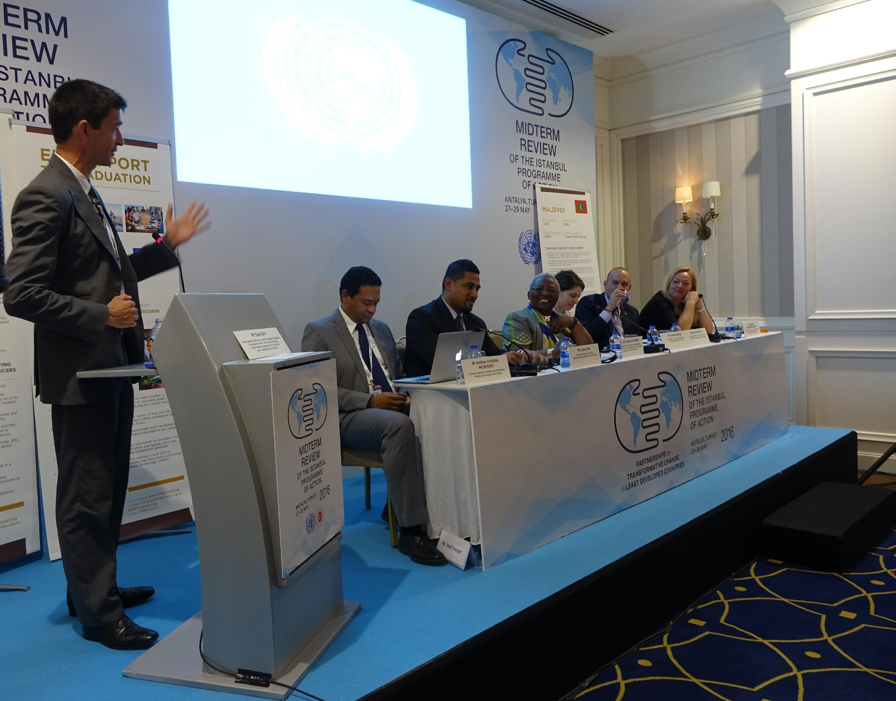
Progress so far
Scoping missions
Consultations – Antalya IPoA
Internal discussions
Development of LDC platform prototype
Formation of focus group

Slide 5
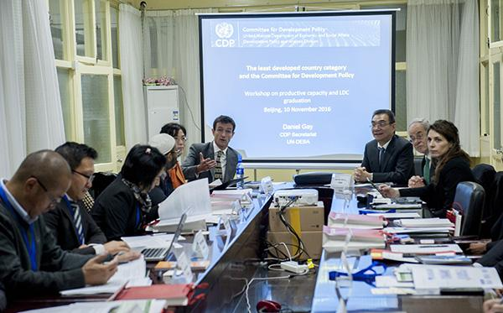
Progress cont.
Training with 10 LDCs in Beijing with Justin Lin & Charles Gore
Testing & discussion of LDC platform
Consultations with agencies in Geneva
Improvement of concept
Further country feedback
Engagement of designer

Slide 6
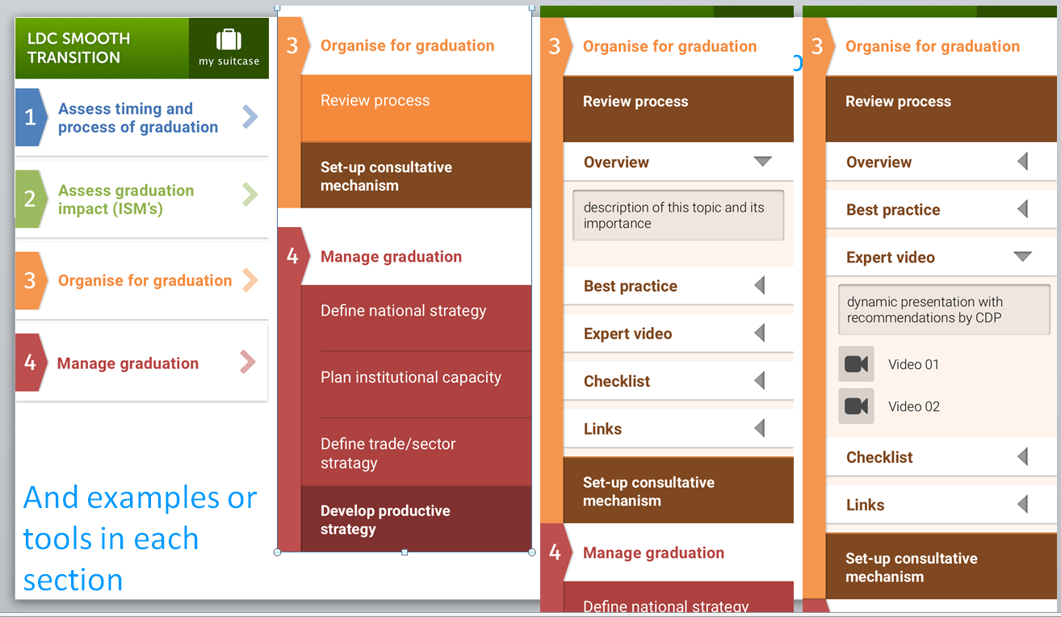
Previous iteration

Slide 7
New version
Before
During
After
First eligibility finding
Graduation recommendation
Graduation
Activities
Checklist
Between first eligibility finding and graduation recommendation
Between graduation recommendation and graduation becoming effective
Post graduation

Slide 8
Tools
CDP monitoring reports
Impact assessments
UNCTAD vulnerability profiles
Productive capacity studies (GIFF)
Productive capacity indicators (UNCTAD)
OECD production transformation policy reviews
UNIDO structural transformation reviews
ITC market analysis tools
Diagnostic Trade Integration Studies (DTIS)
CDP Cost-benefit analysis tool
Help & sources of collaboration
UN DESA/ CDP, UNDP, UNCTAD, UNFCCC, UNOHRLLS, ITC, WTO, EIF, OECD, Regional commissions, graduated countries and other potential graduates

Slide 9
Next steps
In conjunction with designer:
Create simple structure and concept by mid-2017
Test with LDC focus group
Finalise concept
Build simple website with basic structure
Add features and populate with information later
Build website
Test, focus group
Target soft launch by end-2017/ early 2018
March 2018 adopted by CDP
Soft launch

Slide 10
Questions
How can CDP members contribute?
Act in an advisory role?
Contribute short case studies to the website?
Eg. On institutional set-up for graduation?
Incorporating productive capacity into planning?
Use of international support measures?

