Slide 1

Model Disability Survey and World Health Surveys
Alarcos Cieza
Disability and Rehabilitation
World Health Organization

Slide 2

Model Disability Survey (MDS)
Disabling barriers – Break to include

Slide 3

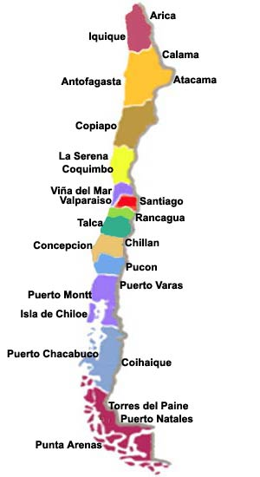

Chilean law requires the state to carry out a disability survey every 10 years

Slide 4
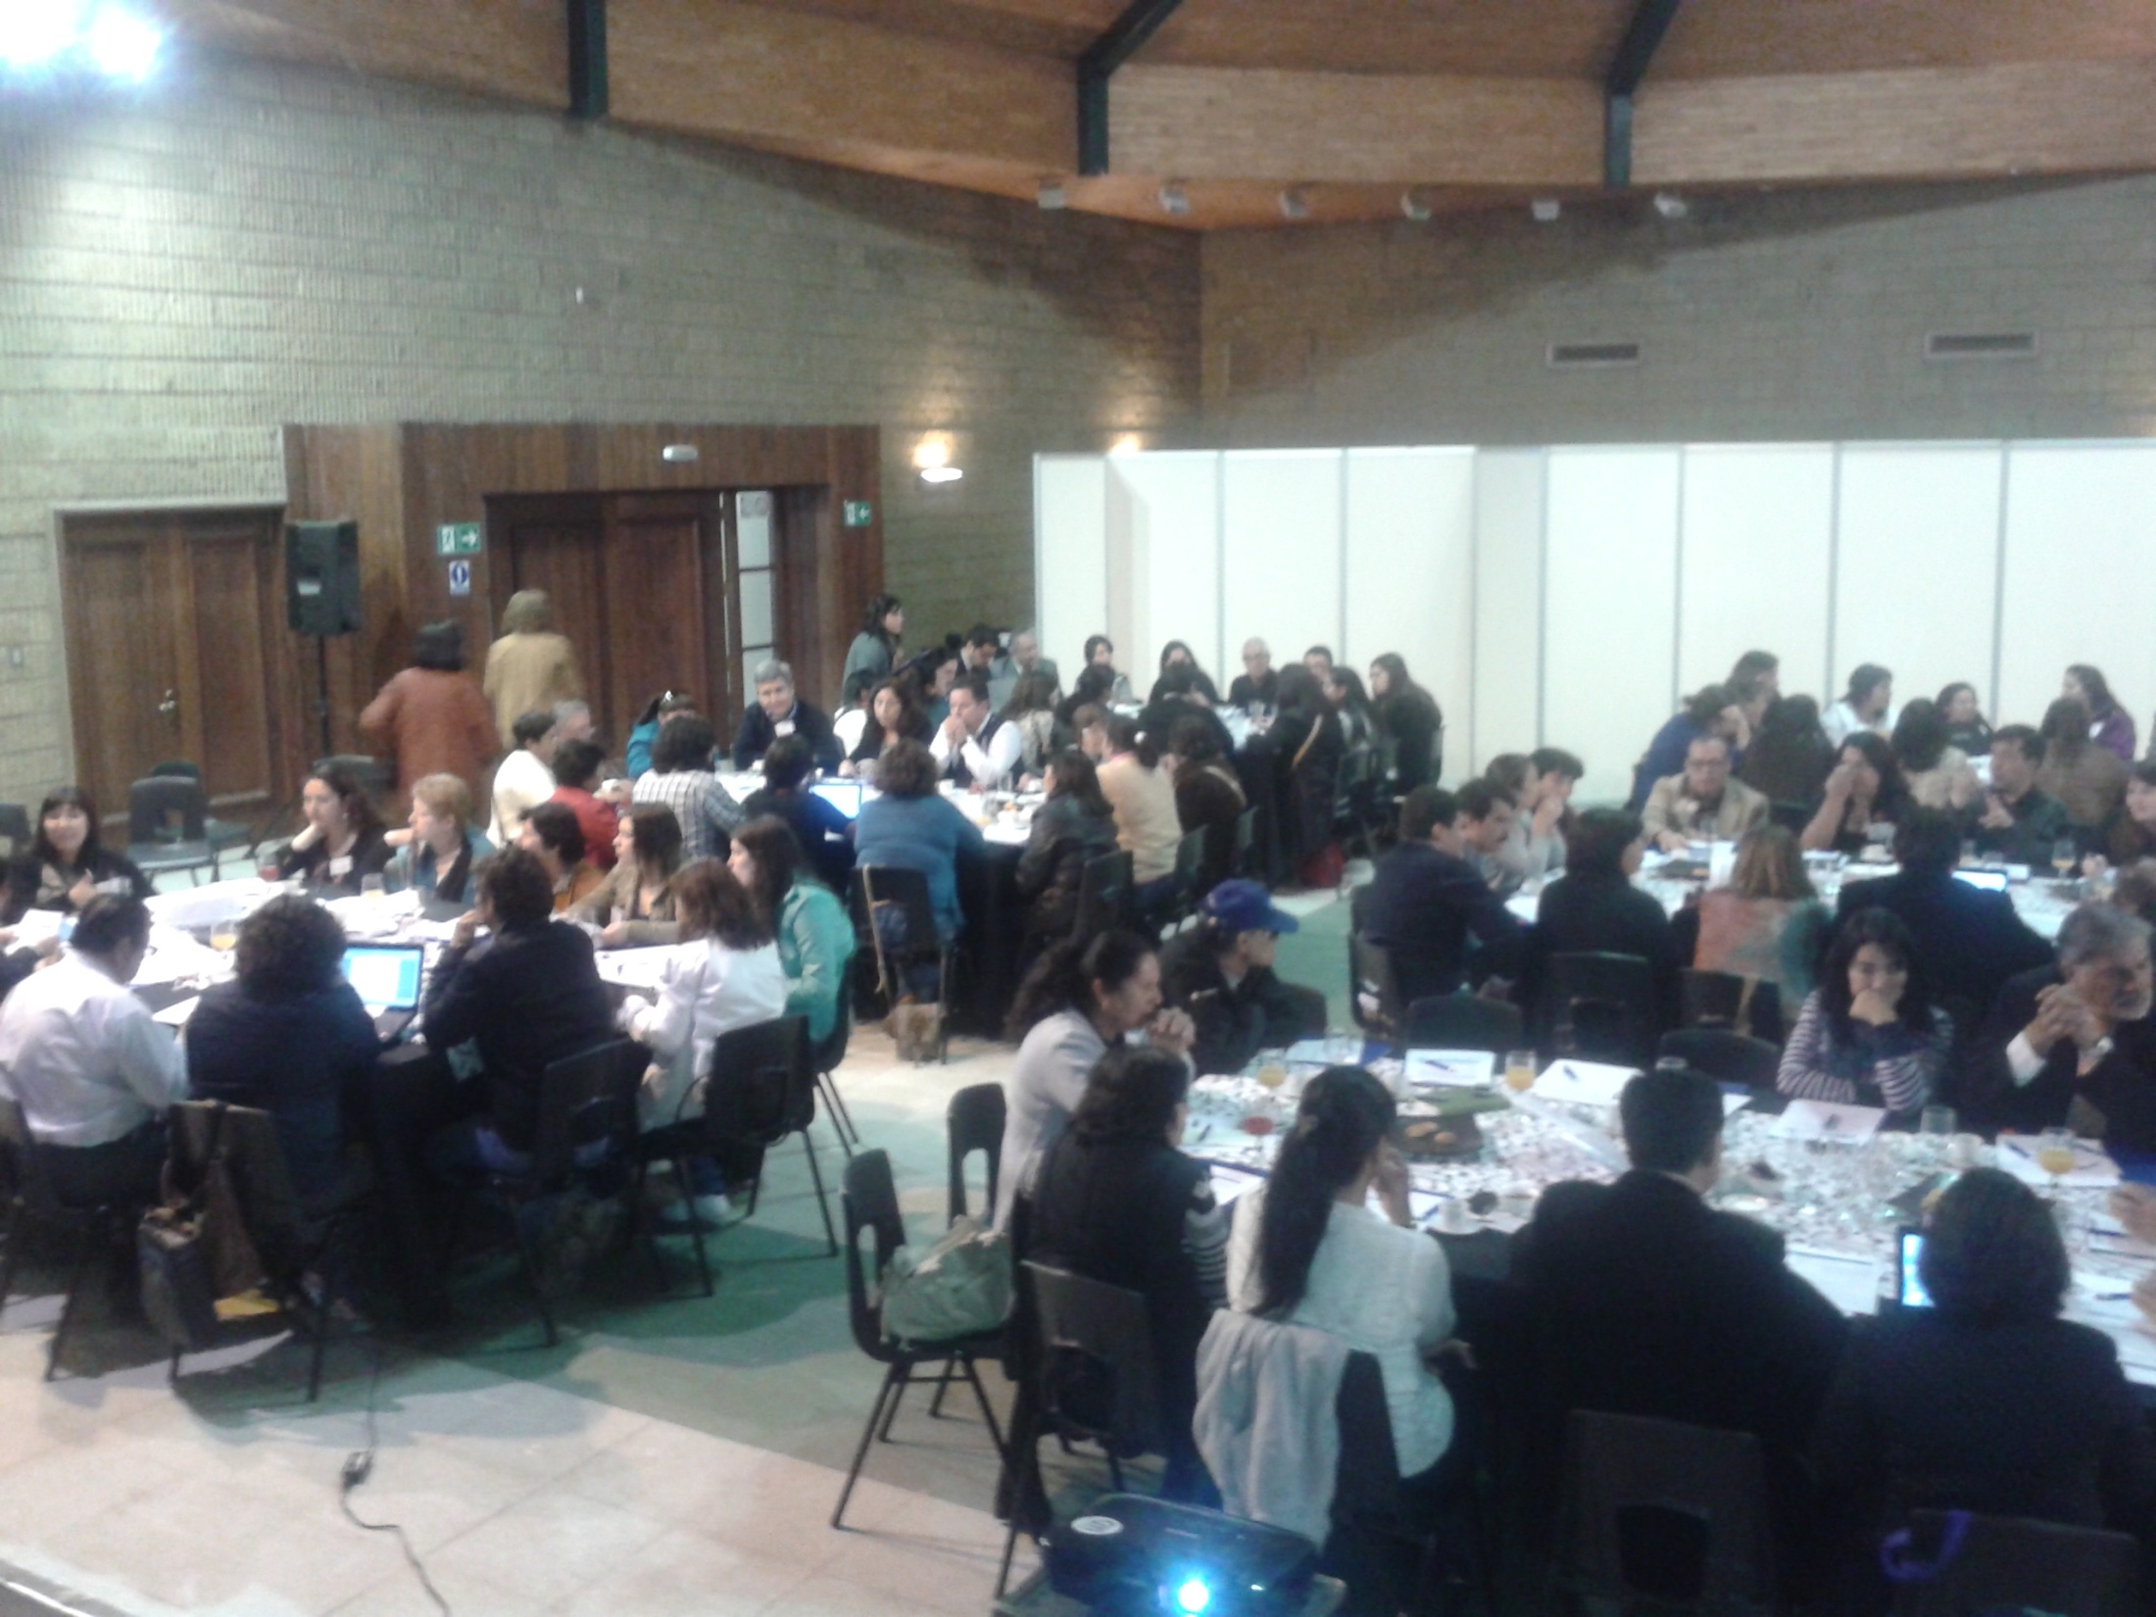
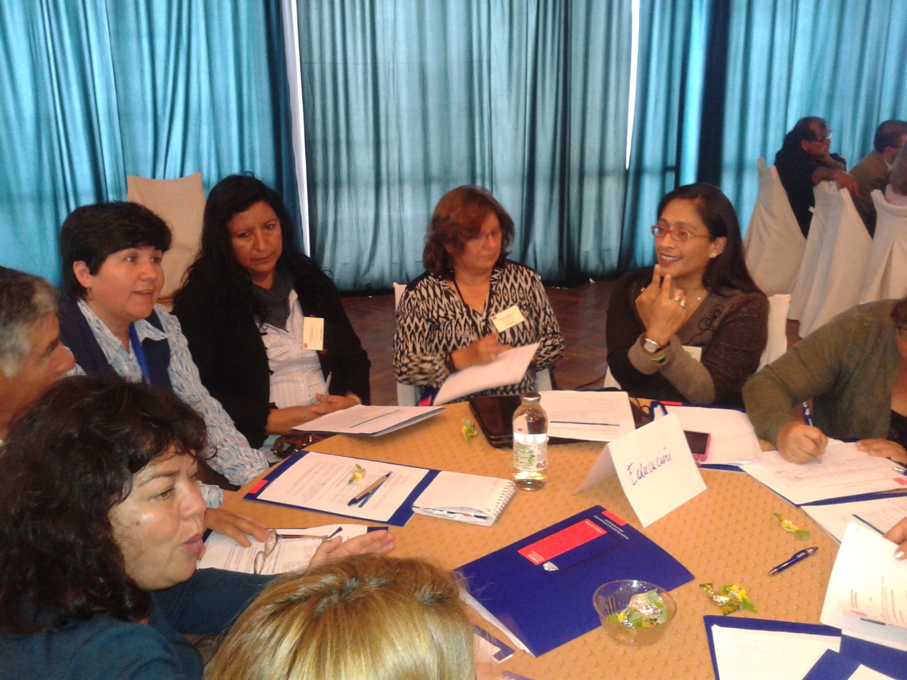
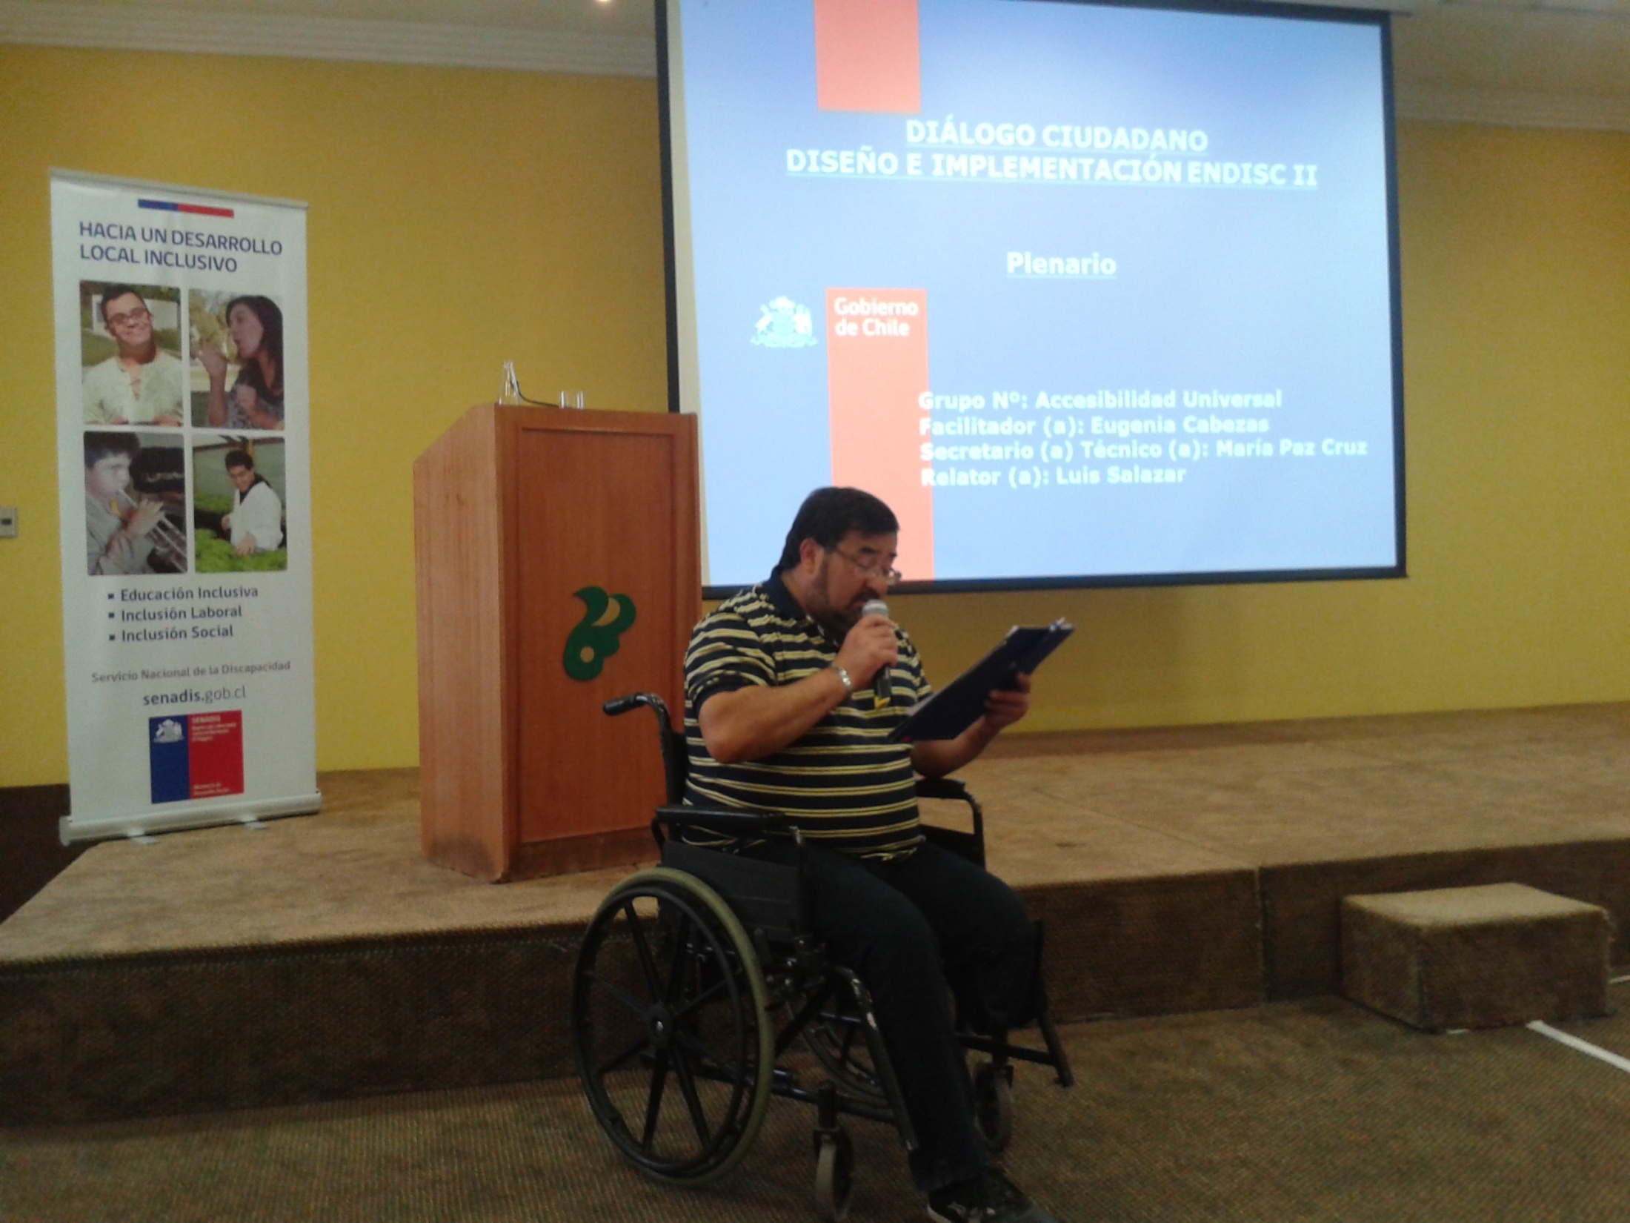
Civil society dialogs

Slide 5
Topics addressed in the civil society dialogs
Accesibility
Rights and Access to Justice
Health Care Use and Dependency
Recreation Activities and Sports
Education
Gender, Emotionality and Sexuality
Health
Political and Social Participation
Labour Inclusion

Slide 6
Comparison
ENDISC I | MDS
X | √
√ | √
X | √
X | √
X | √
X | √
Public buildings
Private buildings
Information
Places of recreation
Urbanisation

Slide 7
70% was covered by the MDS!!
Accesibility
Rights and Access to Justice
Health Care and Dependency
Culture, Recreation and Sports
Education
Gender, Emotionality and Sexuality
Health
Political and Social Participation
Labour Inclusion
Notes:
What Chile added
Satisfaction with health, education and justice services
Perception of discrimination
Comprehensive Participation in political and social life
Comprehensive Participation in cultural events, sports and leisure activities

Slide 8

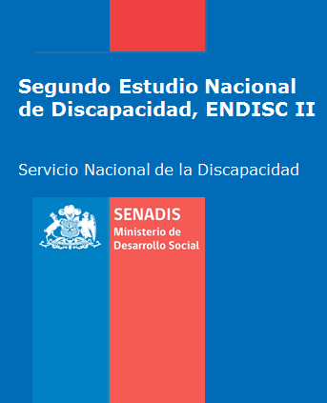
2004
2015
Notes:
What Chile added
Satisfaction with health, education and justice services
Perception of discrimination
Comprehensive Participation in political and social life
Comprehensive Participation in cultural events, sports and leisure activities

Slide 9
Article Number | CRPD Article Name | MDS
Annex 1
5 | Equality and Non-discrimination | ✔
6 | Women and disabilities | ✔
7 | Children with disabilities | ✔
8 | Awareness-raising | ✔
9 | Accessibility | ✔
10 | Right to life
11 | Situations of risk and humanitarian emergencies
12 | Equal recognition before the law | ✔
13 | Access to justice
14 | Liberty and security of the person | ✔
15 | Freedom from torture or cruel, inhuman or degrading treatment or punishment
16 | Freedom from exploitation, violence and abuse
17 | Protecting the integrity of the person | ✔
18 | Liberty of movement and nationality | ✔
19 | Living independently and being included in the community | ✔
20 | Personal mobility | ✔
21 | Freedom of expression and opinion, and access to information | ✔
22 | Respect for privacy
23 | Respect for home and the family | ✔
24 | Education | ✔
25 | Health | ✔
26 | Habilitation and rehabilitation | ✔
Notes:
Support monitoring of the CRPD
Statistical and research data for policy implementation
Disaggregated data to assess implementation and address barriers

Slide 10
* To be added in the next revision x Already covered
Disability indicators for the SDG framework covered in the MDS
Target Indicator | Model Disability Survey | Universal targets |  |  | Vulnerable persons |  |  | Disability targets
 |  | 1.1 Poverty | 3.8 Health coverage and financial risk protection | 9.c Access to ICT and to internet |  | 1.3 Social protection | 4.5 Gender disparities, equal access in education |  | 8.5 Full and productive employment and decent work | 10.2 Social, economic and political inclusion
% PwD below $1.25(PPP)/day | * | x |  |  |  |  |  |  |  | x
% PwD covered by social protection/disability benefits | x |  |  |  |  | x |  |  |  | x
% PwD benefiting from health coverage | x |  | x |  |  |  |  |  |  | x
School net attendance for CwD | x |  |  |  |  |  | x |  |  | x
Unemployment rate (by PwD) | x |  |  |  |  |  |  |  | x | x
% PwD owning a mobile phone | * |  |  | x |  |  |  |  |  | x
% PwD with internet access | * |  |  | x |  |  |  |  |  | x

Slide 11
2004
2015

Slide 12


2004

Slide 13
2015

Slide 14

Notes:
Visible or invisible
Temporary, episodic or long-term

Slide 15
World population on the disability continuum
Number of persons
Low
Disability
Extreme

Slide 16
2004
2015

Slide 17
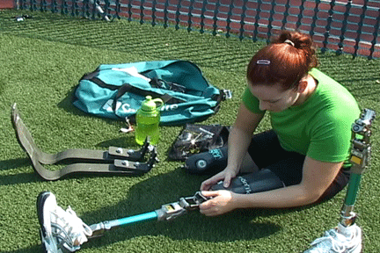
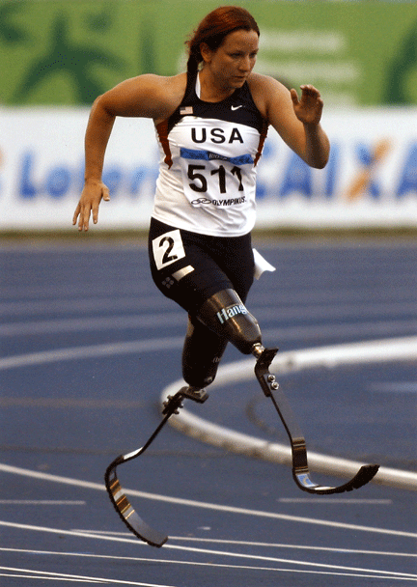
2004
Because of your health, do YOU HAVE …. ?
Health condition
Impairment in
body functions & structures
Activity
limitation
Participation
restriction
Environmental factors
Personal factors
2015
Notes:
In the ICF model, disability is understood as impairments in body functions & structures, activities limitations and participation restrictions.
In the ICF model, the level of disability experienced by a person is the outcome of the interaction between a health condition and environmental and personal factors.

Slide 18
In the MDS we capture both,
difficulties because of your health
The result of the interaction of capacity with the environment and the person
Notes:
Katy Sullivan

Slide 19
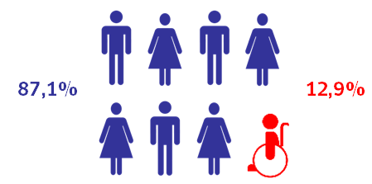
2004

Slide 20
Difficulties because of
your health …
2015
The result of the interaction of capacity with the environment and the person…
?

Slide 21
We want to understand disability and not only calculate its prevalence

Slide 22
Content of the MDS
Section 1000
Socio-demographic Characteristics
Section 2000
Work History and Benefits
Section
3000 (A+B)
Environmental factors
Section 4000 Functioning
Section 5000
Health Conditions &
Capacity
Section 6000
Health Care Utilisation
Section 7000
Well-Being
Section 8000
Empowerment
Notes:
The individual questionnaire is composed of altogether seven sections, which give the MDS a modular character.
All modules are needed if the MDS is used as an stand alone survey.
Three modules, the two in blue and the one in green, are however essential to fully describe the experience of disability: environmental factors, functioning, and health conditions“.
Countries implementing modules of the MDS in existing disability surveys are therefore requested to implement these three modules.

Slide 23

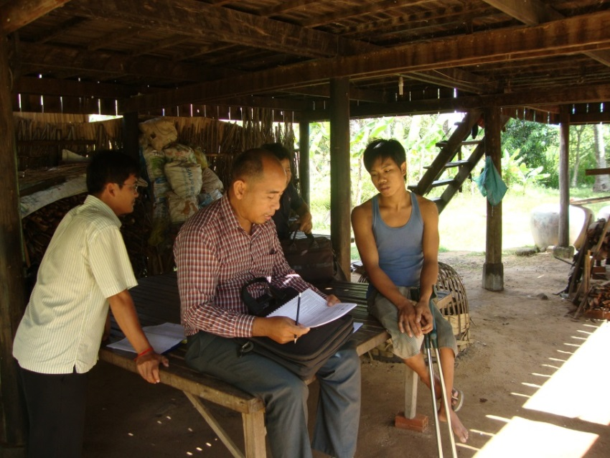
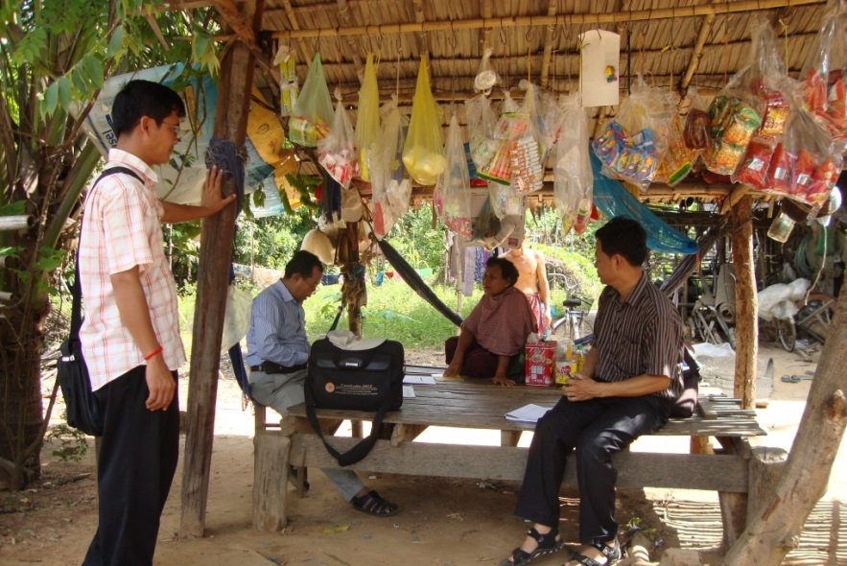
Example Cambodia
First pilot study, August 2014
Rural and urban areas
Convenience sample, 500 interviews

Slide 24
Moderate capacity difficulties
Mild capacity difficulties
Cut-off score 47.37
No capacity difficulties
Severe capacity difficulties
No difficulties
Extreme
difficulties
CAPACITY
(difficulties because of your health)

Slide 25
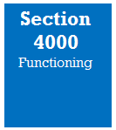


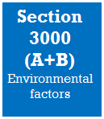
How much of a problem is getting things done as required at work?
 | N | No disability N=27 | Mild disability N=144 | Moderate disability N=200 | Severe disability N=128
Currently not working | 29 | 3,7 % | 4,51 % | 4,4 % | 14,43 %
Working | 399 | 96,3 % | 94,73 % | 93,41 % | 79,38 %
Other working situation** | 11 | 0 | 0,75 % | 2,2 % | 6,19 %
**sick leave, retired by age
To what extent does your workplace or school make it easy or hard for you to do the things you need or want to do at work or school?

Slide 26

How much of a problem do you have in engaging in local or national politics and in civil society organisations?
How much of a problem did you have with voting in the last elections?

Slide 27
Pilot Studies
Finished: Cambodia (N=500), Chile (N=300), Malawi (N=500), Pakistan (N=3977)
Ongoing: Oman (N=500)
In preparation: Brazil (N=2000)
National Disability Surveys
Finished: Sri Lanka, Chile
Planned: Oman, Brazil, The Philippines

Slide 28
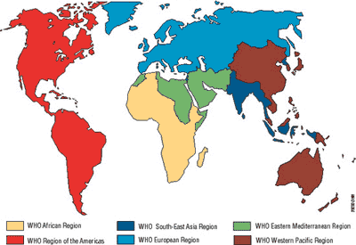
Regional implementation from 2016 on
EURO
SEARO
AMRO
EMRO
AFRO
WPRO

Slide 29
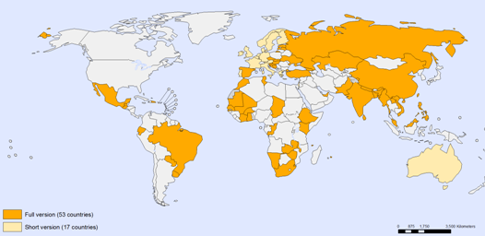
World Health Survey
Implemented by WHO in 2002–2004 in partnership with 70 countries to generate information on the health of adult populations and health systems.
The total sample size in these cross-sectional studies includes over 300 000 individuals (representing 64% of the world population) .

Slide 30
WHS and Disability
The largest multinational health and disability survey ever
A single set of questions with consistent methods to collect comparable health data
59 countries (representing 64% of the world population) had weighted data sets that were used for estimating the prevalence of disability of the world’s adult population

Slide 31
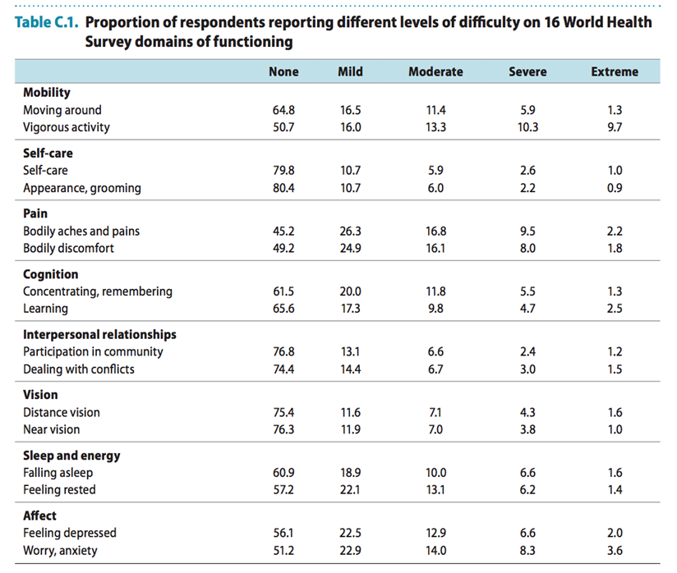
Notes:
The choice of domains included in the World Health Survey was informed by analysis of WHO’s Multi-Country Survey Study (MCSS)

Slide 32
Study on Global Ageing and Adult Health (SAGE)
The WHO Multi-Country Surveys team developed SAGE as a data collection platform to compile comprehensive information on the health and well-being of adult populations.
SAGE has adapted and added to the methods and instruments developed by WHO for the World Health Survey.

Slide 33
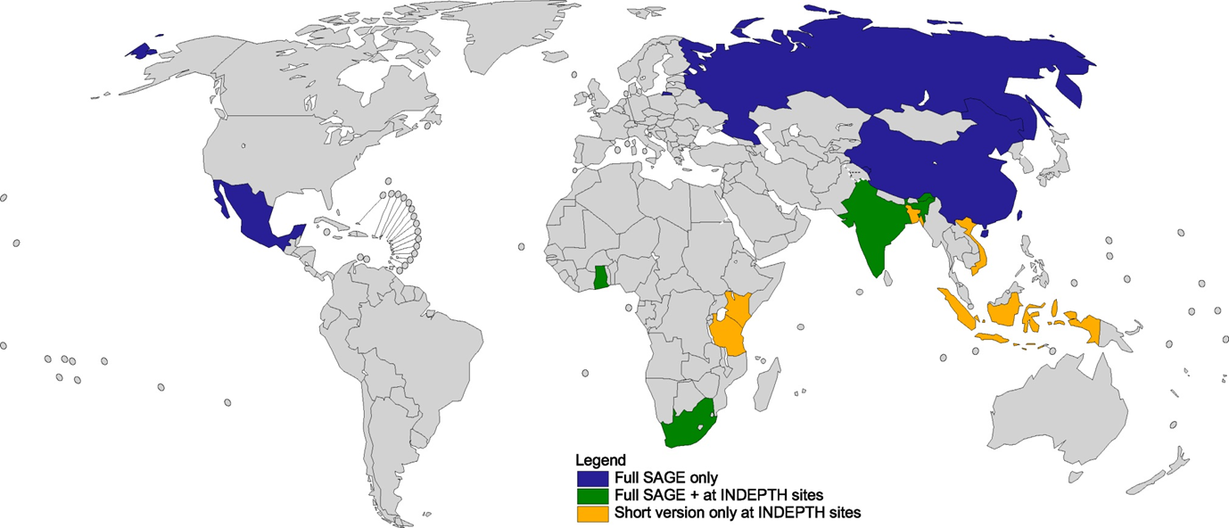
SAGE collects household data primarily on persons aged 50 years and older in China, Ghana, India, Mexico, Russian Federation and South Africa
Data also collected in the adult population aged 18 to 49 years in 23 additional countries.
Notes:
SAGE-INDEPTH Wave 1, 2007
A short version of the SAGE questionnaire, focusing on health and well-being, was implemented in 2007 as part of the SAGE-INDEPTH collaboration. Face-to-face interviews were conducted during routine surveillance rounds in eight health and demographic surveillance system (HDSS) field sites from the International Network for the continuous Demographic Evaluation of Populations and Their Health in developing countries (INDEPTH): South Africa (Agincourt), Viet Nam (Filabavi), United Republic of Tanzania (Ifakara), Bangladesh (Matlab), Kenya (Nairobi), Ghana (Navrongo), Indonesia (Purworejo), and India (Vadu).

Slide 34


Overlap SAGE MDS
HOUSEHOLD CHARACTERISTICS
Composition
Living conditions
Economic status
Consumption
Geographical location
COVERAGE
UTILISATION OF SERVICES
HEALTH STATES
Capacity in multiple domains
RISKS FACTORS
CHRONIC DISEASES
Tobacco
Alcohol
Physical Inactivity
Nutrition
Morbidity
- Health conditions
INDIVIDUAL CHARACTERISTICS
Socio-demographics
Income
Economic activity
Health Insurance
Minority status
TIME USE
SOCIAL NETWORKS / COHESION
VALUATION OF HEALTH STATES
WELL BEING
MORTALITY
HEALTH & HEALTH RELATED OUTCOMES
Notes:
The shortened version of the SAGE instrument covers eight different health domains of mobility, self-care, pain and discomfort, cognition, participation in interpersonal activities, sleep/energy, affect and vision.
In 2012, a pilot study of SAGE used 12 health state domains: affect, bowels and bladder, breathing, cognition, digestion, hearing, interpersonal activities, mobility, pain and discomfort, self-care, sleep and energy, and vision.
MDS covers 16 functional domains:
Mobility, hand and arm use, self-care, seeing, hearing, energy & drive, breathing, affect (depression and anxiety), interpersonal relationships, handling stress, communication, cognition, household tasks, community and citizenship participation, caring for others, work & schooling

Slide 35
Overlap SAGE MDS
FUNCTIONING
in multiple domains
HOUSEHOLD CHARACTERISTICS
Composition
Living conditions
Economic status
Consumption
Geographical location
COVERAGE
UTILISATION OF SERVICES
Need of care and support because of health problems
HEALTH STATES
Capacity in multiple domains
+ WG-6
RISKS FACTORS
CHRONIC DISEASES
Tobacco
Alcohol
Physical Inactivity
Nutrition
Morbidity
- Health conditions
ENVIRONMENTAL FACTORS
Facilitating and hindering aspects of the broad environment
Social Support & Relationships
Attitudes of others
Accessibility to Information
Personal assistance
Assistive devices: mobility and self-care, seeing, hearing & communication
Facilitators: education, work and at home
INDIVIDUAL CHARACTERISTICS
Socio-demographics
Income
Economic activity
Health Insurance
Minority status
TIME USE
SOCIAL NETWORKS / COHESION
VALUATION OF HEALTH STATES
WELL BEING
MORTALITY
EMPOWERMENT
HEALTH & HEALTH RELATED OUTCOMES
Notes:
The shortened version of the SAGE instrument covers eight different health domains of mobility, self-care, pain and discomfort, cognition, participation in interpersonal activities, sleep/energy, affect and vision.
In 2012, a pilot study of SAGE used 12 health state domains: affect, bowels and bladder, breathing, cognition, digestion, hearing, interpersonal activities, mobility, pain and discomfort, self-care, sleep and energy, and vision.
MDS covers 16 functional domains:
Mobility, hand and arm use, self-care, seeing, hearing, energy & drive, breathing, affect (depression and anxiety), interpersonal relationships, handling stress, communication, cognition, household tasks, community and citizenship participation, caring for others, work & schooling

Slide 36
Alarcos Cieza, MSc, MPH, PhD
Disability and Rehabilitation
World Health Organization
Avenue Appia 20
1211 Geneva 27
Switzerland
Tel.: +41 22 791 1998
Fax: +41 22 791 4874
Email: ciezaa@who.int
Website: www.who.int/disabilities/

