Slide 1
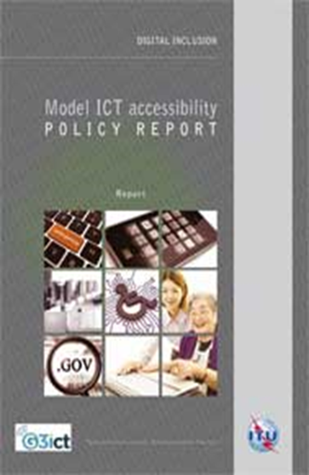
Model ICT Accessibility Policy Report
Provides policy guidelines and legal and regulatory framework
Designed to help countries develop their own accessibility policies and regulations
Modular design includes stand-alone sections on:
1. Model ICT legal, policy and regulatory framework
2. Model ICT accessibility framework on public access
3. Model mobile communications accessibility policy framework
4. Model television/video programming accessibility framework
5. Model web accessibility policy framework
6. Model accessible ICT public procurement policy framework
www.itu.int/en/ITU-D/Digital-Inclusion/Pages/Reports.aspx
www.itu.int/en/ITU-D/Digital-Inclusion/
www.itu.int/accessibility
http://www.itu.int/en/ITU-D/Regional-Presence/Americas/Pages/EVENTS/2016/15526.aspx
Notes:
Let’s take a closer look at the mobile and web accessibility policies in the Model ICT Accessibility Policy report.
As I mentioned this morning, the report covers different aspects of ICT accessibility.
It is organized by 6 different modules, each one covering a different area of ICT accessibility, from changes to existing ICT legislation to public access to ICTs, mobile accessibility, TV and video programming , government websites and accessible public procurement.
I’ll share the highlights of Modules 3 and 5 on mobile and web accessibility.

