Slide 1
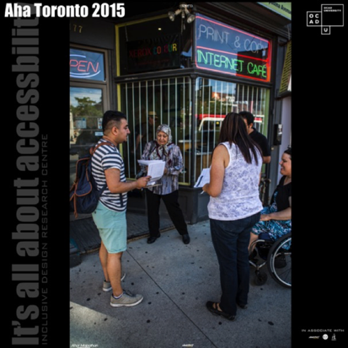
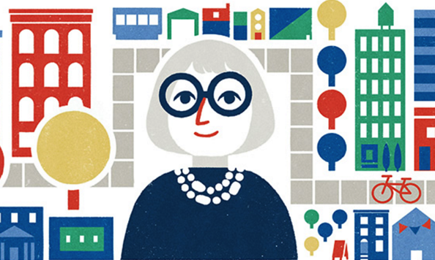
Inclusive Urban Development
Opportunities & Challenges of Emerging Technologies
Jutta Treviranus
Inclusive Design Research Centre
OCAD University, Toronto Canada
Notes:
Alt Text
1: Aha! Toronto project student teams, that include very diverse members, approach businesses to discuss accessibility.
2. An illustration of Jane Jacobs, the “mother of inclusive urban development” from Toronto, with a colorful city in the background.

Slide 2
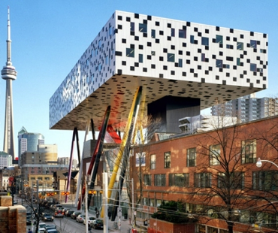
Inclusive Design Research Centre
inclusive design of emerging information and communication systems, policies and practices
or... digital inclusion and designing for diversity
since 1993
open source, open access, open standards, open data
over 96 research partner organizations globally
Inclusive Design Institute -
inclusive infrastructure
2
Notes:
Inclusive Design Research Centre Logo
Picture of OCAD University iconic building with the CN tower in the background
Inclusive Design Institute Logo

Slide 3
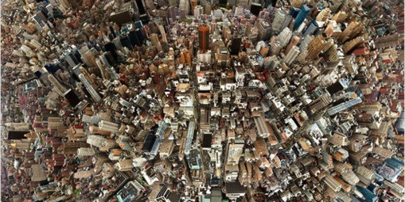
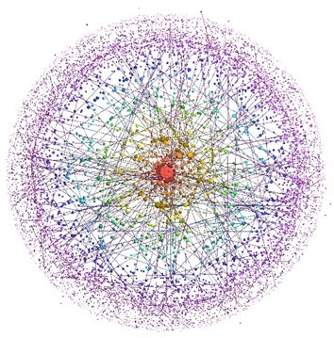
City as Complex Adaptive System
a dynamically evolving system of systems
not something we can engineer, something we must grow
must create supportive scaffolds for organic growth
Enter new technologies:
new sensors, monitors, “internet of everything”
Open data
Smart systems
Notes:
An aerial view of a very large and complex city.
A colourful illustration of a large network.

Slide 4
“Cobra Effect”
unintended consequences of over simplistic “solutions” to complex problems
Notes:
1. A coiled cobra.

Slide 5
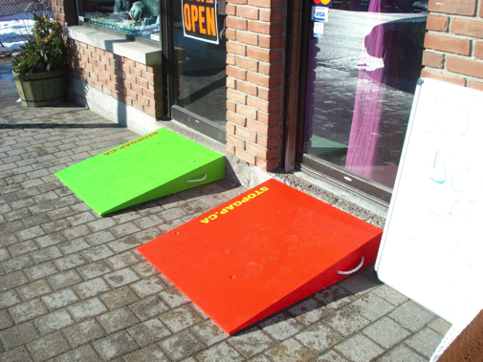
Collaborative, Small Interventions
Create collaboration
iterative small successes
E.g., StopGap, Aha!, AXSMap, BIG IDeA
home to diverse humans
Home to our physical, intellectual, social, emotional, evolving selves
Notes:
A photo of Luke Anderson, founder of StopGap taking his electric wheelchair up a StopGap plywood ramp.
A picture of a hackathon with participants of all ages including a toddler who looks very happy.
A series of colourful Stopgap ramps in from of storefronts.

Slide 6
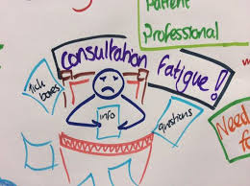
Consultation Fatigue…
and the Risks of Check Marks
Problem of representation- not leaving the unrepresented stranded
People do not fit well into categories – falling through the cracks
We are each a jagged spectrum of skills and needs
The danger of check marks – inclusive design is never “done” – an ongoing mindset
Accessibility - from compliance to Collaboration
Notes:
1. A hand cartoon of someone with consultation fatigue, frowning as they fill out a form.
1. Series of check boxes with check marks being entered with a red pencil.

Slide 7
Big Data and the outliers …
People with disabilities:
representative samples – as small as samples of one
no statistical significance – but in aggregate greater than the norm
Will never cross impact thresholds
the outliers
E.g., Propelling wheelchair backward with feet
E.g., Hugging the edge not the middle with cane
E.g., eddies for connecting and asking
Notes:
A three-dimensional scatter plot with circles at the edges showing small representative samples.
A lit up visualization of traffic paths through a city.

Slide 8
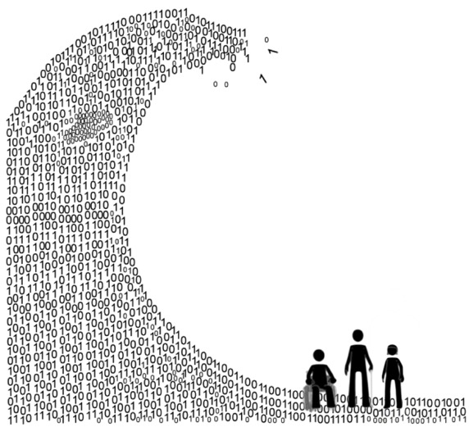
Small, thick and edge data
Small: unique personal data
Thick: data in context
Edge: attending to the outliers and weak signals
Bottom-up data
Post-hoc pattern detection
Not eliding the outliers
Notes:
1. A cartoon of a huge data wave (made up of 0s and 1s rather than water) poised to engulf an individual.

Slide 9
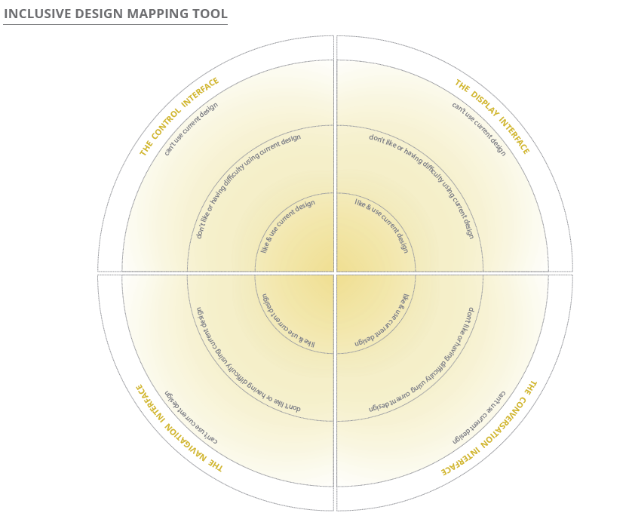
Who to consult….
People that don’t like or have difficulty using your design
People that hate or can’t use your design
Inclusive Design Mapping Tool
Notes:
1. In inclusive design Mapping tool consisting of 3 nested or concentric circles. The inner circle labeled “like and use current design” the middle circle labeled “don’t like or having difficulty using design” and the outer circle labeled “can’t use current design”. The concentric circles are divided into wedges and labeled “the control interface,” “the display interface,” “the navigation interface,” and “the conversation interface.” The mapping tool is used to map the needs of users and stretch the design to the edges, thereby encompassing more user needs.

Slide 10
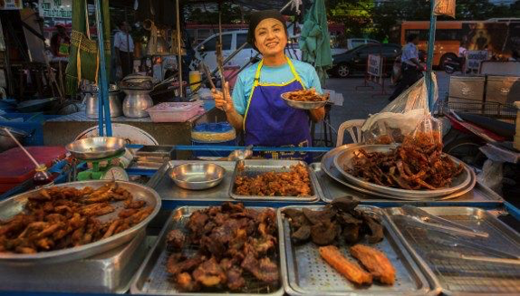
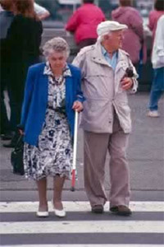
Cities are not thoroughfares for hermits
More than efficiency and independence
diversity-friendly places
playing children
slow moving elders
joy and delight fosters welcome and generosity
Communities
Notes:
A smiling street vendor offering a range of food wares.
An elderly couple crossing the street.
Two children laughing and talking in a playground, they are both in different wheelchairs.

Slide 11
3 Dimensions of Inclusive Design…
Recognize Diversity and Uniqueness – make people smarter, personal fit
Inclusive Process and tools - “nothing about us without us”, co-design, accessible design & development tools
Systemic - cognizant of context and larger impact, supporting virtuous cycles
Notes:
1. An illustration of the three dimensions of inclusive design characterized as a galaxy with 1. the first principle as a scatter plot in the middle, 2. the inclusive process and tools orbiting and 3. the systemic impact spiraling out from the middle.

